Slide 1
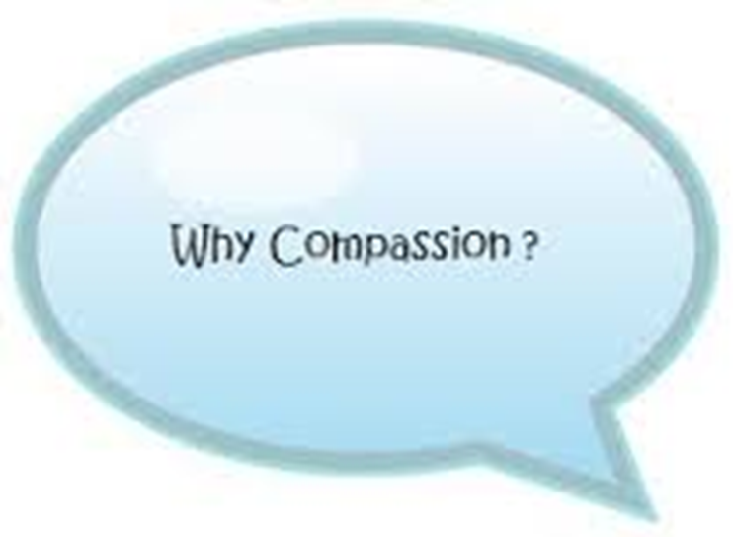
Cum Scientia Caritas
and can we teach it?
Compassion empowered with Knowledge
Vijay Nayar
Autumn Seminar
September 2015

Slide 3
Francis Inquiry
“Patients must be the first priority in all of what the NHS does by ensuring that, within available resources, they receive effective care from caring, compassionate and committed staff, working within a common culture, and protected from avoidable harm and any deprivation of their basic rights.”

Slide 4
Francis Inquiry
“As a part of this mandatory annual performance appraisal, each clinician and nurse should be required to demonstrate their ongoing commitment, compassion and caring shown towards patients, evidenced by feedback of the appraisee from patients and families, as well as from colleagues and co-workers.”

Slide 5
Compassionate care ties closely with respect and dignity in that individual patients, carers and relatives must be treated with sensitivity and kindness. The business of the NHS extends beyond providing clinical care and includes alleviating pain, distress, and making people feel valued and that their concerns are important.

Slide 6
Emotive
ability to subjectively experience and share in another’s psychological state or feelings
Moral
internal altruistic orientation that motivates the practice of empathy
Behavioural
ability to convey understanding of another’s perspective
Cognitive
the helper’s intellectual ability to identify and understand/analyse another person’s feelings and perspective from an objective stance
Empathy

Slide 7
Compassion in practice
The 6 Cs
The six enduring values and behaviours that underpin Compassion in Practice

Slide 8
commitment
care
compassion
communication
courage
competence
Care
Competence
Communication
Commitment
Courage

Slide 9
Care
Holistic
“Cradle to the grave”
Individualised care
Promote self-care
‘Hub of care’
Accessible for all
Continuum of health through to illness

Slide 10
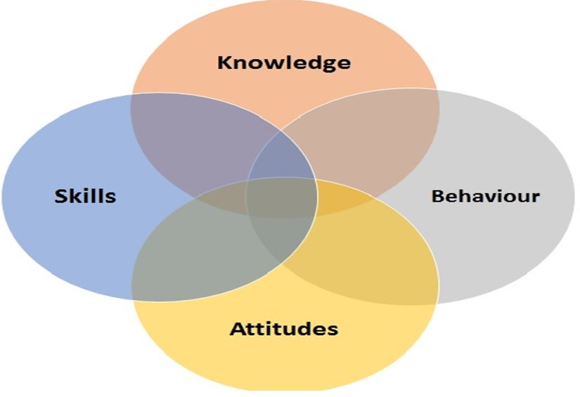
Competence
Confident and capable
Use appropriate knowledge, skills and attitudes in decision making
Understanding and knowledge of a range of conditions
Developing a wide range of skills to deal effectively with all aspects of care
Generalists with lots of specialist skills
Ability to recognise limitations
Navigating role to appropriate expertise

Slide 11
Communication
Consulting skills
Patient-responsive
"no decision about me without me"
Facilitate relationships
Motivational interviewing
Signposting and referring patients
Team working
Dignity and respect
Flexibility

Slide 12
Courage
Autonomous practitioners
Advocates for patients
Challenging patients’ perception
Sole responsibility for patient care
Leadership
Assertive
Adaptable
Resilience
Speak up when we have concerns
Innovate

Slide 13
Commitment
Improve care and experience of patients
Shared responsibility through interdependent working
Delivering services that are responsive to local population needs
Maintaining professional standards
Team/clients/wider team in the community
Altruism

Slide 14
ATTITUDES &
BEHAVIOURS
PRACTICAL SKILLS
KNOWLEDGE
CARE
COMPETENCE
COMMUNICATION
COURAGE
COMMITMENT

Slide 15
Cum Scientia Caritas

Slide 16
treat others as you want to be treated
Treat others as they want to be treated

Slide 17
“to consider patients as people, to be moved by their suffering, and to be their companions on difficult and life-changing journeys”

