Slide 1
Trainees in Difficulty
Brendon O’Leary
(with thanks to Claire Giles and Janet Rutherford)

Slide 2
TiD definition
A trainee in difficulty is one whose progress is causing concern or who is not meeting curricular requirements. This may be due to
  ill health,
  life events,
  difficulties with learning or
  through less than satisfactory professional conduct.

Slide 3
Trainees in Difficulty
Don’t assume that a trainee who performs badly is a bad trainee………
The trainer needs to be humble enough to explore their own potential role in this

Slide 4
Identifying the struggling trainee
RDMp helps identify problems with …PERFORMANCE
SKIPE is a framework that can be used to help identify…..
CAUSAL/INFLUENTIAL FACTORS

Slide 5
Steinert 2008:BMJ 336, 150-153
Where does the
problem lie?
Unsupportive
Overly critical
Unreasonable expectations
Disinterested
Non challenging
Failure to meet learner’s needs
Teacher
Work
(e.g. workload, unsupportive staff)
Social
(e.g. marital, financial)
Personal
(e.g. substance abuse, illness)
Training
(e.g. unsupportive VTS, lack of guidance)
Knowledge
Skills
Attitudes
Learner
Environment

Slide 6
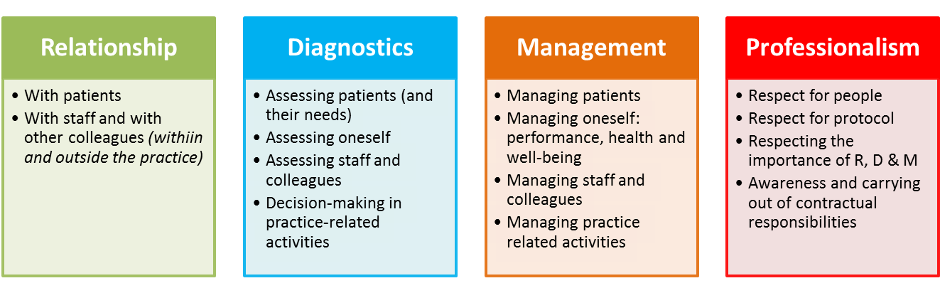
RDM-p
relate to someone, diagnose their needs, manage the process, and at all times ensure you act professionally.
Tim Norfolk

Slide 7
Evidencing
May start as “gut feeling” but try to evidence with clear statement of areas of concern
Collect evidence from several sources:
  Verbal statements from others:
  Written statements from others:
  Things you have noticed: This may be K, S & A
    Record the specifics of the event.
  Things the trainee has noticed that they have difficulty with

Slide 8
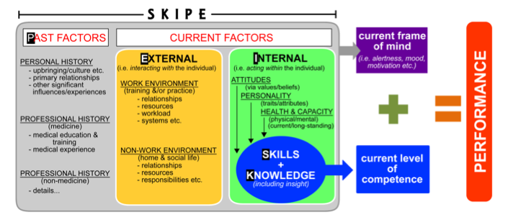
Trainees in Difficulty – Looking for the Cause

Slide 9
Trainees in Difficulty – Looking for the Cause
Skills and Knowledge
  Don’t jump off into deeper issues until the ‘SK’ issues have been properly tested.”
  BUT we tend to concentrate on ‘SK’ as we are more familiar with that and ignore other factors.

Slide 10
Trainees in Difficulty – Looking for the Cause
Discussions with the trainee

Slide 11
Trainees in Difficulty – Looking for the Cause
Discussions with the trainee
Keep open and non-judgemental
Establish an equal relationship based on honesty and respect
Avoid assumptions
Consider learning styles
Include the trainee’s perspective, not just the evidence you have gathered
Explore their goals
Use motivational interviewing

Slide 12
Trainees in Difficulty – Looking for the Cause
Ways to achieve an adult-adult relationship

Slide 13
Trainees in Difficulty – Looking for the Cause
Ways to achieve an adult-adult relationship
Establish a safe environment – comfortable, open and honest
Start low and go slow
Build an accurate picture together
Validate feelings and explore specifics before suggesting a trainee’s perceptions needs ‘adjusting’
Encourage reflection and self-evaluation
Develop a joint management plan

Slide 14
Trainees in Difficulty – Looking for the Cause
Preventing Conflict

Slide 15
Trainees in Difficulty – Looking for the Cause
Preventing Conflict
Ensure good feedback skills
Establish the supportive purpose of the session
Build rapport initially by stressing the positives
When moving onto a trickier area, explore the trainee’s perspective initially, avoid judgemental words, use Socratic questioning
Watch verbals and non-verbals
Tread carefully, be sensitive and validate feelings

Slide 16
Trainees in Difficulty – Looking for the Cause
SID Framework
S = Share your concerns
  Colleagues, TPD, Deanery
I = Involve the trainee
  Always 2 sides to a story
D = Document
  Detailed, factual, accurate, relevant, objective and justifiable.
  Use descriptive, specific and non-judgemental language

Slide 17
Coming up with a plan:
Poor Knowledge

Slide 18
Coming up with a plan:
Poor Knowledge
Identify if general or specific
Get the trainee to evaluate their own knowledge using Curriculum Self-assessment rating scale, MCQ websites, PEP etc
Do lots of RCA
RCGP Essential Knowledge Challenge
Get them to help out in nurse-led chronic disease clinics
Look at the AKT feedback as well as their results
Consider an AKT course
Consider small study groups to share the work
Cram stats

Slide 19
Coming up with a plan:
Poor Motivation

Slide 20
Coming up with a plan:
Poor Motivation
Stephen Covey’s The Seven Habits of Effective People – find out what the trainee sees themselves doing in the future
NLP – core values and the wheel of life
Motivational interviewing
Role modelling – share with them how you deal with your own difficulties

Slide 21
Coming up with a plan:
Constantly Uncertain/ Can’t Make Decisions

Slide 22
Coming up with a plan:
Constantly Uncertain/ Can’t Make Decisions
Explore complexity theory – competence, capability, complexity, certainty and chaos
Encourage them to explore ICE with the patient
Encourage them to discuss dilemmas with pts and aim for shared decision making
Don’t give them the answers every time they ask – facilitate them finding the answer themselves
Encourage them to start learning in a non-linear way

Slide 23
Coming up with a plan:
Lacking Confidence

Slide 24
Coming up with a plan:
Lacking Confidence
As before, but a bit more!
Establish where they are on the transition curve
Make sure they have enough clinical experience with effective feedback
Encourage reflection
Encourage them to find answers for themselves
Encourage them to discuss their anxieties with their peers

Slide 25
Coming up with a plan:
The Muddly Consulter

Slide 26
Coming up with a plan:
The Muddly Consulter
Establish an agenda and encourage screening
Signpost and summarise
Work on systematic problem-solving skills
Video regularly, stop a consultation every 2mins ‘What was going on in your head then?’
Joint surgeries, taking turns to lead, making your reasoning explicit
Create some discomfort by shortening their consultation timings

Slide 27
Coming up with a plan:
Common Themes
Review your approach regularly
Ensure pt safety, and be explicit about that
Debriefs, nominated supervisor for every surgery
Regular random case analysis, videoing, joint surgeries
Role play as a way of reinforcing altered behaviour
Increase number CBDs and COTs
Give praise where due and be prepared to challenge too
Encourage reflection and self-evaluation
Timetable regular reviews
Talk, talk, talk and share your concerns with others
DOCUMENT

