Slide 1
Soft Tissue Infections
Adrian Boyle

Slide 2
Overview
Cellulitis
Necrotising Fasciitis
Skin Abscess

Slide 3
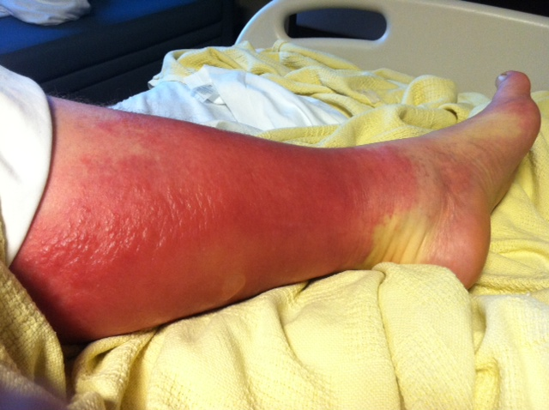
Case 1: A 35 year old man with a hot swollen left leg
But:
48 hours ago he went wild swimming
36 hours ago he went water skiing on the sea
He was bitten by a cat and another person
He injects drugs
He also has a vesicular rash and a runny nose
So what?

Slide 4
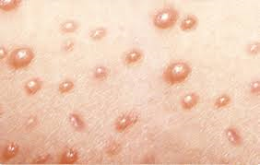
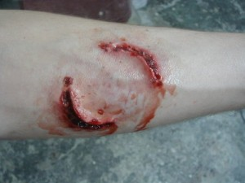
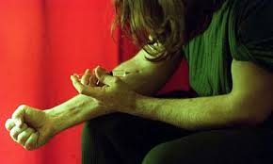
Aeromonas species
Ciprofloxin / Macrolide
Vibrio vulnificus
Doxycycline / Macrolide
Amoxicillin with Fluclox
Ciprofloxin with Clarithromycin
Everyone gets Flucloxacillin
Pasturella Multicoida
Augmentin
(think teeth in wound)
Eikenella corrodens
Augmentin
Think PEP
MRSA
Vancomycin

Slide 5
Which cellulitis patients need to be admitted?
CREST 2008 / NICE 2014
Evidence ‘lite’ area
Severity of illness
Septic
Wound
Severity of person
Frail / Peripheral Vascular Disease / Immunocompromised
Severity of location
Hands / Face / Perineum

Slide 6
Cellulitis Pitfalls
Bilateral Cellulitis is rare, think chronic venous insufficiency instead
Swelling will progress over 24-48 hours after starting oral antibiotics
Additional Penicillin V is not usually helpful if you give enough Flucloxacillin
(Leman P EMJ 2005)
5 day course is probably as good as a 10 day course
(Hepburn P Arch Int Med 2004)
Blood cultures are almost never useful and expensive

Slide 7
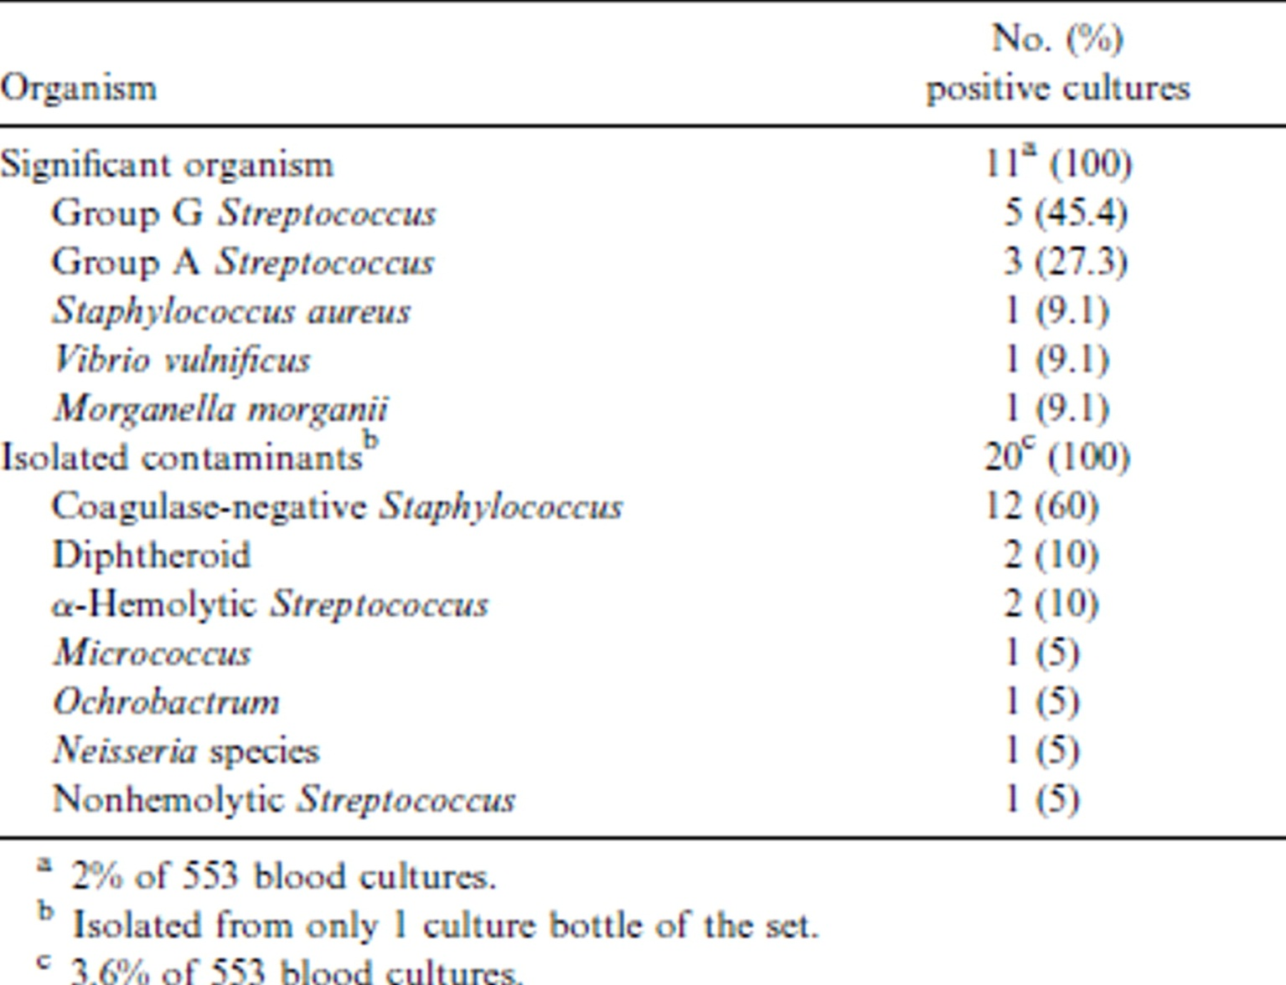
Microorganisms isolated from cultures of blood specimens from 553 patients with cellulitis.
Bezalel Perl et al. Clin Infect Dis. 1999;29:1483-1488
© 1999 by the Infectious Diseases Society of America
Notes:
Microorganisms isolated from cultures of blood specimens from 553 patients with cellulitis.

Slide 8
Microorganisms isolated from cultures of blood specimens from 553 patients with cellulitis.
Bezalel Perl et al. Clin Infect Dis. 1999;29:1483-1488
© 1999 by the Infectious Diseases Society of America
Notes:
Microorganisms isolated from cultures of blood specimens from 553 patients with cellulitis.

Slide 9
Case 2
A 30 year old presents with severe, atraumatic pain in her left leg. She is unable to walk with the pain.
She grazed her leg while climbing over a barbed wire fence two days ago.
Does she have cellulitis or necrotising fasciitis?

Slide 10
Necrotising Fasciitis or Cellulitis?
75% of Necrotising Fasciitis cases are initially misdiagnosed
20% mortality rate
24 hour delay to surgery is associated with a nine fold OR of death
15% amputation rate

Slide 11
So how do I know someone hasn’t got Necrotising Fasciitis?
Risk factors
Diabetes (44%)
Cirrhosis
Pressure sores
Recent surgery
Leukaemia
Monoclonal antibody drugs, especially Avastin
Injecting drug users
Surgery / Central venous catheters

Slide 12
Hard
Tricky
Straightforward
Stage 1 (early) | Stage 2 (intermediate) | Stage 3 (late)
Warm to palpation Erythema Tenderness to palpitation (extending beyond apparent areas of skin involvement) Swelling | Blister or bullae formation (serous fluid) Skin fluctuance Skin induration | Haemorrhagic bullae Skin anaesthesia Crepitus Skin necrosis with dusky discoloration progressing to frank gangrene

Slide 13
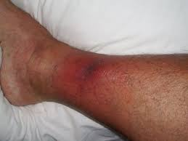
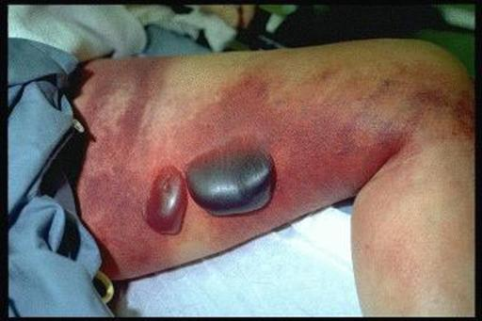
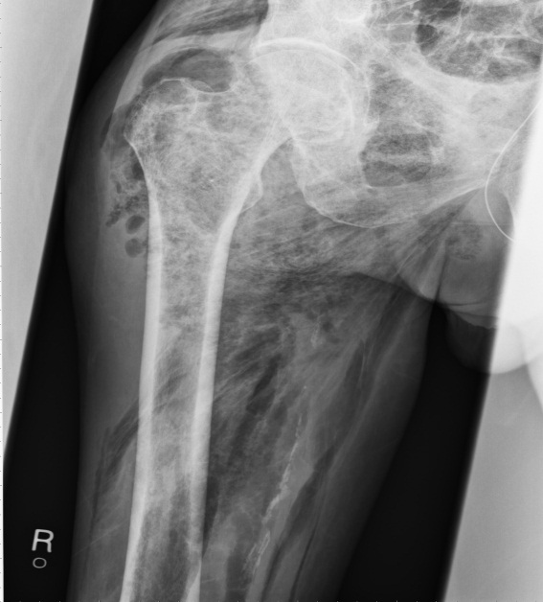
Hard
Tricky (ish)
Straightforward
Stage 1 (early) | Stage 2 (intermediate) | Stage 3 (late)
 | Blister or bullae formation (serous fluid) Skin fluctuance Skin induration | Haemorrhagic bullae Skin anaesthesia Crepitusgangrene

Slide 14
So how do I know someone hasn’t got Necrotising Fasciitis?
Physical findings
Reassuring Features
Swelling
Erythema
Pain
Fever
Disproportionate pain *
Failure to improve on antibiotics
Bullae **
Lymphangitis

Slide 15
LRINEC: Laboratory Risk Indicators of Necrotising Fasciitis
CRP > 150 mg/l 4
WCC <15/mm 0
15-25 1
>25 2
Hb >13.5 g/dl 0
11-13.5 1
<11 2
Na <135 mmol/l 2
Creat >141 µmol 2
Glucose >19 mmol/l 1
<6 Less than 50%
6-7 Intermediate risk
>7 High risk 75% risk

Slide 16
LRINEC: Validation Studies Scores >6
 | Sensitivity | Specificity | PPV | NPV
Liao 2012 | 59% | 84% | 38% | 92.5%
Wong 2004 | 90% | 95% | 92% | 96.0%
Holland 2009 | 80% | 67% | 57% | 86%
Thomas 2012 | 56% | 60% | 25% | 85%
Incompletely validated
Useful adjunct to clinical judgement

Slide 17
How do I persuade a surgeon that a patient has Necrotising Fasciitis?
X-ray? (gas seen in 20%)
MRI?
CT?
Ultrasound?
Insist on debridement?
Ask for their name and GMC number?
Find another surgeon?

Slide 18
Finger test
This involves infiltrating the suspect area with local anaesthetic and making a 2-cm incision down to the deep fascia.
If the index finger dissects the subcutaneous tissue off the deep fascia easily along the tissue plane, the test is positive.

Slide 19
The finger test: other positive macroscopic findings
Other positive macroscopic findings are:
Grey necrotic tissue
Fascial oedema
Thrombosed vessels
Thin, watery, foul-smelling fluid, described as dishwater pus
Non-contracting muscles.
Urgent definitive surgical debridement should follow.

Slide 20
Adjunctive Treatments for Necrotising Fasciitis
Clindamycin
Intravenous Human Immunoglobulin G (off label)
One small RCT for Severe Infections only

Slide 21
Case 3

Slide 22
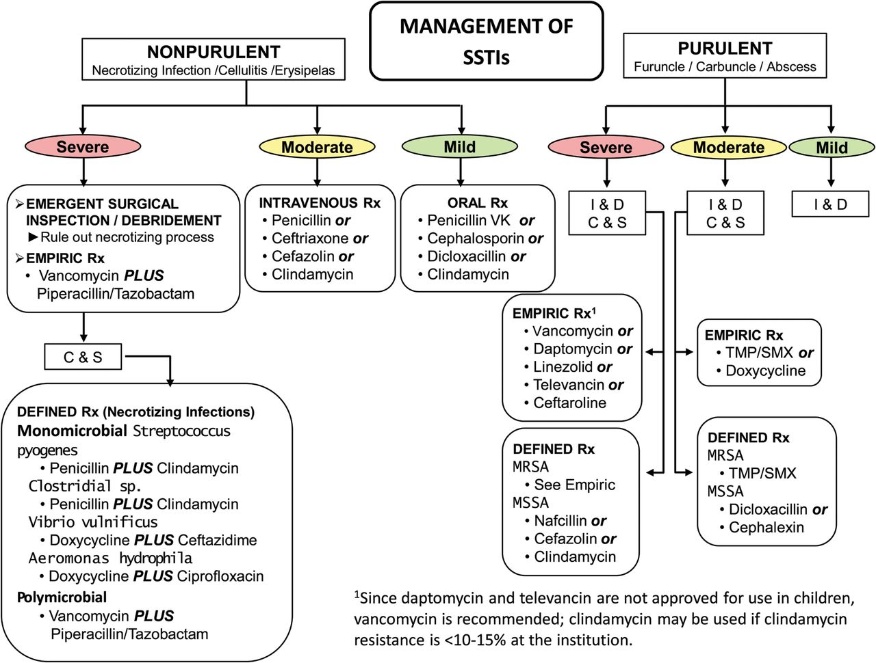
Infectious Diseases Society of America 2014
Purulent skin and soft tissue infections (SSTIs).
Dennis L. Stevens et al. Clin Infect Dis. 2014;59:e10-e52
Notes:
Purulent skin and soft tissue infections (SSTIs). Mild infection: for purulent SSTI, incision and drainage is indicated. Moderate infection: patients with purulent infection with systemic signs of infection. Severe infection: patients who have failed incision and drainage plus oral antibiotics or those with systemic signs of infection such as temperature >38°C, tachycardia (heart rate >90 beats per minute), tachypnea (respiratory rate >24 breaths per minute) or abnormal white blood cell count (<12 000 or <400 cells/µL), or immunocompromised patients. Nonpurulent SSTIs. Mild infection: typical cellulitis/erysipelas with no focus of purulence. Moderate infection: typical cellulitis/erysipelas with systemic signs of infection. Severe infection: patients who have failed oral antibiotic treatment or those with systemic signs of infection (as defined above under purulent infection), or those who are immunocompromised, or those with clinical signs of deeper infection such as bullae, skin sloughing, hypotension, or evidence of organ dysfunction. Two newer agents, tedizolid and dalbavancin, are also effective agents in SSTIs, including those caused by methicillin-resistant Staphylococcus aureus, and may be approved for this indication by June 2014. Abbreviations: C & S, culture and sensitivity; I & D, incision and drainage; MRSA, methicillin-resistant Staphylococcus aureus; MSSA, methicillin-susceptible Staphylococcus aureus; Rx, treatment; TMP/SMX, trimethoprim-sulfamethoxazole.

Slide 23
Infectious Diseases Society of America.
Purulent skin and soft tissue infections (SSTIs).
Dennis L. Stevens et al. Clin Infect Dis. 2014;59:e10-e52
Notes:
Purulent skin and soft tissue infections (SSTIs). Mild infection: for purulent SSTI, incision and drainage is indicated. Moderate infection: patients with purulent infection with systemic signs of infection. Severe infection: patients who have failed incision and drainage plus oral antibiotics or those with systemic signs of infection such as temperature >38°C, tachycardia (heart rate >90 beats per minute), tachypnea (respiratory rate >24 breaths per minute) or abnormal white blood cell count (<12 000 or <400 cells/µL), or immunocompromised patients. Nonpurulent SSTIs. Mild infection: typical cellulitis/erysipelas with no focus of purulence. Moderate infection: typical cellulitis/erysipelas with systemic signs of infection. Severe infection: patients who have failed oral antibiotic treatment or those with systemic signs of infection (as defined above under purulent infection), or those who are immunocompromised, or those with clinical signs of deeper infection such as bullae, skin sloughing, hypotension, or evidence of organ dysfunction. Two newer agents, tedizolid and dalbavancin, are also effective agents in SSTIs, including those caused by methicillin-resistant Staphylococcus aureus, and may be approved for this indication by June 2014. Abbreviations: C & S, culture and sensitivity; I & D, incision and drainage; MRSA, methicillin-resistant Staphylococcus aureus; MSSA, methicillin-susceptible Staphylococcus aureus; Rx, treatment; TMP/SMX, trimethoprim-sulfamethoxazole.

Slide 24
Suggestions
Adrenaline containing local anaesthetics
ED incision and drainage of uncomplicated sites
Limbs / Axilla / Back

Slide 25
Skin Abscesses: stuff you don’t need to do
Wound swabs usually useless
Packing not always necessary if small
Antibiotics rarely useful unless septic or significant cellulitis (85% use in US)
Ultrasound guided needle aspiration
Infectious Diseases Society of America 2014

Slide 26
Antibiotics or Not? IDSA recommendation
‘The decision to administer antibiotics directed against S. aureus as an adjunct to incision and drainage should be made based on the presence or absence of systemic inflammatory response syndrome (SIRS)
Temperature >38°C or <36°C,
Tachypnea >24 breaths per minute
Tachycardia >90 beats per minute
White blood cell count >12 000 or <400 cells/µL’

Slide 27
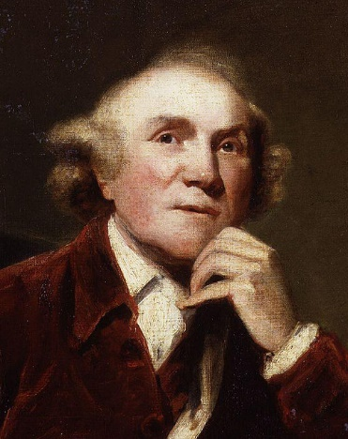
The history of treatments for infections
Pre-history Eat roots
Medieval Period Exorcisms and chanting
John Hunter Surgery
1942 Alexander Fleming Penicillin
1949 Benjamin Duggar Tetracycline
1964 Eli-Lilley 1st Cephalosporin
1970-80a Synthetic Macrolides
1980-90s Refinements of all of the above
21st century Antibiotic resistance becomes overwhelming, back to eating roots

Slide 28
Key Take Homes
Cellulitis
When to suspect unusual bugs
Necrotising Fasciitis
Finger sweep test
Abscess
Reserve antibiotics for septic people

