Slide 1
Julia Whiting
Health Visitor Programme Lead, East of England
Models of Practice Education Evaluation

Slide 2
Introduction
Evaluation of practice teaching models is limited
There is an unchallenged assumption that the ‘best’ model is the traditional one student with one practice teacher
A recent unpublished thesis suggests that the important element is the one to one support, with appropriate knowledge and skills, and creation of the learning environment – not whether it is provided by a practice teacher or mentor (Devlin, 2012)

Slide 3
Background
A move away from the traditional 1:1 ratio to a ‘long-arming model’ for a number of years in the East of England – agreed with and supported by HEI’s - in line with models of practice recommended by NMC (2011)
This alone would not meet significant increase in student numbers from 2011
In Norfolk the model of ‘roving’ or peripatetic Practice Teacher championed by practicing PT’s in collaboration with HEI to meet the challenge

Slide 4
The Roving (Peripatetic) Practice Teacher
Roving PT freed up from ‘traditional’ caseload responsibilities but remains part of caseload holding team meeting NMC requirements – either by a significantly reduced caseload or attached to corporate caseload
Students placed with mentors – experienced HV’s who have mentor training + additional day delivered by HEI and PT’s
Works with mentors and directly with students in their placement or in their own team
Delivers action learning sets, study days, aligning theory with practice, support group for mentors

Slide 5
A range of approaches
Roving CPT
Mentor and
Student
Mentor and
Student
Mentor and
Student
Mentor and
Student
Mentor and
Student
Mentor and
Student
NQCPT
Student
Student
Student CPT
Student

Slide 6
Perceived Benefits
Develops enhanced skills and confidence of mentors
Develops leadership role of PT’s
Students placed throughout the organisation in every team – not just where PT’s based
Gives flexibility to offer range of placements, manage RtP’s etc
Raises practice standards across the
organisation – essential for improving
outcomes and protecting the public
Supports innovation
MUCH BETTER THAN 1:1 ??

Slide 7
Survey
Simple on line survey commissioned by the East of England giving quantitative and qualitative data
Student attrition and achievement - % of modules passed at first attempt also utilised
Two Key Questions
1) To what extent is the use of a practice teacher with due regard model meeting the learning needs of students and the requirements of practice based learning?
2) What are the benefits and challenges of adopting this model?

Slide 8
Survey
Responses received from
PT’s 53
Mentors 60
Students 92
75% located in a practice placement with a mentor and allocated a practice teacher with due regard
70% of practice teachers that responded supervise no more than 3 students
Does not distinguish between traditional one to one model, long arming or peripatetic model

Slide 9
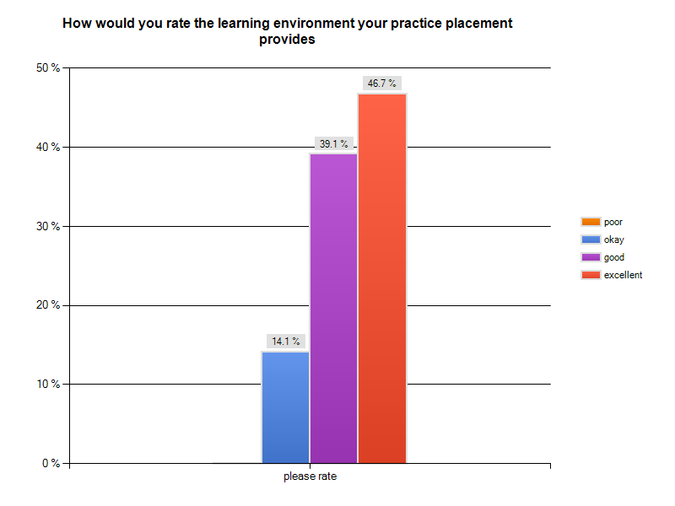
Headline Results
94% of students reported that their practice placement met their learning needs and most of them indicated that they felt their practice placement was excellent (47%) or good (39%).
No students rated their placement as poor.

Slide 10
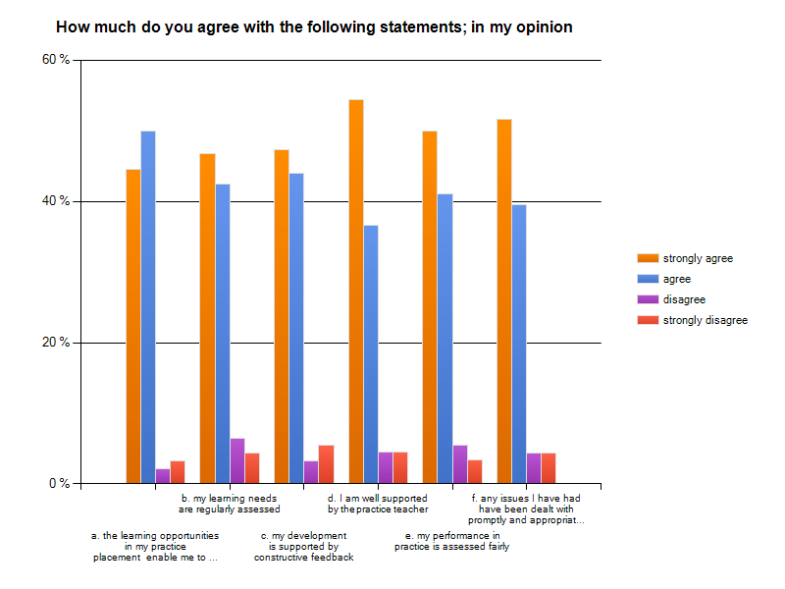
Student Views

Slide 11
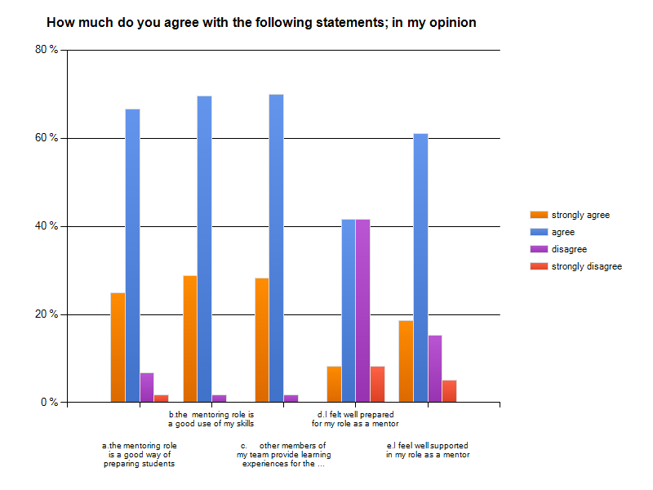
Mentor Views

Slide 12
Practice Teacher Views
62% of practice teachers felt that the quality of the practice placement was reduced when adopting a PT with due regard model
HOWEVER
This is not born out by attrition rates or achievement data.
High practice teacher mentor ratio – low attrition rates and high achievement
Low Practice teacher mentor ratio – higher attrition rates and lower achievement
55% of Practice Teachers felt the quality of service delivery to be reduced – mainly due to additional workload for mentors
75% of mentors though the service was unchanged or improved
Some practice teachers acknowledged benefits …….
‘ ‘The student is getting a broader view of practice areas and caseloads’
‘It provides a rich layered practice experience’ (PT)

Slide 13
Some final comments…
Total pleasure
It has been refreshing seeing the enthusiasm of the student. Consolidated practice has now arrived and now all the frustrations and hard work has paid off to see a student who is now confident, knowledgeable and fit for practice
It is enjoyable, challenging but tiring!!!
I am energised by the teaching role and couldn’t envisage any other job that would give me as much satisfaction, despite the niggles we have experienced
I love it

Slide 14
Conclusions
The data suggests, that on balance, there does not appear to be any significant difference between the one to one practice teacher model and the practice teacher with due regard model from the student perspective.
There is evidence that this approach is providing the student with a broader range of learning opportunities and experiences.
The data does not indicate a rise in student attrition or reduction in student achievement in areas where the PT with due regard model is used.
It would seem that the quality of the practice learning experience is likely to be related to a number of other challenging external factors such as office environment, staff workload issues, caseload complexity and high levels of safeguarding issues.

Slide 15
Recommendations
Improved preparation and support of mentors to include; learning outcomes of the programme, student learning and progression and supporting assessment processes.
On-going continuing professional development of practice teachers and mentors including the provision of structured forums with HEI’s and development of peer networks.
An in-depth comparative study of the impact of using a variant of the practice teacher with due regard model (peripatetic model).
A review of practice teacher with due regard role in terms of time required for teaching and assessing of students by practice teachers in line with their dual responsibilities.

Slide 16
DH funded evaluation
Questions
1) Are the new models of practice education safe
and effective in relation to NMC standards?
Regarding learning hours
Regarding practice teaching hours
Regarding assessment
Regarding range of practice experience
2) Given that competency is assessed by HEI’s at graduation is there any difference regarding individual’s perception of preparedness to fulfil their health visiting role within 6 months of qualification?

Slide 17
Evaluation 2
2 HEI’s commissioned to undertake evaluation
Phase 1 September to December 2012 – collecting supporting quantitative evidence from current graduates
Audit of practice portfolios for evidence of objective setting and monitoring, records of contact with PT – teaching and meetings, assessments, student achievement and necessary actions etc.
Questionnaire to newly qualified HV’s re individual’s perception of preparedness to fulfil their health visiting role within 6 months of qualification
Report on graduation rates and degree levels of new graduates
Phase 2 January to March 2013 – use of a focus group approach to explore qualitative differences in the new and traditional models of practice education.

Slide 18
Early Results – audit of practice portfolios from students using roving PT model
The NMC requires all students undertaking a programme leading to registration as a specialist community public health nurse (SCPHN) to have a named practice teacher responsible and accountable for:
Organising and co-ordinating learning activities, primarily in practice learning environments for pre-registration students, and those intending to register as a specialist community public health nurse (SCPHN) and specialist practice qualifications where this is a local requirement.
Supervising students and providing them with constructive feedback on their achievements.
Setting and monitoring achievement of realistic learning objectives in practice. Assessing total performance – including skills, attitudes and behaviours.
Providing evidence as required by programme providers of the student’s achievement or lack of achievement.
Liaising with others (e.g. mentors, sign-off mentors, supervisors, personal tutors, the programme leader, other professionals) to provide feedback and identify any concerns about the student’s performance and agree action as appropriate.
Signing off achievement of proficiency at the end
Findings - The NMC Standards to Support Learning Assessment In Practice (NMC 2008) are fully met
Cohort of 29 FT students using roving PT model – all successfully completed. 5 with First Class Honours.

