Slide 1
Sexual Health in Primary Care
Dr Sadriye Eriksson, GPST3
Mersea Island Medical Practice

Slide 2
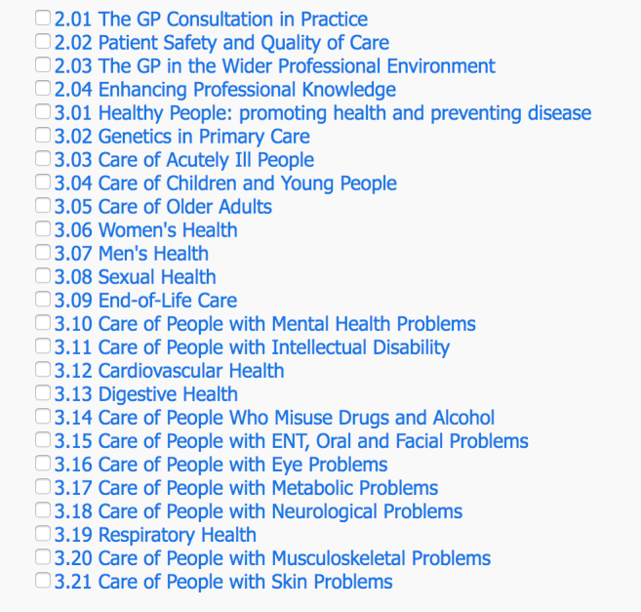

Slide 3
What RCGP Expects from GPs
http://www.rcgp.org.uk/training-exams/gp-curriculum-overview/online-curriculum/applying-clinical-knowledge-section-1/3-08-sexual-health.aspx

Slide 4
Why is Sexual Health Important
Sexual health of the UK population is in decline
UK has highest teen pregnancy rate in Western Europe
TOP rates have increased over recent years
Anecdotal evidence that many women not offered a range of contraceptive options especially LARC
Rates of STIs are increasing
Burden in under 25s, urban areas

Slide 5
Components of a sexual history
Symptoms-to guide examination and tests
Exposure history
Contraception use/pregnancy risk
Other sexual health issues ( including psychosexual issues)
HIV/ HepB/HepC risk assessment for testing and prevention
Assessment of risk behaviours, leading to partner notification and sexual health promotion

Slide 6
Last sexual intercourse
Date
Partner gender
Type
Condom usage
Previous sexual partners in the last 3 months
Previous STI
Blood born virus risk (hep b and c , HIV)
Current symptoms
For woman – LMP, contraception, cytology
Any competency / child protection issues

Slide 7
HIV risk assessment
Current/past use of injecting drugs, personal history or that of partners
SI with anyone from abroad
SI with men/bisexual partner
Medical treatment abroad
SI with HIV positive partner
Sex work
History of HIV testing

Slide 8
How to ask…..
May use ‘warning shot’
‘I am going to ask you some personal questions, these are all for a reason, and they are all confidential-is that ok with you?’
Don’t apologise…

Slide 9
How to ask…..
‘when did you last have sex/sexual contact?’
‘was that with a regular or a one-off partner?’ ‘ was it someone you know or didn’t know?’
‘was that a male or female partner?’
What kind of sex was it? Was it vaginal/oral/anal sex’
‘Did you use condoms? Do you use condoms always, sometimes or never?’
‘does that person have any symptoms?’

Slide 10
How not to ask..
No closed questions to start
‘Are you married?’
‘Are you in a stable relationship?’
‘Are you sexually active?’
‘are you homosexual?’
Want questions that are precise and useful without being blunt, that are understood by both patient and clinician

Slide 11
Symptoms
Women
Change to discharge
Change to bleeding
Dysuria
Abdominal pain
Pain with sex
Genital skin problems
Men
Urethral discharge
Dysuria
Testicular pain
Genital skin problems
Perianal/anal symptoms

Slide 12
Key points
Risk assessment is the key to management
History taking is the key to risk assessment
Don’t apologise for asking
Don’t make assumptions

Slide 13
Services Available
https://www.essexsexualhealthservice.org.uk/
0300 003 1212

Slide 14
Home Testing
Test At Home service is available 24 hours a day and offers STI testing for Chlamydia, Gonorrhoea, Syphilis & HIV. This service is provided for Essex Sexual Health Service by SH:24.
SH:24 is a free online sexual health service, delivered in partnership with the NHS.
They provide free test kits, information and advice - 24 hours a day.
https://sh24.org.uk/

Slide 15
Resources
BASHH Guidelines
https://www.bashh.org/documents/Sexually%20Transmitted%20Infections%20in%20Primary%20Care%202013.pdf
E-Learning Course on RCGP
http://elearning.rcgp.org.uk/course/info.php?popup=0&id=179
https://www.relate.org.uk/

