Slide 1
Rolling with the punches: Developing your personal recipe for resilience
Dr. Amy Iversen and Dr. Charlotte Feinmann

Slide 2
Outline of the workshop:

Slide 3
Introductions >>
You!!! (small group exercise)
PLEASE TAKE 5 MINUTES AND INTRODUCE YOURSELF TO YOUR GROUP AND POST UP YOUR KEY INGREDIENTS FOR RESILIENCE
Your first name
Where you work
Your discipline
Your ingredients for resilience
MY RECIPE FOR RESILIENCE:
500 g Mindfulness
250 g of slack
A pinch of enjoyment

Slide 4
MINI-DIDACTIC
Definitions & terms:
*Thanks to Steve Blades for some slides

Slide 5
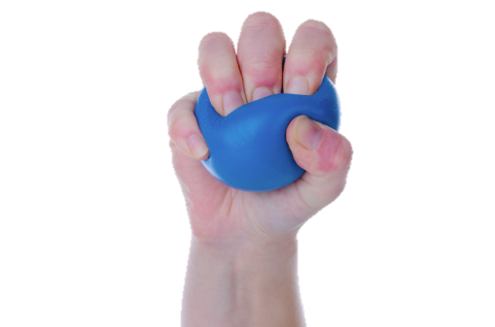
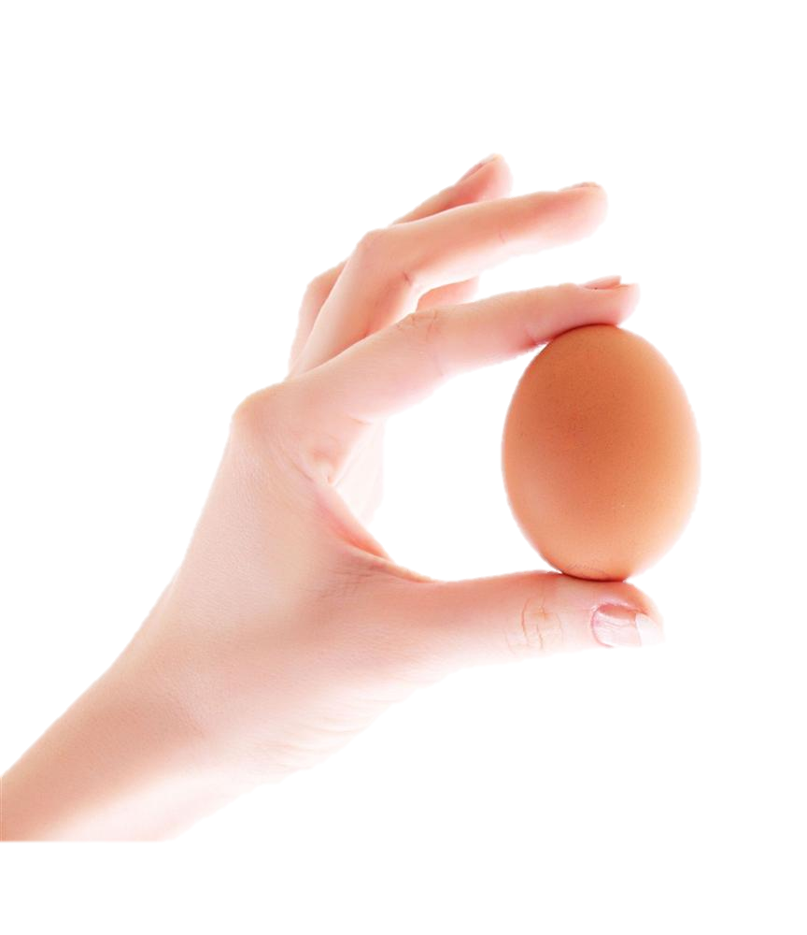
RESILIENCE = ?
The ability to spring back into shape
Notes:
the ability of a substance or object to spring back into shape

Slide 6
RESILIENCE
The different abilities of anticipating, reducing the impact of, coping with, and recovering from the effects of adversity. Resilience is therefore not just the immediate ability to respond to negative ‘events’ but rather a process of positive adaptation before, during and after adversity

Slide 7
What is Resilience?
“Resilience is the ability to know where, how and when to use your energies to improve things for yourself and how to recruit help in that endeavour”
BRIGID DANIEL
Daniel, B. The Value of Resilience as a Concept for Practice in Residential Settings. Scottish Journal of Residential Child Care, February/March 2003

Slide 8
What is Resilience?
Resilience is the ability to be successful both personally and professionally, in the midst of a high-pressured, fast-paced and continuously changing environment
GSK

Slide 9
What is Resilience?
A set of flexible cognitive, behavioural and emotional responses to acute or chronic adversities which can be unusual or commonplace
These responses can be learnt
Coming back from adversity (not bouncing back)
Neenan, 2009

Slide 10
Challenges to resilience for doctors
Excessive workload
Dealing with suffering and constant demands
Dealing with uncertainty about future
Dealing with one’s own mistakes or fear of them
Lack of professional support
Externally imposed change/managers
Boredom
Reluctance to seek help

Slide 11
YERKES-DODSON CURVE

Slide 12
How Can We Develop Resilience?
Likely that some people may be more biologically predisposed toward being resilient; but psychological and environmental factors can contribute to its development
The good news is that resilience is not a binary quality that people either have or do not have – it involves thoughts, beliefs, attitudes and behaviours that can be learned and developed

Slide 13
Psychological and Environmental Factors that Contribute to Resilience
Positive Self-Regard
Internal Locus of Control & Evaluation
Existential Concepts of Freedom and Responsibility (Victor Frankl)
Everything can be taken from a man or a woman but one thing: the last of human freedoms - to choose one's attitude in any given set of circumstances
Ability to cope with pressure

Slide 14
Coping with pressure
Thinking
Behaviour
Lifestyle behaviours

Slide 15
The ABC Model
A – Activating event or situation
B – Beliefs about the event
C – Consequences
Emotional, such as anxiety or anger
Behavioural such as aggression or avoidance
Physiological such as palpitations, shaking

Slide 16
The Power of Thinking
“Man is disturbed not by things but by the views he takes of them”
Epictetus, AD 55-135
“My life has been full of terrible misfortunes most of which have never happened”
Michael de Montaigne

Slide 17
Unhelpful thinking patterns
All or nothing thinking
Overgeneralisation
Disqualifying the positive or focusing on the negative
Magnification or minimisation
Thoughts feelings fusion
Using should, must or ought statements
Catastrophising
Personalisation
Mind reading or predicting the worst

Slide 18
Unhelpful styles: Perfectionism
High standards and conscientiousness
Self criticism
Chronic doubt and guilt
Exaggerated sense of responsibility
High demands of others and difficulty delegating
Procrastination
Frustration with inefficiencies

Slide 19
Behaviours
Support networks
Reflection
Assertiveness
Avoid procrastination
Develop goals
Time management
Work – life balance

Slide 20
Lifestyle Choices
Alcohol
Caffeine
Smoking
Exercise
Nutrition
Relaxation

Slide 21
Styles underpinning resilience
High frustration
Tolerance
Self acceptance
Self belief
Humour
Perspective
Curiosity
Adaptability
Meaning

Slide 22
It’s all about the way you think
Success is not final, failure is not fatal: it is the courage to continue that counts.”
Winston Churchill
You must make a decision that you are going to move on. It wont happen automatically. You will have to rise up and say, ‘I don’t care how hard this is, I don’t care how disappointed I am, I’m not going to let this get the best of me
Joel Osteen, Your Best Life Now: 7 Steps to Living at Your Full Potential
Failure is the condiment that gives success its flavor.”
Truman Capote

Slide 23
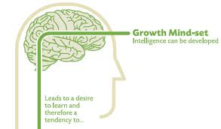
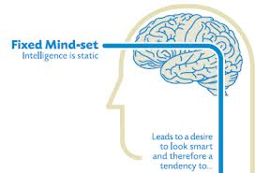
Mindset (Carol Dweck)
Notes:
In a fixed mindset, people believe their basic qualities, like their intelligence or talent, are simply fixed traits. They spend their time documenting their intelligence or talent instead of developing them. They also believe that talent alone creates success—without effort. They’re wrong.
In a growth mindset, people believe that their most basic abilities can be developed through dedication and hard work—brains and talent are just the starting point. This view creates a love of learning and a resilience that is essential for great accomplishment. Virtually all great people have had these qualities.

Slide 24
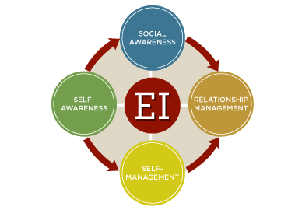
Emotional Intelligence
Notes:
Self-Awareness: ability of an individual to be in tune with her/his own feelings and to recognize the impact that his/her feelings have on others. The competency that underpins this dimension is emotional self-awareness.
Self-Management: ability to keep negative emotions and impulsive behavior under control, stay calm and unflappable even under stressful situations, maintain a clear and focused mind directed on accomplishing a task. The required competencies for this dimension are positive outlook, emotional self-control, achievement orientation, and adaptability.
Social Awareness: ability to read or sense other people’s emotions and how they impact on the situation of interest or concern. The competencies for this dimension include empathy and organizational awareness.
Relationship Management: ability to influence, guide and handle other people’s emotions. The competencies that underlay this dimension include inspirational leadership, influence, coach and mentor, conflict management, and teamwork.

Slide 25
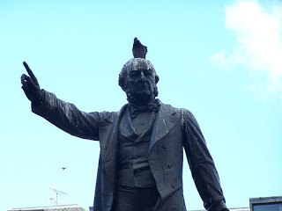
Some days you are the pigeon, and some days you are the statue

Slide 26
It’s all about the way you think
Perseverance: Willing to persist despite adversity
Equanimity - balance take what comes in life
Meaningfulness: acknowledgement that life is worth living
Self resilience: individuals self belief
Existential aloneness: sense of independence and freedom

Slide 27
Fuel for Resilience
Try to cope with workload
Maintain curiosity and commitment
Open mind to try new things
Accept failure and move on
Positive emotions in adversity
R
D. S. Eley et al, PeerJ, 2013

Slide 28
WHEN DISASTER STRIKES!

Slide 29
WHEN DISASTER STRIKES!
Count to 10 before reacting
Find memories of when you HAVE coped
Activate the calming part of your psyche:
Breath
Meditate
Keep your hand on your heart
Give someone a hug!
Go for a walk outside
Find one positive thing you can learn from the situation

Slide 30
Questions
How did you manage to go on? How did you cope until this point?
What ALREADY goes well that you want to continue?
Where are you now on a scale of 1 – 10? How did you get there from 0?
At your highest point, what was different?
So, if a miracle happened… what would be different?
How will you know things are better?
How will your wife/ child/ dog know things are better?
Even before you got here today, what improvements had you noticed?
What’s better since we last met?
Blayney et al, Clinical Medicine, 2014

Slide 31
Tasks
Do something different
What will happen when you try …. to see if it helps?
Notice when you overcome a bad habit
Notice what you did when you successfully overcame the urge to do that
Notice exceptions
What’s different on an occasion when that problem seemed easier?
Blayney et al, Clinical Medicine, 2014

Slide 32
Professional Attitudes
Listen with a constructive ear
Notice good intentions and effective use of resources
Redefine stability as change
Identify the skills active when adapting to remain stable in a difficult situation
Assume that you do not know
Avoid making assumptions and let the patient find the answer
Predict that positive change will happen
Reinforce by using when rather than if, or will rather than might
Blayney et al, Clinical Medicine, 2014

Slide 33
10 Top Tips for Developing Resilience
Keep a rational mindset
Get a mentor/coach
Learn your blind spots
Give yourself a break
Ask for help
Take control
Manage stress
Get fit
Be mindful
Help others
And ……………?

Slide 34
Recommended reading
Doug Strycharczyk on Mental Toughness:
http://www.amazon.co.uk/Developing-Mental-Toughness-Improving-Performance/dp/0749463775/ref=sr_1_2?ie=UTF8&qid=1384186097&sr=8-2&keywords=mental+toughness
Liggy Webb’s new book (2013)
http://www.amazon.co.uk/Resilience-Everything-Around-Keeps-Changing/dp/0857083872/ref=sr_1_fkmr0_1?ie=UTF8&qid=1384186146&sr=8-1-fkmr0&keywords=noonan+resilience
Nicholson and Clarke’s well-received book:
http://www.amazon.co.uk/Resilience-Bounce-back-whatever-throws/dp/1854585444/ref=sr_1_1?ie=UTF8&qid=1384186224&sr=8-1&keywords=clark+resilience
The CBT/REBT-focused approach to resilience
http://www.amazon.co.uk/Developing-Resilience-Cognitive-Behavioural-Michael-Neenan dp/041548068X/ref=sr_1_1?s=books&ie=UTF8&qid=1384186296&sr=1-1&keywords=neenan+resilience

Slide 35
Neuroscience
Russo et al. Neurobiology of Resilience. Nature Neuroscience 15, 1475–1484 (2012)
Charney, D.S. Psychobiological mechanisms of resilience and vulnerability: implications for successful adaptation to extreme stress. Am. J. Psychiatry 161, 195–216 (2004)
McEwen, B.S., and Gianaros, P.J. (2011). Stress- and allostasis-induced brain plasticity. Annu. Rev. Med. 62, 431–445.
Holzel, B.K., Carmody, J., Evans, K.C., Hoge, E.A., Dusek, J.A., Morgan, L., Pitman, R.K., and Lazar, S.W. (2010). Stress reduction correlates with struc- tural changes in the amygdala. Soc. Cogn. Affect. Neurosci. 5, 11–17
Karatsoreos, I.N., Bhagat, S., Bloss, E.B., Morrison, J.H., and McEwen, B.S. (2011). Disruption of circadian clocks has ramifications for metabolism, brain, and behavior. Proc. Natl. Acad. Sci. USA 108, 1657–1662

Slide 36
Notes:
To help summarize several of the main points in this brochure, think of resilience as similar to taking a raft trip down a river.
On a river, you may encounter rapids, turns, slow water and shallows. As in life, the changes you experience affect you differently along the way.
In traveling the river, it helps to have knowledge about it and past experience in dealing with it. Your journey should be guided by a plan, a strategy that you consider likely to work well for you. Enjoy your journey
Perseverance and trust in your ability to work your way around boulders and other obstacles are important. You can gain courage and insight by successfully navigating your way through white water. Trusted companions who accompany you on the journey can be especially helpful for dealing with rapids, upstream currents and other difficult stretches of the river.
You can climb out to rest alongside the river. But to get to the end of your journey, you need to get back in the raft and continue

