Slide 1
USEFUL LINKS
https://www.gov.uk/guidance/nhs-entitlements-migrant-health-guide
https://www.childrenslegalcentre.com/resources/primary-health-care/
https://www.doctorsoftheworld.org.uk/useful-resources
https://www.refugeecouncil.org.uk/

Slide 2
Refugees in primary care
S Moody MbChB BSc DMCC DTM&H

Slide 3
Definitions: Refugee
a person who ‘owing to a well-founded fear of being persecuted for reasons of race, religion, nationality, membership of a particular social group, or political opinion, is outside the country of his nationality, and is unable to or, owing to such fear, is unwilling to avail himself of the protection of that country…’ (1951 Refugee Convention)

Slide 4
Definitions: Migrant
No formal legal definition
An international migrant is someone who changes his or her country of usual residence, irrespective of the reason for migration or legal status.
For work: Economic migrant
However, this doesn't take into account the societal implication of the work ‘migrant’

Slide 6
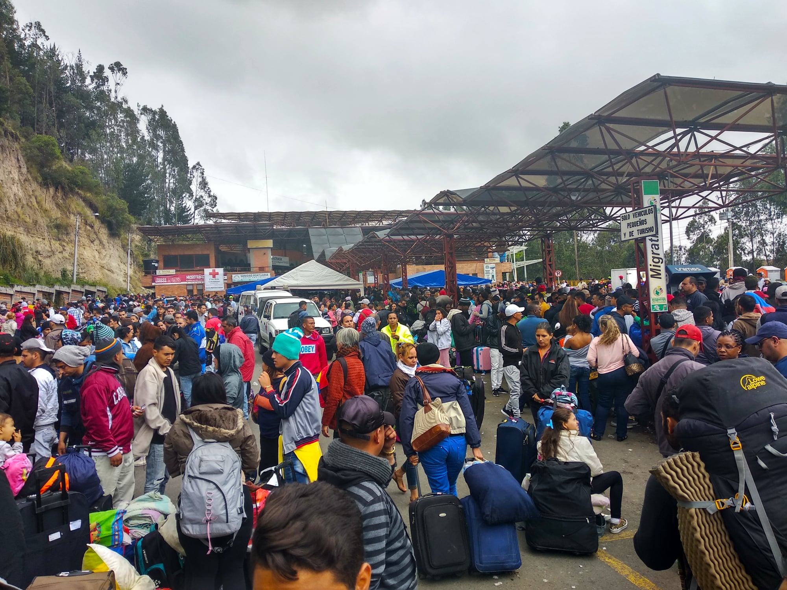

Slide 7
Definitions: IDP
"persons or groups of persons who have been forced or obliged to flee or to leave their homes or places of habitual residence, in particular as a result of or in order to avoid the effects of armed conflict, situations of generalized violence, violations of human rights or natural or human-made disasters, and who have not crossed an internationally recognized state border.“
LEGAL RIGHTS??

Slide 8
Definitions: Asylum Seeker
A person who has left their country of origin and formally applied for asylum in another country but whose application has not yet been concluded.

Slide 9
Definitions: Refused asylum seeker
A person whose asylum application has been unsuccessful and who has no other claim for protection awaiting a decision. Some refused asylum seekers voluntarily return home, others are forcibly returned and for some it is not safe or practical for them to return until conditions in their country change.

Slide 10
Legality of treating the displaced
NHS guidance: ‘All asylum seekers and refugees, students, whose on work visas, those who are homeless, overseas visitors, whether here lawfully or not, are eligible to register for a GP.’
GP’s cannot refuse one from applying.

Slide 11
The reality
Practices have their own registration policies (Some may be against NHS guidance/plain wrong)
Practices can mess around due to confusion, but the following are ALWAYS exempt from costs:
Refugees
Asylum seekers, including rejected asylum seekers
Victims of slavery, torture or human trafficking
Legally however, there is NO formal obligation to prove identity or immigration status when registering.

Slide 12
NHS guidance clearly outlines that a practice cannot refuse a patient because they do not have identification or proof of address.
Where a patient applies to register with a general practice and is subsequently turned down, the GP must nevertheless provide, free of charge, any immediately necessary treatment that is requested by the applicant for a period of up to 14 days (this can vary according to circumstances).
If a GP practice refuses to register a patient the practice must notify the applicant, in writing, of the refusal and the reason for it, within 14 days of its decision.
https://www.gov.uk/guidance/nhs-entitlements-migrant-health-guide

Slide 13
Take home
A displaced person can ALWAYS apply.
They do not need proof of identity/address/status.
Restrictive practice policies should be challenged/referred to official advice.
Encourage to apply – even if rejected, you can offer 14 days of cover
Continue treatment already underway before asylum is refused (send that referral!)

Slide 14
Clinical challenges

Slide 15
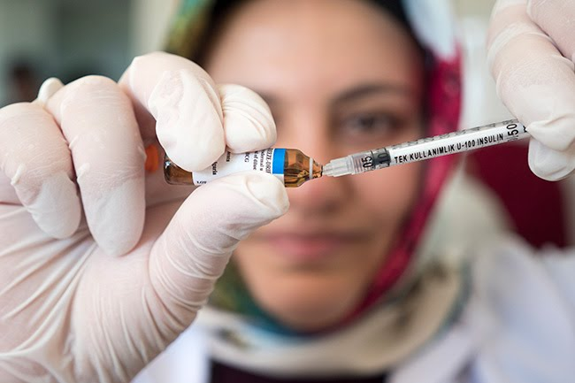

Slide 16
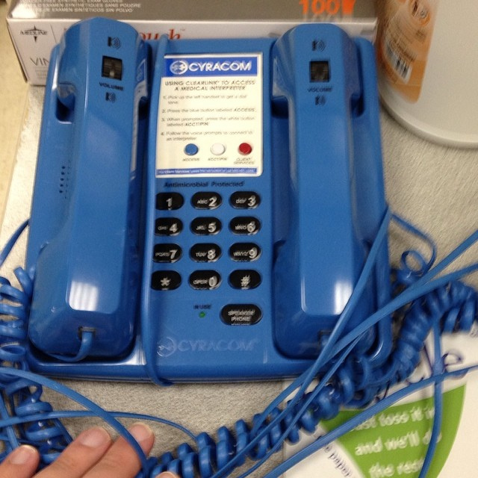

Slide 17
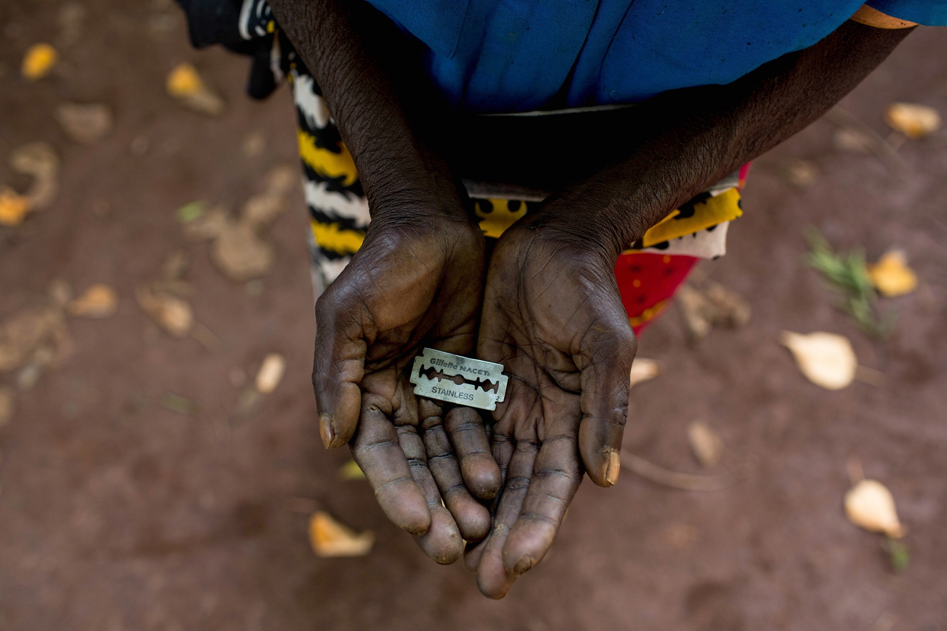

Slide 18
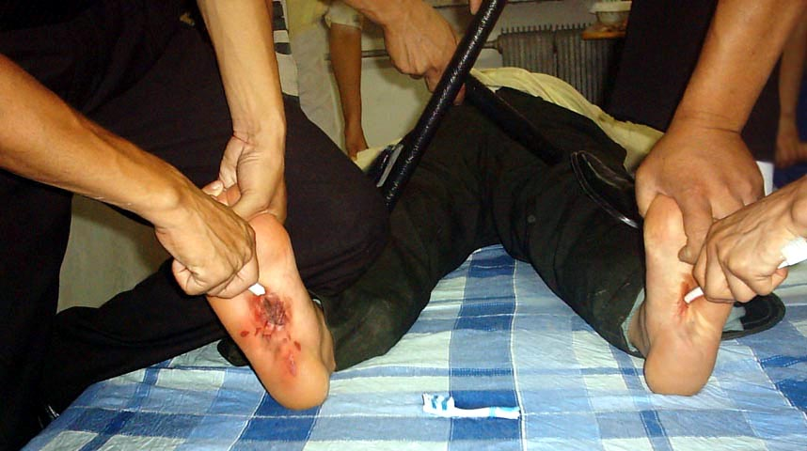
Falanga

Slide 19
Psychological torture and PTSD

Slide 20
HIV/TB/Hepatitis
ALWAYS SCREEN AS STANDARD
Rapid referral
CXR for Ghon focus
HIV+TB – IPT
Lifelong fluconazole, eg. Cryptococcal meningitis

Slide 21
GET HELP FROM THE PRO’S

