Slide 1

Introducing the
Professional Support Unit “PSU”

Slide 2

What do we offer
Single point of contact
Access to specialist services
Expert advice

Slide 3
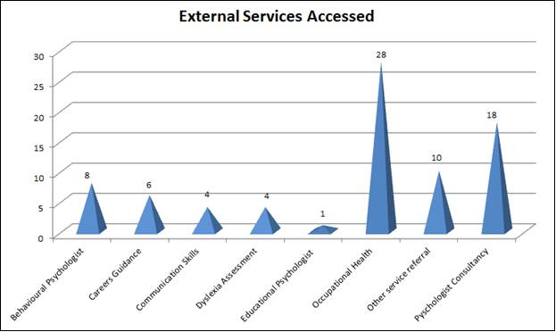
Support Services Accessed

Slide 4

Referral to PSU
  Supportive
  Confidential
  Impartial advice
  Challenging
  Not punitive

Slide 5

PSU Support
General confidential advice trainees/trainers
Repeated exam failure
Help with educational plan
Disability & Adjustments
Occupational Health Referral
Careers
Notes:
5

Slide 6
7 early warning signs
The ‘Disappearing Act’
Low work rate
‘Ward Rage’
Rigidity
‘Bypass Syndrome’
Career problems
Insight failure
Paice, 2006
Notes:
Number of Causes and Contributory Factors and these are some of the Early Warning Signs that can often indicate underlying problems
Disappearing - not answering bleeps; disappearing between the clinic and the ward, lateness or frequent sick leave are all potential early warning signs leading to the big “houdini” Disappearing act.
Low Work Rate - slowness in doing procedures, clerking patients, dictating letters, making slow decisions, arriving early and leaving late and still not achieving a reasonable workload.
Ward Rage - bursts of temper, shouting matches, real or imagined slights.
Rigidity - poor tolerance of ambiguity, inability to compromise, difficulty prioritising, inappropriate “whistle blowing‟.
Bypass Syndrome - junior colleagues or nurses find ways to avoid seeking the doctor’s opinion or help.
Career problems - difficulty with exams, uncertainty about career choice, disillusionment with medicine.
Insight failure - rejection of constructive criticism, defensiveness, counter-challenge.
Work-based
Absence from duty/persistent lateness
Poor time management/backlog of work
Failure to learn and change
Clinical performance markers
Over or under investigating
Poor decision making
Poor record keeping
Complaints
Failure to follow guidelines
Missed diagnosis
Cognitive
Memory problems
Poor problem solving/reasoning
Decision-making difficulties
Poor concentration /attention
Learning problems
Language/Cultural
Poor verbal fluency
Poor understanding
Psychological/Personality
Irritability
Unpredictability
Forgetfulness
High self-criticism/perfectionist
Arrogance
Lack of insight /denial
Risky/impulsive
Social
Isolation
Withdrawal
Poor personal interactions

Slide 7

What lies beneath
Disruptive Behaviours
Workload
Psychological Factors
Sleep Loss
Family Pressure
Training and Education
Health Issues

Slide 8
Classifying the scale of concern

Slide 9
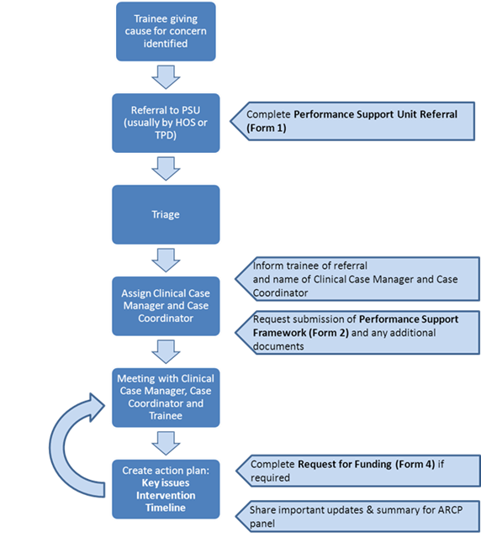
Referral - The Process
Form 3 Clinical Case Manager Assessment completed

Slide 10

Thank you
Any Questions..?

