Slide 1
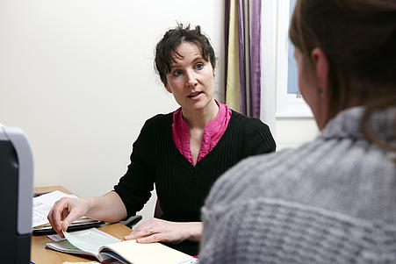
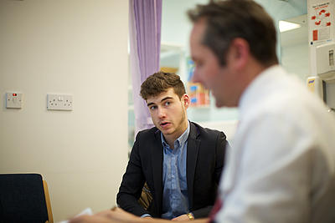

Trainees in difficulty
How can you help?
Francesca Crawley
Notes:
Introductions –
Paper plane exercise for larger groups.
Referral reason
Barriers to referral
How to overcome barriers

Slide 2
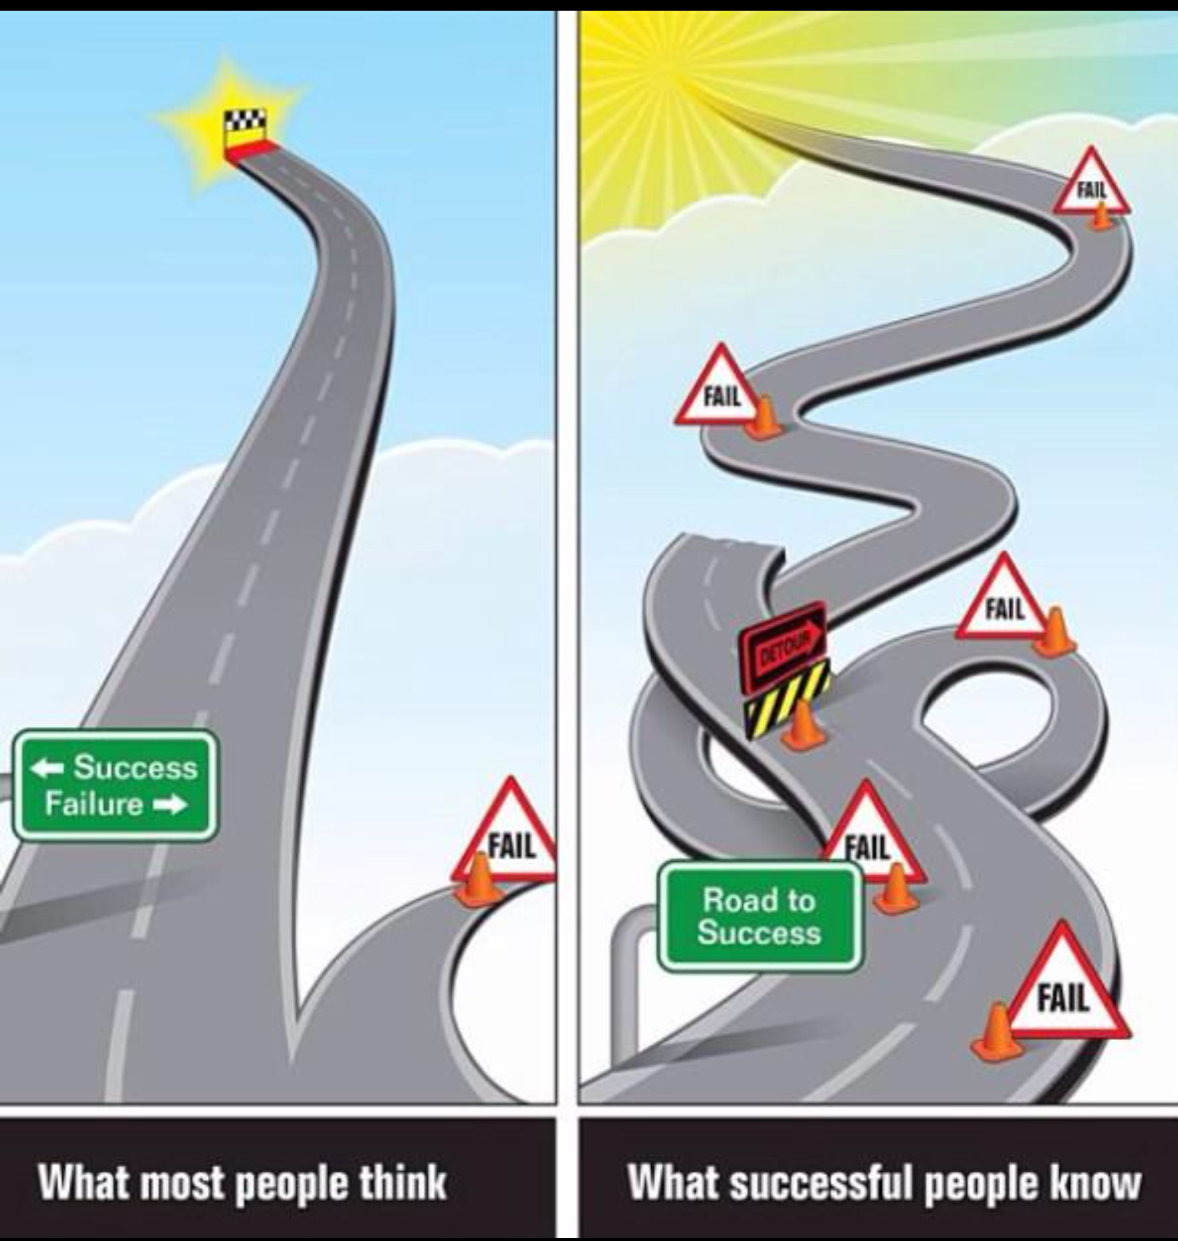

Slide 3
Is there a sure-fire way of recognising struggling trainees, reducing your anxiety, getting them back on track and ensuring they will be excellent doctors ?
No…
Seriously... You’d have heard about it

Slide 4
What are your experiences?

Slide 5

Performance

Slide 6
Performance
Workload
Psychological Factors
Life events
Sleep Loss
Family Pressure
Training and Education
Health Issues
Cultural factors
Diagnose
Document
Do something

Slide 7
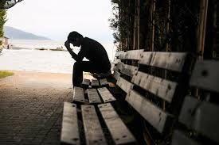
What signs might alert you that a collegue was struggling?

Slide 8
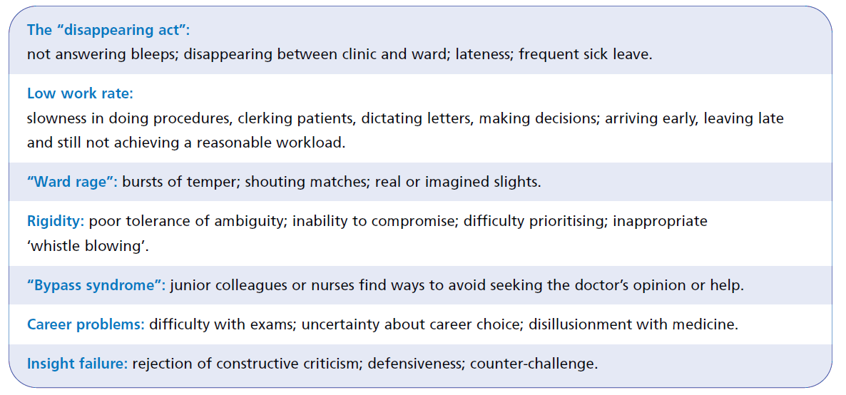

Slide 9
Why aren’t these issues tackled earlier?
  Fear of confrontation
  Fear of retaliation
  Denial
  Lack of confidence in skills
  Cultural issues
  Lack of “evidence”
  Desire to rescue or protect
  Avoidance
  Frustration
  Helplessness

Slide 10
How dangerous is dangerous ?
What is the risk to:
  Patients?
  Self?
  Team?
  Organisation?
Dangerous
Destructive
Disruptive
Disturbing
Distracting

Slide 11
Scale of concern: examples of TiD
involvement in serious untoward incident(s)
repeated complaints from patients, relatives or healthcare professionals
serious disciplinary issues
poor performance in the workplace, clinically, managerially or inter-personally.
failure to engage in educational process
erratic behaviour or issues around bullying or harassment
adverse progress review outcomes (e.g. ARCP outcome 3)
high
intermediate
low
Non-attendance at educational programme
Educational portfolio not up to date
Some incidents of arriving late
Unavailable on occasions when bleep required
Serious Untoward Incidents
Undue absence from the workplace
Complaints from patients, relatives or healthcare professionals
Poor performance in the workplace clinically, managerially or inter-personally.
Failure to engage in the educational process
Erratic behaviour or issues around bullying or harassment
repeated exam failure
continued failure to complete work based assessments
problems with generic skills such as team working or professionalism
health/disability matters requiring specialist help
repeatedly arriving late or low attendance
repeated delay in acquiring areas of professional competence
Repeated Incidents/Inability to resolve
non-attendance at educational programme
some incidents of arriving late
unavailable on occasions when required
some absent portfolio documents
some gaps in knowledge or skills
reported minor non-clinical skills gaps
occasional miscommunication
TiD=trainee in difficulty
HEE EoE Professional Support Unit (2018)
Notes:
Classifying the Scale of Concern
The level of concern about individual trainees varies on a case by case basis. The Educational Supervisor and Clinical Supervisor (usually with the TPD in the case of GPSTs), should meet with the trainee in the first instance to classify the concern from level 1 (low level) to level 3 (high level).
It is expected that trainees demonstrating level 1 concerns are managed at trust level or within the specialty/school

Slide 12
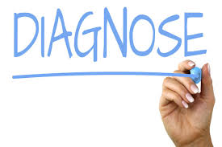



Slide 13
Diagnose
Poor performance is a symptom not a diagnosis

Slide 14
Diagnose
Symptoms
Knowledge
Skills
Attitudes

Slide 15
Diagnose
Trainee factors
Health
Life stresses
Sleep
“Personality”
Cultural factors
Expectations
Symptoms
Knowledge
Skills
Attitudes

Slide 16
Diagnose
Trainee factors
Health
Life stresses
Sleep
“Personality”
Cultural factors
Expectations
Environment
Workload
Rotas
Lack of feedback
Wrong level of expertise
Symptoms
Knowledge
Skills
Attitudes

Slide 17
Diagnose
Trainee factors
Health
Life stresses
Sleep
“Personality”
Cultural factors
Expectations
Environment
Workload
Rotas
Lack of feedback
Wrong level of expertise
Symptoms
Knowledge
Skills
Attitudes
Trainer
Bullying
Disorganised
Burnt-out
Absent

Slide 18
How do you make the diagnosis?
...you need information
For symptoms:
Usually from observation
Significant Incidents
Documented reports

Slide 19
How do you make the diagnosis?
...you need information
For causes:
Talk to the trainee
Talk to the supervisors
May need more specialist help
eg Occ Health
Assessments eg for dyslexia

Slide 20
The complicated bits...
Human Resources & Employment Law
Discrimination / Equality considerations
Health and Safety
Litigation and Tribunals
Confidentiality
Bullying / Harassment issues
Talk to HR & Deanery

Slide 21
What is an ideal intervention?
Appropriate: addresses the problem
Focused: suits the individual
Effective: results in genuine, long lasting change
Efficient: requires an acceptable investment of time, money, energy or other resources
Measurable: makes a difference that can be quantified

Slide 22
Intervention
Trainee factors
Manage health
Address issues
Clear expectation
Feedback
Mentoring
Coaching
Trainee factors
Manage health
Address issues
Clear expectation
Feedback
Mentoring
Coaching
Environment
Change
Improve
Reduce workload
Protected time
Environment
Change
Improve
Reduce workload
Protected time
Symptoms
Knowledge
Skills
Attitudes
Trainer
Talk
Change
Train
Trainer
Talk
Change
Train

Slide 23
Rule 1 of Doing Things Right...
Don’t try it on your own
Who can help?

Slide 24
Who can help?
Clinical Supervisor
Educational Supervisor
College Tutor
DME
Medical Director
HR
Deanery- the Professional Support and Wellbeing Service

Slide 25
PSW- process
Can self refer for exam failure
Otherwise, referred by a trainer
Referrals triaged and assigned a case manager
Meeting, generally face to face. Confidential
Action points shared with the referrer and TPD.
FU as required.

Slide 26
PSW: Support Services Available
Exam Support | High Level Occupational Health
Careers Support | Emotional Intelligence Testing
Psychological Support | Signposting to other External Services
Communication Skills Support | Trainer Support
Screening, diagnosis and follow on support for Neuro-diverse Conditions
Notes:
Exam workshops and 1:1 sessions
1:1 Careers Support sessions – High level support from an external provider. No in house support at present
6 sessions with Psychological support service – Hammet Street Consultants
Communication skills support for accent reduction, role play, confidence building, conflict management, CSA practice and team working as well as comms skills workshops for IMGs
Specialised OH for those with complex health concerns
In house emotional intelligence testing for more targeted support
Signposting to other external services such as charities specifically for doctors
Psychological Support and meetings with Deputy Deans
Screening, Full cognitive assessments and strategic coaching

Slide 27
Support Services Accessed in EoE
Notes:
Support services remain relevant
All have shown an increase apart from OH which we are pushing back on as feel this should sit with employer. In certain circumstances, we will request a high level OH report.
Large increase in neurodiverse screening & support – change of provider who could offer more services.
Large increase in careers support. Addressing this with our careers strategy and educator development – would hope to see this level out over the year.
Comms skills workshops, workplace observations and accent reduction are new for 2019

Slide 28
Rule 2 of Doing Things Right...
Keep good records

Slide 29
When writing:
Clear, concise, unambiguous
Accurate
Jargon free
Factual and objective
Describe sources
Separate facts from opinion
Focus on behaviour not “personality”
Acknowledge good points as well as bad
Record in eportfolio

Slide 30
Rule 3 of Doing Things Right...
Do something (sensible…)

Slide 31
Rule 4 of Doing Things Right...
Recognize your anxieties…
but don’t be stopped by them

Slide 32
Best practice
Document everything
Eportfolio
Action plan-
Shared
Seek advice and help – you’re not alone
Professional / supportive tone
Respect Confidentiality Emails

Slide 33

Animation

