Slide 1
Optic disc swelling and IIH in paediatrics
Nevila Mukaj
GPST2

Slide 2
Case study
12 year old female
Referred by Optometrist for Papilloedema
Blurred vision on and off
Appears when getting up from lying position 10/7
Lasts for a few seconds

Slide 3
Presenting complain
Headaches, intermittent
Localised in parietal area
Intermittent vomiting ( started 4 days after headaches)
Headaches improve after vomiting

Slide 4
Presenting complain
At the time of the symptoms she was in camping trip participating in games and not able to concentrate
Fever on the day of the presentation
No diplopia
No trauma
BP 106/74 mmHg

Slide 5
History
PMH: NIL
Wears glasses ( short sighted )
Growth and development normal
Up to date with vaccination
Not taking any medication or vitamins
NKDA

Slide 6
Social and family history
Lives with parents
No social concerns, attends school
Mum and maternal grandmother have migraines
No family history of eye problems

Slide 7
Examination in emergency eye clinic
Visual acuity : right eye 6/5, left eye 6/6
Colour vision normal
Pupils equal and reacting to light/accomodation
No RAPD found in both eyes
Anterior segments normal in both eyes
Visual fields to be done ( next visit)

Slide 8
Fundoscopy right eye
Red reflex seen, media clear
Blurred disc margins noted with swollen disc
Hyperaemia noted
The veins seem engorged
No haemorrhages seen
Spontaneous venous pulsation not noted
Macula normal ( left eye similar findings)

Slide 9
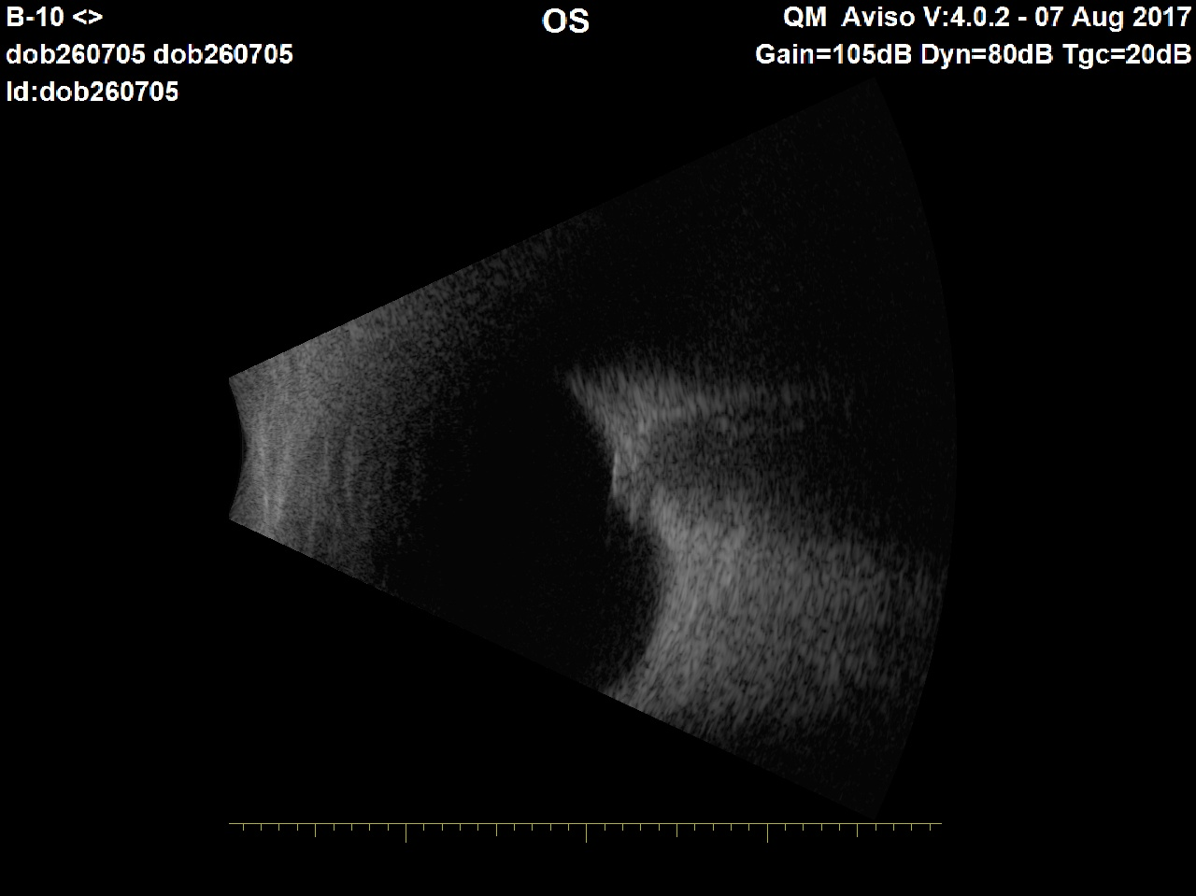
B scan image Left eye ( 7/08/17)
No drusens noted

Slide 10
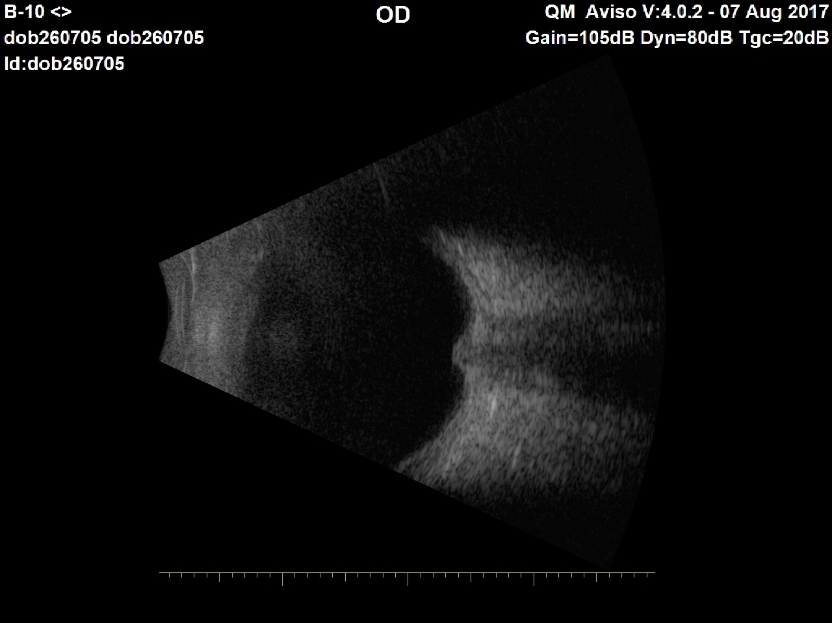
B Scan image right eye ( 07/08/17)
No drusens noted

Slide 11
Diagnosis and management
Provisional diagnoses as papilloedema
Referred to paediatrics at Colchester general for further investigations the same day

Slide 12
Hospital admission 7/08/17
MRI :
The ventricles are normal in size and are undisplaced. No significant alteration of signal is seen in the brainstem, cerebellum or cerebral cortex. Trace of fluid in the left mastoid air cells of doubtful significance.

Slide 13
Hospital admission
No blood test done at this point
Documented as normal neurology and no red flag symptoms on the discharge letter
Discharged home with follow up by local paediatric team and ophthalmology

Slide 14
15/08/17
Headaches continue and have not subsided
Episodes of vomiting again
Presented to optometrist who referred her to us for increasing signs of papilloedema
Seen in emergency eye clinic

Slide 15
Findings
Comparing to the previous optic nerve head picture, her oedema had increased with exudates in he right eye and disc haemorrhages seen in the left
She has grade IV papilloedema
She was seen by Mr Bansal as well on this occasion and referred urgently to paediatric team in hospital

Slide 16
Hospital admission ( 2nd ) 15/08/17
On this admission she had: MRV which did report no cortical venous or dural sinus thrombosis seen.
Blood tests: U&E, FBC, LFT, CRP, ESR, Coagulation, Bone profile, Haematinics, LH, Prolactin, FSH were all normal.

Slide 17
Hospital admission (2nd)
She was seen by ENT and examination was unremarkable ( due to hyperaemic left ear/tonsil and palpable neck lymph node)
Discussed with neurology at Addenbrooke’s hospital and transferred there for possible LP
Diagnosis on discharge letter benign intracranial hypertension

Slide 18
15/08/17 Addenbrook’s hospital
Diagnostic and therapeutic LP
Commenced on Acetazolamide
For follow up by paediatric neurologist and Ophthalmologist in Addensbrook’s

Slide 19
Swollen optic disc in children
Manifestation of systemic disease in paediatric patients
Causes:
optic nerve infectious
infiltrative,
inflammatory or oedema with or without raised intracranial pressure.

Slide 20
Bilateral disc swelling and with raised ICP
Papilloedema
Tumour.
Cerebral trauma.
Intracerebral or subdural haemorrhage.
Cerebral inflammation/infection.
Cerebral abscess.
Idiopathic intracranial hypertension

Slide 21
Other causes
Adrenal dysfunction and Addison disease
Hypothyroidism
Hyperthyroidism
Hypocalcaemia
Respiratory failure

Slide 22
Other causes
Medication :
tetracycline, minocycline,
lithium,
isotretinoin,
nalidixic acid
corticosteroids (both use and withdrawal)

Slide 23
Optic neuritis
Bilateral in 75% of cases in kids
Immune mediated
85% of cases are associated with a recent immunization or an infection, usually a viral infection
Non viral infection, such as pertussis, infectious mononucleosis, toxoplasmosis, or brucella.

Slide 24
Optic neuritis
Specific meningeal infections and infiltrations involving the optic nerves, including cryptococcus, tuberculosis, and sarcoidosis
Vasculitis, such as systemic lupus erythematosus
Syphilis
Leukaemia
Associated with bee and wasp stings

Slide 25
Other causes
Toxic optic neuropathy ( mainly malnutrition /B12 deficiency in paediatrics)
Malignant hypertension
MS
Anti-tumor necrosis factor (anti-TNF) drugs
Diabetic papillopathy

Slide 26
Paediatric Idiopathic Intracranial Hypertension (IIH)
Prevalence of IIH in paediatric population is not known, but is not uncommon
IIH is prone to misdiagnosis.
Accurate diagnosis is essential because of the risk of visual failure
Under 6 years, a specific cause can usually be identified

Slide 27
Paediatric IIH
Prepubertal children with IIH have a lower incidence of obesity compared with adults
Primary or idiopathic causes are seen after 11 years
There is no sex predilection
They face the same risk as adults to develop permanent visual loss.

Slide 28
Signs and symptoms
Headaches intermittent , worst at night
Aggravated by sudden movements
Blurred vision
Visual loss (typically visual field but rarely visual acuity loss)
Transient visual obscurations
Double vision
Photophobia

Slide 29
Signs and symptoms
Irritability
Vomiting
Loss of concentration
Clumsiness
Dizziness
Fever

Slide 30
General physical examination
Signs and symptoms of otitis media or mastoiditis should raise the suspicion of venous sinus thrombosis.
Acne vulgaris, should ask patient about use of retinoid acid or tetracycline.
Signs of thyroid or adrenal dysfunction

Slide 31
General physical examination
Neurological exam will be normal with the expectation of papilloedema or/and weakness of abducens nerve.
Visual acuity is helpful
Visual fields is important for both examining and monitoring response to therapy.

Slide 32
Investigations
Magnetic resonance imaging (MRI) of the brain with magnetic resonance venography (MRV) is preferred. Increased sinus venous pressure is known mechanism of raised ICP
The importance of venous sinus pressure is seen in children who develop increased ICP after thrombosis of 1 or more dural sinuses, usually secondary to otitis or mastoiditis
Studies of paediatric IIH patients have shown elevated sagittal sinus pressure, which could lead to resistance to CSF absorption at the arachnoid villi.

Slide 33
LP
LP studies will be normal in IIH except for an elevated opening pressure.
The diagnosis of IIH requires that the CSF be of normal composition with respect to cell count, protein, and glucose.
CSF pressure may be normal in patients with florid papilledema. If the diagnosis of IIH is suspected, repeat lumbar puncture or prolonged pressure monitoring should be considered.

Slide 34
Treatment goals
To preserve optic nerve function while managing ICP.
Management is multifaceted.
Optic nerve function should be carefully monitored with an assessment of visual acuity, colour vision, optic nerve head appearance, and perimeter.

Slide 35
Medical treatment
Successful in treating paediatric IHH in most patients.
Sometimes, the symptoms of IHH resolve with the initial diagnostic lumbar puncture.
When medical treatment is required, most children respond to medications such as acetazolamide, steroids furosemide, or topiramate.

Slide 36
Medical treatment monitoring
Acetazolamide is administered at an initial dosage of 25 mg/kg/day, which is titrated upward until a clinical response is attained (maximum, 100 mg/kg/day).
Electrolyte concentrations must be monitored to evaluate for the development of hypokalaemia and acidosis.

Slide 37
Medical treatment monitoring
If the patient remains on treatment for more than 6 months, renal ultrasonography should be ordered to look for the presence of renal calculi.
If acetazolamide is ineffective, prednisone can be given at a dosage of 2 mg/kg/day for 2 weeks, followed by a 2-week taper.

Slide 38
Surgical treatment
Surgical procedures are indicated for children with severe headaches, visual loss, or both, despite maximal tolerated medical treatment.
Optic nerve sheath fenestration
Sinus stenting
Shunting
LP

Slide 39
Treatment and follow up
The care of patients with IHH requires a multidisciplinary approach in treatment and monitoring.
Prompt and accurate communication among specialists is necessary to ensure timely treatment and optimal outcomes.
There are no standard guidelines for the treatment of IIH

Slide 40
Treatment and follow up
The frequency of the follow-up visits is determined by a number of factors, to include the following:
Initial visual function of the patient
Underlying disease causing increased ICP
Compliance of the patient with medical therapy ( blood test monitoring for Acetazolamide)

Slide 41
Treatment and follow up
Optic nerve function should be carefully monitored with an assessment of visual acuity, color vision, optic nerve head appearance, and perimetry
OCT may be of value in follow up and monitoring for recurrence in paediatric IIH.

Slide 42
Education
Patient and parental education as to the seriousness of permanent visual loss should be given.
In particular, it is essential to educate patients regarding the potential for disabling blindness.
Early intervention in rapidly declining visual function is crucial to improve the long-term visual outcome.

Slide 43
References
BMJ
Nice
International journal of nephrology
BNF
Journal of Developmental Medicine and Child Neurology

Slide 44
Thank You

