Slide 1
PAIN MANAGEMENT

Slide 2
The TEAM:
-Clinical Psychologist/Clinical Lead
-Consultants
-Specialist Pain Nurses
-Physiotherapist
-Occupational Therapist
-Psychology support Nurse
- Team Assistant
-Admin staff

Slide 3
Evolution of pain management
Chronic pain management has evolved over the years.
Traditionally: Cartesian model Gate Control Theory
Biopsychosocial model
Slowly heading towards more self management techniques as it is now treated as a long term condition (LTC).
CHUFT ACE

Slide 4
Evidence based service
NICE Guidelines (2016): low back pain and sciatica
×No to: imaging, orthotics, manual therapies, acupuncture, electrotherapies, opioids, tricyclic antidepressants, anticonvulsants, spinal injections, spinal fusion, disc replacement.
√Yes to: non-invasive treatments, self management, exercise, psychological therapy, return to work programmes, NSAIDs, after the above epidurals, spinal decompression.
Care Closer to home Package: quality incentive indicator for chronic pain management , respiratory, cardiac, stroke is to ensure there is a clear mental health pathway.
Clinicians and Clients

Slide 5
Triage:
Electronic referral
Enter via the Gateway
Referrals from GPs ,Spinal MDT, Orthopaedics, other specialists – i.e. Rheumatology
Check that ALL relevant investigations have been performed and documented
Check RED FLAGS have been ruled out and documented
Advise that all patients attend psychology based pain seminar as per the NICE guidelines

Slide 6
Triage:
All incomplete or inadequately documented referrals are REJECTED which can lead to delays for patients

Slide 7
The Pain Seminar
Facilitators: Dr Tara Kipling, Clinical Psychologist
Michael Linnett, Physiotherapist
Clarissa Gregory, Occupational Therapist
Chicky Fenning, Psychology Support Nurse

Slide 8
Introduction
9.30 Introduction and Housekeeping
9.50 The Donut and Chronic pain
10.10 Physical activity
10.20 Pacing
10.45 Break
11.00 Mood and Thoughts
11.30 Sleep
11.45 Communication
12.00 Relaxation
12.20 Next steps and feedback
12.30 Finish

Slide 9
DONUT
Mood
Cognition
Relationships
PAIN
Behaviour
Thoughts
Body Sensations

Slide 10
Understanding Pain Video
Understanding Pain in less than 5 minutes, and what to do about it!

Slide 11
Definition of Chronic Pain
“An unpleasant sensory and emotional experience associated with actual or potential tissue damage or described in terms of such”
International Association for the study of pain (1994)

Slide 12
Why Pain?
Pain is an important defence mechanism against damage to the body's tissues.
Chronic pain is as a result of on going tissue damage.
Or is it ?

Slide 13
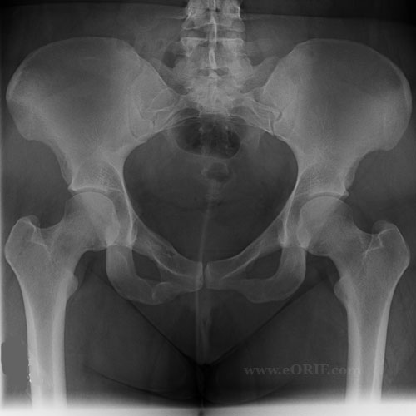
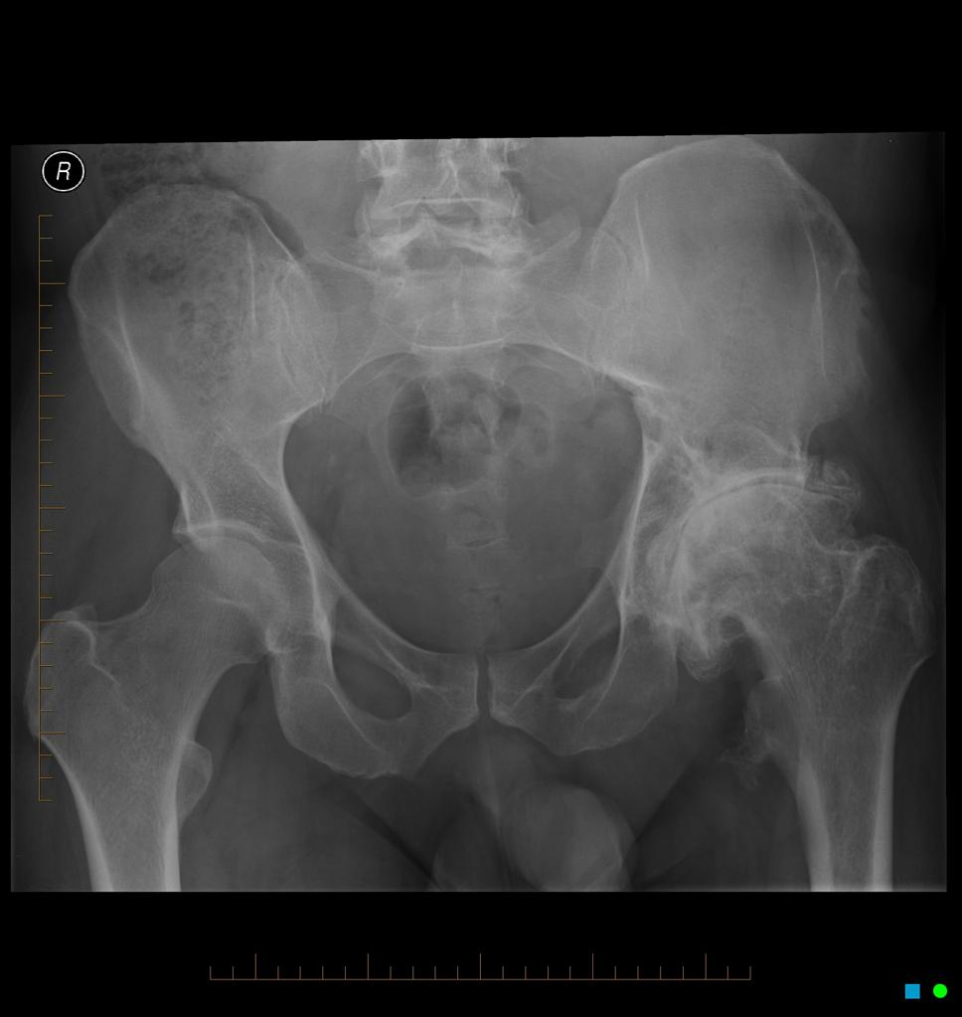
Pain or no pain that is the question

Slide 14
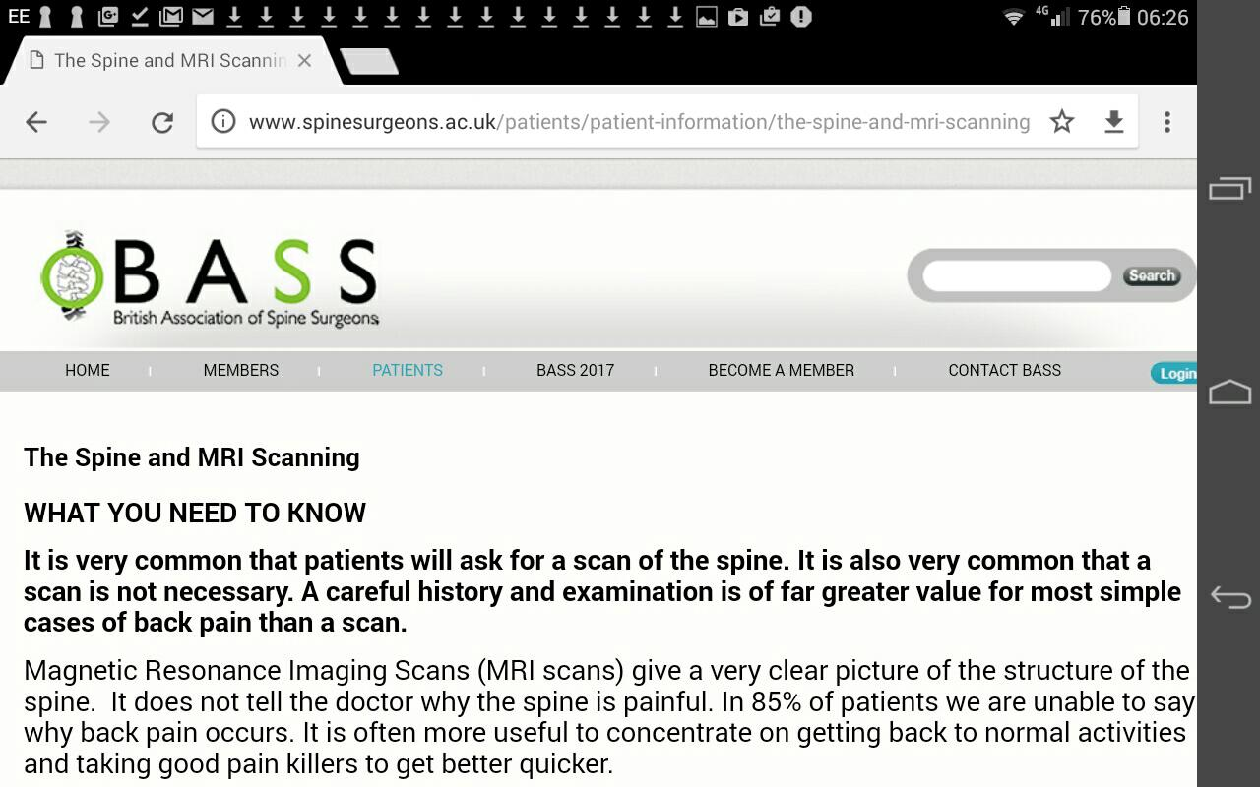
The Spine and MRI

Slide 15

Rugby players and boxers sustain continued tissue damage on a regular basis but rarely suffer from chronic pain.

Slide 16
Why do I have chronic pain and they don't ?
Tissue damage plus behaviours, beliefs and past experiences change the way your brain works which leads to an increased pain experience. (The donut)
When this continues over a long period of time our brain continues to produce pain signals even if the tissue damage has healed.
Those that don’t develop chronic pain even with long term tissue damage often don’t display or have been exposed to the complex variables that chronic pain suffers experience.

Slide 17
Both these people have hurt their back for the first time and go to see the GP.
Patient A
Patient B
Age 40
Male
Self employed brick layer
Football x 3 weekly
X rays moderate wear told by GP will get better in 6 weeks. Keep active and take pain killers, advised to continue with sport as able
No family history
No time off work
Age 40
Male
Self employed scaffolder.
Football x 3weekly
X rays moderate wear. Told by GP has back of a 70 year old. Advised to stop playing football and take up something less strenuous.
Father had long history of debilitating back pain.
Signed off work for 6 weeks

Slide 18
How does pain become chronic ?
As pain persists the nerves become more sensitised and your brain produces more pain (Fire alarm)
Why does my pain spread and change?
Nerves will continue to tell your brain that there is ongoing problems in the body in conditions such as OA and ongoing pathological processes. This is why pain killers that target the nerves such as Gabapentin can help.
Chronic pain is produced by the brain
Phantom limb pain.
Injections
Operations

Slide 19
Are you telling me my pain is made up?
No your pain is very real indeed. Its just not originating from the place that you may traditionally think it is coming from and understanding of this will help to improve your ability to manage your pain.
Will this approach cure my pain?
No probably not, but the research suggests that this Biopsychosocial approach is the most effective way of helping to manage chronic pain.

Slide 20
What can I do to help manage my pain?
There are many ways to help to manage your pain including pacing, stress management, relaxation techniques and others which will be discussed later in this talk
Exercise.

Slide 21
How can exercise help ?
Helps decreases stress
Can Improve mood
Endorphins, enkephalins, dynorphins
Improves strength and power
Improves joint mobility
Can help with sleep
Can help decrease the sensitivity of the nerves.
Helps with weight loss.
Helps to improve posture

Slide 22


PACING

Slide 23
Pacing :
Involves, breaking activities up into manageable chunks, so that you an get things done without increasing your pain.

Slide 24
Pacing:
Activity and Pain
Chronic pain can interfere with the ability to perform some activities.
Pain makes it difficult to carrying out activities
Individuals may then limit or stop doing activities

Slide 25

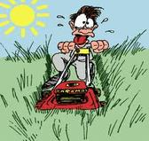
Pacing:
Over activity vs Under activity
Some people with chronic pain identify that they already use pacing because they break up their activities and take rests.
However, in many cases, their decision to rest or stop an activity is based on how they feel

Slide 26
Pacing:
Good days vs bad days.
Many people with chronic pain push or force themselves to get something done in the short-term, and then end up with much worse pain and are unable to do much for several days.
Pacing is the opposite of this. The purpose of pacing is to make it possible for you to be active every day while still keeping your pain under
control.

Slide 27
Over-doing vs Pacing:

Slide 28
How To Pace: BASELINE TOLERANCE
BASELINE TOLERANCE
Activity | Estimate | Trial 1 | Trial 2 | Trial 3 | Baseline Tolerance
Ironing | 20 min | 18 min | 15 min | 20 min | 15 min
Sitting (armchair) | 30 min | 25min | 30min | 27 min | 25 mini
Swim

Slide 29

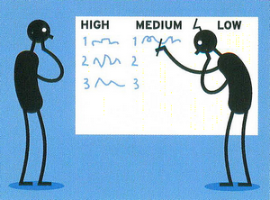
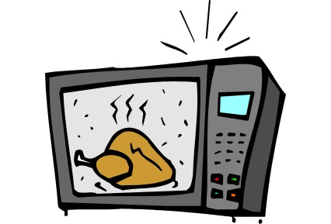

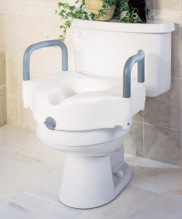
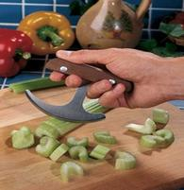

How To Pace: PLAN, PRIORITISE, PROBLEM SOLVE, use PRACTICAL SOLUTIONS
2) PLAN
3)PRIORITISE
4)PROBLEM SOLVE
5)Use PRACTICAL SOLUTIONS

Slide 30

How To Pace:
6) AVOID rushing
7) Gradually INCREASE activity levels
8)Be aware of Obstacles to Pacing, i.e. Work related, Unhelpful thoughts etc.
9) REMEMBER TO SET GOALS !!!

Slide 31
Usually there would be a break now
BREAK

Slide 32
DONUT
Mood
Cognition
Relationships
PAIN
Behaviour
Thoughts
Body Sensations

Slide 33



Mood
Chronic pain can result in you feeling a wide range of emotions from low mood, anxiety, frustration, anger and many more.
The following strategies may help you cope better with these emotions:
Relaxation
Distraction: behavioural, cognitive and social
Practical solutions
Increasing physical activity

Slide 34


Thoughts
Chronic pain can also impact on your thoughts; you may think more about how things used to be, worries about the future or thoughts that play on your mind on a daily basis. Here are some ideas of how to work with your thoughts:
Identify what thoughts you are having
Write them down
Now challenge them..look for evidence for and against.
Balance the evidence and try and generate any alternative thought.
Be careful of the words you use: Can’t, should, ought and BUT

Slide 35
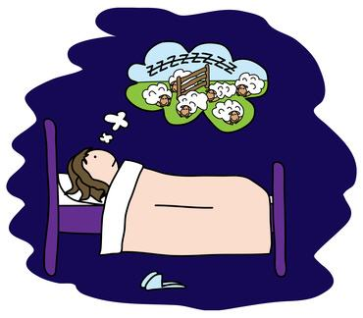
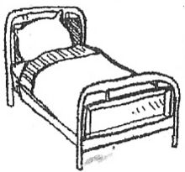

SLEEP HYGIENE:
1.ASSOCIATIONS.

Slide 36

SLEEP HYGIENE:
2. SLEEPY HEAD

Slide 37

SLEEP HYGIENE:
20 MINUTE RULE

Slide 38
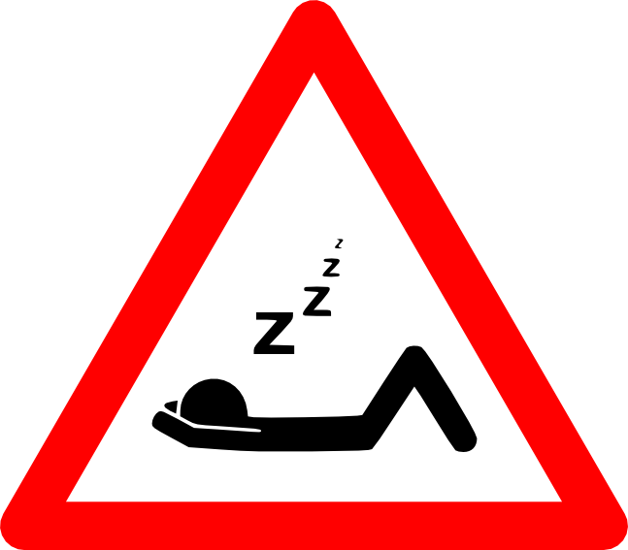
SLEEP HYGIENE:
4. NO CATCHING UP ON SLEEP

Slide 39

SLEEP HYGIENE:
BED TIME ROUTINE

Slide 40
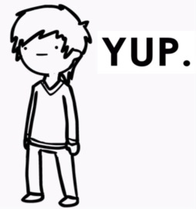

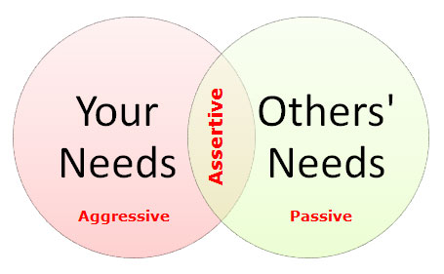
relationships
Communication
Styles of communication: Passive:
Aggressive:
Assertive:

Slide 41
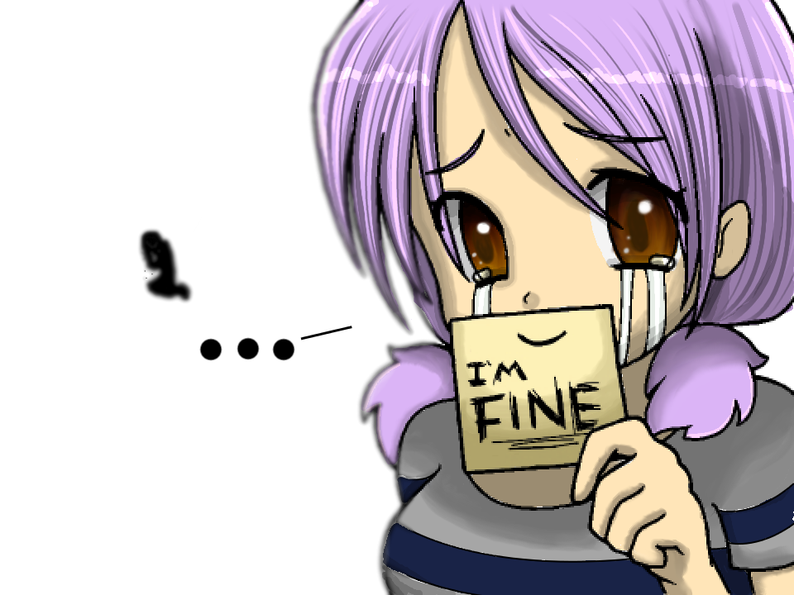

Slide 42
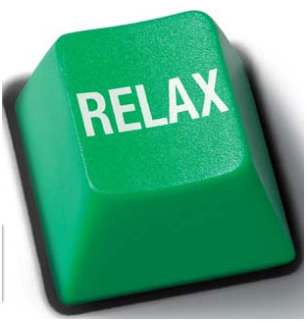
Relaxation
The effects of Chronic pain on your body can cause muscular, physical tension and research shows us the more tension we have the more pain that we feel. They are very closely related. We can help this by using simple relaxation techniques that can help the physical and emotional tension that pain brings. Using diaphragmatic breathing and passive muscular relaxation we can reduce your tension levels which will help you with your pain and your mood. Therefore helping you to cope with what pain brings. It does not require any medication, just some time and practise.

Slide 43
Next steps: :
Understanding your Pain and Medication (1 hr)
Relaxation classes (5 weeks)
Pacing workshop (5 weeks)
MBSR course (8 weeks)
Mind and Mood group (8 weeks)
Movement and Exercise (5 weeks)
Pain Toolkit App
Support group

Slide 44
Role of the Pain Nurse Specialist:
Triage
Individual new patient assessment
Medication reviews
1-1 Pain Seminars
PEG Therapy (External neuromodulation)
Support Groups
Understanding Pain Medication, 1-1 and groups

Slide 45
Understanding your Pain Medication:
-A one hour group session
-Available as a next step following on from the pain seminar
-Can be an individual session if clinically necessary

Slide 46
Aim of the Understanding Pain Medication Presentation
-Provide information on the different types of pain , in particular differentiating between nociceptive pain and neuropathic pain
-Talk about the concept of the Gate control theory of pain
- Inform about The WHO Analgesic ladder and the different types of pain medication including Neuromodulators
-Potential side effects of the medication
-Tolerance , Dependence and Addiction
-Option of attending for an individual medication review

Slide 47
Opioid Reduction Programme
-In the process of setting up a formal Opioid reduction programme.
-Currently running adhoc.
-Liaising with hospice, Stars, A&E and Acute Pain Team.
-Contract for weaning off, only available for prescribing.
-Aiming to reduce by 10% every 2 weeks as a guideline
-Withdrawal effects recorded on database
-Only for prescribed opioids

Slide 48
Opiod Reduction Programme
-Access via triage.
-Booked to Pain Seminar then nurse assessment
-Understanding Pain Medication
-Back to nurse to sign contract
-Agree start date
-GP’s to oversee reduction
-Pain Nurse review every 6-8 weeks

Slide 49

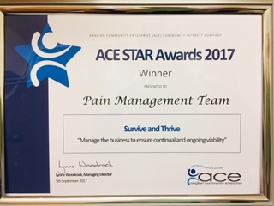

AWARDS:

