Slide 1
Is the grass really greener?
Reflections on ST4 in Australia

Slide 2
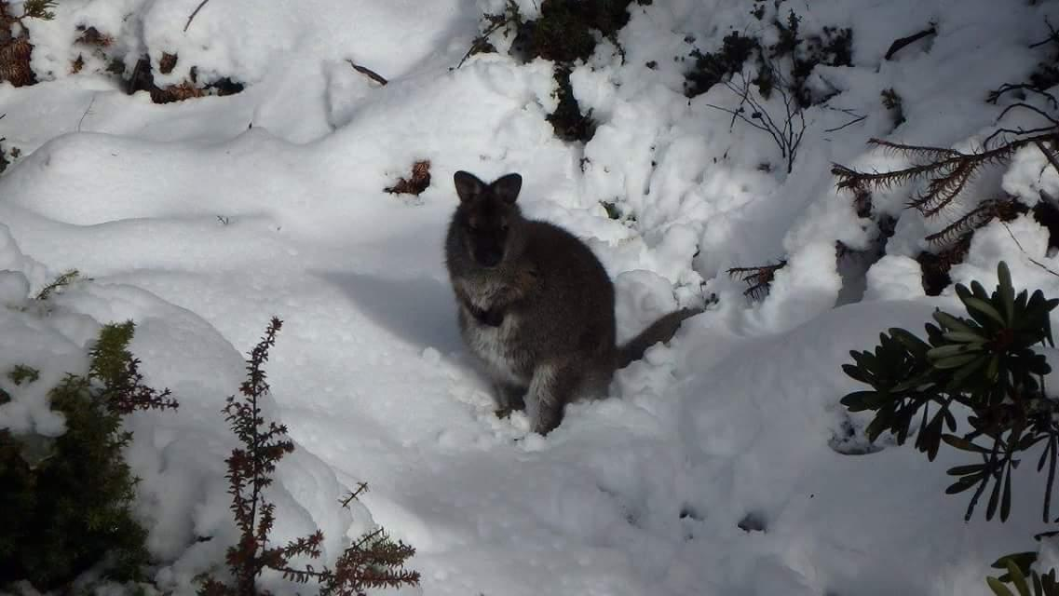
Tasmania not Tansania...

Slide 3
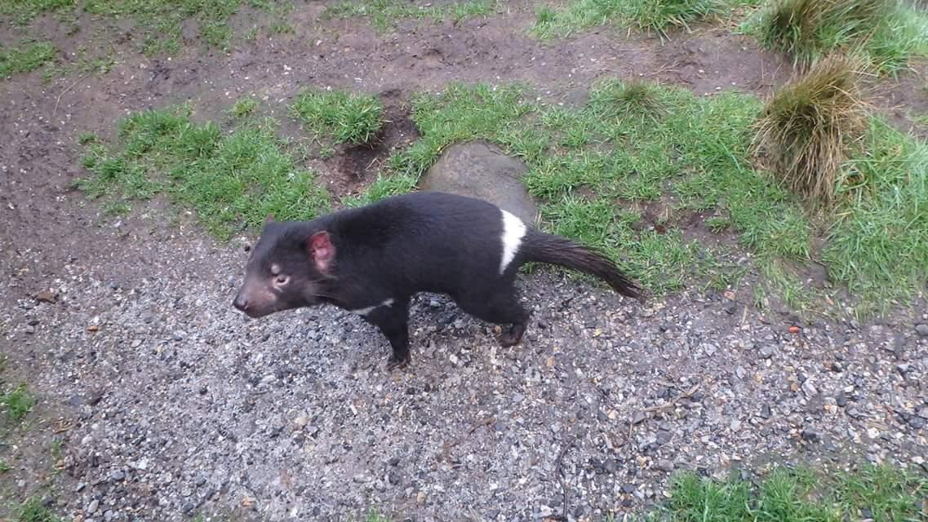
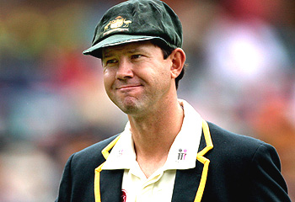
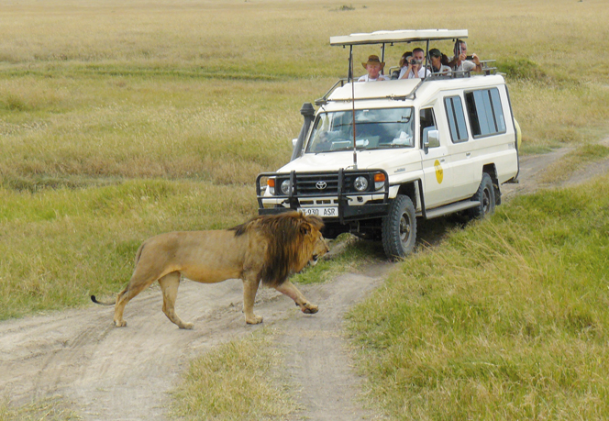
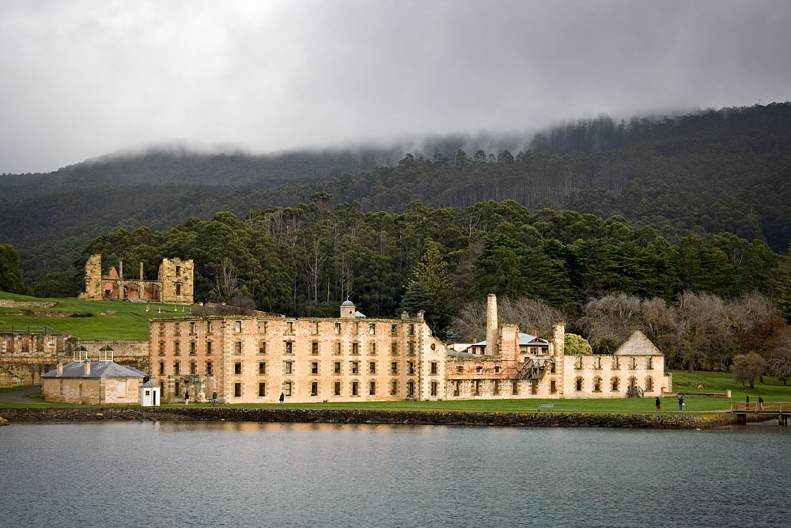
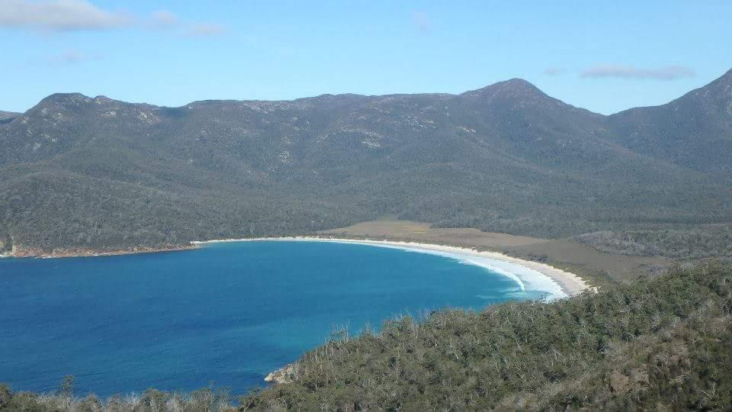
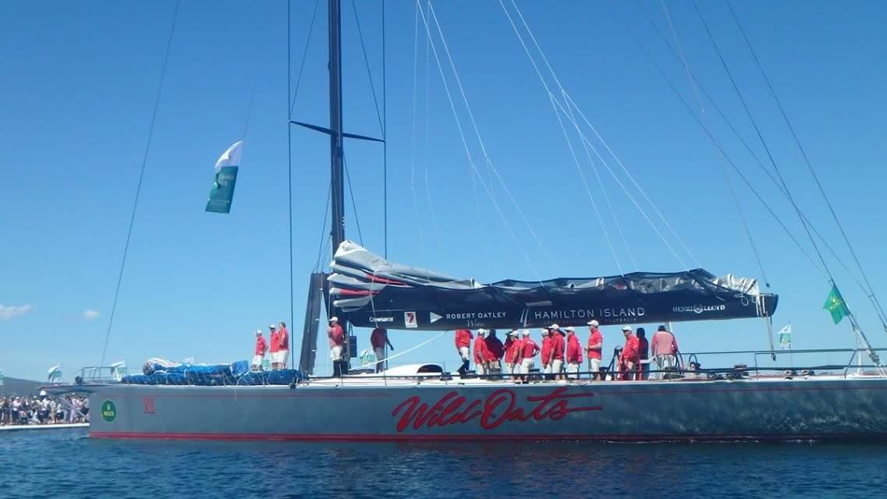
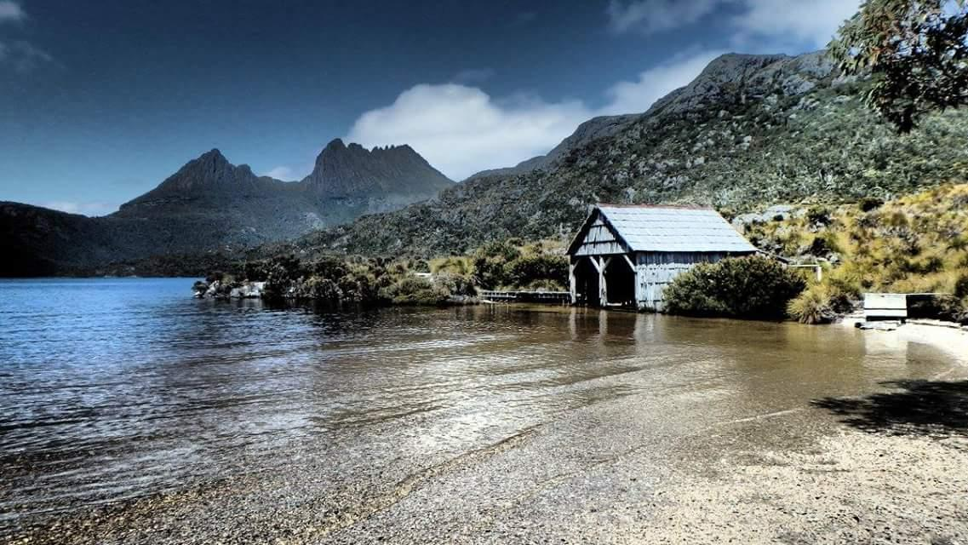
Tasmania not Tansania...

Slide 4
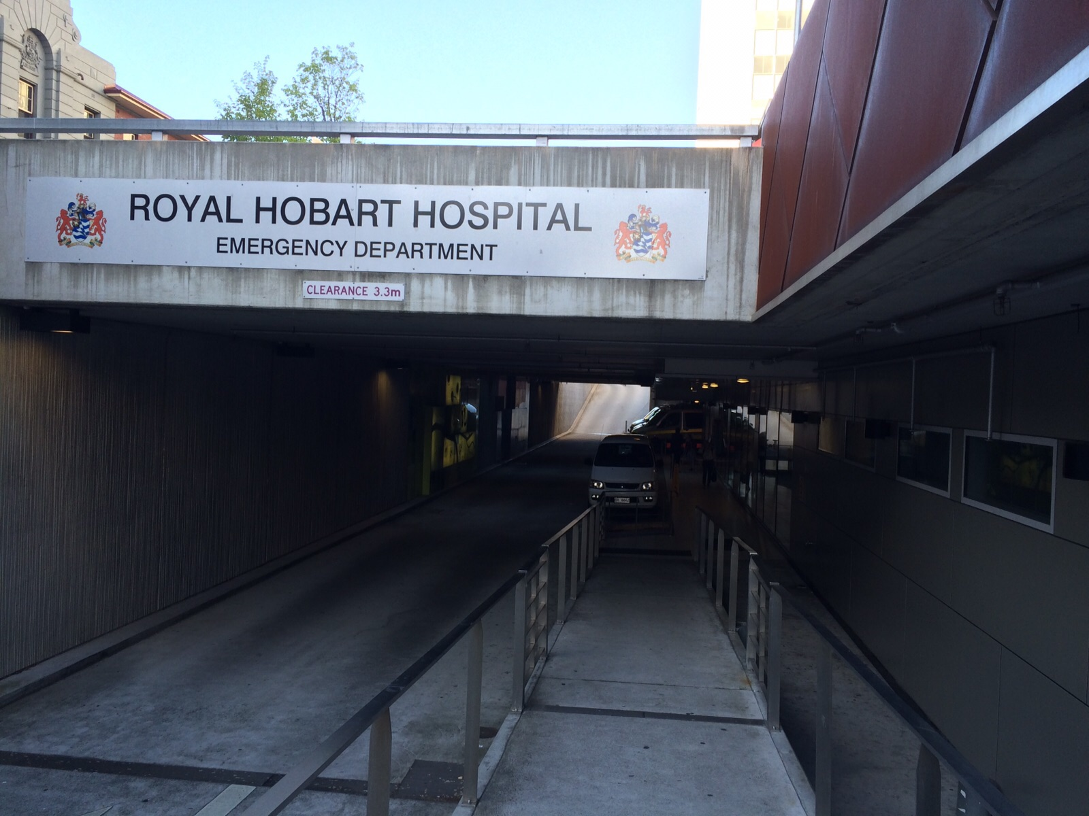
Royal Hobart Hospital
Population of 500,000
250,000 in Hobart
Approx 500 beds
Trauma and tertiary referral centre for just about anything
Approx 160 presentations a day

Slide 5
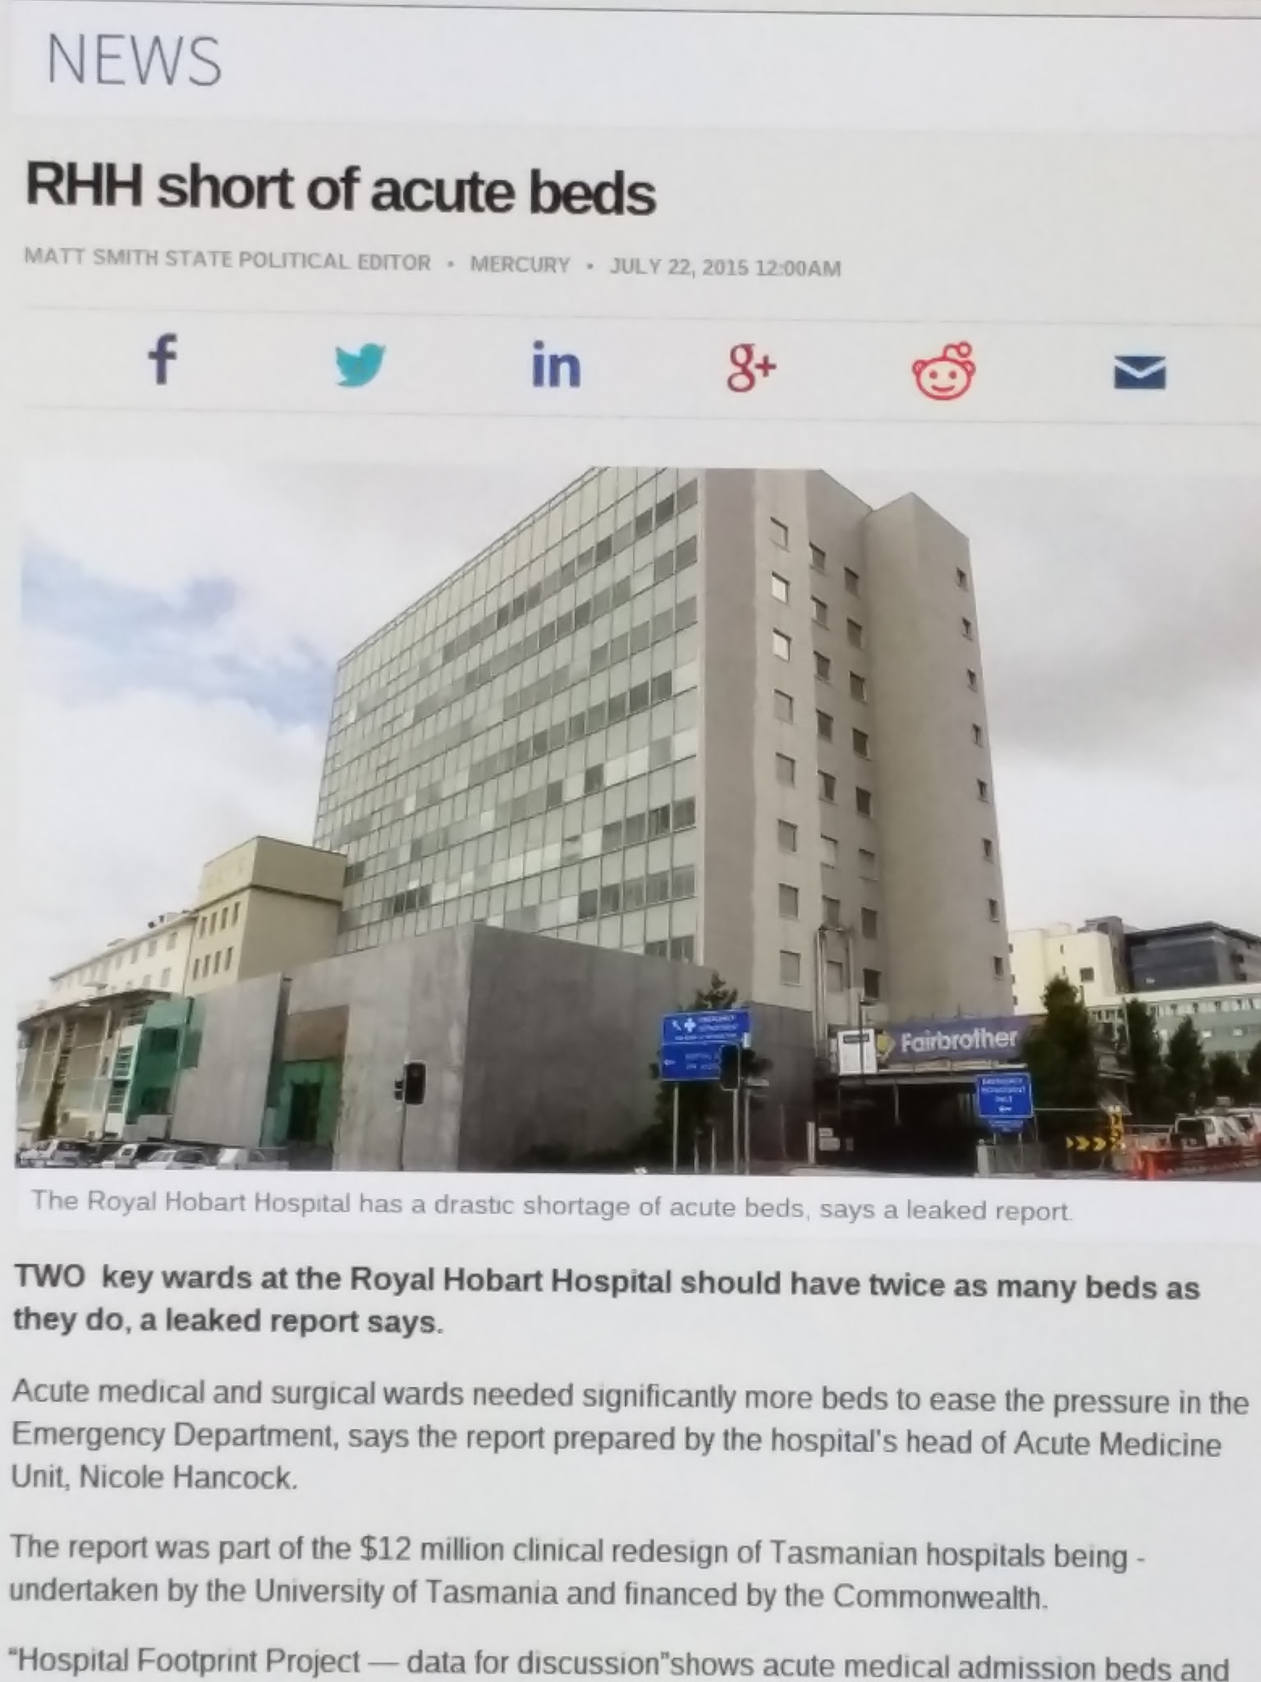
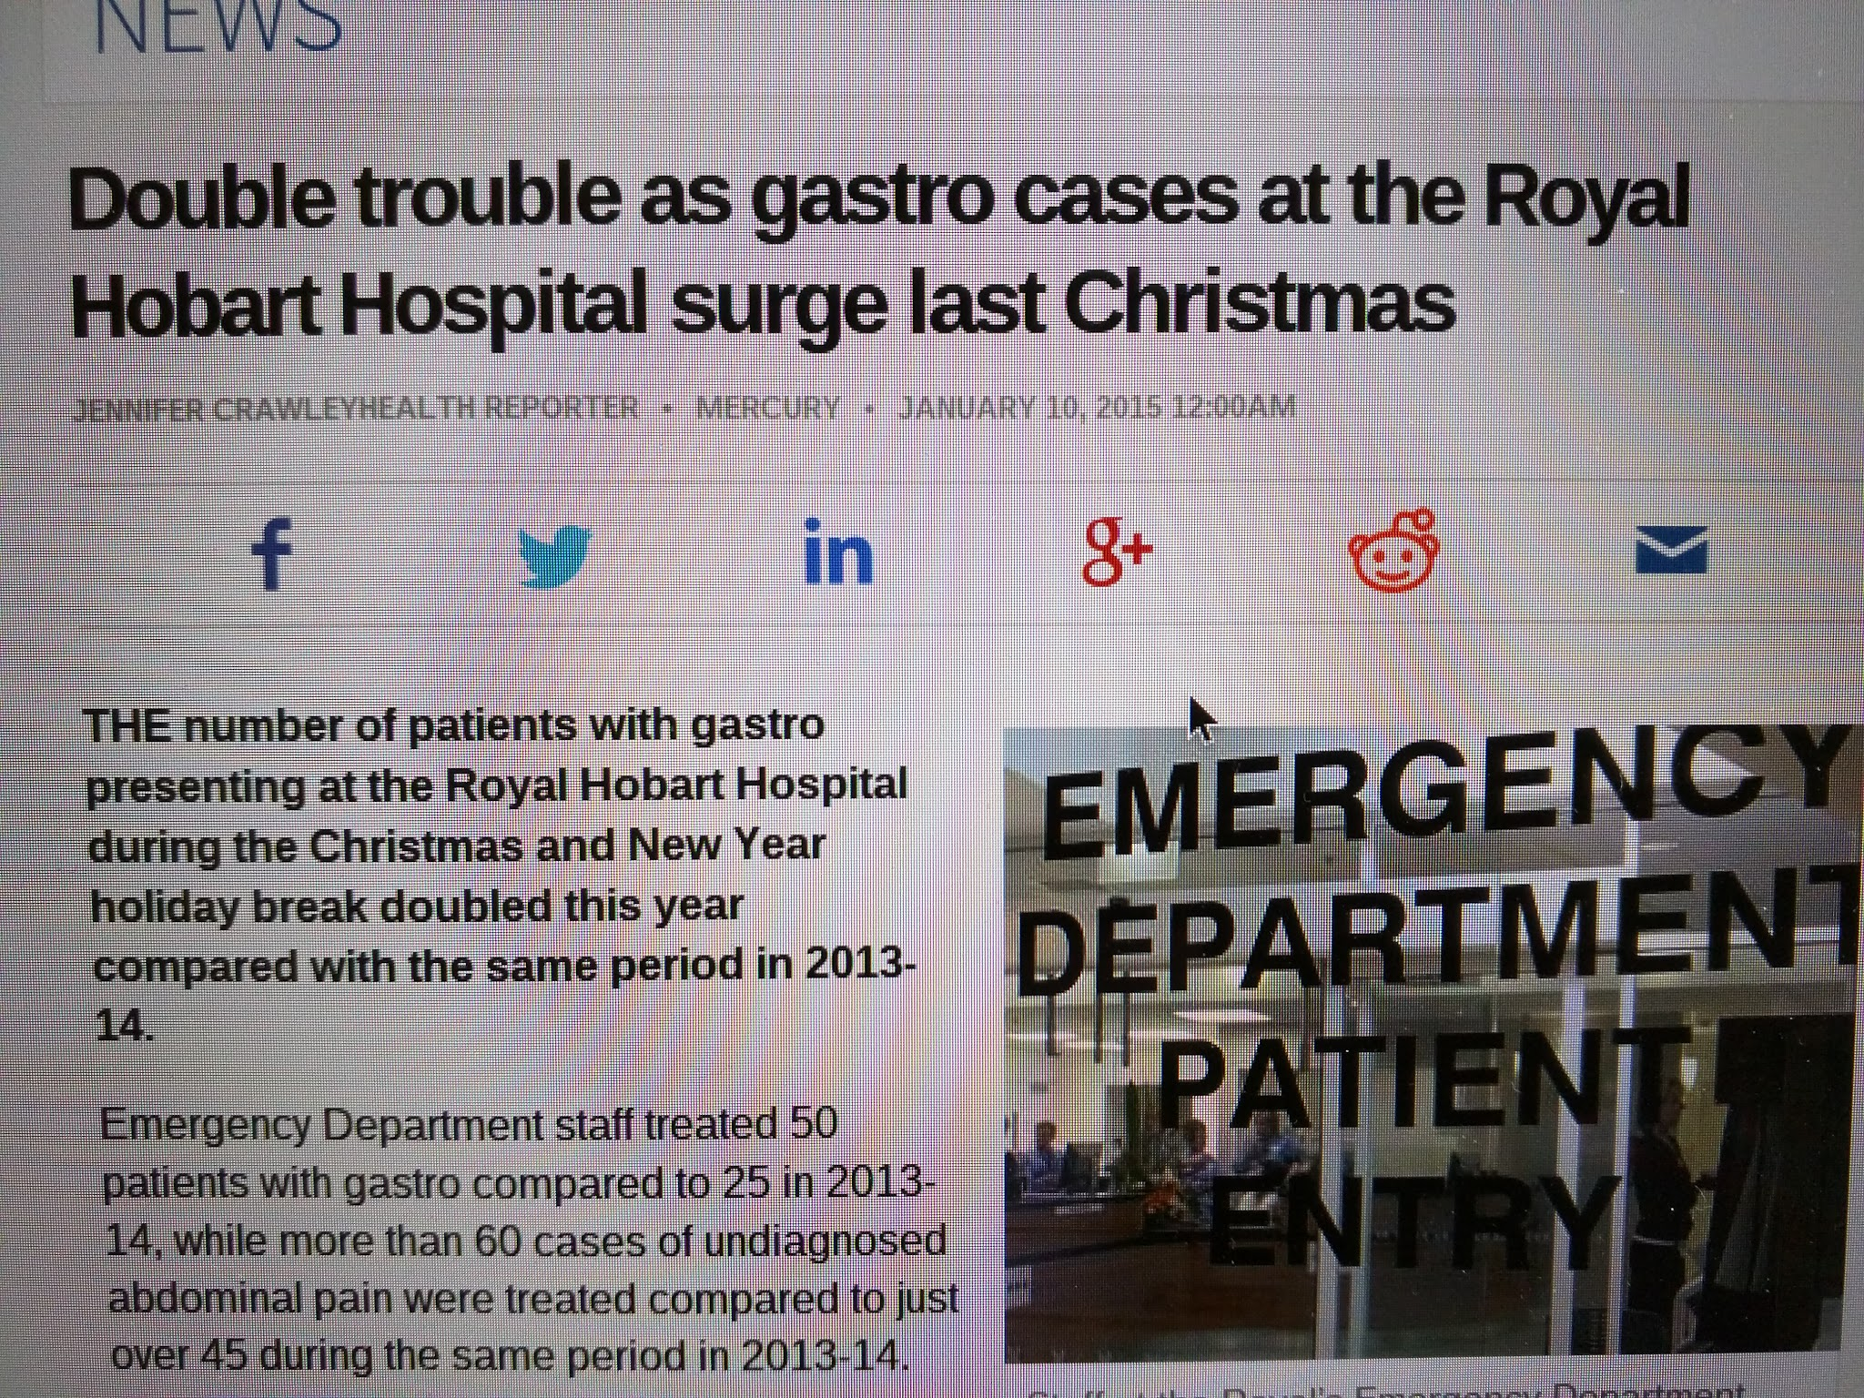
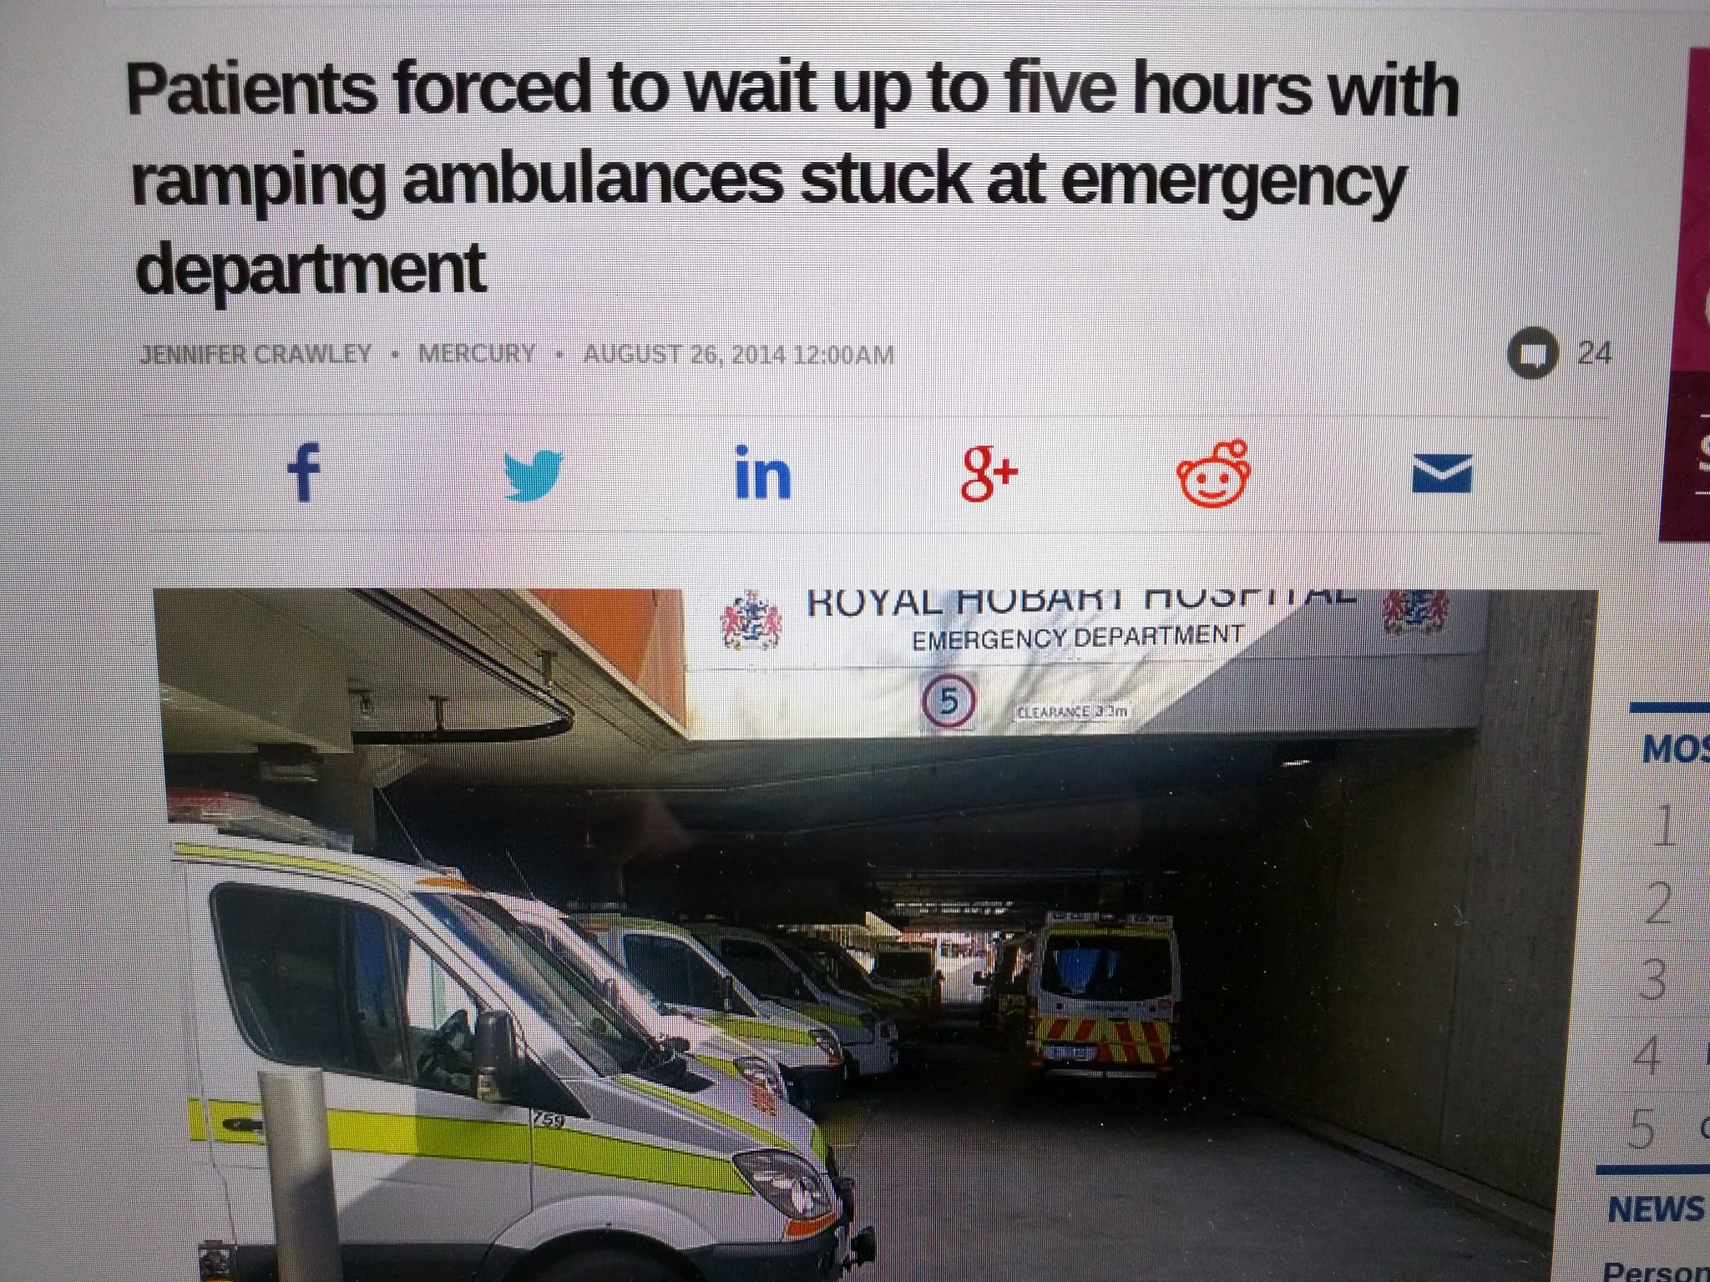
Shifting targets
The UK is not alone
> 5% year on year increase in patient numbers
Increasing social care needs
Overcrowding in ED not acknowledged as a hospital wide problem

Slide 6
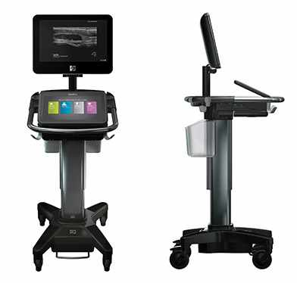
Workload and support
Approx 40 hour week
Roughly 8-16 patients a shift
Consultant cover from 8am to 11pm every day
Critical care
More procedures
Certifying deaths
PENs - amazing!
Aides but no HCAs less ENPs
EMAT
Ultrasound
CT in ED
Lipase
BNP

Slide 7
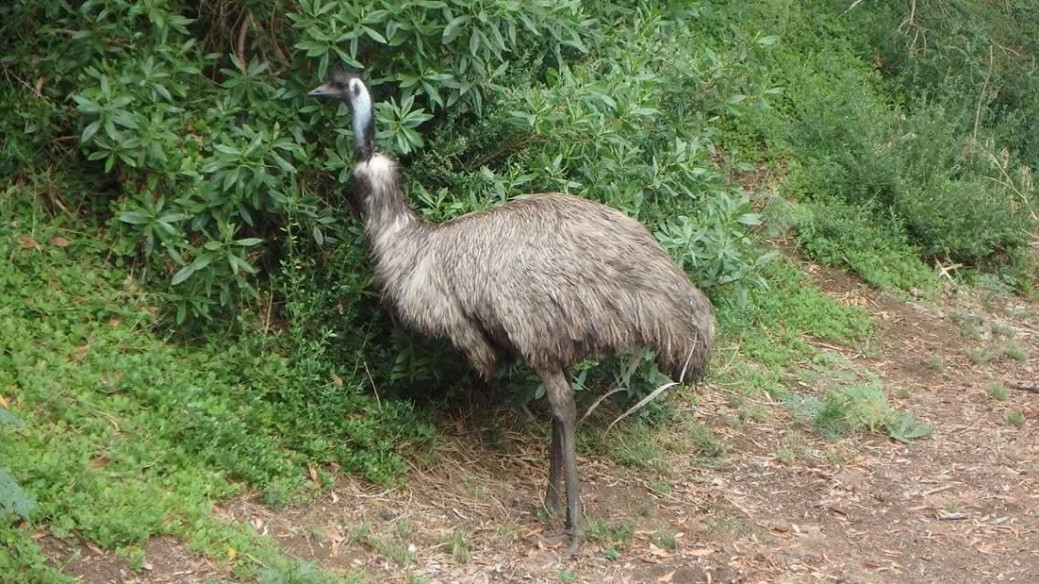
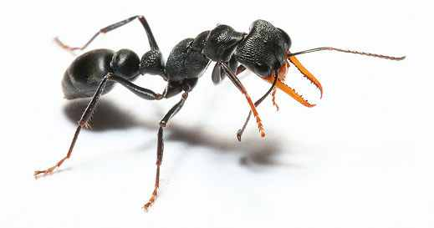
There is only one emu in tasmania...
10 bed unit
Aim to discharge within 24 hours
<15% conversion rate
Set proformas for common uses e.g. anaphylaxis
Very popular with inpatient teams

Slide 8
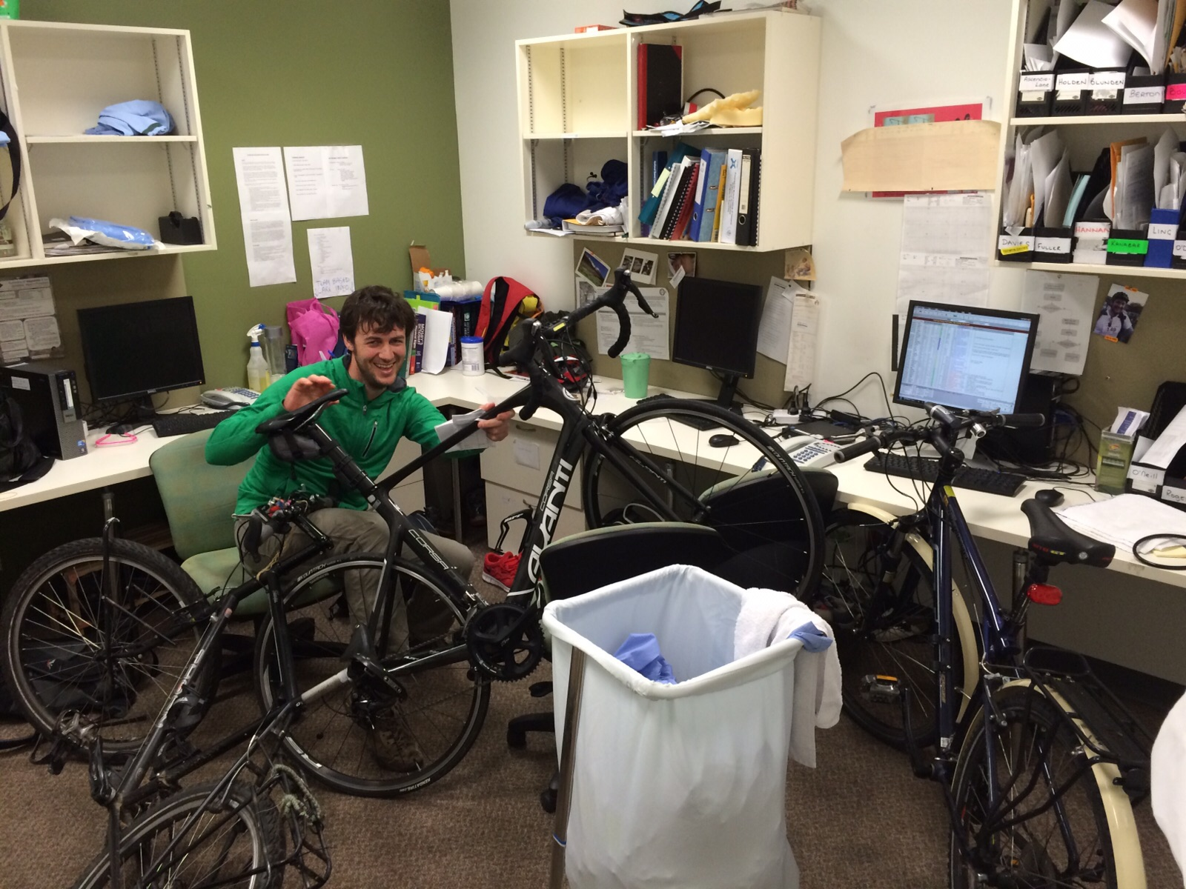
Training and WBPAs
4 hours teaching a week
Increasingly SIM focused
Combined with departmental feedback
Significantly less WPBAs
Shift report similar to ESLE
Dedicated registrar office

Slide 9
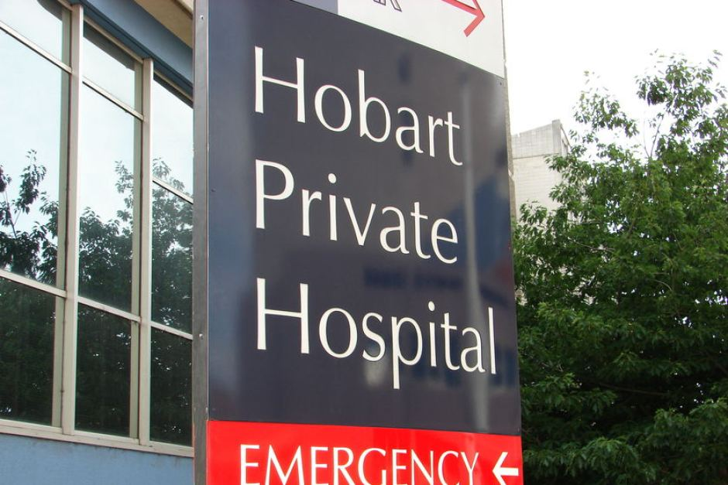
The dreaded private sector
ED consultants and registrars
Approx 60 patients a day
More time with patients
Less hostility
Free lunch!
Greater patient satisfaction

Slide 10
And a few cases that will stick with me

Slide 11
Cases
49 year old paramedic who rescues snakes in his spare time - bitten by snake…
35 year old recreational diver with intense hip pain…
71 year old single gunshot wound to the face / neck. Arrested on route, required surgical airway…
45 year old set on fire by her husband, approx 40% and airway burns…

Slide 12
