Slide 1
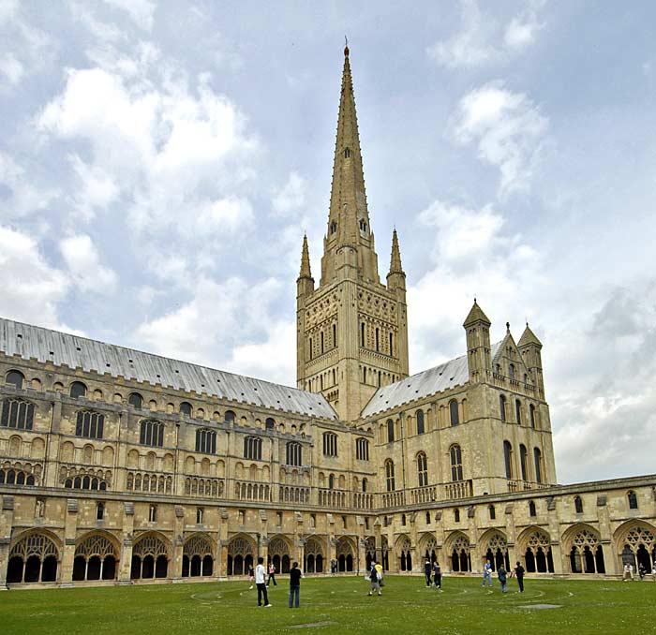
Norwich Oculomotility Study Day 2019 Assessment of Strabismus Pattern Recognition
Narman Puvanachandra
Consultant Paediatric Ophthalmologist & Strabismologist
Training Program Director Ophthalmology
Associate Professor & Associate Postgraduate Dean
Norfolk & Norwich University Hospital

Slide 3
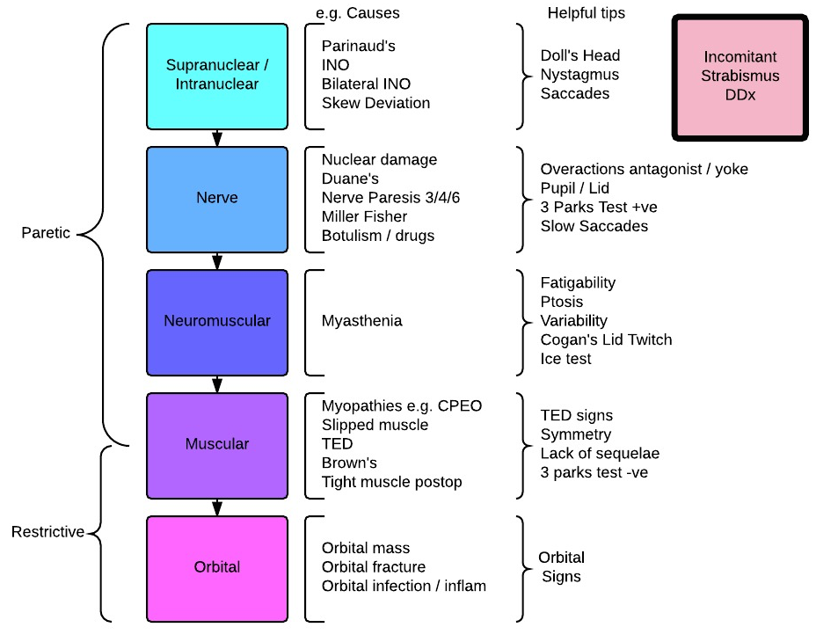

Slide 4
Extraocular muscles actions
Superior Rectus
Inferior Oblique
Superior Rectus
Medial Rectus
Lateral Rectus
Lateral Rectus
Inferior Rectus
Superior Oblique
Inferior Rectus

Slide 5
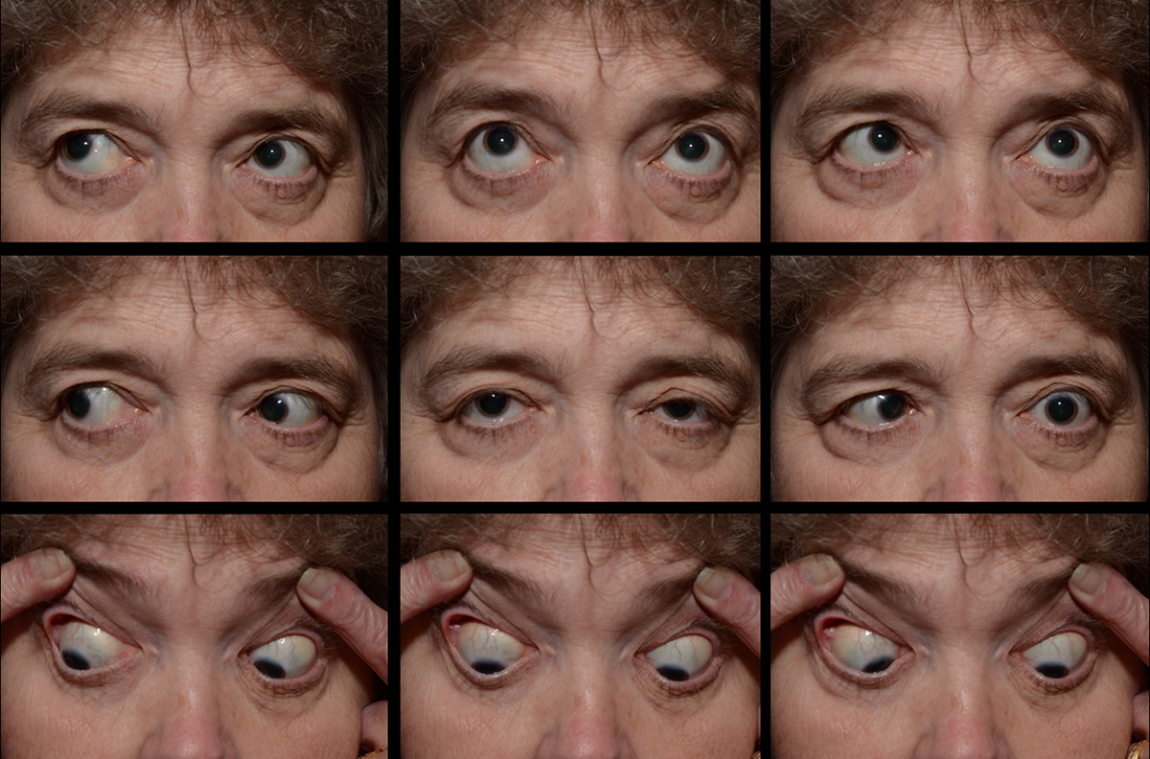
Notes:
Left 6th

Slide 6
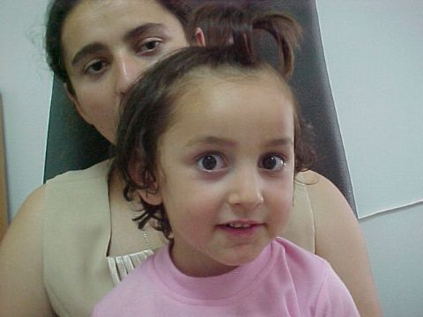
Notes:
Daune’s Type 1 - CHP

Slide 7
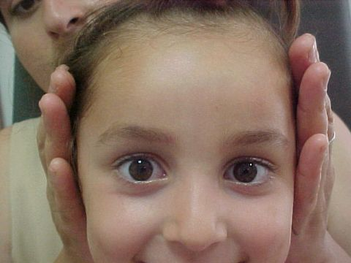

Slide 8
Notes:
Left Duane’s Type 1
History: This 3-year-old girl presents with a left face turn and small esotropia with right hypertropia in the primary position. She has limited abduction of the left eye and slightly limited adduction of this eye also with slight narrowing of the left fissure on adduction. Some left hypotropia is present in straight upgaze. Visual acuity is 20/20 in each eye. The refractive error is OD +.50, OS +.75. She fuses the Worth four light in right gaze.
Diagnosis: Duane syndrome, Class I esotropia

Slide 9
ABduction Deficit
Paretic
Restrictive
6th Nerve Paresis
Myasthenia
Slipped LR
TED (tight MR)
Duane’s I / III
Tight MR (postop)
Orbital Mass
Chronic 6th
Orbital Wall #

Slide 10
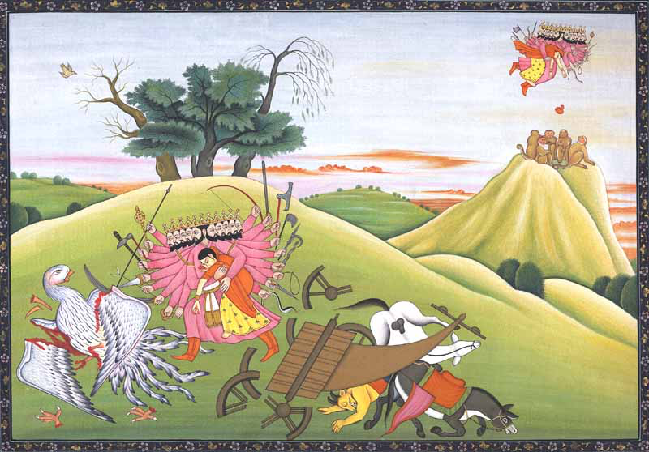
Notes:
Sita abduction by King Ravana of Lanka
Ramayana

Slide 11
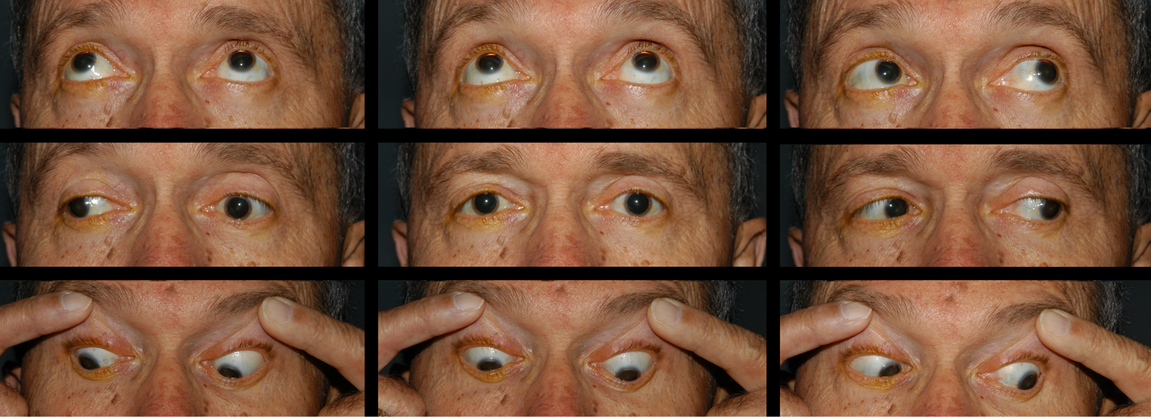
Notes:
Left INO

Slide 12
Abducting nystagmus

Slide 14
ADduction Deficit
Paretic
Restrictive
INO
MR paresis (recovering 3rd +/- aberrant regeneration
Myasthenia
Slipped MR
TED (tight LR – rare)
Duane’s II/III
Tight LR (postop)
Orbital Mass

Slide 15
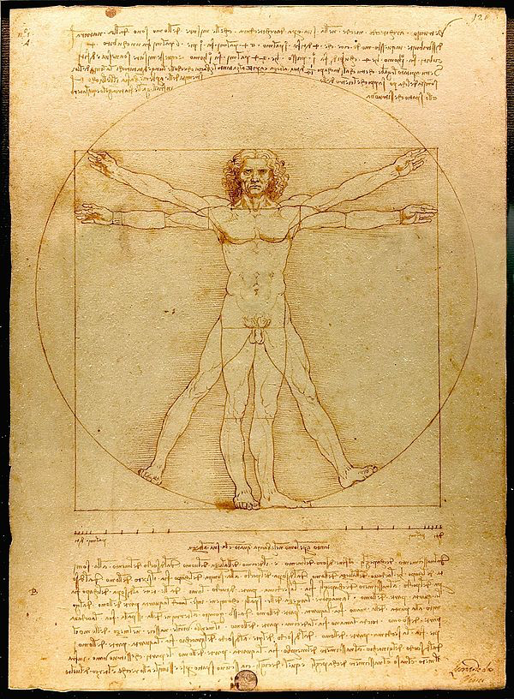
Notes:
Vitruvian Man – Leonardo Da Vinci (adducting)

Slide 16
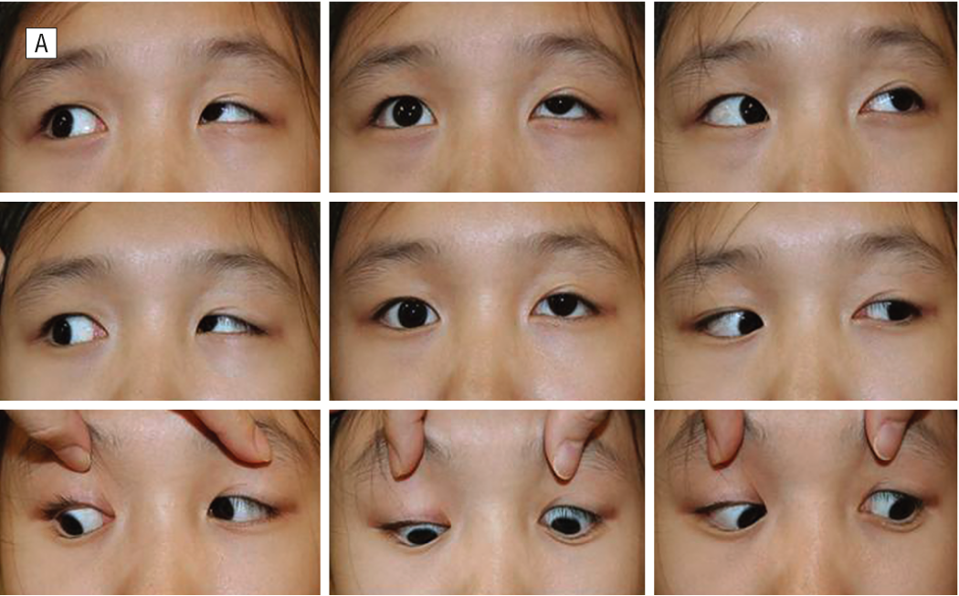
Notes:
Left 4th

Slide 17
Monocular Depression Deficit
Paretic
Restrictive
SO Paresis
IR Paresis (? Partial 3rd)
Myaesthenia
Slipped IR
TED (tight SR – rare)
Tight SR (postop)
Orbital Mass
Orbital Floor #

Slide 18
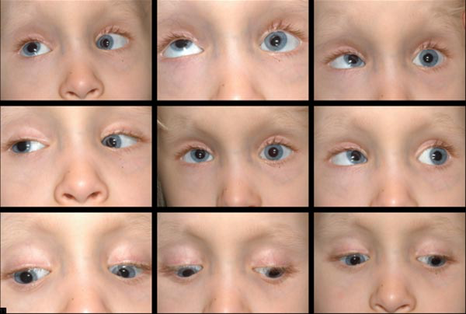

Slide 19
Monocular Elevation Deficit
Paretic
Restrictive
SR Paresis (? contralateral SO paresis sequelae)
IO Paresis (rare)
Monocular Elevation Deficiency
Myaesthenia
Slipped SR
TED (tight IR)
Brown’s Syndrome
Tight SO tuck / IR (postop)
Orbital Mass
Heavy Eye
Orbital Floor #
Ocular Surgery (Molteno / buckle)

Slide 20
Assumption of Mary by Botticini
Notes:
Assumption of Mary by Botticini

Slide 21
Notes:
Orbital floor fracture

Slide 22
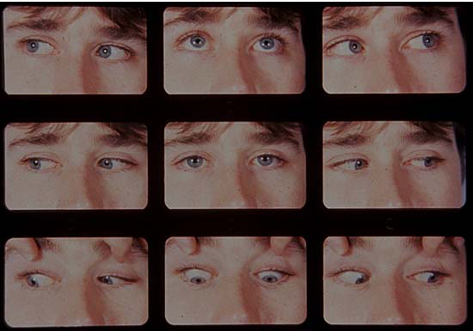

Slide 23
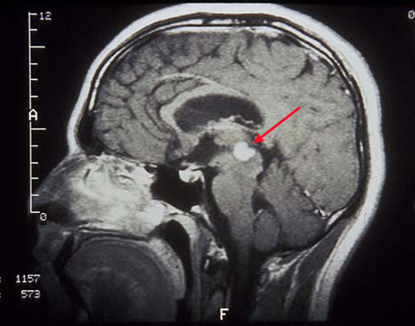

Slide 24
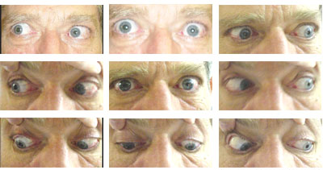

Slide 25
Binocular Elevation Deficit
Paretic
Restrictive
Parinauds (Dorsal Midbrain)
PSP + other supranuclear
Age Related
CPEO
TED (tight IR)
CFEOM
Heavy Eyes
Bilateral Orbital Floor #

Slide 26
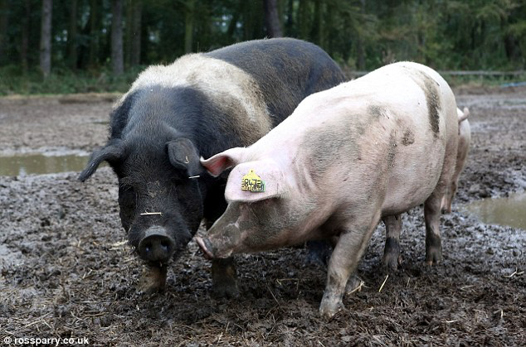
Notes:
Sisteen Chapel Vatican
Michaelangelo

Slide 27
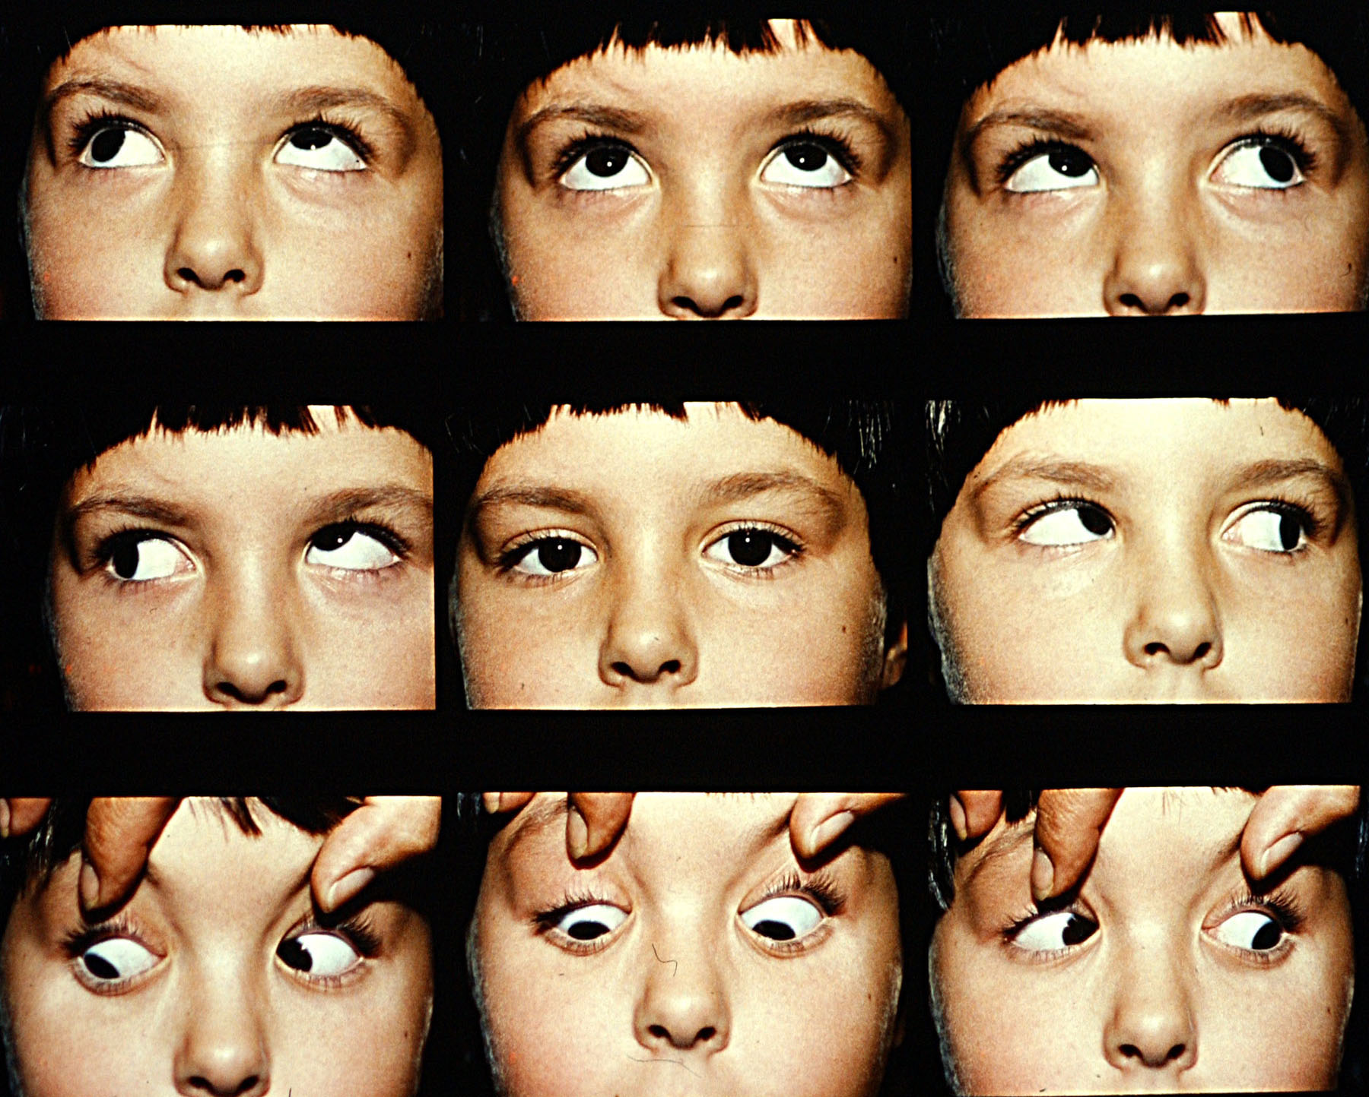

Slide 28
Upshoot of Eye in Adduction
Paretic / Overaction
Restrictive
Primary IO Overaction
SO Paresis (Park’s / torsion)
Contralateral SR paresis
D.V.D.
Duane’s (add / abd deficit)

Slide 29
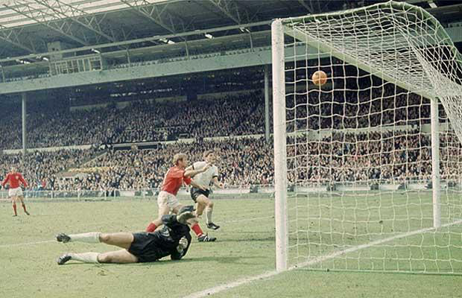

Slide 30
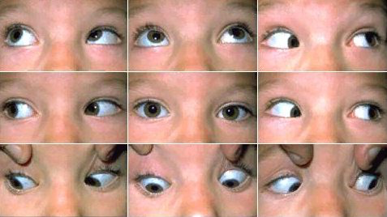
Notes:
Right Brown’s – note Right Downshoot in Adduction

Slide 31
Downshoot of Eye in Adduction
Paretic / Overaction
Restrictive
IO paresis (rare, Park’s test)
Brown’s (V pattern)
Duane’s Syndrome

Slide 32
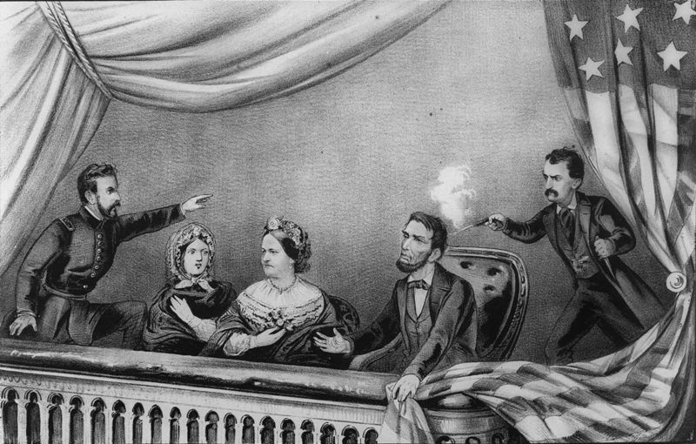
Notes:
John Wilkes Booth
Dr.Samuel Mudd

Slide 33
Notes:
Limitation elevation, abduction, depression, some adduction, amaurotic pupils

Slide 34
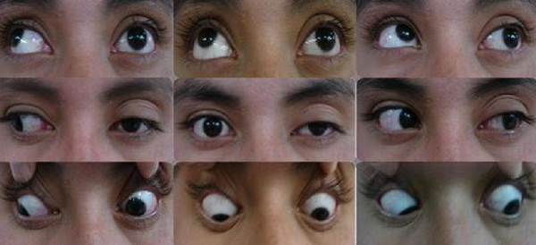

Slide 35
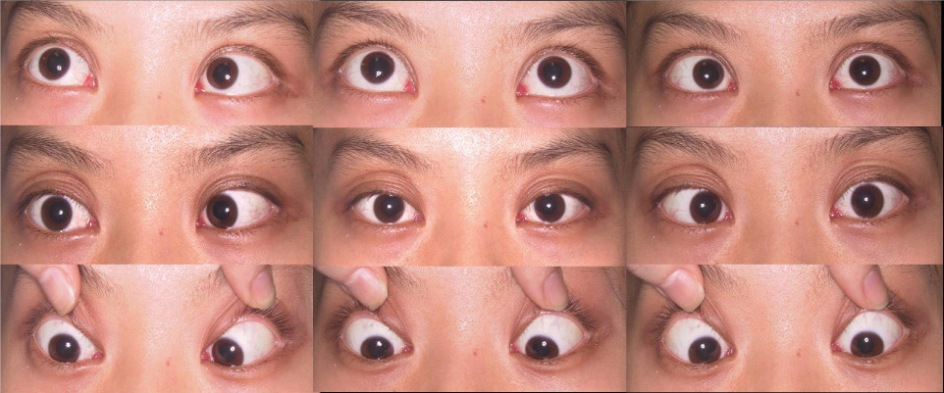
Multiple Oculomotility underactions
Paretic
Restrictive
3rd / 4th / 6th combined
Myaesthenia
Miller Fisher / Botulism
CPEO / myopathies
TED
Orbital mass / infection
CFEOM

Slide 36
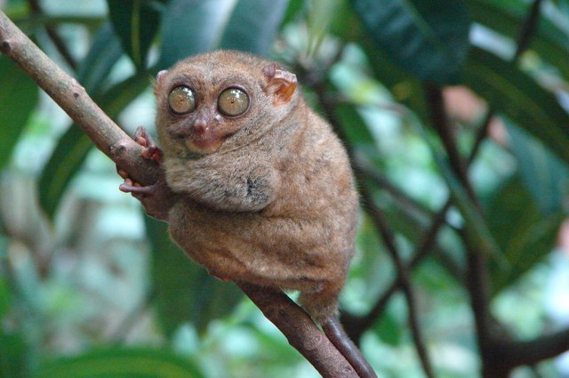
Notes:
Tarsier

Slide 37
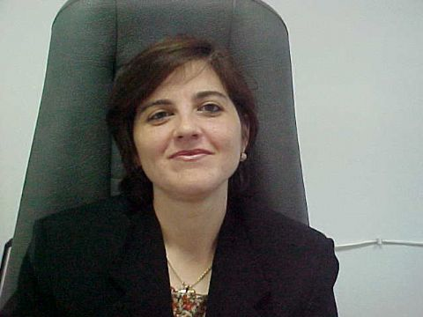
Notes:
History: This 34-year-old woman noticed that her left eye was higher when she was in her teens. She objected to the hyper deviation. While observing her eyes looking in a mirror she determined that by using her left eye for fixation the right hypotropia was less objectionable. She then consciously used her left eye and assumed the head tilt shown in the pictures. Her visual acuity is 20/20 in each eye, the refractive error is +.50 in each eye, and the remainder of the eye examination is normal. She is not bothered by diplopia and has no measurable fusion. She would like to have the vertical deviation treated if it would improve her head position.
Diagnosis: superior oblique palsy

Slide 39
Notes:
Expert Commentary
Comments of Eugene M. Helveston, M.D.
This patient clearly has a left superior oblique palsy. In the absence of any history of trauma, the longstanding signs and the patients otherwise good health the most likely etiology is congenital. This diagnosis is confirmed by a left hypertopia which is greater in right gaze and with the head tilted to the left (positive Bielschowsky test). But, her clinical appearance is not typical with regard to her head posture. The usual head posture for a left superior oblique palsy would be head tilt to the right with chin depression. This posture would make it easier for the patient to fuse by looking up and to the left or away from the field of action of the paretic left superior oblique. Instead of assuming this posture, the patient elects to fix with her paretic left eye and face up and to the left to achieve a cosmetically less objectionable right hypotropia. The limited upgaze of the right eye is due to inhibitional palsy of the antagonist of the yoke. In this case when the patient fixes using the left eye with the paretic superior oblique, the extra innervation needed by the LSO is sent to the normal right inferior rectus according to Herings law. Then the right superior rectus is inhibited according to Sherrington's law. This patient does not show as much pseudo ptosis of the right upper lid as you might expect in such a case. If the patient is troubled by the left hypertropia and the head posture she is a candidate for surgery. In the absence any other clinical signs or important history, no further workup is indicated.
In this case the patient would benefit from a left inferior myectomy (or equivalent weakening procedure but NOT anterior transposition) and since the deviation looks to be more than 25 prism diopters in right gaze adding a recession of the right inferior rectus of 4.0 mm would be appropriate. The surgeon should take care to adequately free up the inferior rectus before recession to reduce post operative lower lid lag and secure the inferior rectus well to avoid slippage of this muscle.
Comments of David A. Plager, M.D.
This patient has a long standing strabismus manifested by a moderate left hypertropia that worsens in right gaze and left head tilt. In the absence of other explanation, such as a restrictive process, this pattern is most compatible with a left superior oblique palsy. The long standing nature of the deviation along with the characteristic facial asymmetry with the relatively shallow mid face on the right side suggests this is a congenital palsy. In the absence of other (coincidental) neurologic symptoms, no work up or neuro imaging is indicated.
The patient has correctly noticed that a hypodeviation is less cosmetically objectionable than a similar sized hyperdeviation and therefore forces fixation with the paretic eye. This does not change the surgical strategy for correcting this deviation.
A weakening (myectomy or, if preferred, recession) of the left inferior oblique will go a long way toward correcting the deviation. She almost certainly has laxity of the left S.O. tendon, but this can not be determined until the traction test is performed at the time of surgery. If it is markedly lax, I would tuck it to match the tautness of the RSO. If it is not significantly lax, then I would leave it alone.
The magnitude of the deviation is not given, but it appears to be small enough that a single muscle procedure on the ipsilateral I.O. should provide a very high likelihood of improvement with virtually no risk of overcorrection. If a second muscle is deemed necessary by a large primary position deviation (>15-20 pd) and the LSO is not markedly lax, then a small recession of the RIR should be added.
Comments of Werner Cadera, M.D.
This patient has a Left Superior Oblique Palsy. Due to the relatively long history and in the absence of any trauma, it likely is congenital in origin. She has no diplopia, also suggesting a congenital, rather than an acquired problem. As long as there are no other neurological signs or symptoms, then no neuro imaging is needed at this time. It would be useful to obtain measurements in the "cardinal positions" of gaze to guide the treatment. Interestingly, she has forcibly adopted a rather unique head position for this condition in order to have a right hypotropia rather than a left hypertropia for cosmetic reasons. This would not change the surgical therapy as such. She has no diplopia now, but might be at risk to become diplopic after her deviation is surgically altered. It would be useful to test this with prisms in the office, using progressively larger basedown prisms over the left eye to see if there is any point where she becomes diplopic. One can even use the synoptophore if there is any significant torsion causing cyclo diplopia.
In this patient, the deviation seems rather large in primary position. If it is over 15 diopters or so in primary position (as it seems to be), it likely would be necessary to work on 2 muscles to obtain the best results. Weakening the overacting left inferior oblique and also recessing the right inferior rectus would be a good plan. The amount of recession of the right inferior rectus would depend on the amount of deviation measured preoperatively.

Slide 40
Park’s 3 Step Test
Step 1: LHT in primary position
ONLY WORKS IN PARETIC PROBLEMS NOT RESTRICTIVE

Slide 41
3-Step Test
Step 1: LHT in primary position
RSR - RIO -
LSO - LIR-
ONLY WORKS IN PARETIC PROBLEMS NOT RESTRICTIVE

Slide 42
3-Step Test
Step 2: LHT in worse in RIGHT gaze
RSR - RIO-
LSO - LIR-

Slide 43
3-Step Test
Step 3: LHT worse on LEFT tilt
Better
RSR -
Worse
LSO -

Slide 44
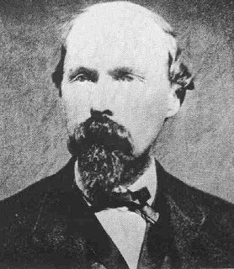
Notes:
John Wilkes Booth
Dr.Samuel Mudd

Slide 45
Muscle Sequelae
Original Paretic Muscle
Overaction of the Contralateral Yoke
Overaction of the Ipsilateral Antagonist
Underaction of the Contralateral Antagonist
Causation
Hering’s Law
Unapposed Contraction
Sherington’s Law due to RIR+
Hering’s Law due to LIO+
LSO -
RIR+
LIO+
RSR-

Slide 46
Muscle Sequelae
Hering’s Law
Unapposed contraction
+
RSR
RIO
LIO
LSR
Sherington’s Law
RIR
RSO
LSO
LIR
+
Hering’s Law
Occur in Paretic strabismus
Concomitance spreads over time
Differentiate two paretic muscle using head tilts (Intorters worse on ipsiltateral head tilt)

Slide 48
More Cases!

Slide 49
Notes:
History: This 30-year-old woman was operated for a ponto cerebellar tumor three years ago at which time she developed a third nerve palsy. One year ago she had a recession of the right lateral rectus 7.0 mm and resection of the right medial rectus 7.0 mm. Visual acuity is OD 20/30 and OS 20/20. The patient has diplopia when the right upper lid is lifted. She is functioning well and wishes further treatment.
Diagnosis: acquired third nerve palsy in an adult

Slide 50
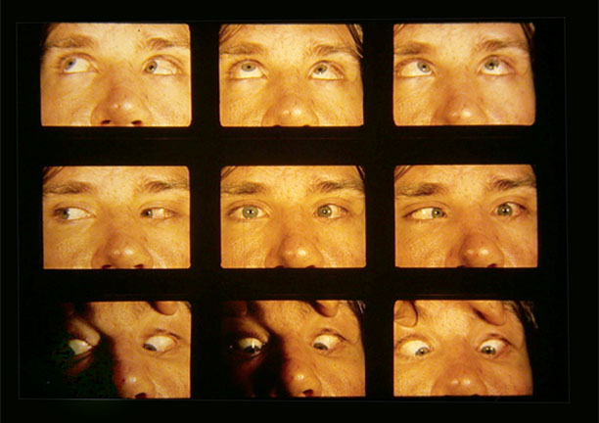

Slide 51
Notes:
Congenital Esotropia with bilateral IOOA
Expert Commentary
Comments of Eugene M. Helveston, M.D.
This case appears to be straightforward. A moderate angle of esotropia is present and has been said to be present since shortly after birth. The refractive error is a low hyperopia of only +1.00 and visual acuity is normal at 20/20 in each eye. There appears to be a slight elevation of the adducted eye in gaze upward and to each side. In addition there is a slight decrease in the ET in up gaze and increase of the ET in down gaze. However, this difference appears to be just borderline for saying that this patient has a "V" pattern. For this reason I will assume the slight vertical incomitance is not clinically significant in this girl. There is no indication for additional work-up, but I would suggest that the examiner confirm OKN asymmetry which is a constant in congenital esotropia which is the diagnosis I think is appropriate here. I would also suggest looking carefully for dissociated vertical deviation (DVD) and latent nystagmus and make a note of the findings for future reference. When looking at these patients in follow-up it is useful information to know of the presence, or absence of DVD and nystagmus. For treatment I would recommend bimedial rectus recession. Others might prefer a recession of one medial rectus and a resection of one lateral rectus of the appropriate amount. Both techniques have their advocates and both can be successful. In my hands a recession of the medial recti 10.5 to 11.0 mm from the limbus would be appropriate. (See The Strabismus Minute Vol I No. 5)
History: This girl is four years old. She was noted to have crossed eyes since shortly after birth and the eyes have remained this way. She is healthy with no complaints. She has two siblings with normal eyes and there is no other family history of strabismus. Visual acuity is 20/20 in each eye without correction. Cycloplegic refraction is +1.00 D in each eye. Except for the strabismus the eye examination is normal. Prism and cover measurement is 40 prism diopters in primary position, up gaze and down gaze.

Slide 52
Notes:
A Pattern Esotropia with SO overaction and IO underaction
History: This child is 2 years old and has had eyes crossed since shortly after birth. Cycloplegic refraction is OD +3.00 D and OS+4.00 D. He has two aunts with strabismus. Vision appears to be okay in both eyes with free alternation. An "A" pattern is present with the slight depression of the adducting eye in lateroversions. The inferior obliques "underact" and the superior obliques "overact" in their principal field of action. Prism and cover testing demonstrates 25 prism diopters of esotropia in up gaze and 20 prism diopters of exotropia in down gaze both measured in the distance. The media are clear and the fundus is normal in each eye.
Diagnosis: "A" pattern esotropia
Comments of Steven M. Archer, M.D.
No systemic work-up is needed. Sensory testing to determine if this patient fuses would be helpful but may not be possible at this age. Indirect ophthalmoscopy to look for fundus intorsion could provide confirmation of the clinical impression. Passive duction testing at the time of surgery could be helpful in ruling out Brown syndrome.
This child has A-pattern esotropia. In view of the hyperopia, there may be an accommodative component to the esotropia. There is apparent overaction of the superior obliques that can account for the A-pattern. The bilateral limitation of elevation in adduction could be due to mild bilateral Brown syndrome, but I would expect this to be associated with, if anything, an exotropia in up-gaze.
The first step in treatment is a trial of spectacles to correct the hyperopia. Regardless of the effect of the spectacles, this child will still need surgical treatment of the A-pattern. This should be in the form of bilateral superior oblique tenotomies. I would have some reservation about this if sensory testing demonstrated fusion, but the lack (I assume) of a chin-up head posture suggests that this is not the case. If the esotropia in primary position is not corrected by spectacles then it will need to be treated with bilateral medial rectus recessions. Shifting the tendons upward for the A-pattern in addition to the superior oblique tenotomies can be helpful when the esotropia is significantly greater in up-gaze than in primary position, but is not indicated in this case.

Slide 53
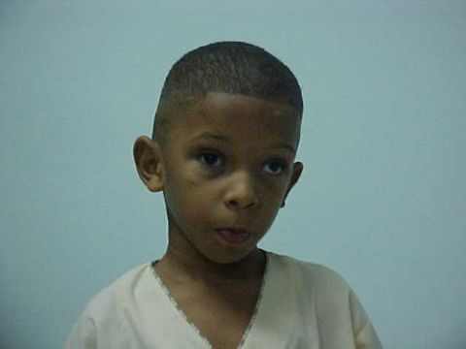
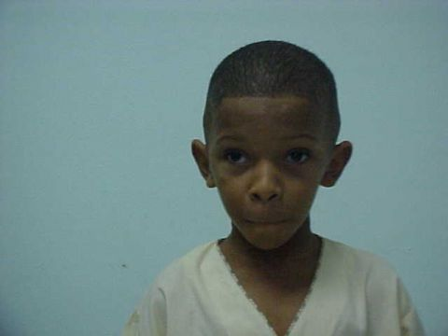
Notes:
Bilateral Duane’s Type 2
History: This 5-year-old boy has 20/20 vision in each eye and his refraction is OD and OS +.50 sphere. Head posture is as shown below with head tilt to the left. Adduction is limited in both eyes, but enophthalmos and up and down shoot are seen mostly in the right eye. When assuming the head posture shown, this boy fuses the Titmus stereo fly (4,000 seconds).
Diagnosis: Duane syndrome, bilateral Class II

Slide 54
Notes:
http://telemedicine.orbis.org/telemedicine/bins/show_picture.asp?cas_id=1205&picNum=16&picType=MID

Slide 55
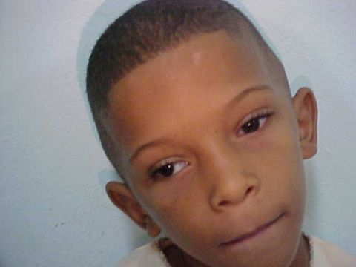
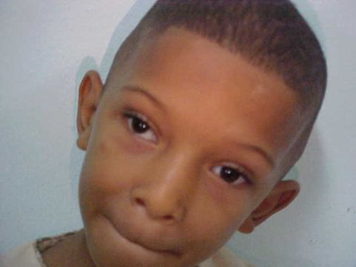
Notes:
Expert Commentary
Comments of Arthur L. Rosenbaum, M.D.
This child appears to have asymmetric bilateral exotropic Duane syndrome. The pictures clearly substantiate this diagnosis in the right eye and to a lesser extent in the left eye. I do not actually see globe retraction or narrowing of the palpebral fissure in the left eye on attempted adduction. However, there is an unequivocal inability to fully adduct the left globe. I have never seen a compensatory head posture using a large head tilt, as shown in the photos. I assume that he is adopting this posture to somehow neutralize the upshoot and/or downshoot of the right globe in adduction. At any rate, he seems to be a fusing patient with an anomalous head posture and therefore a surgical candidate.
I would recommend a right lateral rectus Y-splitting procedure with larger recession of each half of the split right lateral rectus and transposition of the superior half superiorly and the inferior half inferiorly. This should reduce the exotropia in the primary position and improve the upshoot and downshoot as well as his head posture. I would not recommend treatment of the left eye at this time.
In such patients, we are beginning to perform disinsertion of the right lateral rectus muscle with attachment to the lateral orbital wall accompanied by a partial transposition of the lateral halves of the superior and inferior rectus muscles to the lateral rectus insertional stump, with posterior fixation. The first few cases that we have performed have done extremely well, although some have required subsequent medial rectus recession, since the patient no longer has any lateral rectus function. However, I think it is too early to recommend this type of treatment at the present time. The time honored option is to weaken the right lateral rectus muscle, as described in the first part of this discussion.

