Slide 1
Night safe
Introduction to the programme
Faculty Day October 2015

Slide 3
Crisis
Recruitment and retention crisis
Increasing demand
Target drivers for trusts
Quality drivers for clinical staff

Slide 5
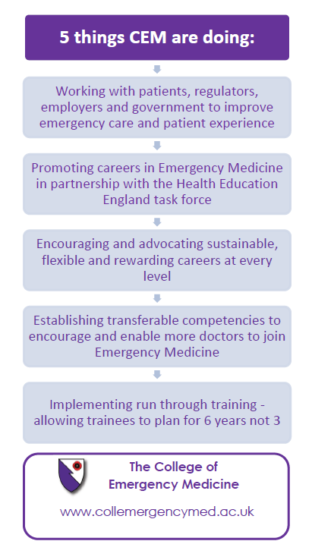

Slide 6
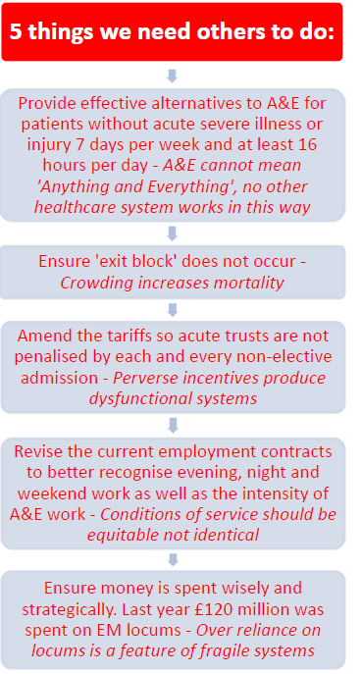

Slide 7
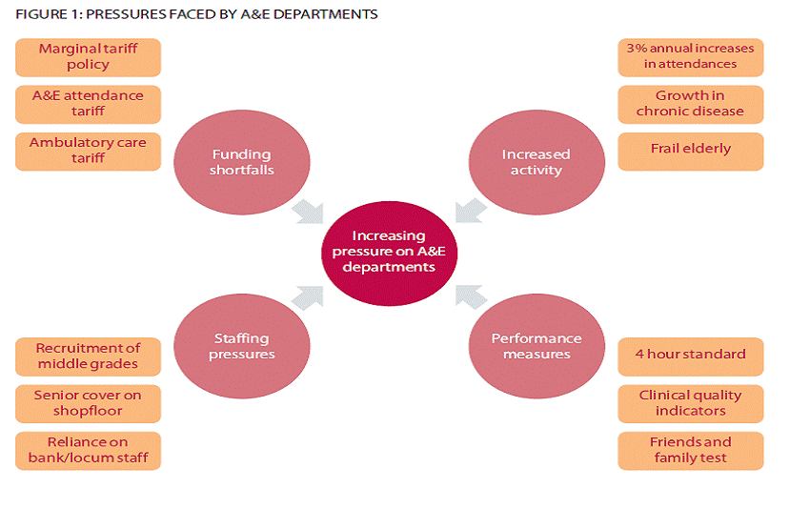

Slide 9
Structure
GMC
Royal Colleges
Workforce groups
Health Education
England
Speciality Schools
Trusts
LETB
(WereDeaneries)
Training Programme
Directors
Postgraduate
Education
dept
Trainees and non trainees
College Tutors
Educational Supervisors
Clinical Tutor /
Director of Medical
Education
Clinical Supervisors

Slide 10
Structure
GMC
Royal Colleges
Workforce groups
Health Education
England
Speciality Schools
LETB
(Were Deaneries)
Trainees and non trainees
Training Programme
Directors
Trusts
College Tutors
Postgraduate
Education dept
Educational Supervisors
Clinical Tutor /
Director of Medical
Education
Clinical Supervisors

Slide 11
Structure
GMC
Royal Colleges
Workforce groups
Health Education
England
Speciality Schools
LETB
(Were Deaneries)
Trainees and non trainees
Training Programme
Directors
Trusts
College Tutors
Postgraduate
Education dept
Educational Supervisors
Clinical Tutor /
Director of Medical
Education
Clinical Supervisors

Slide 12
GMC
Crisis
ED Staffing is a safety issue

Slide 13
Health Education
England
Tasked to try to resolve issue

Slide 14
Workforce groups
LETB
(Were Deaneries)
Tasked to work together to resolve issue

Slide 15
GMC
Royal Colleges
Workforce groups
With funding
Health Education
England
Speciality School
LETB
(Were Deaneries)
Take advice from Royal College,
Speciality School

Slide 16
GMC
Royal Colleges
Workforce groups
Health Education
England
Speciality Schools
LETB
(Was Deaneries)
Trusts
Training Programme
Directors
College Tutors
Work with Trusts, TPDs College tutors

Slide 17
Solutions
Increase entry to ACCS
5 to 8 year solution 
Increase other professionals eg ENP ANP Paramedics
Shortages, long run in time
Run Through training 
Aid retention
Improve working conditions X
under negotiation!!!!!!!!
Recruit overseas 
work and return programme
New career pathways 
DREEM
Improve existing workforce ????

Slide 18
Improve existing workforce - Night safe
Large non-training workforce
Underutilised?
Limited educational opportunity
Limited career progression

Slide 19
(retention v Locum work) Unhappy?
Could take a bigger role

Slide 20
Night safe
Funded by workforce partnerships
Small groups
Intensive programme
Interactive + “homework”
Self assessment at start
Assessment of programme by feedback
Repeat programme if successful

Slide 21
First diet
Ran in late spring early summer 2015
12 participants
Eight days
Good faculty buy in – at least 3 faculty per day
Good attendance – one or two missed days
Venue worked well
Excellent deanery support (Anna)

Slide 22
Problems
Rotas, prior commitments
Missed days will be caught up in the autumn diet
Travel in this large region

Slide 23
Outcome (first diet)
On a scale of 1 to 5 1 - not confident, no knowledge to 5 - very confident I can manage this | Pre course Rating Average | Post course Rating Average
Emergency department DAY TO DAY management | 3.75 | 4.20
Managing complex minor injuries | 3.58 | 4.10
Managing Acute Medical Emergengies | 3.67 | 4.60
Managing psychiatric paitents | 2.75 | 4.00
Procedural sedation | 3.00 | 4.30
Co-ordinating the process of RSI (rapid seqence induction of anaesthesia) | 2.17 | 3.40
Managing major Trauma | 3.25 | 4.00
Leading the hopital Trauma Team | 2.83 | 4.00
Leading the cardiac arrest team and managing cardiac arrests | 3.33 | 4.30
Managing sick children with medical conditions | 2.75 | 4.10
Managing patients with altered mental status or who are unconscious | 3.58 | 4.30
Supervision of junior doctors such as FY2s and CT1s | 3.33 | 4.40

Slide 24
2nd diet under way

Slide 25
?

