Slide 1
Evaluation of the educational value of simulated scenarios for Foundation Doctors with a focus on debriefing
Aleksandra Bartnik

Slide 4
Research question
What is the educational value of debriefing in relation to:
Content and conduct
Faculty
Psychological safety

Slide 5
Methodology
Phenomenologial approach concerned with perceptions, experiences and expectations
Combined deductive and inductive approaches
Framework analysis
Questionnaires for 26 FDs as the main source of data
Complemented by focus groups for specific topics
Contrasted with data from 2 interviews with the faculty to triangulate data sources
Timing of data collection directly after debriefing sessions
Formal UCL Ethics Committee Approval

Slide 6
Results – Final framework
 | Content | Conduct | Outcomes | Faculty | Psychological comfort
Foundation doctors | Communications skills, teamwork, leadership and application of protocols are the most important topics The learning points should be general and for everyone | Everyone should be involved in debriefing It should not be overly negative or target individuals Recall in debriefing helps make sense of chaos | The aim of debriefing is to gain understanding and develop strategies | A dedicated lead for debriefing is essential Leaders personality and non-clinical skills are more important than clinical expertise Leader should be amiable and enthusiastic about simulation | Supportive familiar peer group is a single most important factor improving comfort followed by introduction and small size groups A degree of discomfort is common among FDs Stress is inevitable like in clinical work
Faculty | The emotional impact on the learner is the most important topic but technical skills may have to be covered beforehand | Leader and group should be honest with the learner and not provide false reassurance | The aim of debriefing is to encourage participation in simulation and to help learner understand their actions | Faculty is essential for quality debriefing | Learning cannot occur without discomfort Faculty should allow learner to express discomfort

Slide 7
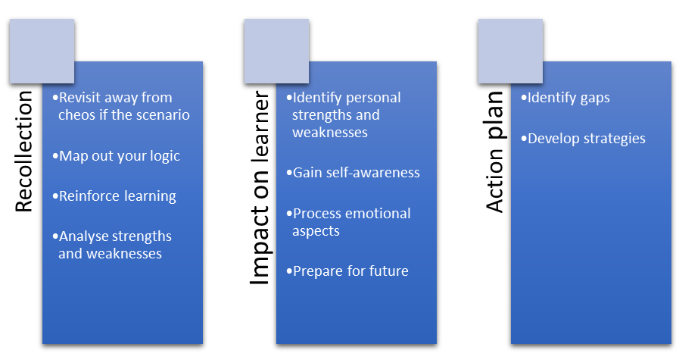
Educational value of core elements of debriefing as perceived by Foundation Doctors

Slide 8
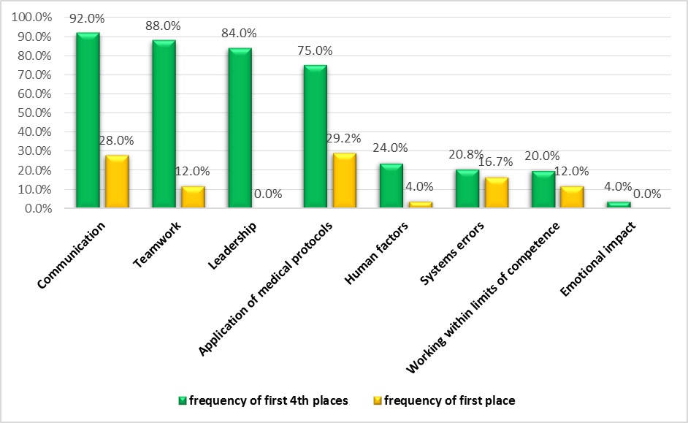
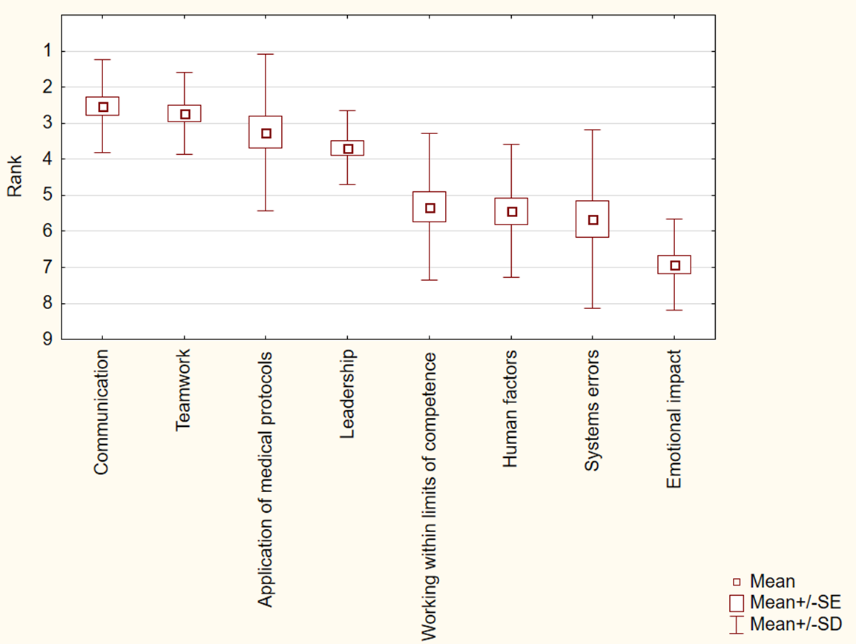
The ranking of topics for debriefing according to Foundation Doctors

Slide 9
Features of debriefing help and hamper learning as perceived by Foundation Doctors

Slide 10
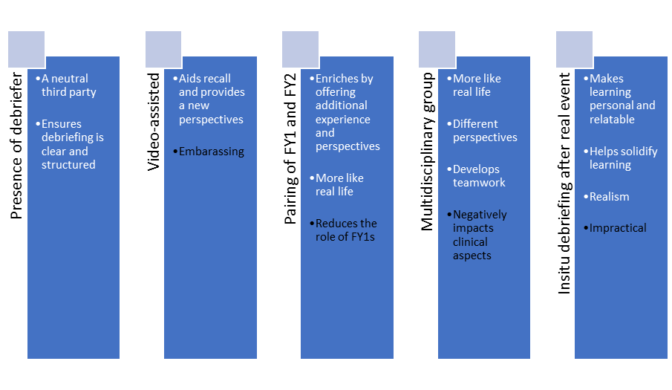
Would Foundation Doctors welcome less conventional debriefing modalities?

Slide 11
What do FDs expect of faculty
Personality:
nonjudgmental,
approachable,
friendly
Clinical expertese
Non-clinicall skills and attitudes:
encouraging participation,
enthusiastic about simulation,
skills in critical feedback,
honest and impartial
Personality - stern
Debriefing style - negative, domineering

Slide 12
Psychological comfort
Supportive peer group
Introduction
Small group
Unfamiliar group
Simulation itself
Large group

Slide 13
Main themes and discussion
Content and conduct of debriefing
Shared understanding as the key outcome of debriefing (Wallace 2007)
Debriefing as a tool to make sense of chaos (Gallagher 2005)
Communication, teamwork, application of protocols and leadership are the most valued topics. (the issues with comparison between studies)
Emotional impact – a stark divergence between the learners and faculty

Slide 14
Main themes and discussion
Faculty
Presence of faculty to lead debriefing is essential
Task-versus-relationship dilemma (Rudolph 2006)
Advocacy-inquisitive style
Personality and attitudes are superior to clinical expertise (Tan 2005)

Slide 15
Main themes and discussion
Psychological comfort
Peer group attitude is the single largest determinant
The importance of confidentiality and introduction
Moving the heat from the individual to the group (Rudolph 2013)
Psychological discomfort is an element of the learning environment (Ledderman 1992)

Slide 16
Reflection on methodology
The use of pre-determined themes and the emergence of the 4th theme
Why boundaries between themes are artificial
Why knowing what the learner wants is important and did I answer the research question?
The challenges of nomenclature and comparison between studies
Questionnaire design and the order effect

Slide 17
Implications for designing debriefing for Foundation Doctors
Debriefing should focus on communications skills, application of medical protocols, leadership and teamwork.
Recollection of the events from the scenario should form an integral part of debriefing
Critical feedback should be conveyed in a way that is clear and honest without the use of conciliatory techniques such as “sugar-coating” or “sandwich feedback”.
The primary aim of the faculty should be to understand the learner as the first step to help the learner modify their behaviours
Faculty should open the discussion to the group early and avoid dwelling on critiquing the individual in the hot seat
Faculty leading debriefing should be selected based on personality and excellent non-clinical skills. Faculty less senior then consultant can lead debriefing as clinical expertise is a secondary requirement.
Learners should be challenged in order to achieve a degree of psychological discomfort
Groups should be small and consist of colleagues who know one another
Debriefing must always be proceeded by introduction and assurance of confidentiality

Slide 18
Thank you

