Slide 1
Long-acting Reversible Contraception
Dr Caroline Marfleet
Consultant in SRH
Colchester Hospital University Foundation Trust
23rd November 2016

Slide 2
Issues to be Discussed
Abortion rates 2014
Perfect and Typical Failure rates
NICE Guidance 2005
Intrauterine Contraception
Sub Dermal Implants
Injectables
Notes:
Why do we need to improve patient experience? Because of abortion statistics and low use in younger age groups

Slide 3
Abortion Statistics, England and Wales 2014 National Statistics Dept of Health
Total no of abortions 184,571 (lowest since 1997)
0.4% down from 2013; 0.6% down from 2004
Highest rate was for women aged 22 at 28 per 1000
Under 16 rate was 2.5 per 1000
Under 18 rate was 11.1 per 1000
Both lower than 2013 and 2004
37% were repeat abortions
Notes:
Still double rate from 1970

Slide 4
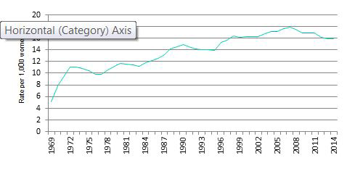
Age-standardised abortion rate per 1,000 women aged 15-44 (2013 ESP), England and Wales, 1969 to 2014

Slide 5
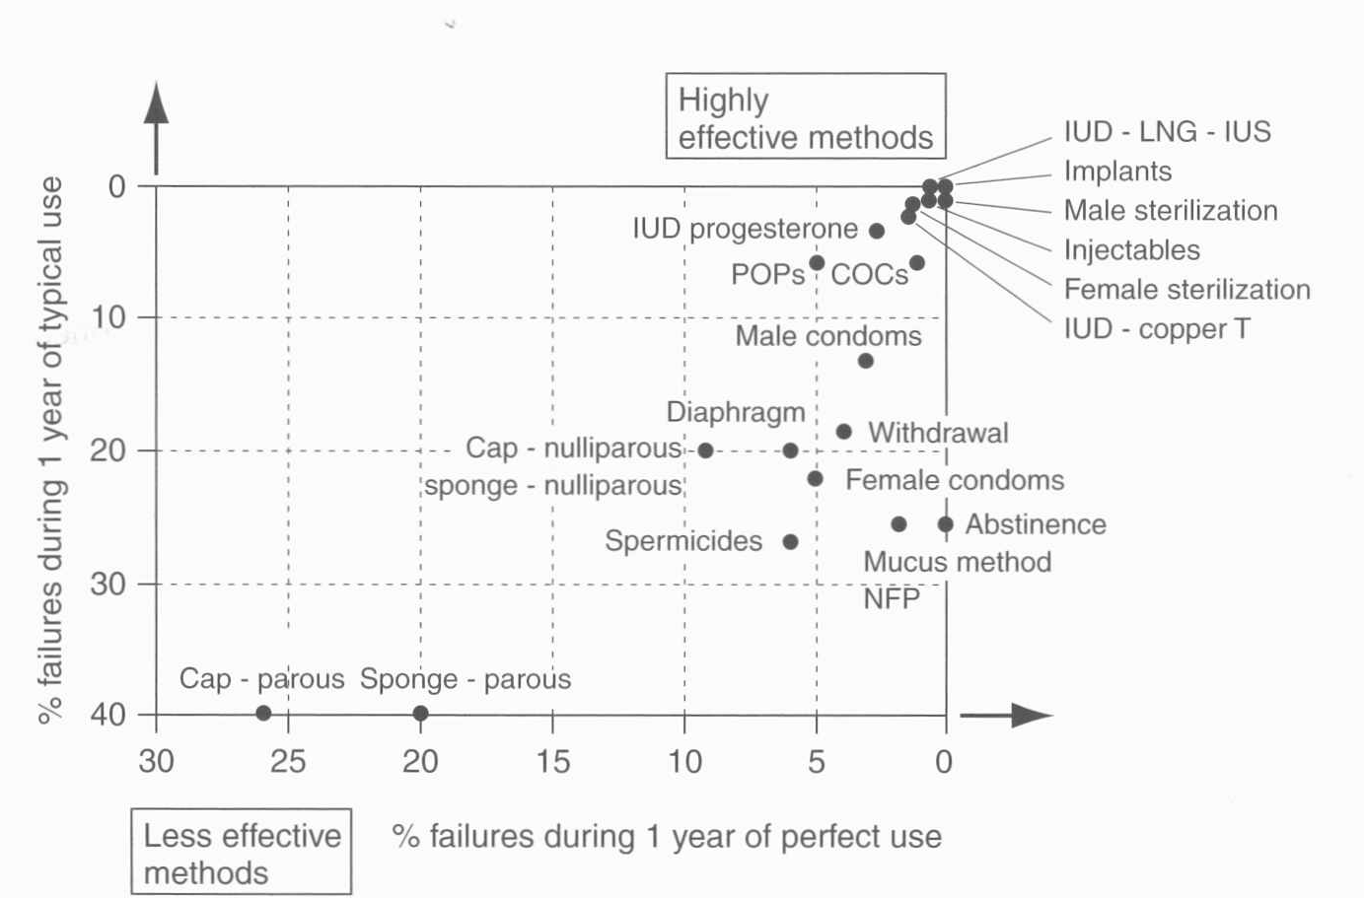
Perfect and typical use failure rates of contraceptives

Slide 6
NICE Guidance 2005
LARC methods are more cost effective than the combined oral contraceptive pill even at 1 year of use
IUDs, the IUS and implants are more cost effective than injectables
Increasing the use of LARC will reduce unwanted pregnancies

Slide 7
NICE Guidance 2005
Adolescents IUDs, IUS, Implants: no contraindications to use DMPA: If other LARC methods unacceptable; regular review if use longer than 2 years | Women aged > 40 IUDs, IUS, Implants: no contraindications to use DMPA: regular review if used longer than 2 years | Nulliparity All LARC methods: no contraindications to use

Slide 8
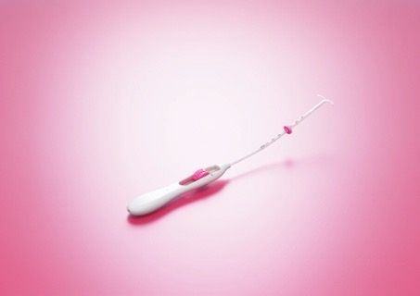
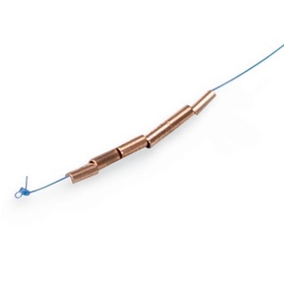
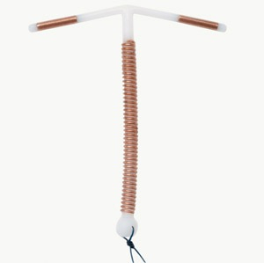
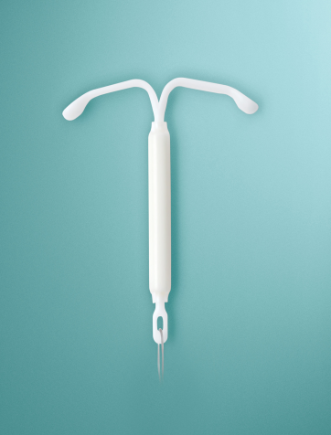
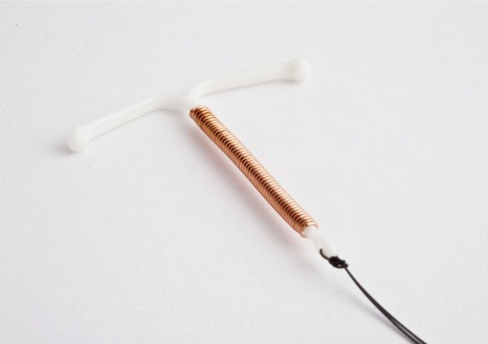
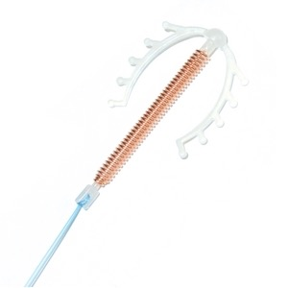
Intrauterine Contraception
Jaydess
Gynefix
TT380S
Mirena
NovaT380
MultiLoadCu385

Slide 9
LNG-IUS - Mirena
Failure rate = female sterilisation
Reversible and no effect on future fertility
Effective for 5 years
Reduces menstrual loss and relieves pain
1st line treatment for HMB
Minimal systemic effects
Reduces risk of ectopics and no increased risk of PID
Can be fitted in nulliparous women (consider local anaesthesia)
If fitted > age 45, need not be changed until after menopause

Slide 10
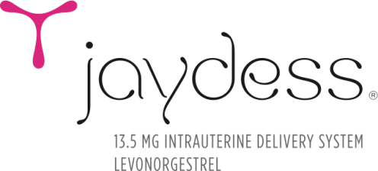
Jaydess® and Mirena®: key comparisons
levonorgestrel
Up to 3 years contraceptive cover¹
Smallest IUS
Lowest daily hormone dose
Insertion tube diameter 3.8mm
Up to 5 years contraceptive cover²
Up to 5 years treatment for Heavy Menstrual Bleeding (HMB)
Mirena® is indicated for protection from endometrial hyperplasia during oestrogen replacement therapy for up to 4 years²
Insertion tube diameter 4.4mm
28mm width
30mm length
Silver Ring
32mm width
32mm length
1. Jaydess Summary of Product Characteristics (SPC). Bayer plc. 2. Mirena Summary of Product Characteristics (SPC). Bayer plc.
3. NICE Guidelines, Heavy Menstrual Bleeding: clinical guideline 44. January 2007

Slide 11
Inserter comparison
EvoInserter®
Mirena
Jaydess
Levosert

Slide 12
Mirena, Jaydess (levonorgestrel) & Levosert – a comparison¹⁻⁵
 | Jaydess | Mirena | Levosert
Hormone | Levonorgestrel
Content | 13.5mg | 52mg
Initial release rate | 14mcg/day | 20mcg/day
Dimensions of T-body | 28 x 30 mm | 32 x 32mm
Type of inserter | One-handed EvoInserter |  | Two-handed tube and plunger
Diameter of insertion tube | 3.8mm | 4.4mm | 4.8mm
Insertion tube | Curved |  | Straight, flexible
Double sided scale | Yes |  | No
Indications & duration | Contraception for 3 years | Contraception for 5 years HMB for 5 years Endometrial protection during HRT for 4 years | Contraception for 3 years HMB for 3 years
Price | £69.22 | £88 | £66
Contraception Cost per annum | £23.07 | £17.60 | £22
HMB Cost per annum | Not licensed for HMB | £17.60 | £22
Endometrial protection Cost per annum, | Not licensed for endometrial protection | £22 | Not licensed for endometrial protection
Jaydess Summary of Product Characteristics. Bayer HealthCare.
Mirena Summary of Product Characteristics. Bayer HealthCare.
Levosert Summary of Product Characteristics. Actavis.
Faculty of Sexual & Reproductive Healthcare: New Product Review Levosert , April 2015
MIMS online. www.mims.co.uk Accessed 11.05.15 .

Slide 13
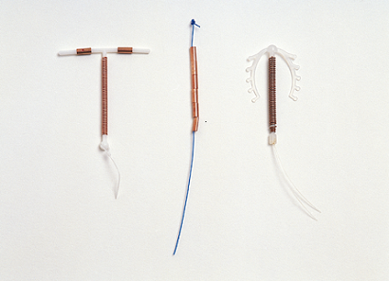
Copper IUDs
Use IUDs with >300 sqmm Copper
Effective: failure rate < 2 in 100 women over 5 years
Reversible and no effect on future fertility
No systemic effects
Reduces risk of ectopic pregnancy
Can be fitted in nulliparous women (consider local anaesthesia)
Failure rate < 1% when used for post coital contraception
TT380 licensed and effective for 10 years
Cu IUDs fitted > age 40 may be left until after menopause
Is least costly LARC method

Slide 14
Incidence of Ectopic Pregnancy
Ectopic pregnancy is a recognised risk for all intrauterine contraception (IUC)
Jaydess®- The overall incidence of ectopic pregnancy in Phase II and III clinical trials with Jaydess® was 0.11 per 100 women-years¹ (= 1 in 1000 women)
All women - In comparison, the incidence of ectopic pregnancy amongst all women aged 20-34 years as estimated from retrospective analysis of data from a large managed care database in the US was 0.11-0.23 per 100 women-years^{2,3}
The possibility of an ectopic pregnancy must be carefully considered and evaluated. An ectopic pregnancy should be especially considered in the case of lower abdominal pain, especially in connection with missed periods or if an amenorrhoeic woman starts bleeding
Before insertion a woman must be informed of the benefits and risks of Jaydess®, including the risk of ectopic pregnancy as this may impact future fertility particularly for nulliparous women
Jaydess® Summary of Product Characteristics, Bayer plc,
Trabert B, Holt VL, Yu O, et al. Population-based ectopic pregnancy trends, 1993-2007. Am J Prev Med.2011 May;40(5):556-560.
3. Trabert B et al. Am J Prev Med 2012; 42(1):107-108.
Notes:
This data is also from the Educational material part of the Risk Management Plan.
The background ectopic rate is US data as there is no equivalent published UK data. It is there to give a ballpark figure to put the Jaydess figures into context.
The 0.11 per 100 women years is pooled data from all trials involving Jaydess

Slide 15
STI screening prior to IUD/IUS insertion
STI risk assessment (history and examination) should be performed for all women prior to IUD insertion
Risk factors include:
sexually active women < 25 yrs
A new sexual partner in last 3/12
> 1 sexual partner in last year
Having a regular sexual partner who has other sexual partners
Hx of STIs or attending as a previous contact of STIs
Alcohol/substance abuse
No indication to test for other lower genital tract organisms in asymptomatic women
Prophylactic antibiotics are not recommended for routine IUD insertion unless woman is assessed at higher risk and results unavailable

Slide 16
UK MEC for use of IUD/IUS
Past PID (assuming no current risk )UK MEC 1
Current PID UK MEC 4
Chlamydia infection symptomatic UK MEC 4
Chlamydia infection asymptomatic UK MEC 3
Purulent cervicitis or gonorrhoea UK MEC 4
Other current STIs (excluding HIV & Hepatitis) UK MEC 2
Vaginitis (BV or TV) UK MEC 2
Increased risk for STIs UK MEC 2
Notes:
BASHH guidance and Faculty MEC 2016

Slide 17
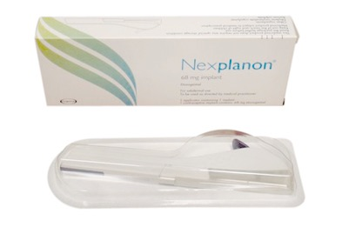
Nexplanon
40mm x 2 mm sub dermal rod releasing etonogestrel over 3 years
Contains 3% Ba sulphate so is radio-opaque
New applicator to minimise risk of deep insertions
On-line based training including Module 17 (www.fsrh.org), to be followed by model arm and live patient training

Slide 18
Nexplanon
Single rod releasing 30-40 mcg etonorgestrel per day
Failure rate: < 0.1 in 100 over 3 years
Most effective LARC method
Lasts 3 years ( no need to change early if high BMI)
Unpredictable bleeding pattern; no data on endometrial protection
Can check FSH; remove when postmenopausal
Not recommended for women on enzyme inducers
Faculty of SRH; CEU guidance Progestogen-only implants 2008

Slide 19
Nexplanon
20% amenorrhoea
50% infrequent, frequent or prolonged bleeding
Not associated with weight change, mood, libido or headaches
May be associated with acne
Does not adversely affect bone density
Can be used up to age of 55 years (when contraception will no longer be needed)
Faculty of SRH; CEU guidance Progestogen-only implants 2008

Slide 20
Efficacy - Nexplanon
Is unmatched, aside from abstinence (true) and vasectomy
1st year failure rate is < 1 in 1000 (< 0.1%)
Nearly all failures that have been reported were either failure to insert at all; had the insertion in a conception cycle or as a result of drug interactions
FSRH Clinical Guidance Progestogen-only Implants 2/2014
Notes:
Always palpate and document the implant is felt after insertion

Slide 21
Nexplanon and EIDs
The SPC advises that these lower the blood levels of Etonogestrel
Women on short term treatment with EIDs are advised to use a barrier method for the duration of treatment and for 28 days after cessation
Women on long term treatment are advised to transfer to an unaffected method (DMPA, IUS or CuIUD) and have implant removed
UULP – attempt to compensate by adding daily Cerazette (not Faculty endorsed)
FSRH Clinocal Guidance Progestogen-only Implants 2/2014
Notes:
UULP= unlicensed use of licensed product

Slide 22
Weight and Nexplanon
BMI > 30 =UKMEC 1
May be offered without restriction to very overweight women – not more prone to ‘lost’ implants, provided correct placement
MSD SPC suggests ‘consider early replacement in 3rd year in heavier women
JG - consider early replacement in young highly fertile women weighing > 100 kg, especially if starting to menstruate regularly
MSD SPC Nexplanon
J.G. Contraception 6th Ed
Notes:
If menstruating regularly contraception is relying on mucus effect

Slide 23
Replacement of a Sub dermal Implant
New implant may be inserted through same incision where previous implant was removed
Insert subdermally along a fresh track adjacent to previous track to avoid insertion into thickened scar tissue
Because of risk of skin atrophy, switch arms after 2 consecutive implants
FSRH Clinical Guidance Progestogen-only Implants 2/2014

Slide 24
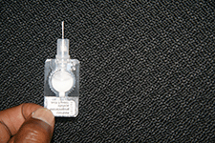
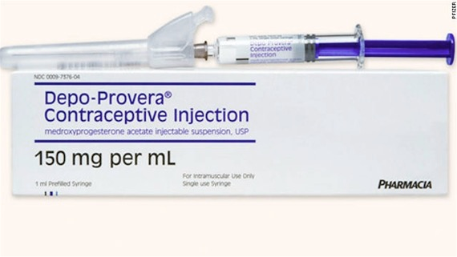
Injectables
Sayana Press

Slide 25
Injectables
Depoprovera
Sayana-Press
Medroxyprogesterone acetate
150 mg/ml every 13 weeks by deep i.m. injection
If necessary, can be given from 10 weeks
CEU guidance states it can be given up to 7 days late without need for additional precautions
Cost: £6.01
Annual cost: £26.11
Medroxyprogesterone acetate
104 mg in 0.65 ml suspension every 13 weeks s.c. into upper thigh or lower abdomen
Can be given up to 7 days early or late without need for additional precautions
Cost: £6.90
Annual cost: £27.68
FSRH Clinical Guidance Progestogen-only Injectables Dec 2014
FSRH CEU New Product Review June 2013

Slide 26
4 unique aspects!
Cannot be speedily reversed
Can cause delayed return of (but no loss of) fertility
Can truly cause weight gain (mean of 3 kg in 2 years)
Excellent choice for women on EIDs so no change in usual injection frequency during EID use
FSRH CEU Guidance Progestogen-only Injectables Nov 2008
Notes:
Essential counselling points: The liver’s clearance of the progestogen equated to total hepatic blood flow so good choice for women on EIDs since they will not increase this 100% clearance

Slide 27
What does s.c. DMPA add to the range of contraceptives available?
Patient satisfaction with s.c. DMPA is similar to users of i.m. DMPA
Given every 13 weeks +/- 7 days
S.c. DMPA may be less likely to cause haematoma than i.m. so may be preferable if woman is on anticoagulants or has a bleeding disorder
May be advantages of s.c. administration in very obese women if there is concern about i.m. DMPA reaching muscle
Potential for self administration (outside product licence)
FSRH New Product Review Sayana Press June 2013

Slide 28
Bleeding changes
80% of women in a large cohort study experienced changes in bleeding pattern over 3 years
30-34% of users are amenorhoeic at 3 months
70.3% of users are amenorhoeic by 12 months
Amenorrhoea is more likely as duration of use increases
Aktun et al Contraception 2005; 72:24-27 Use of a long acting progestin injectable contraception in Turkish women
Notes:
Most common reason for discontinuation is bleeding problems

Slide 29
Managing bleeding problems
Spotting or light bleeding is common in 1st injection cycle
A repeat injection may be given up to 2 weeks early
Consider risk of STIs (especially Chlamydia)
Investigate for gynaecological pathology if clinically indicated
Consider use of COC pill short term
Consider use of Mefenamic acid
FSRH CEU Guidance Progestogen-only Injectables Nov 2008

Slide 30
MHRA Guidance 2004
Women < 18 yrs – DMPA may be used as 1st line contraception after all options have been discussed and are considered unsuitable or unacceptable
A re-evaluation of the risks and benefits of treatment should be carried out every 2 years in those who wish to continue use
Women with considerable life style and/or medical risk factors for osteoporosis should consider other methods of contraception

Slide 31
Consider baseline risk factors for osteoporosis before starting DMPA
Alcohol use
Smoking
Chronic use of medicines that can reduce bone mass
Family history of osteoporosis
Previous low trauma fracture
Low BMI or eating disorder

Slide 32
Don’t forget Bridging -
If a woman’s method of choice cannot be started immediately
start a short acting method such as COCP, patch, ring or POP until pregnancy can be excluded and the preferred method can then be initiated
Faculty of SRH Clinical Guidance 2010

Slide 33
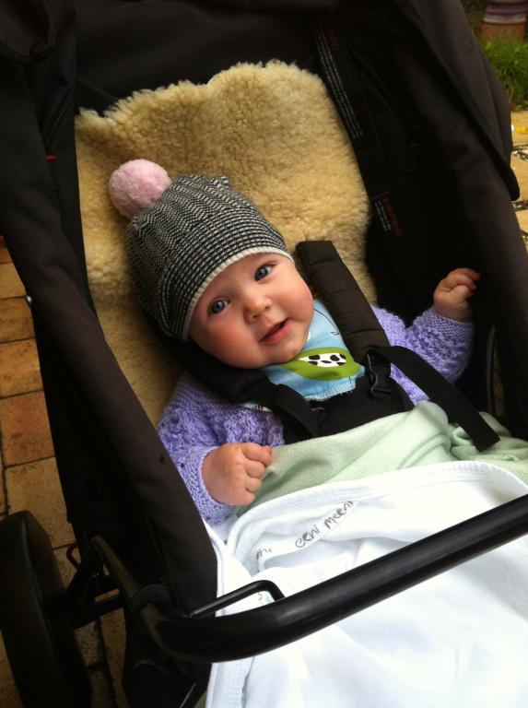
Thank you for listening!

