Slide 1
Keeping out of Trouble
Dr Sally Old
1 December 2017

Slide 2


Slide 3
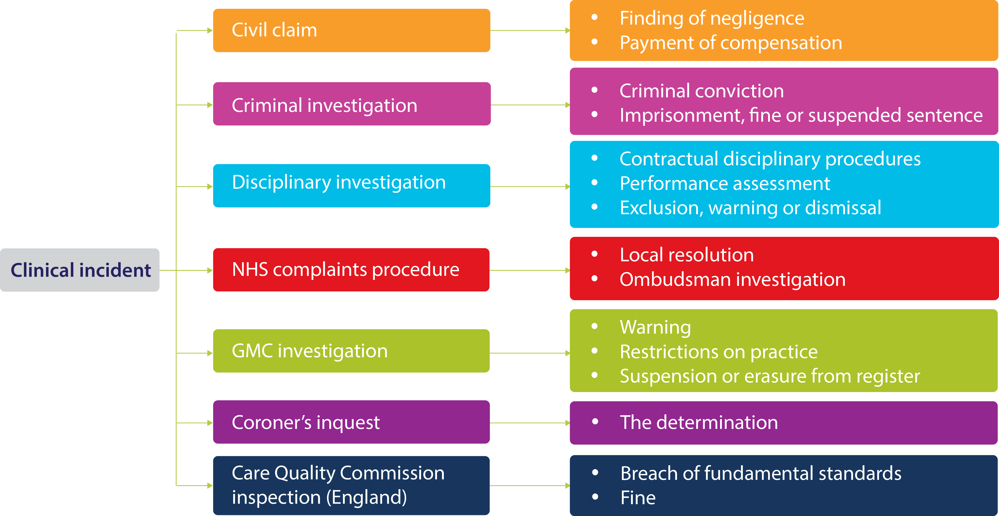
Multiple jeopardy

Slide 4
The six Cs
Communication
Clinical Management
Consent
Chaperones
Confidentiality
Clinical Records
And a bit about what to do when you are involved in an incident….

Slide 5
Communication
You must listen to patients, take account of their views, and respond honestly to their questions.
You must give patients the information they want or need to know in a way they can understand…
When you are on duty you must be readily accessible to patients and colleagues seeking information, advice or support.
You must work collaboratively with colleagues, respecting their skills and contributions.
GMC, Good Medical Practice, paras 31,32, 34,35
Notes:
There is clear guidance from the GMC and other regulators on how we should communicate

Slide 6
Continuity and coordination of care
You must contribute to the safe transfer of patients between healthcare providers and between health and social care providers. This means you must:
  a share all relevant information with colleagues involved in your patients’ care within and outside the team, including when you hand over care as you go off duty, and when you delegate care or refer patients to other health or social care providers,
  b check, where practical, that a named clinician or team has taken over responsibility when your role in providing a patient’s care has ended. This may be particularly important for patients with impaired capacity or who are vulnerable for other reasons.
  Good Medical Practice, para 44

Slide 7
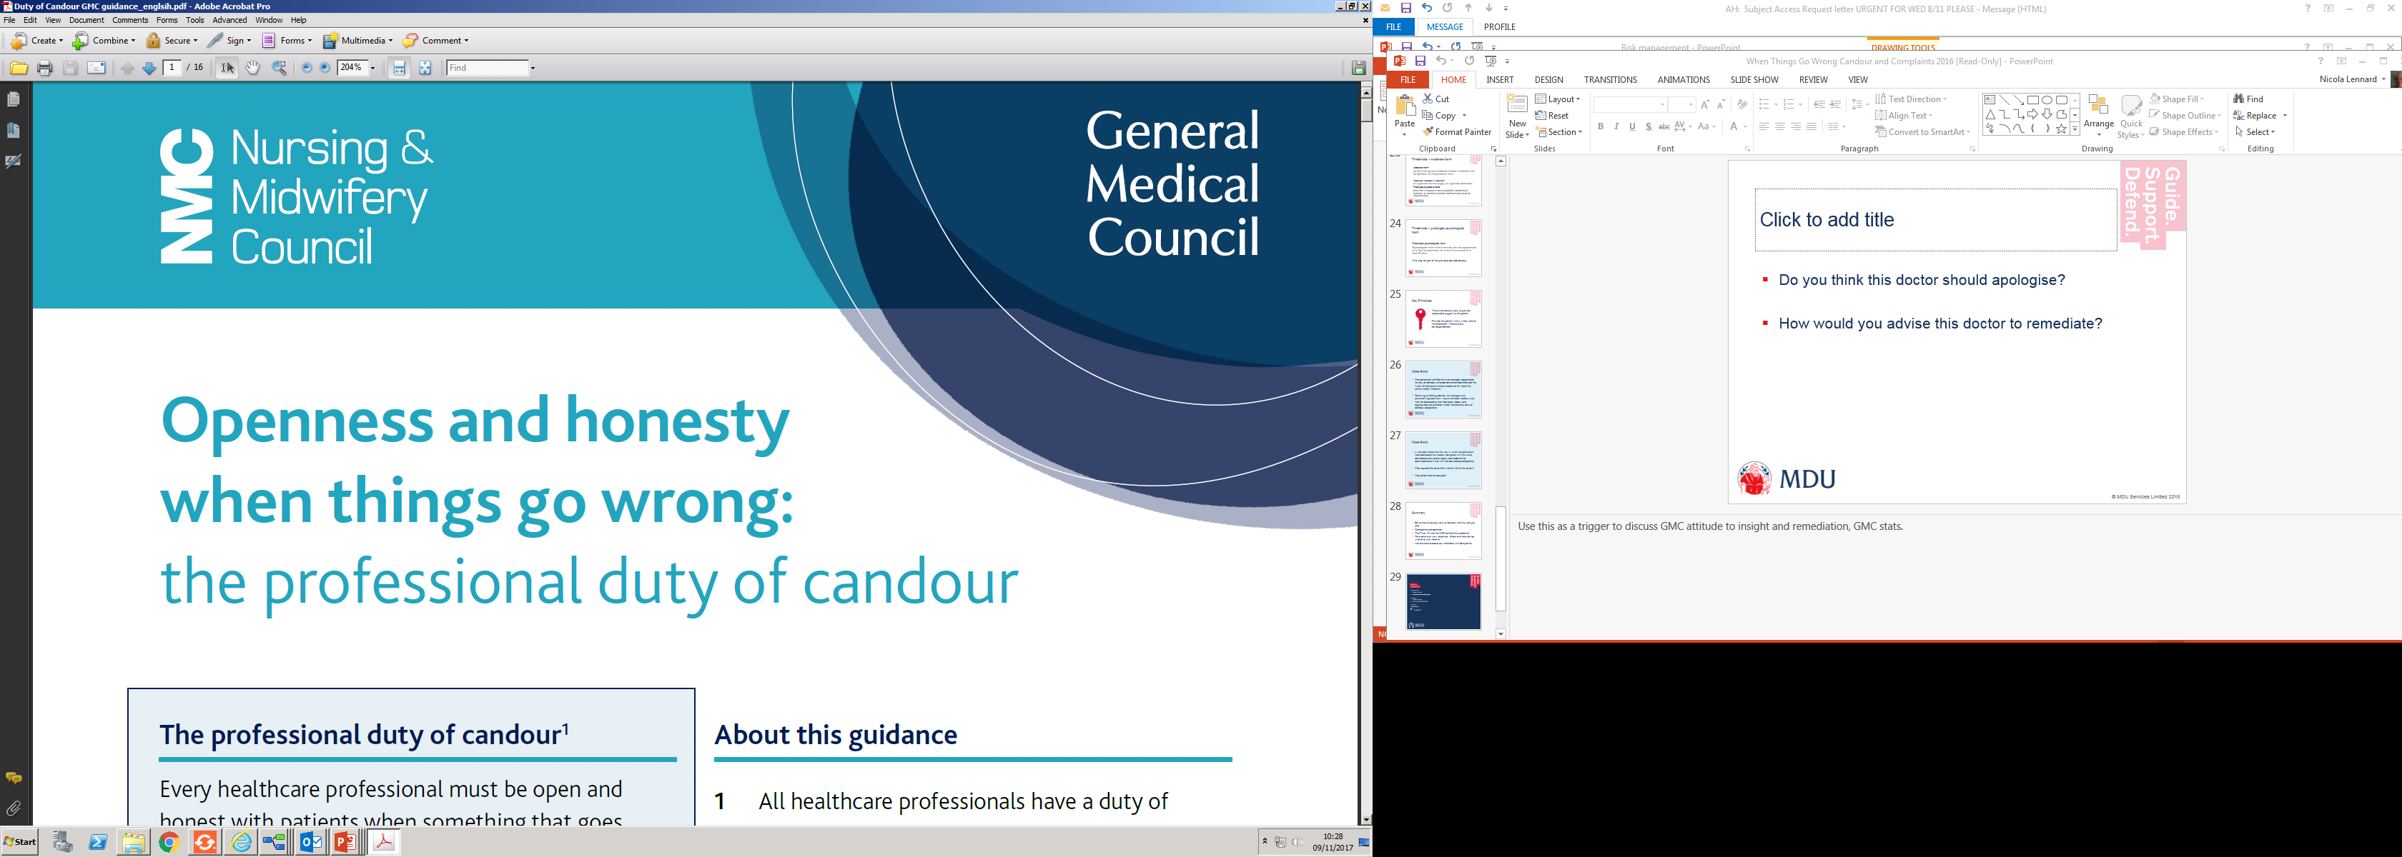
Communication and Candour
Deal promptly and effectively with complaints
Apologise where appropriate
Notes:
Mention statutory duty and ethical duty of candour

Slide 8
Good Medical Practice
You must be open and honest with patients if things go wrong. If a patient under your care has suffered harm or distress, you should:
  Put matters right (if that is possible)
  Offer an apology
  Explain fully and promptly what has happened and the likely short-term and long-term effects
    Good Medical Practice, paragraph 55

Slide 9
Statutory Duty of Candour
Duty now applies to all those bodies providing regulated activities (including GPs and private clinics)
Only in England
Duty is on organisation, not individual
Relevant legislation is The Health and Social Care Act 2008 (Regulated Activities) Regulations 2014
Regulation 20 is the relevant one
Notes:
Extract from The Health and Social Care Act 2008 (Regulated Activities) Regulations 2014
Regulation 20 effective from 27 November 2014 for NHS trusts and from 1 April 2015 for GPs, dentists and other organisations registered with CQC, such as private providers.
CQC expects that an organisation’s staff will cooperate with it to ensure obligation is met.
Problems for individuals:
The due diligence defence
It’s not our fault – we trained, provided guidance, but the staff didn’t do it.
CQC guide on candour
The guidance continues:
The provider has policies and procedures in place to support a culture of openness and transparency, and these are followed by all staff where the individual is professionally qualified, it may include fitness to practise proceedings and professional disciplinary cases.
Where a provider becomes aware that staff have not acted in accordance with the requirements placed on them under the Duty of Candour they must refer the individual(s) concerned to their relevant professional regulator/body, police, or other relevant body etc

Slide 10

Key Principles
The organisation must
Tell the patient
(or their representative) in person if a notifiable patient safety incident occurs
Give full explanation of what is known at the time
Provide an apology and keep a written record of the notification to the patient
Notes:
As soon as is reasonably practicable after a notifiable patient safety incident occurs, the organisation must tell the patient (or their representative) about it in person.
The organisation has to give the patient a full explanation of what is known at the time, including what further enquiries will be carried out. Organisations must also provide an apology and keep a written record of the notification to the patient.
Tell the patient (or their representative) in person if a patient safety incident occurs
The organisation must give full explanation of what is known at the time
Organisations must provide an apology and keep a written record of the notification to the patient. Failure to notify may be a criminal offence.
Will also need to inform CQC (same triggers as for duty of candour)

Slide 11
Key Principles
A notifiable patient safety incident has a specific statutory meaning: it applies to incidents where a patient suffered (or could have suffered) unintended harm that results in death, severe harm, moderate harm or prolonged psychological harm. Severe and moderate harm definitions are derived from the NPSA's Seven Steps to Patient Safety.

Slide 12
Thresholds – severe harm
Severe harm
a permanent lessening of bodily, sensory, motor, physiologic or intellectual functions, including removal of the wrong limb or organ or brain damage, that is related directly to the incident and not related to the natural course of the service user’s illness or underlying condition.
Notes:
Example:
A patient undergoes a CABG and is appropriately consented for the risks of operation, including stroke and death. Unfortunately the patient sustains a large stroke during the operation.

Slide 13
Thresholds – moderate harm
Moderate harm
(a) harm that requires a moderate increase in treatment, and
(b) significant, but not permanent, harm;
Moderate increase in treatment
an unplanned return to surgery, an unplanned readmission
Prolonged episode of care
extra time in hospital or as an outpatient, cancelling of treatment, or transfer to another treatment area (such as intensive care);
Notes:
Moderate harm
(a) harm that requires a moderate increase in treatment, and
(b) significant, but not permanent, harm;
Moderate increase in treatment
an unplanned return to surgery, an unplanned readmission,
a prolonged episode of care, extra time in hospital or as an outpatient, cancelling of treatment, or transfer to another treatment area (such as intensive care);
Example
A patient arrived for planned surgery but had not been given advice to stop their warfarin. The operation is postponed.
A doctor causes a pneumothorax when inserting a central line (a recognized complication). The patient’s care is transferred to ITU for a few days as a result. They make a full recovery.

Slide 14
Thresholds – prolonged psychological harm
Prolonged psychological harm
Psychological harm which a service user has experienced, or is likely to experience, for a continuous period of at least 28 days
Notes:
A patient experienced pain during delivery due to incomplete anaesthesia from an epidural. She found the episode traumatic and subsequently experienced anxiety and depression for 28 days.

Slide 15
Maintaining Clinical Skills – GMC guidance
You must keep your professional knowledge and skills up to date
You must regularly take part in activities that maintain and develop your competence and performance.
You must be familiar with guidelines and developments that affect your work
You must take steps to monitor and improve the quality of your work
Good Medical Practice, paragraphs 8,9,11,13

Slide 16
Consent – the Montgomery judgment
Supreme Court: Montgomery -v- Lanarkshire Health Board
The doctor is ….. under a duty to take reasonable care to ensure that the patient is aware of any material risks involved in any recommended treatment, and of any reasonable alternative or variant treatments. The test of materiality is whether, in the circumstances of the particular case, a reasonable person in the patient’s position would be likely to attach significance to the risk, or the doctor is or should reasonably be aware that the particular patient would be likely to attach significance to it.

Slide 17
GMC consent guidance
“The amount of information about risk that you should share with patients will depend on the individual patient and what they want or need to know. Your discussions with patients should focus on their individual situation and the risk to them”.
Consent: patients and doctors making decisions together (2008) (extract from paragraph 28)

Slide 18
GMC consent guidance
“You must tell patients if an investigation or treatment might result in a serious adverse outcome, even if the likelihood is very small”.
Consent: patients and doctors making decisions together (2008) (extract from paragraph 32)

Slide 19
GMC and intimate examinations
Explanation to patient
Obtain consent
Offer a chaperone
Privacy to undress
Avoid personal comments
Careful documentation

Slide 20
Chaperones
You should record any discussion about chaperones and the outcome in the patient’s medical record. If a chaperone is present, you should record that fact and make a note of their identity. If the patient does not want a chaperone, you should record that the offer was made and declined.
GMC Intimate Examinations and Chaperones, para 13

Slide 21
Confidentiality
When disclosure is sought in circumstances out of the ordinary, seek advice.
Most breaches of confidentiality occur inadvertently.

Slide 22
Confidentiality – points to consider
Does the patient have capacity to determine who should access their notes?
Are you able to seek the patient’s consent?
Are you being asked to disclose confidential data about a third party?
Is the information disclosure likely to be harmful to the patient?
Is there a legal requirement/public interest justification to the disclosure?
Notes:
Do you know what a Caldicott Guardian is?
GMC guidance.

Slide 23
Clinical records should include…
Relevant clinical findings
The decisions made and actions agreed, and who is making the decisions and agreeing the actions
The information given to patient
Any drugs prescribed or other investigation or treatment
Who is making the record and when
GMC, Good Medical Practice 2013, para 21

Slide 24
Clinical Records
Date and time
Contemporaneous
Legible, if handwritten
Factual, accurate and complete
Telephone and face to face consultations, discussions with colleagues
For good clinical care
Medico-legal defence
Disclosable to patient under DPA
Notes:
Keeping good records is essential. They form an integral part of good patient care and and the keeping of clear, accurate patient records is a GMC requirement.
Use only approved abbreviations and write left to right in full.
Try to make notes objective and avoid humorous comments – remember pxs can read notes
It can be much more difficult to defend a claim or complaint if there are no notes. Many claims only become apparent a number of years later and by this time your memory for a particular patient may have faded considerably.
If not contemporaneous should be clearly marked as a retrospective change.

Slide 25
Doctor
(n) Medical practitioner, physician
(vb) To treat
(vb) To botch, cobble, alter, falsify, fudge, pervert, tamper with, castrate (O.E.D.)
Notes:
We should never do that last kind of ‘doctoring’.

Slide 26
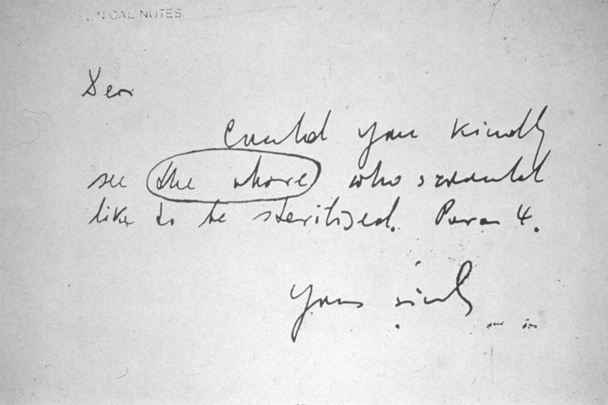
Illegible records
Notes:
Handwritten notes and letters carry risks all their own.
What do you think this slide says?
The above resulted in a complaint. The Dr later explained that the circled
writing says ‘the above’…

Slide 27
And what to do if something does happen…
Writing reports
GMC investigations

Slide 28
Writing reports
Introduce yourself
Chronological account of your involvement
Should be able to stand on its own
Avoid jargon
Include names of other staff
Use active voice ‘I did this’ (not ‘this was done’)
Notes/memory/description of usual events?

Slide 29
Insight and Remediation
Does the doctor appreciate what went wrong?
Has the doctor put things right?
Notes:
Insight and remediation are taken heavily into account by the GMC - not just at a panel hearing, but also at the earlier stages of a GMC investigation.
Demonstrating insight and remediation when something goes wrong is a really important part of good practice, even if there is no suggestion of a complaint to the GMC. We are all human and things will go wrong sometimes – but it is best to be really open when that does happen and be pro-active in discussing that with your trainer or colleagues to identify learning points for yourself, finding ways to make sure that the same thing doesn’t go wrong again. And if a complaint is made to the GMC, being able to show that you have adopted that sort of approach is likely to be helpful for your case. In general practice, we would advise you to make use of your significant event analysis structure, whenever something goes wrong and there are possible learning points, even if no harm has come to the patient or there has been no complaint.

Slide 30
Insight Improves Outcome
GMC study of the 147 cases heard at MPTS panels in 2013 that related to conduct and performance.
Insight shown - 5% erased
No insight shown – 59% erased
Notes:
To look at the impact of insight, the GMC studied all the cases heard by panels in 2013 in relation to conduct and performance.
These numbers are very striking and really emphasise the importance that the GMC place on demonstrations of insight, as shown by an apology for what happened and remediation work to put right whatever went wrong in a case.
Insight, apologies and remediation are important at panel hearings and can also be really influential earlier in the investigation process. In our first example, Doctor AA who looked back and believed she could have done better with a respiratory patient, it probably helped that the doctor offered an open, reflective response to the GMC, expressing insight into what had happened.

Slide 31
When something goes wrong….
Put it right if possible
Apologise, if appropriate
Reflection – discuss/read/learn. Don’t wait for appraisal.
Remediation
Co-operate with investigations
Co-operate with complaints procedure
Contact your defence organisation.

