Slide 1
Global Health in HEE in the EoE
What’s not to like?
Roger Tisi
APD, HEE
Spring Symposium 2016

Slide 2
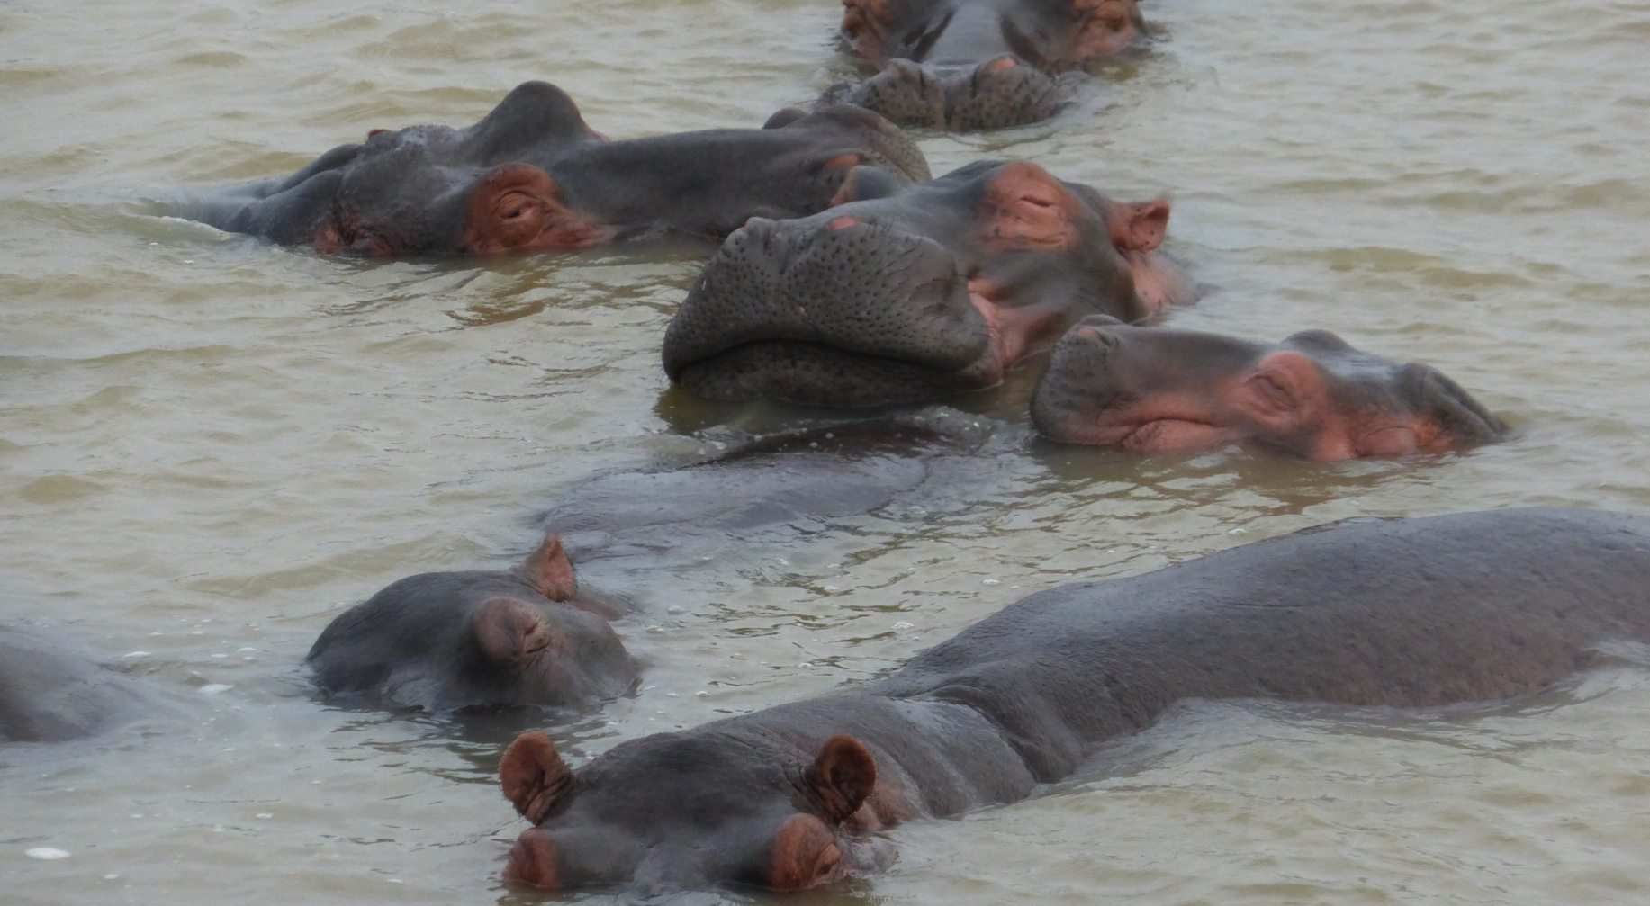
Happy as a pig in mud…

Slide 3
What does HEE do?
Send GPSTs for the time of their life
Work with our partner charity Africa Health Placements
Place our GPSTs where they are needed
An awful lot of good (to them and the communities)

Slide 4
How does it work?
A year OOP between ST2 and ST3
Open to anyone that is eligible to work in SA
OOP for the whole year
Magically produces a four year programme

Slide 5
What’s new
Now part of a national programme
Application at entry into GPST training
Interview in addition to the SAC
Supported education throughout the 4 years

Slide 6
How do trainees qualify?
You have to be a GPST in HEEoE
You have to be able to meet the visa requirements of the SA Government and the registration requirements of the HPCSA
You have to have “satisfactory progress” outcomes in your ST1 and ST2 ARCPs
You have to have the support of your TPD and Educational Supervisor

Slide 7
Why they might not…
LTFT not an option in SA
If qualified outside of the UK
If not making expected educational progress
If they demonstrate at interview an inability to cope with uncertainty and frustration

Slide 8
What do we plan to do?
Provide suitable hospital posts in ST1 and 2
Maintain a dedicated Educational Supervisor throughout the 4 years
Help prepare before and after the year OOP
Trouble shoot any problems whilst away
Ensure have an ST3 post to return to

Slide 9
What do we plan to do?
Fund the Diploma in Tropical Medicine
Develop an educator network and resources
Develop a network of alumni
Spread the love

Slide 10
The e-portfolio
We would hate them to miss it but…
We don’t insist on WPBAs
We do like trainees to use it to keep in touch
Remember, they are OOP…

Slide 11
Employment implications
You do not lose your NTN
It does not affect your duration of service (but does not add to it)
http://bma.org.uk/developing-your-career/specialty-training/out-of-programme

Slide 12
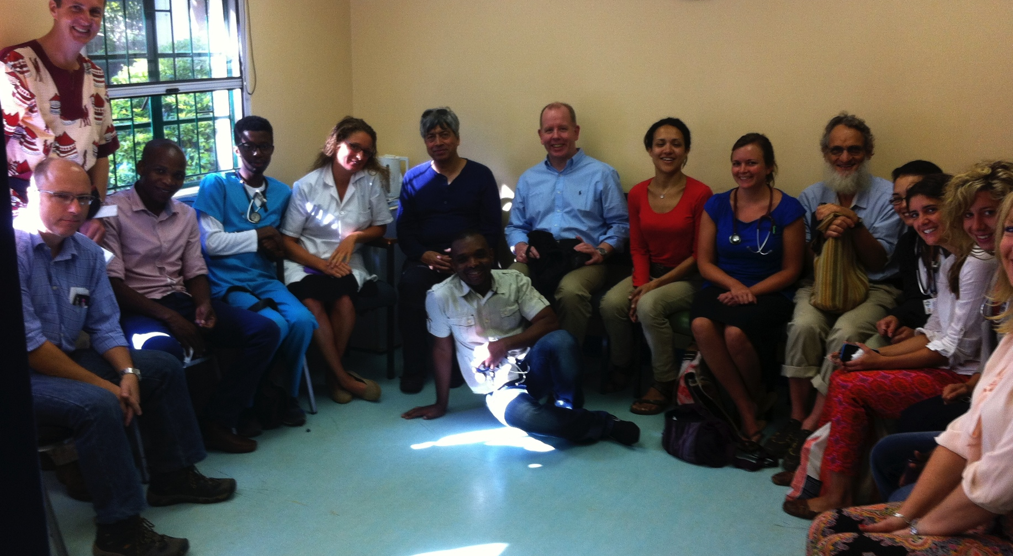

What’s it like?

Slide 13
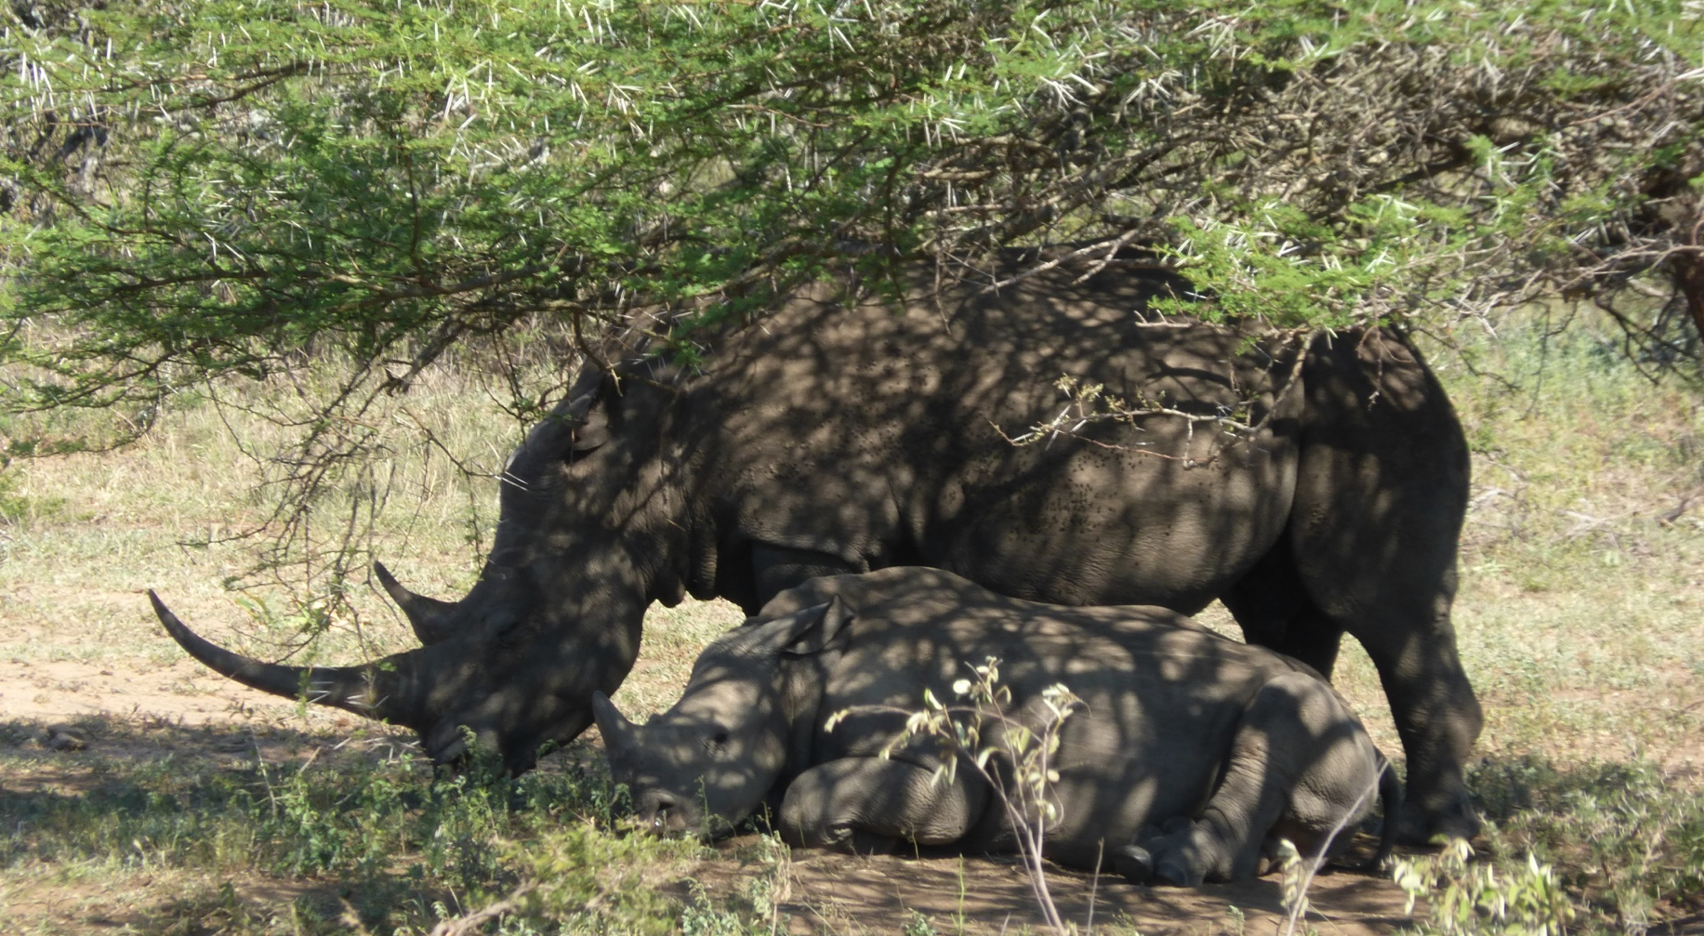
A short film …
Notes:
Show the AHP video at this point

Slide 14
Over to Geeta…

Slide 15
The future
Global Health Fellowships
Joint working with other LETBs
Stimulating recruitment
Developing the concept of Global Health

Slide 16
What might this mean for trainees?
Kudos
Funding
Educational and pastoral support
A chance to develop a career in Global Health
Leadership experience (in several arenas)

Slide 17
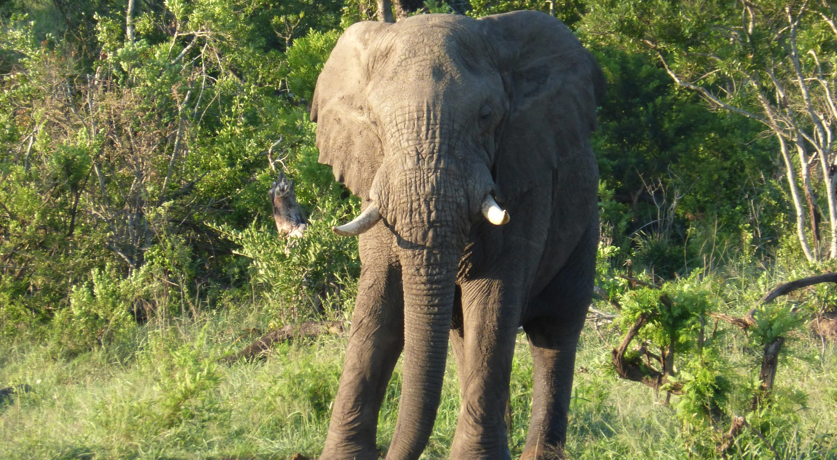
The elephant in the room?

Slide 18
Problems?
Disruption to training and employment?
Visas and registration
Homesickness and culture shock
Illness and accident
Responsibility (or lack of it)
Does not count towards your CCT

Slide 19
Problems?
Uni-professional
Ability of AHP to cope
Can we spot suitable candidates at recruitment?
Can we resource this locally?
When it goes belly up…

Slide 20
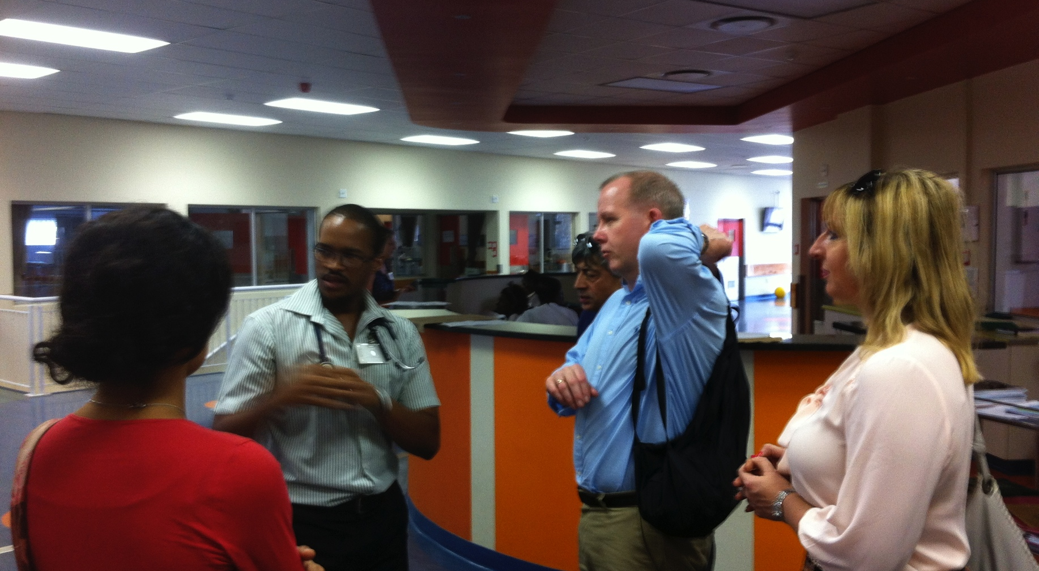
But, if Roger and Hilary can hack it…

Slide 21
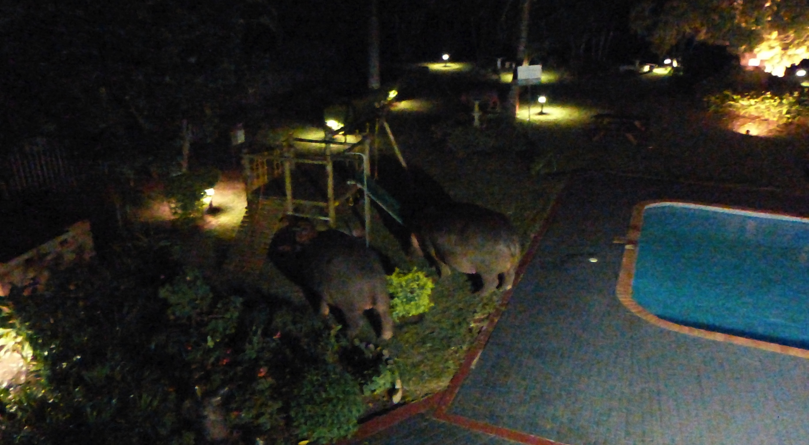
…and cope with hippos in the hotel pool…

Slide 22
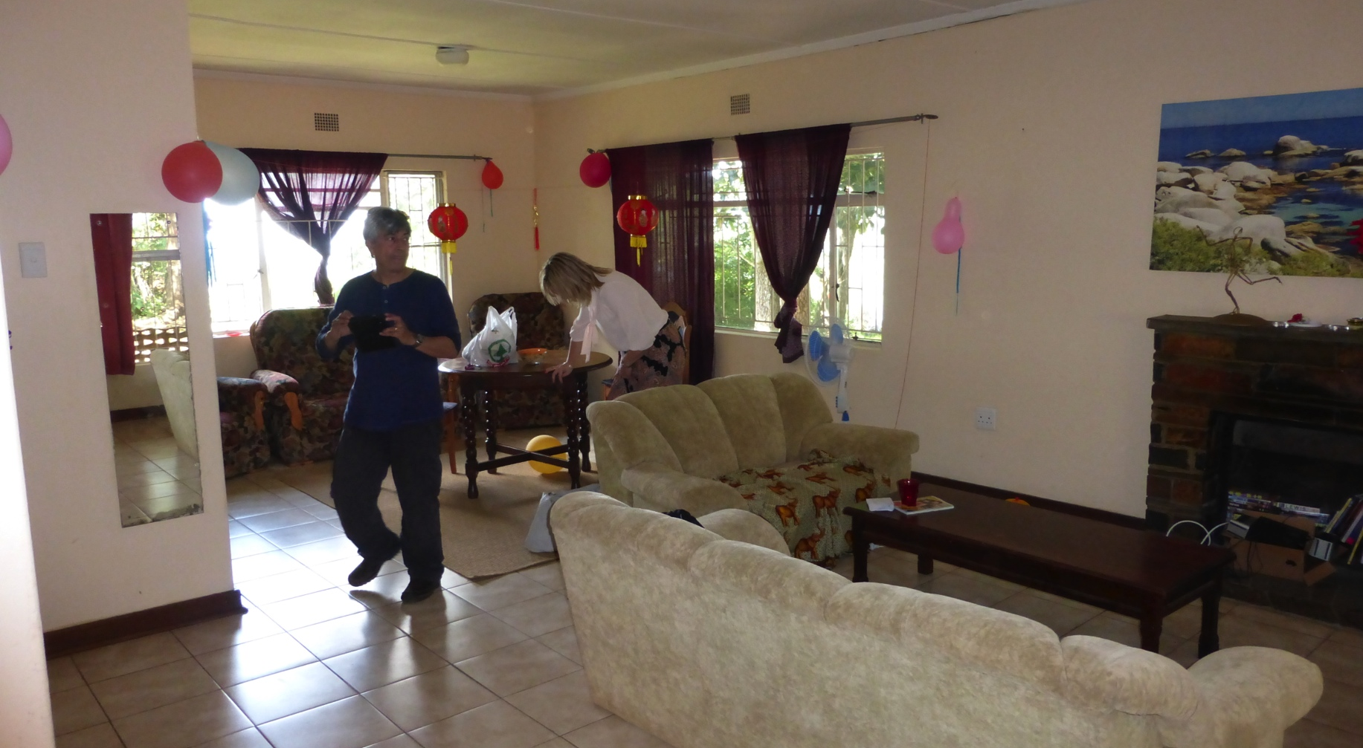
…and you get to live somewhere half decent…

Slide 23
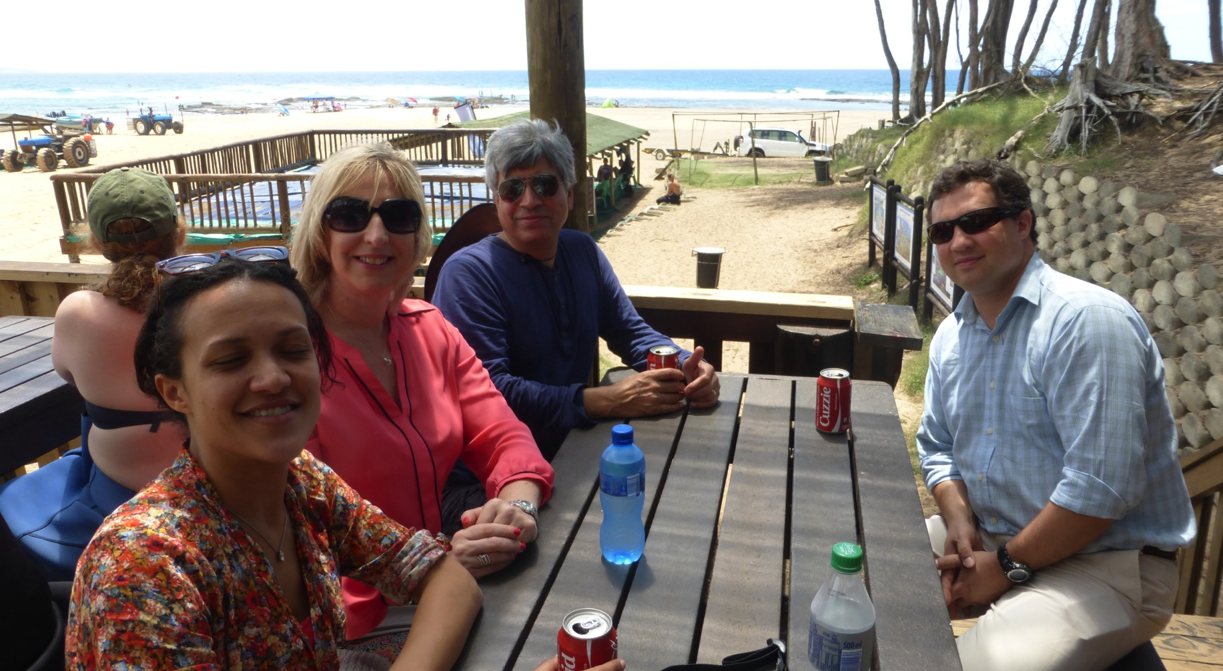
…and get enough time and money to make the most of it…

Slide 24
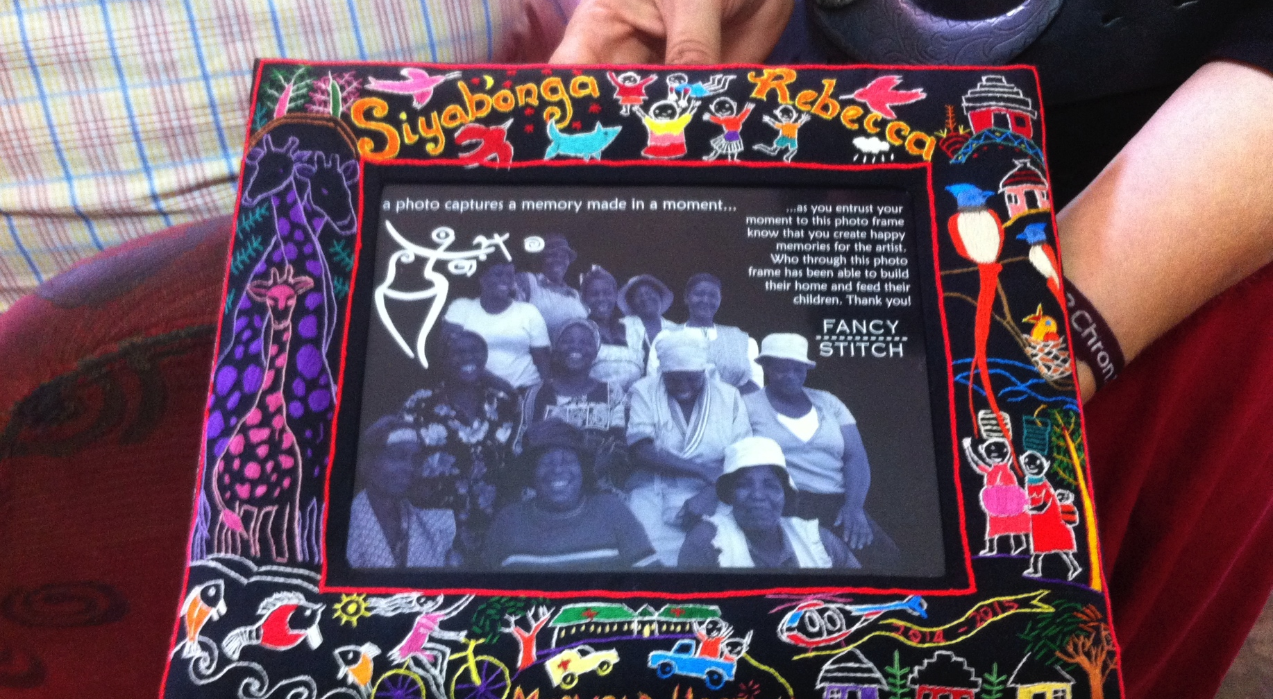
…what’s not to like?

Slide 25
What can I do today?
Listen to us talking
Talk to us at break time
E-mail Roger at rtisi@nhs.net or Hilary hilaryfoster@nhs.net
Talk to our “graduates”
Talk to your TPD
Become part of our network

