Slide 1
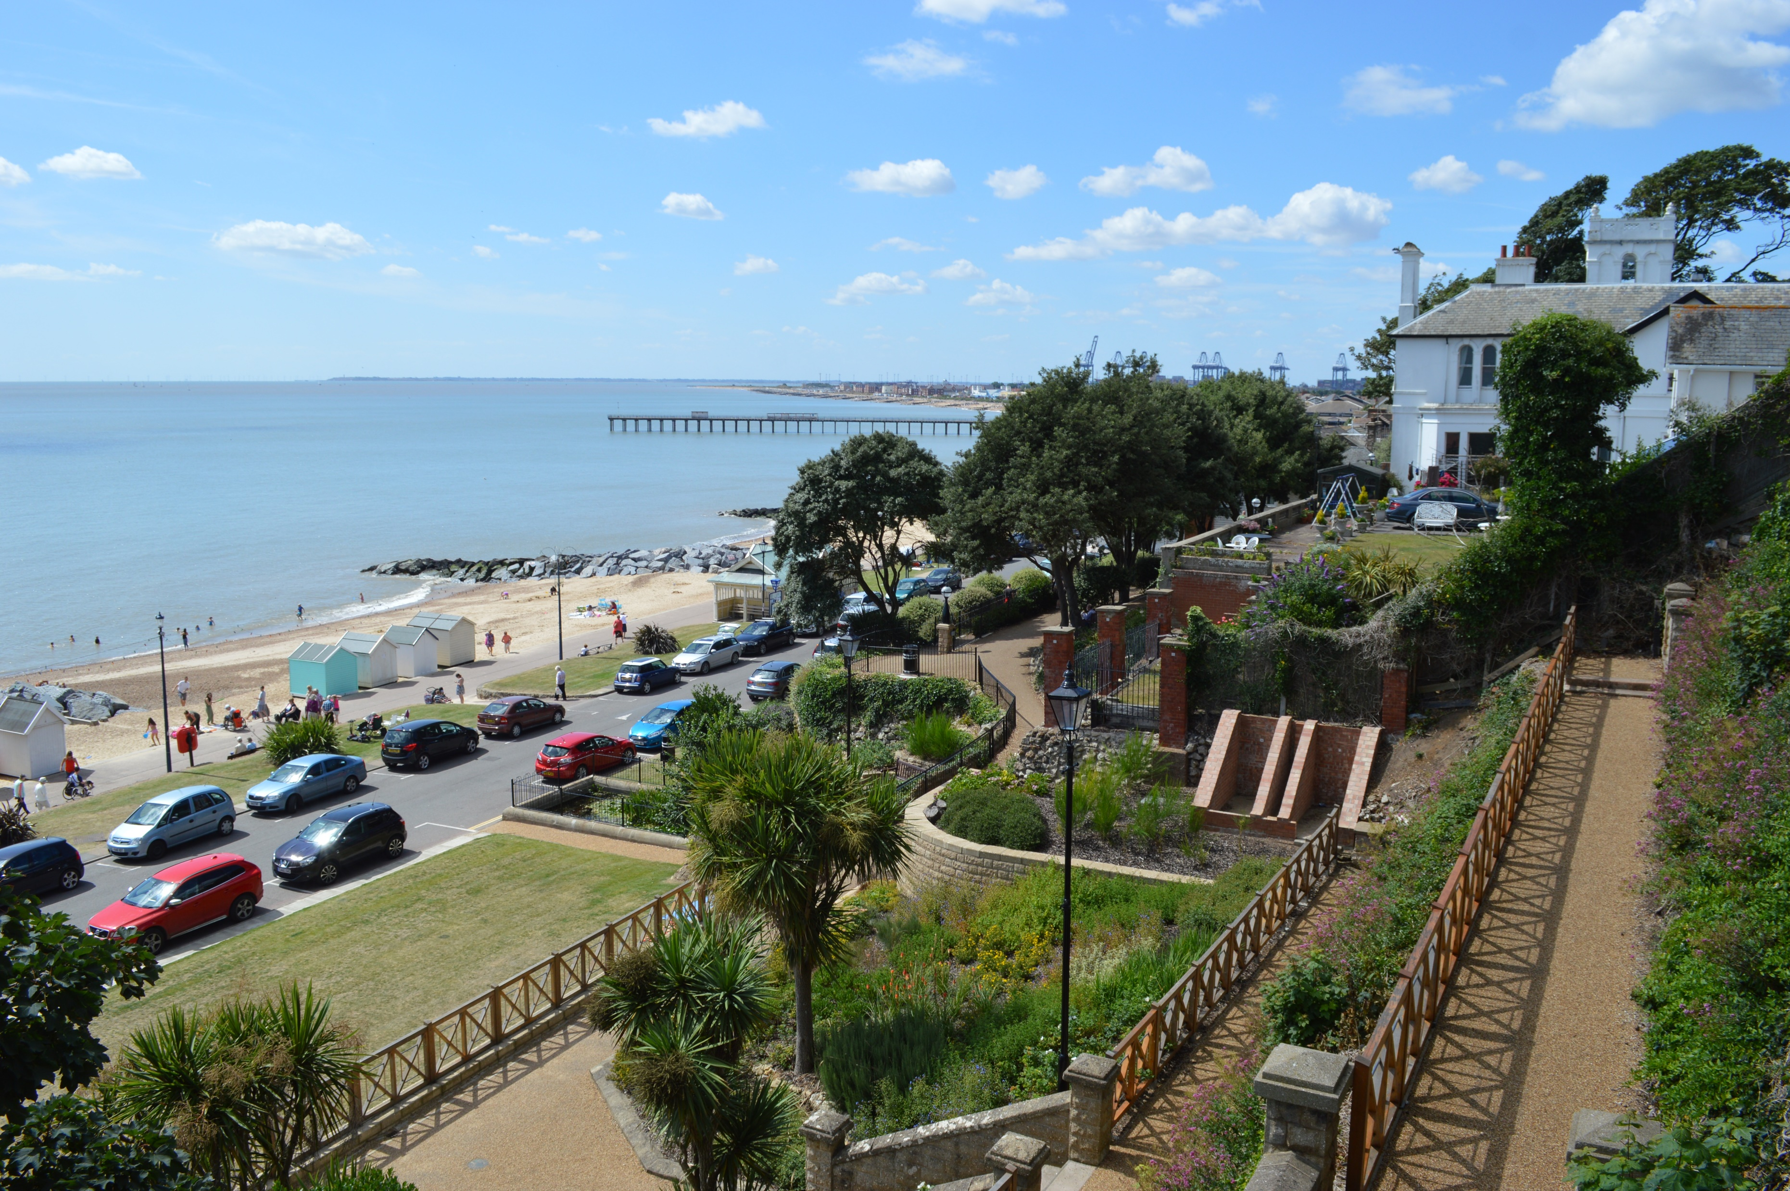
Celebration Day
Trailblazer Deprivation Fellowship 2022/3
East of England
Kayleigh Weedon

Slide 2
Trailblazer Fellowship 2022/23

Slide 3
Deep End EoE SNEE Champion
Trailblazer Fellowship 2022/23

Slide 4
Deep End EoE SNEE Champion
Trailblazer Fellowship 2022/23
Deep End EoE Website

Slide 5
Deep End EoE SNEE Champion
Trailblazer Fellowship 2022/23
Deep End EoE Website
GPVTS teaching

Slide 6
Deep End EoE SNEE Champion
Trailblazer Fellowship 2022/23
Deep End EoE Website
GPVTS teaching
Prison Medicine

Slide 7
Deep End EoE SNEE Champion
Trailblazer Fellowship 2022/23
Deep End EoE Website
HEFT Talk
GPVTS teaching
Prison Medicine

Slide 8
Deep End EoE SNEE Champion
Trailblazer Fellowship 2022/23
Deep End EoE Website
HEFT Talk
GPVTS teaching
Prison Medicine
Suffolk HOP (Health Outreach)

Slide 9
Deep End EoE SNEE Champion
Trailblazer Fellowship 2022/23
Deep End EoE Website
HEFT Talk
GPVTS teaching
Domestic Violence Speaker
Prison Medicine
Suffolk HOP (Health Outreach)

Slide 10
Educational Roles
UEA
GP Trainer
Research Role (Principle Investigator)
Deep End EoE Champion
Trailblazer Fellowship 2022/23
Deep End EoE Website
HEFT Talk
GPVTS teaching
Domestic Violence Speaker
Prison Medicine
Suffolk HOP (Health Outreach)

Slide 11
Coastal Medicine
Educational Roles
UEA
GP Trainer
Research Role (Principle Investigator)
Deep End EoE SNEE Champion
Trailblazer Fellowship 2022/23
Deep End EoE Website
HEFT Talk
GPVTS teaching
Domestic Violence Speaker
Prison Medicine
Suffolk HOP (Health Outreach)

Slide 14
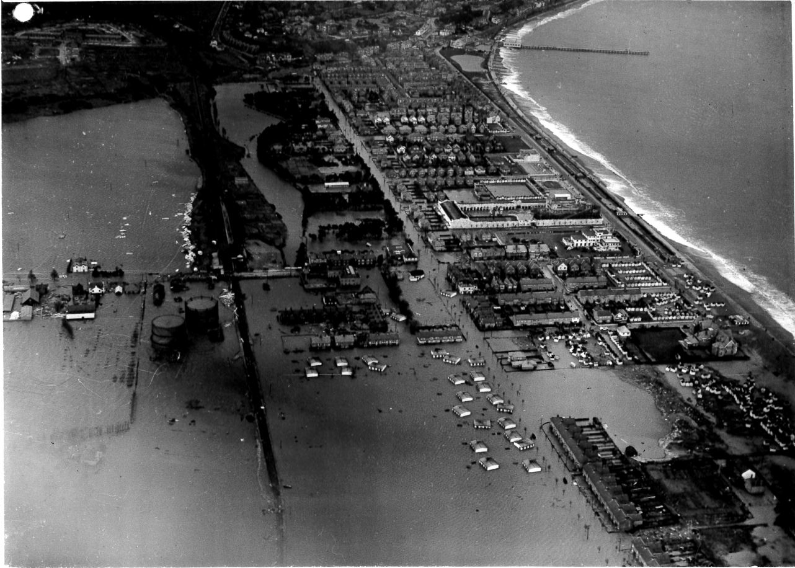

Slide 15
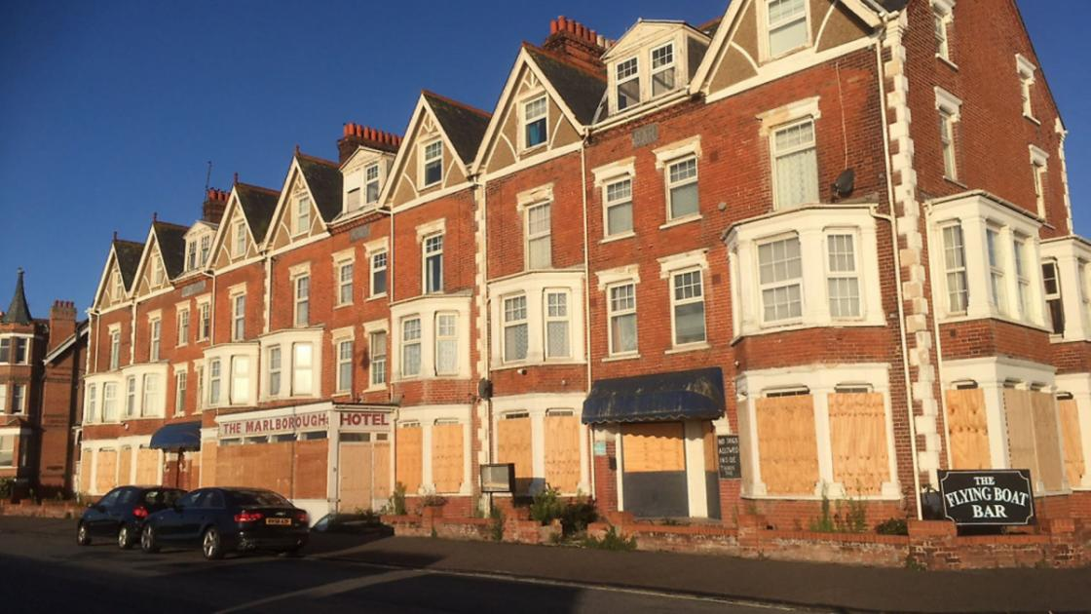

Slide 16
Coastal Medicine
Educational Roles
UEA
GP Trainer
Research Role (Principle Investigator)
Deep End EoE SNEE Champion
Dublin Conference
Trailblazer Fellowship 2022/23
Deep End EoE Website
HEFT Talk
GPVTS teaching
Domestic Violence Speaker
Prison Medicine
Suffolk HOP (Health Outreach)

Slide 17
Coastal Medicine
Educational Roles
UEA
GP Trainer
Research Role (Principle Investigator)
Deep End EoE SNEE Champion
Dublin Conference
Trailblazer Fellowship 2022/23
Deep End EoE Website
Support Network
HEFT Talk
GPVTS teaching
Domestic Violence Speaker
Prison Medicine
Suffolk HOP (Health Outreach)

Slide 18
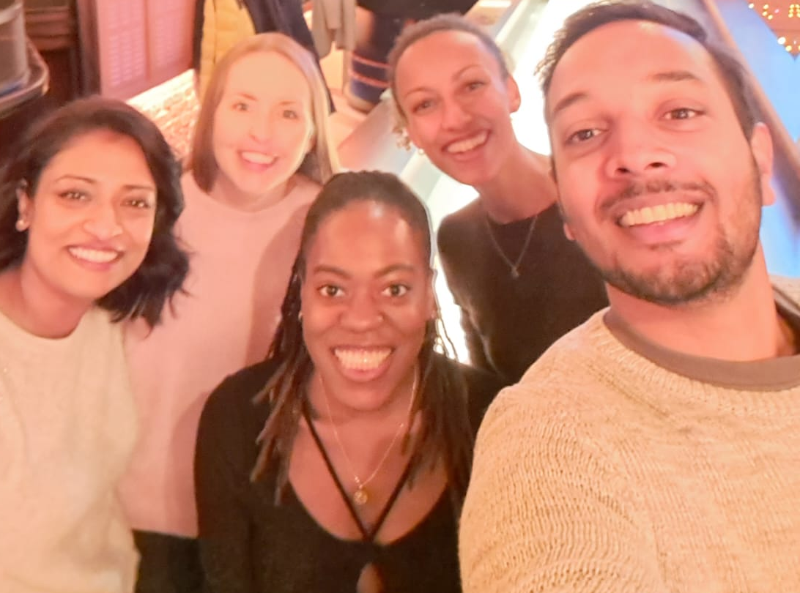
Coastal Medicine
Educational Roles
UEA
GP Trainer
Research Role (Principle Investigator)
Deep End EoE SNEE Champion
E-learning
ALS
Dublin Conference
Trailblazer Fellowship 2022/23
Deep End EoE Website
Support Network
Wellbeing
HEFT Talk
Coaching
Fairhealth Learning
GPVTS teaching
Domestic Violence Speaker
Prison Medicine
Suffolk HOP (Health Outreach)

Slide 19
THANK YOU!

