Slide 1
Unconscious Patient
Mark Tehan MBBS, FRCEM, FIMC
Consultant in Emergency Medicine and Pre-Hospital Emergency Medicine
Broomfield Hospital, Magpas Air Ambulance

Slide 2
Overview
Common EM presentation
Common AM, Anaes & ICM referral
Core part of ACCS syllabus
FRCEM, FRCA & MRCP

Slide 3
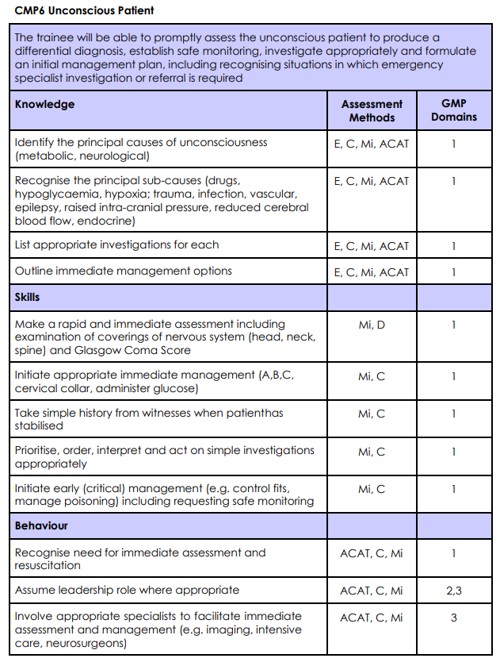
Objectives

Slide 4
Diagnostic
A – E
Airway
Breathing
Circulation
Disability
Exposure

Slide 5
Management
A – E
Airway with C-Spine Protection
Breathing
Circulation
Disability
Exposure

Slide 6
Differential
Drugs
Hypoglycaemia
Hypoxia
Trauma
Infection
Vascular
Epilepsy
Raised ICP
Cerebral Blood Flow
Endocrine

Slide 7
Drugs
Are bad!
Sedatives
Opiates
Dissociatives
Anticholinergics
Think beyond the toxidrome
Serotonin Syndrome
Poisonous Alcohols

Slide 8
Hypoglycaemia
Drugs
Seizures
Sepsis
Liver Failure
Addisons

Slide 9
Hypoxia

Slide 10
Trauma
Traumatic brain injury
Brain Impact (IBA / ‘concussion’ / etc.)
Diffuse Axonal Injury
Subarachnoid Haemorrhage
Subdural haematoma
Extradural haematoma
Cerebral hypoperfusion

Slide 11
Infection
Neurosepsis
Sepsis in the elderly

Slide 12
Vascular / Cerebral Blood Flow
CVA
SAH
Hypotension
The Aorta Will #@&$! You Up

Slide 13
Epilepsy
Generalised seizures
Motor (tonic-clonic)
Non-Motor (absence / non-convulsive seizures)
Post-ictal state

Slide 14
Raised ICP
Space occupying lesion
Hydrocephalus
Trauma
Vascular

Slide 15
Endocrine
Diabetes
Hypoglycaemia
DKA
Myxoedema Coma
Thyroid Storm
Adrenal Crisis

Slide 16
Summary
Standard approach to diagnosis
Standard approach to management
Run in parallel
Drugs
Hypoglycaemia
Hypoxia
Trauma
Infection
Vascular / Cerebral Blood Flow
Epilepsy
Raised ICP
Endocrine

