Slide 1


HEE EOE Foundation open day - 2018
Dr Wilf Kelsall
Neonatal Consultant and PEC
HEE EoE Head of School of Paediatrics
HEE EoE Associate Dean for Academic Training
HEE EOE Associate Dean for Global Health

Slide 2
Foundation open day - 2018
Welcome
I unashamedly want to encourage you to apply for paediatric training in EoE
I am very proud of the training that we deliver in the 17 units across EoE for our 280+ trainees
There are great role models for you
Trainees Consultants Nurses
You will be encouraged to achieve your full potential we want you to succeed !

Slide 3
Foundation open day - 2018
I expect all of you will be paediatric consultants applying for posts from March 2026 – 6m pre CCT
We will provide great training which I hope you will enjoy
Offer general and speciality paediatric training
Support you every step of the way
Clinically Professionally Personally

Slide 4
Paediatric training - reputation
The reputation of our programme is strong so why bother ?
Surely paediatrics is popular ?
Need to increase 1st applications to EoE currently 25 pa
<1 1st choice applicants per post in EoE
Engagement with foundation trainees and students CU / UEA
Paediatrics is challenging but v v rewarding
Paediatrics has had a bad press – HBG
Trainees in paediatrics are well supported
@NHS_HealthEdEng

Slide 5
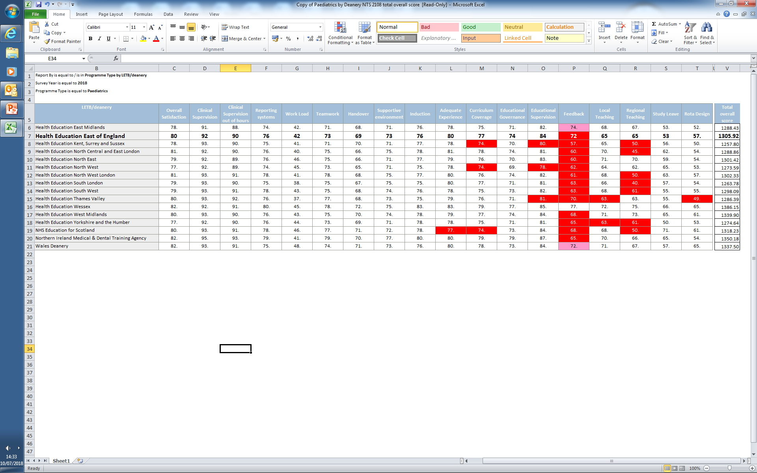
National comparison – EoE ranks 6th in UK

Slide 6
Foundation open day - 2018
We have very supportive TPDs
  Angela D’Amore (L1) and Andrea Turner (L2/3)
  Anne Ingram LTFT lead
  6 additional TPDs currently being appointed to lead on:
  simulation regional training trainee support
  curriculum delivery x 2 faculty development
We will treat you as individuals not as an NTN
  All of us are happy to be contacted as needed
Excellent Administrator Claire Carse

Slide 7
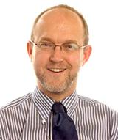
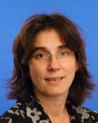
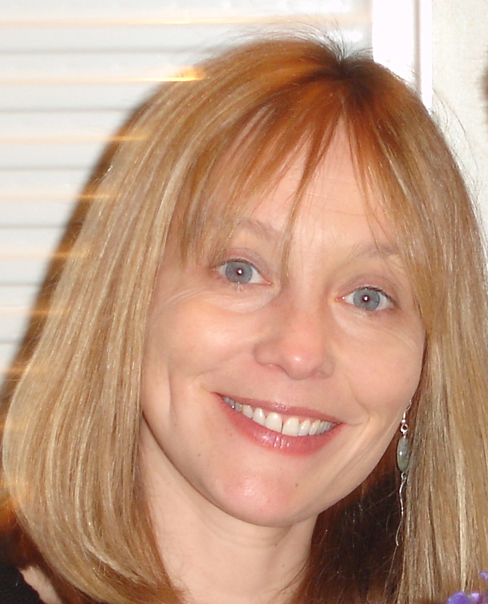
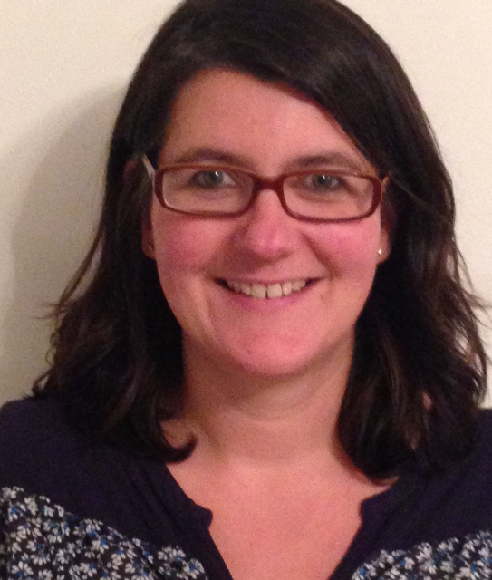
School of Paediatrics – current TPDs
Wilf Kelsall
Head of School
Angela D’Amore
ST1-3 TPD
Andrea Turner
ST4-8 TPD
Anne Ingram
LTFT Advisor
@NHS_HealthEdEng

Slide 8
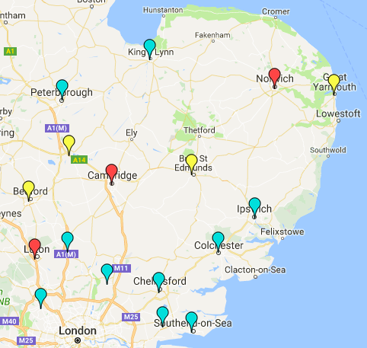
East of England Training Units
17 Trusts
2 Teaching Hospitals
Cambridge
Norwich
15 DGHs
Neonatal Units
3 Level 3
10 Level 2
4 Level 1

Slide 9
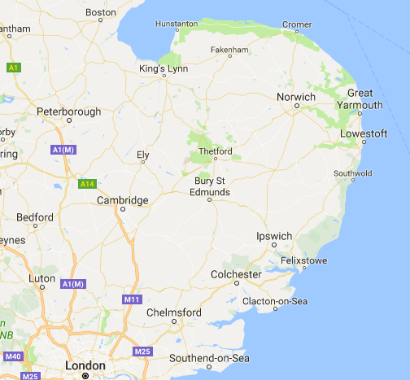
ST1 posts
35 posts
Mostly DGH-based

Slide 10
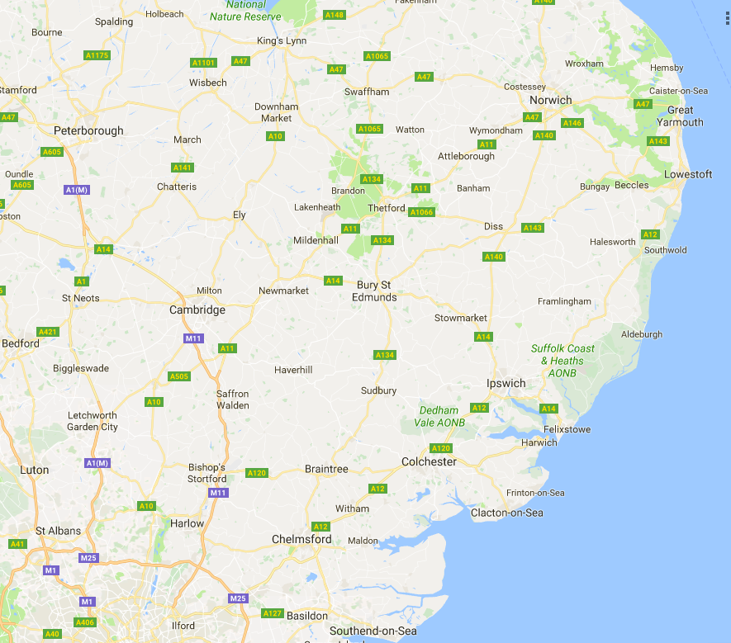
ST1-3 rotations
Basildon /Southend / Watford / Luton / Cambridge
Watford/Luton /Harlow/ Stevenage/ Cambridge
JPH / Colchester / Ipswich / Norwich / Cambridge
King’s Lynn / Peterborough / Norwich
Peterborough / Hinch / Bedford/ Cambridge / Stevenage / WSH

Slide 11
Paediatric Training structure
MRCPCH
Exam
ST1-3
ST4-5
ST6-8
Level 1 Competencies
MRCPCH Exam
Minimum 24mths
Level 2 Competencies
Includes –
6m community
6m neonates (L2/3)
2yrs in same DGH or
ST3/4 in same DGH
May include L3 NICU
Minimum 12m Level 2

Slide 12
Foundation open day - 2018
Satisfactory outcomes do require:
  Progress with exams, take as early as possible
  Engagement with training, portfolio and completion SLEs
  Linking with the RCPCH “PROGRESS” curriculum
  Achieving clinical competencies
  Completion GMC trainees survey
  Attendance at study days
DO NOT panic
We will support you every step of the way – flexibility is key
We want you to succeed

Slide 13
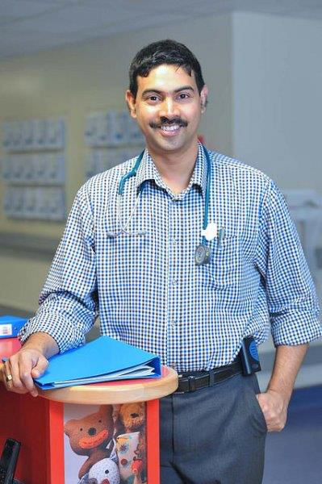
MRCPCH Exam courses
Annual written exam course AKIP
Exam communication skills
Mock exam before every sitting of clinical
Most courses are free or subsidised -£50

Slide 14
Exams at ST3/4 transition

Slide 15
Other requirements in L1 training
Accredited neonatal and paediatric life support training
  NLS
  APLS / EPLS or equivalent
Level 1 and level 2 intercollegiate safeguarding competences

Slide 16
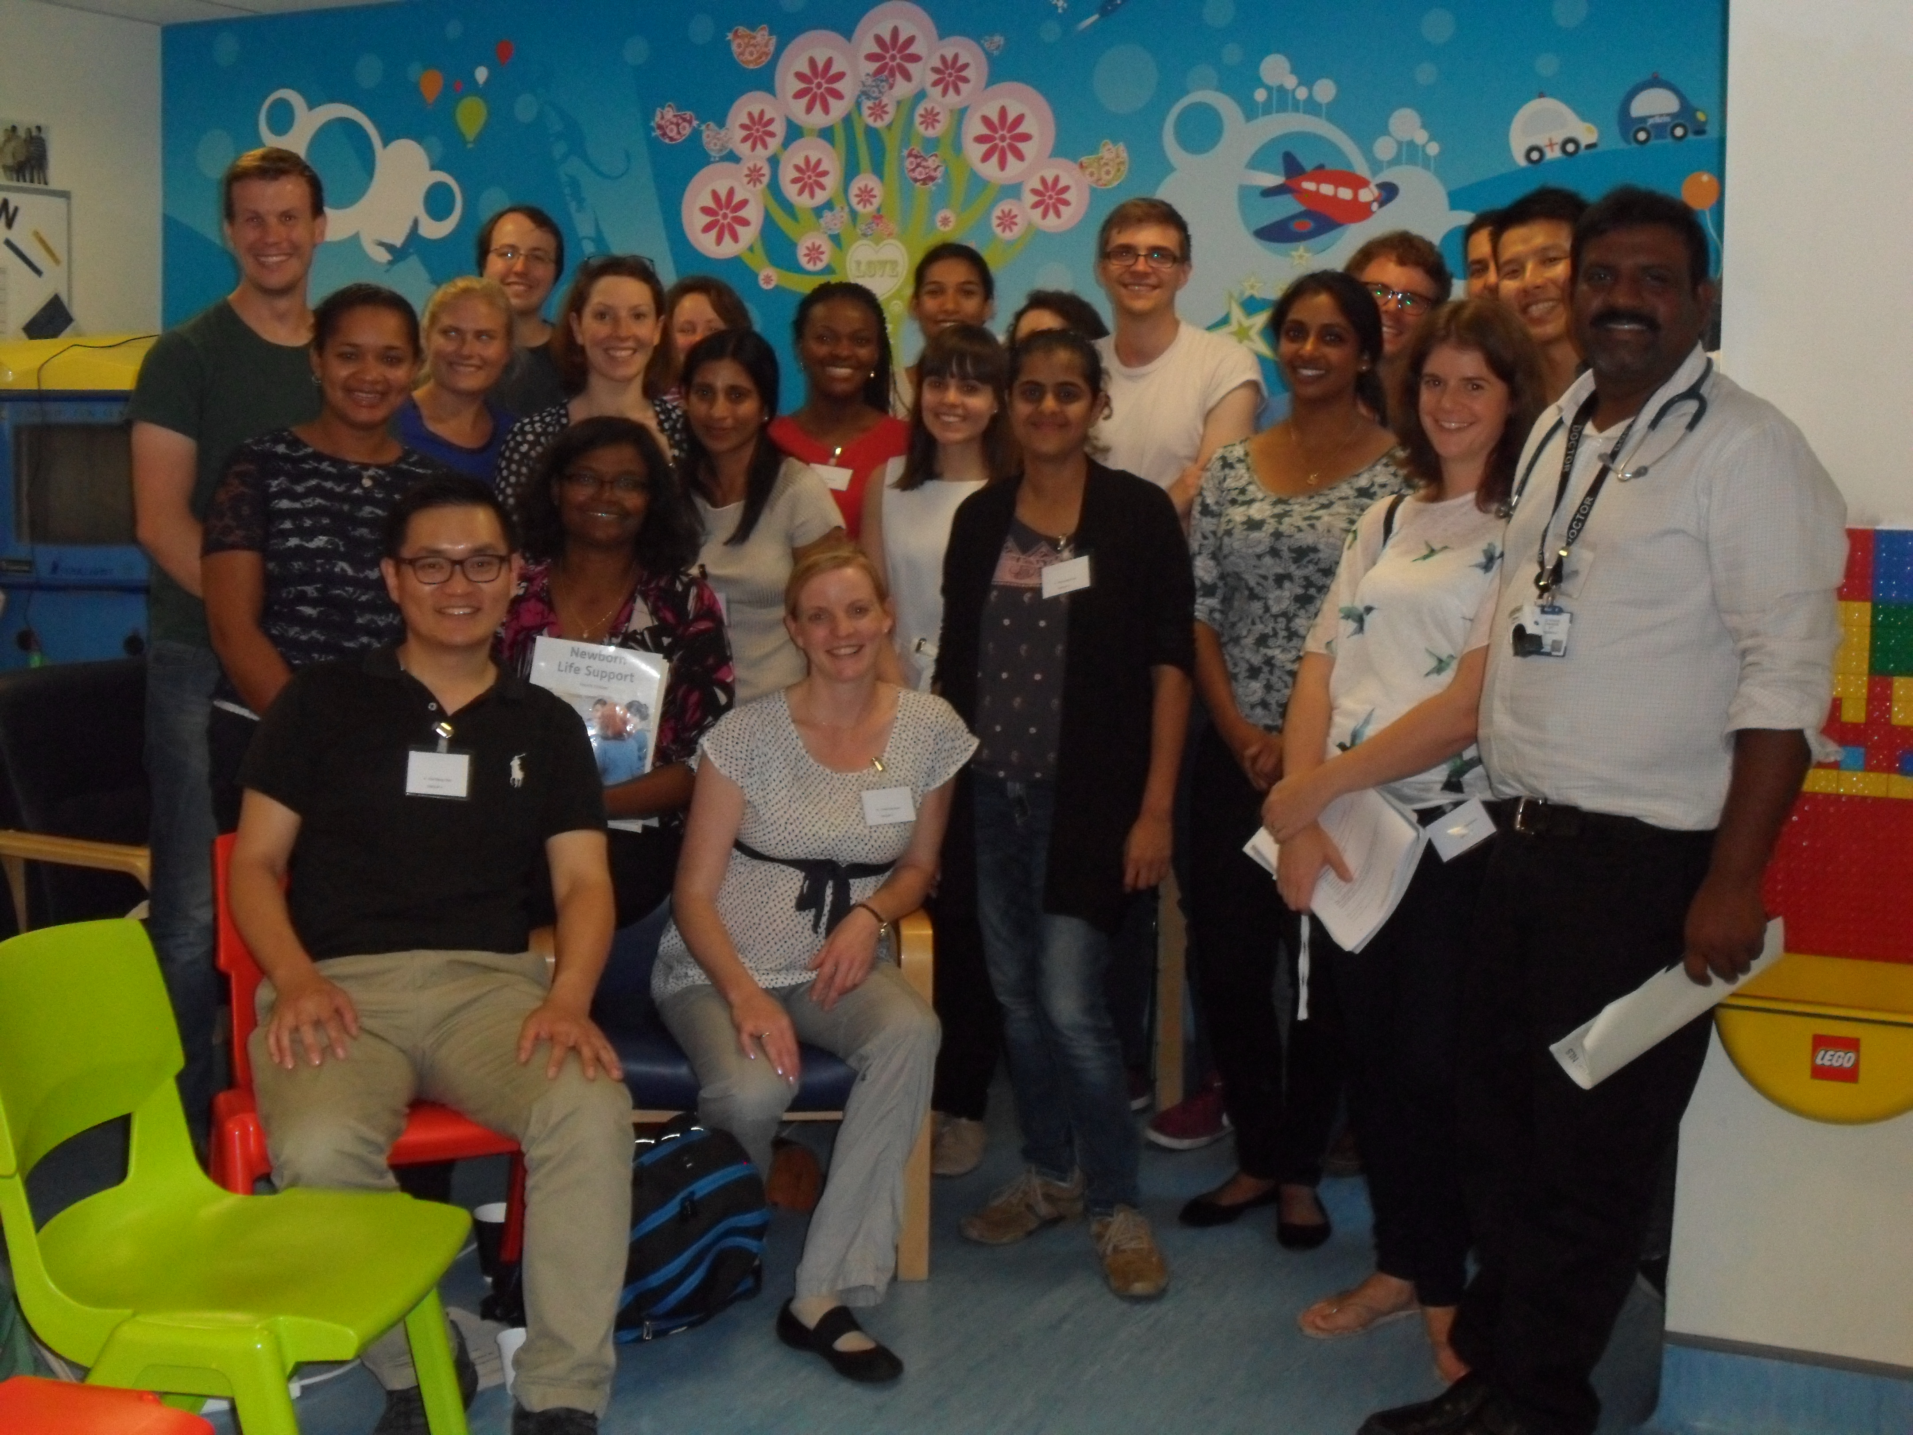
EoE NLS Course
NLS course for ST1 trainees
Spaces also offered to trainees higher in programme
Non-threatening & fun
Subsidised - £50!

Slide 17

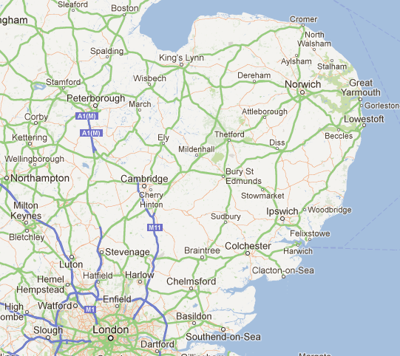
ST4-8 DGH posts
Position by Sept 18
  63 paeds / L2 neonates
  16 core community

Slide 18
Grid Posts
Level 3 training
National competition
Oncology
Neonates
Respiratory
PICU
Emergency Medicine
Neuro-disability
Diabetes
&
Endocrine
Rheumat- ology
Allergy
Gastro-enterology
Community
Child Health
Neurology

Slide 19
Grid trainees
19 grid trainees (5 currently OOP)
Of 68 ST6-8 trainees –
14 grid trainees
45 SPIN

Slide 20
EoE NTN-Grid posts filled

Slide 21
SPIN Rotations
Allergy
Cardiology
Diabetes
Epilepsy
Gastroenterology
High Dependency
Neonatology
Neurodisability
Oncology
Palliative Medicine
Respiratory
Safeguarding
Young People’s Health
General paediatrician with an interest
Can accommodate most trainees
Appointed by interview end year 5
RCPCH SPIN modules

Slide 22
ST6-8 Specialty Posts
L3 NICU – 26 posts
Luton – 7
Norwich – 6
Cambridge – 13
Higher community
13 posts
Paediatric specialties
25 posts
Many DGHs also offer good
special interest training

Slide 23
Trainees in SPIN programmes
45 of 64 ST6-8
trainees are in SPIN
programmes

Slide 24
Time Out of Programme (OOP)
OOP currently under HEE review
    Requires 6month notice
    More “restrictive” - we try to be supportive but consistent
OOPT – approved clinical training
  Guaranteed training, counts, in areas not available in EoE
    Cardiology, Renal
    Overseas on an individual basis
    OOPE – experience
  Clinical experience not counting towards CCT
    Overseas humanitarian work GHF and RCPCH VSO
    Support individual needs for grid applications
@NHS_HealthEdEng

Slide 25
Time Out of Programme (OOP)
OOPR – research
  For recognised research –PhD
  Up to 4 years, with some limited clinical components
OOPC – career break
  Step out of training programme for an agreed period of time
    Domestic responsibilities
    Work in industry
    Developing talents in other areas
    Entrepreneurism
@NHS_HealthEdEng

Slide 26
Successes: Academic training
Seamless programme in EoE
  AFY → ACF (NIHR + Local)→ ACL
Highly attractive but very competitive @ 10 applicants per post
Level 1 trainees you can apply for ACF posts
Posts in Cambridge and Norwich
We do support trainees undertaking research with funding for a PhD - OOPR
Paediatric Research Group

Slide 27
Successes: Trainee engagement
Outstanding trainees often contributing in their own time
Organisations of level 1 and level 2/3 training days
On-going development of Website and use of social media
Delivery of foundation and recruitment events and video
Development of mentoring and trainee support leading HEE EoE
Development of “return to training (RTT) programme”
Organisation of simulation – 2 further successful fellow appointments
School and Deanery QPR visits
School of Paediatrics Day 10th year 8th Feb 2019
Annual PAFTAs and Ceilidh

Slide 28
Paediatric training innovations
Global Health Fellows (CO)
Mentoring Fellows (CM)
Simulation Fellows (EB and MS)
Education “qualifications” IFME - UEA and Cambridge
  Development of year 4/5 student supervisors
Continued development of training opportunities
  Increased GRID and SPIN training opportunities

Slide 29
Successes: Training programme
New grid posts established – Paediatric Mental Health
Level 1 Cardiology posts established in GOS
Level 3 Child mental health – child psychiatry placements established
Global Health fellowships at ST3/ST4 started Sept 2018
Mentoring and simulation fellows established
Educational roles recognised as part of student supervision Sept 2018
New administrator Claire Carse in post and staying !!!!
New trainee representative for EoE at RCPCH – Claire Mathew

Slide 30
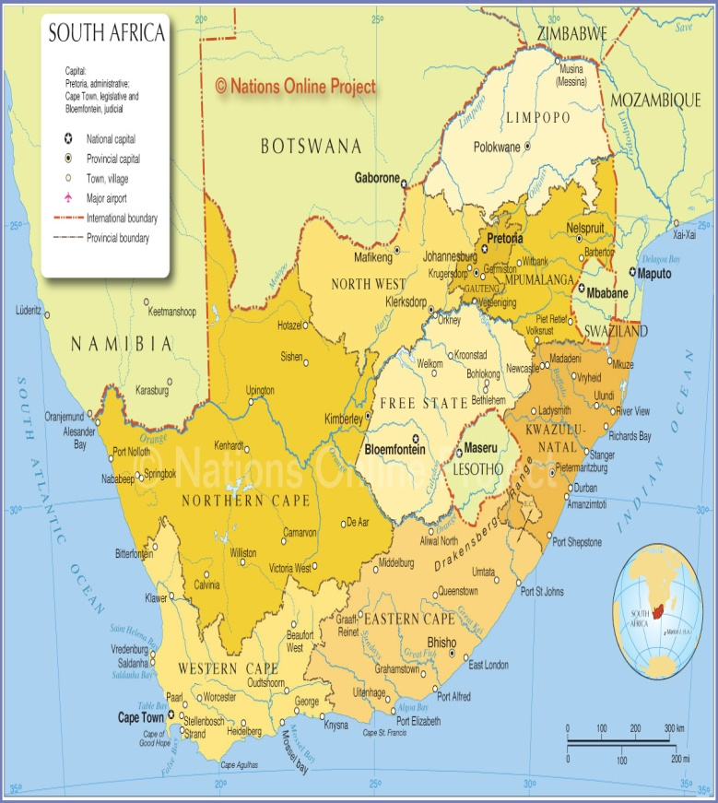
Global Health Fellowships
Kwazulu Natal and Eastern Cape
Global Health Exchange
African Health Placements
HEE EoE
Separate to RCPCH initiatives
Well established national programme initially for GPs and now ACCS
12m placements in rural hospitals
Paid 650K Rand @ £35-40k
Administration fee £5000
Apply 12m in advance
Offer UK training prior to departure
Offer local training on arrival
HIV & clinical skills in anaesthetics and obstetrics (LSCS)

Slide 31
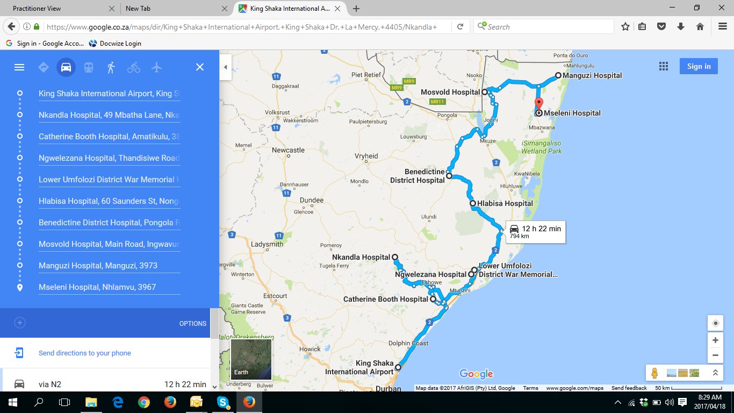
Global Health Fellowships
Kwazulu Natal and Eastern Cape
Rural hospital typically 150-300 beds
Inspirational Senior staff on call
Typically 15 doctors working mainly FY3 equivalent
2 doctors on call – 6 nights per month
  1 for “ER” room
  1 for wards
Cover everything!!
Adults, obstetrics and paediatrics

Slide 32
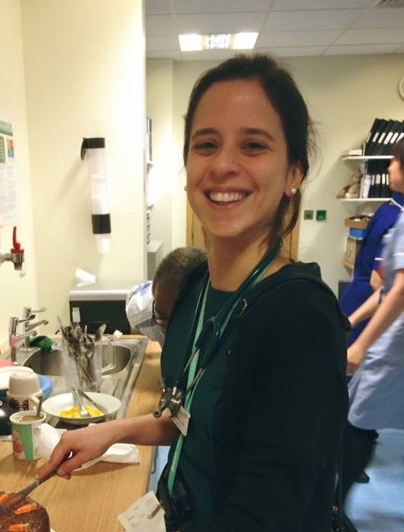
EoE Paediatric Global Health
Fellowships
In partnership with Africa Health Placements (http://ahp.org.za/)
1yr out of programme clinical posts, based in rural community hospitals in South Africa.
Apply locally in EOE after recruitment
  Paediatrics at the end of ST1/2 - OOPE
  Satisfactory progress during ST1 and success with MRCPCH examinations
  Opportunity to contribute towards improving the medical care internationally
  Develop Global Health Interest

Slide 33

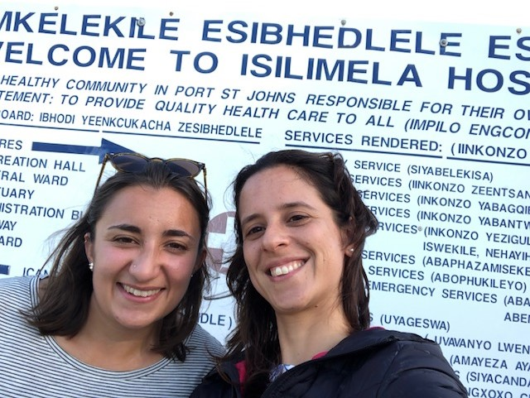
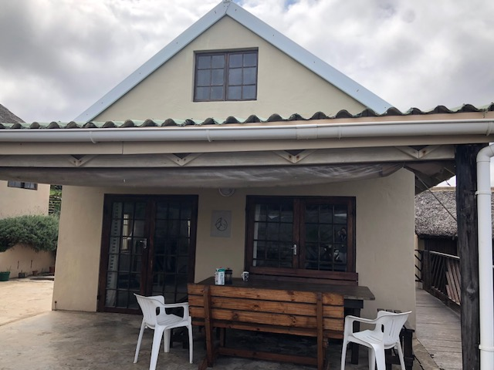

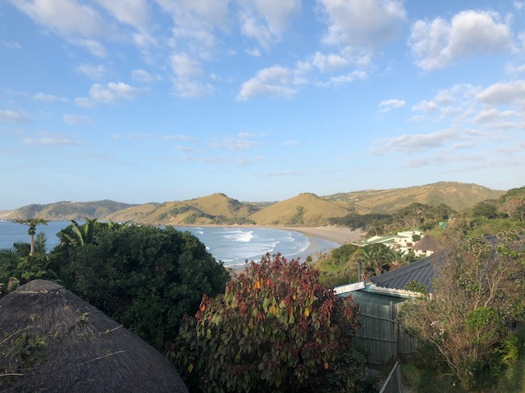
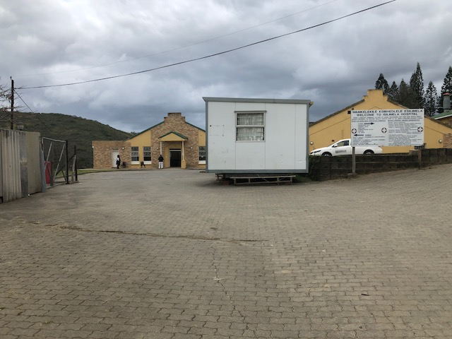
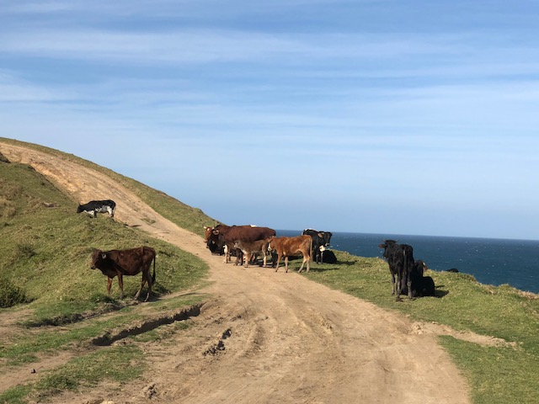
EoE Paediatric Global Health
Fellowships
Hot off the press from Catarina in Isilemela

Slide 34
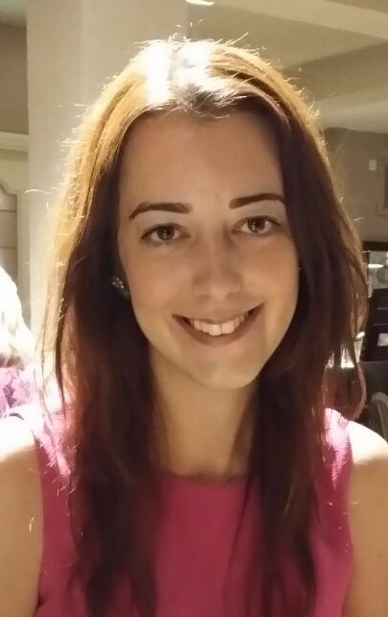
RCPCH Global Links Programme
6-12 month clinical and placements in hospitals across Kenya, Uganda, Myanmar and Sierra Leone.
Post-membership trainees
Interest in teaching, training and mentoring local healthcare staff
Life changing
  Sophie involved in Myanmar on-going Neonatal projects led from CUHFT

Slide 35

Thank you
Questions?
Dr Wilf Kelsall email wilf.kelsall@nhs.net

