Slide 1
DNACPR Decisions
Dr Jim Crawfurd
EM Consultant and Resus Committee Chair
ACCS Regional Training Day
13th Jan 2016

Slide 2
How important is DNACPR?

Slide 3
Why?
Why is it so important to some patients and familes?
Why is it actually not very important at all?

Slide 4
DGH Annual Figures (Approx)
60,000 admissions per year (plus OPA and A&E)
1,500 deaths (ie cardiac arrests)
100 attempted resuscitations
20 successful resuscitations
6 DNACPR related complaints

Slide 5
Issues raised in Complaints
Patient challenging decision
Patient upset at finding form on discharge
Family upset at finding form on discharge (several)
Family upset at finding about decision at/ after death (several)
Family upset at not being involved and questioning whether patient had capacity (several)
Family felt discussion had distressed patient
Patient found discussion distressing
Another patient felt uncomfortable hearing it being discussed with patient in next bed
Family upset that patient with DNACPR directive had been resuscitated

Slide 6
Playing God
Cardiac arrest occurs as part of the natural process of every single death
I think we are more guilty of “playing god” by trying to reverse that process than by allowing it to happen

Slide 7
Wanting to Stay Alive
Public perception that CPR has a good chance of success and that quality of life will be worthwhile after successful resuscitation
In reality outcomes are generally poor
I have never seen anyone come out of cardiac arrest healthier than they were before it…

Slide 8
The Big Misconception
TV dramas – 75% ROSC with 66% survival to discharge with full functional recovery
Newspapers – over-report success stories
Patient estimates
81% of elderly patients in US study believed chance of survival to discharge >50%
25% believed chance was >90%

Slide 9
The Facts
Approx 40% ROSC and 20% survival to discharge
Many will survive in reasonable condition
Majority of survivors are younger and have primary cardiac disease and shockable rhythm
Survival to discharge in elderly, frail, gradually deteriorating patients with non-shockable rhythm is virtually zero

Slide 10
REMEMBER...
These figures are for patients in whom CPR was felt to be appropriate
Figures will be considerably lower for those who are more frail/ have more co-morbidity in whom clinicians feel CPR would not be appropriate

Slide 11
I could have been given the chance to say goodbye
Often the relatives feel we should keep the patient alive for long enough to allow them to say goodbye
This is of no benefit to the patient
But if the patient is already dying then perhaps we can’t do anything for them, but should do what we can for the family…

Slide 12
Do you want us to let you die? Question nurses on home visits are told to ask elderly patients they have just met
Patients asked via form if they would agree to a 'do not resuscitate order'

Slide 13
“Let you Die”
DNACPR is just that – it is a decision not to try to bring someone back from the dead
It MUST NOT have any bearing on other aspects of care
It is not about letting people die, it is about letting them die with dignity when death is inevitable

Slide 14
Resuscitate First, Ask Questions Later
Presumption is in favour of CPR unless clear, written, valid DNACPR instruction is available
No system is 100% perfect
If in doubt, it is less damaging to carry out CPR on someone who had a DNACPR order in place than to NOT carry out CPR on someone who didn’t have one…

Slide 15
Tracey vs Addenbrooke’s 2014
Several headlines were inaccurate
Judge upheld that it is a clinical decision and that the courts should not be guiding medical decision making
Ruling was very much in keeping with existing guidance
Legal duty to inform patient who has capacity unless it would cause “actual harm”

Slide 16
Winspear vs Sunderland
November 2015
28 yr old patient with severe Cerebral Palsy
Admitted with severe pneumonia
DNACPR decision made at 3am by medical reg
“Didn’t want to disturb mother at 3am”
Mother very upset
Judge ruled “no decision without at least attempting to discuss with family”

Slide 17
Concern over:
Poor legibility
Empty boxes
Failure to communicate or follow up on communication attempts
“To be discussed with family...”
“Family not available”....

Slide 18
Why make any decisions?
Patient dignity and quality of life (and death)
Resources
Cardiac arrest team
ICU
Patient choice
Family wellbeing
Staff wellbeing
National Guidance

Slide 19
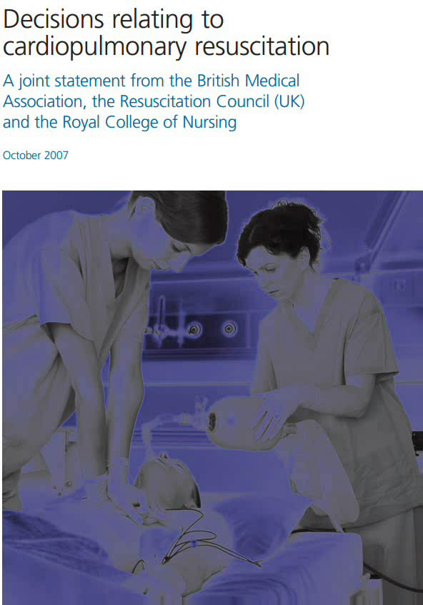
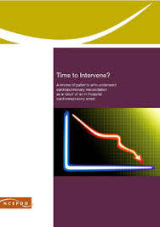
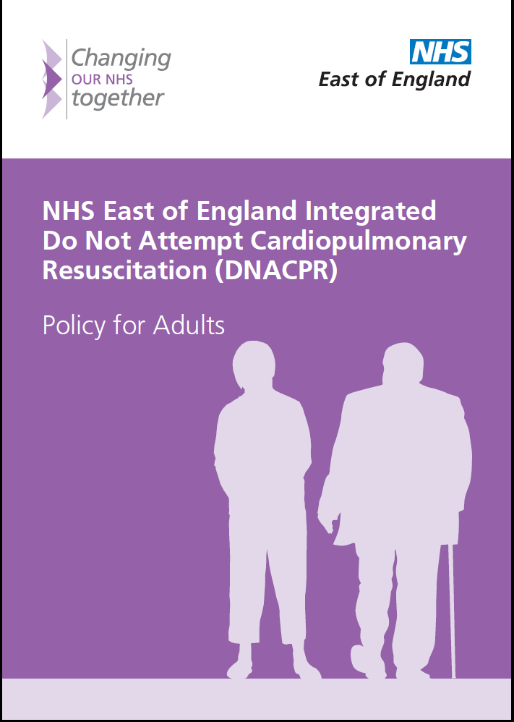
The Guidance

Slide 20
DNACPR Policy – Key Points
Patient Centred
Presumption in favour of CPR if no decision in place
Responsibility lies with Consultant
Responsibility to identify:
Patients in whom CPR would not be appropriate
Patients who would not want CPR
Decision is ONLY about CPR – must not affect other aspects of care
NCEPOD recommend decisions to be made for all patients on admission or first consultant review
Good Documentation and Communication are Vital

Slide 21
“For CPR”
Where clinical staff feel CPR would be appropriate, there is no requirement to discuss with patient or family
If patient wishes to discuss it, then staff should engage and provide adequate information
If a competent patient declares a wish NOT to have CPR then this should be respected

Slide 22
Where CPR would not succeed
Definition:
“There is no realistic prospect of restoring heartbeat and breathing for any sustainable period”
Not appropriate to “seek patient’s/ relatives’ views” as this is a clinically futile treatment which will not be offered
Legal obligation to inform patient (if they have capacity) of decision unless would “cause actual harm”
Legal obligation to inform family/ those close to patient if patient lacks capacity

Slide 23
“Best Interests” decisions
Where CPR might succeed but may leave the patient with “unacceptable quality of life”
Only the patient can decide what they would see as “acceptable quality of life” so discussion is mandatory
Patient’s decision should be respected

Slide 24
“Best Interests” decisions
If patient lacks capacity then decision MUST be discussed with relatives or those close to the patient
Legally appointed Power of Attorney can make decision for the patient
If no POA appointed then role of family is purely to ADVISE doctors on what they think patient would want
Clinicians must then make decision and inform relatives
IMCA if no relatives/close friends

Slide 25
Advance Directives
Where a valid advance directive exists and includes a refusal of CPR applicable to the current circumstance then that refusal should be respected
A patient cannot insist on CPR where it would be futile (ie. CPR would not succeed)

Slide 26
Communicating with Relatives of Patients with Capacity
Several complaints have related to elderly patients who were deemed to have capacity but family felt they should have been informed/ involved
Encourage patient to involve family or inform family of decision
Clinical staff should offer to inform family if patient would prefer
Document this on DNACPR form
Standard confidentiality rules apply

Slide 27
When, who and how
When is the right time to discuss CPR?
Who should discuss it?
How should it be brought up?

Slide 29
In an ideal world...?
As we gradually and gracefully approach the end of our life
With a trusted family GP or consultant
As part of a gradual process
No urgency
All the information we want
Our views respected
As part of the bigger picture

Slide 30
In a non-ideal world...
On admission to hospital?
For some? For all?
By whom?
On post-take ward round?
Too busy? Too late?
Relatives often not present
Only when moribund? (like in the “bad old days”)
Too late (patient choice)?
What if too sudden?

Slide 31
Do I need to make a decision right now?
 | Low Risk of Cardiac Arrest | High Risk of Cardiac Arrest
CPR appropriate | For CPR | Urgently escalate to try to prevent the arrest – ITU? For CPR
CPR not appropriate | No need for urgent decision – explore if comfortable – NO HURRY! | Need urgent decision – explore with patient/family, escalate to seniors, agree a management plan

Slide 32
How to approach?
Depends on situation:
23yr old fit and well, acute appendicitis
45yr old fit and well, acute severe pneumonia
83yr old multiple co-morbidities, mild cellulitis
88yr old multiple co-morbidities, severe pneumonia

Slide 33
Who should approach?
Anyone with adequate communication skills can explore patient/relatives views
Decision needs to be made by someone with clinical understanding of likely outcome
The challenge:
Juniors: adequate time, but sometimes not enough confidence/knowledge
Seniors: Adequate confidence/knowledge, not enough time

Slide 34
Disagreements
Disagreements over DNACPR status are rare when good communication takes place
If disagreement cannot be resolved then a second opinion should be offered
DNACPR decision is SUSPENDED pending the second opinion (local policy at my trust)
Second opinion should be from senior clinician with good understanding of the issues (Resus committee members, ITU consultants etc)

Slide 35
My own view
Increasingly patient-centred
Don’t force it or rush it
Maybe it should be up to the patient
So long as fully informed of risks
Review as condition progresses
Not binding after loss of capacity
Ethically different when family are insisting?
Focus on the “easy ones” not the “hard ones”

Slide 36
Suspending and Voiding
It may be appropriate to temporarily suspend a DNACPR decision, eg. During a surgical procedure
This should be clearly documented on form, as should decision to reinstate DNACPR directive
If decision is revoked then mark form clearly with “VOID” or “Cancelled” in large letters diagonally across form
AAGBI guidance

Slide 37
Discharge Decisions
Historically decisions were always voided on discharge
This is no longer always appropriate
If DNACPR directive is to remain in place on discharge then:
Patient or Family MUST be aware of and in agreement with decision
East of England DNACPR form to be completed and copy given to patient
GP, receiving institution and transfer personnel must be informed

Slide 38
Readmission
DNACPR forms will be in hospital records but decision may have been overturned by GP in the meantime
If a valid form accompanies patient then safe to assume that DNACPR decision stands
If not, then you MUST confirm decision with patient/ relatives and complete new form

Slide 39
The Future is here already...
Putting DNACPR in the right context
UFTO, CAP etc
Focus on what we WILL DO not what we won’t
Consider other limitations, not just CPR
ITU, NIV, dialysis, PEG feeding etc
Resus Council (UK) Form due out soon!
BUT...
A new form does not, by itself, improve practice:
Training, guidance, information packs, introduce slowly

Slide 40
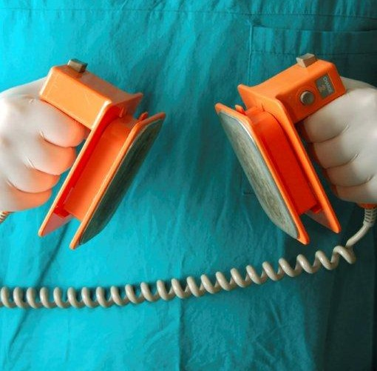
Any Questions?

Slide 41
The Bottom Line
Communication
Communication
Communication

Slide 42
References
https://www.resus.org.uk
Resus Council (UK) Website
“Decisions relating to CPR” guidance
“Decisions relating to CPR – new statement”
“Emergency Care and Treatment Plan” consultation just opened
http://www.ncepod.org.uk/2012cap.htm
NCEPOD statement on CPR decision making
http://www.aagbi.org/sites/default/files/dnar_09_0.pdf
AAGBI guidance for peri-operative management of patients who have a DNACPR decision in place

