Slide 1
Difficult conversations
Vijay Nayar
Autumn Seminar
September 2015

Slide 2
Difficult conversations
Function of feedback
Effective feedback
Difficult conversations

Slide 3
Thoughts about feedback
Function of feedback
Effective feedback

Slide 4
Function of feedback
“How am I doing?”
Motivate
Reinforce effective behaviour
Encouragement to change
Developing self esteem
Increase insight, capability self awareness and effectiveness
Sharing expectations

Slide 5
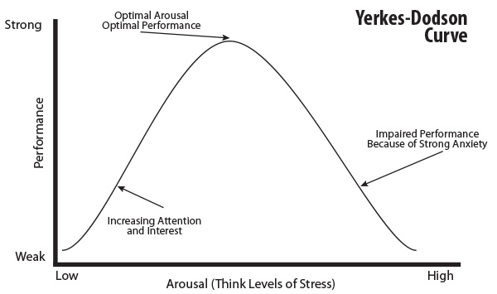
Motivation
and Effort
Certain Goal Impossible

Slide 6
Trainee
Known by
Unknown by
Open | Blind
Hidden | Unknown
Known by
Feedback
Self disclosure
Trainer
Learning needs
assessments
Unknown by

Slide 7

Effective feedback
Meaningful
Accurate
Timely
Encouraging
Reflective
Descriptive of the behaviour not the personality
Give specific examples
Given as close to the event as possible
Sensitive to the needs of the receiver
Directed towards behaviour that can be changed

Slide 8
Positive Feedback
Preserves or enhances the learner’s self respect
Negative feedback
Reduces the learner’s self respect
✓ | X
✓ | X
Feedback about
Good performance
Feedback about performance that needs to be or could be improved

Slide 9
Key principles
When the challenge increases, so must the support
Emotional bank balance - withdrawals cannot be sustained without credits in place first
It does not allow either party to downplay strengths or to duck difficult issues

Slide 10
Defensive reactions to feedback
• Blaming and excuses - "It's not my fault because...”
•Denial - "I can't see any problem with that"
•Rationalisation - "I've had a particularly bad week" "Doesn't everyone do this?"
•Anger - "I've had enough of this"

Slide 11
We can also be defensive…
Obligation - "I'm duty-bound to tell you this"
Moral high ground - "It's for your own good"
Burying and fudging - Taking a long time to get to the point and covering many irrelevancies.
Minimising - "Don't worry, it's not such a big deal. Everyone does it at some time“
Colluding - "You're probably right, perhaps I am overreacting"

Slide 12

Dealing with defensiveness
Name and explore resistance – ‘You seem bothered by this. Help me understand why’
Keep the focus positive – ‘Let’s recap your strengths and see if we can build on any of these to help address this problem’
Try to convince the trainee to own one part of the problem – ‘So you would accept that on that occasion you did lose your temper’

Slide 13
Dealing with defensiveness
Acknowledge emotions – ‘Do you need some time to think about this?’
Keep responsibility where it belongs – ‘What will you do to address this?’
If recipient is in denial: reiterate the facts, describe the behaviour

Slide 14

Strategy for difficult conversations
Time and place, don’t ambush
Provide emotional support
Be clear about concern
Be clear about your objective
Let them tell their story
Manage emotions
A pause has a calming effect
Preserve the relationship
Be fair and consistent
Address defensiveness openly and sincerely
High support and high challenge

Slide 15
Difficult conversations
active listening
open, reflective, facilitating, and closed questions
be challenging
provide insight into strengths and limitations
help trainees to resolve difficulties by
  listening and asking
  not telling and providing solutions

