Slide 1
DIARRHOEA
Dr Seth Saverymuttu
Consultant Gastroenterologist
Broomfield Hospital

Slide 2
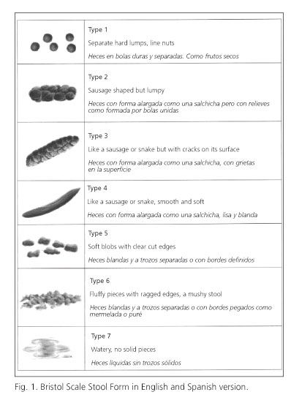
Bristol Stool Chart

Slide 3
CLASSIFICATION OF DIARRHOEA
ACUTE < 4 Weeks
CHRONIC > 4 Weeks
INFECTION DRUGS ISCHAEMIC
IBS (Diarrhoea predominant) DRUGS IBD Ulcerative Colitis, Crohns,Microscopic colitis (COELIAC) INFECTION (IMMUNOSUPPRESSED) INFECTION (NON IMMUNOSUPPRESSED) RARE CAUSES VIPOMS,LAXATIVE ABUSE

Slide 4
GRADING DIARRHOEA
GRADE 1 <4 Loose stools daily
GRADE 2 4-6 Loose stools daily ?Discharge
GRADE 3 7-12 Loose stools daily ? Admit
GRADE 4 >12 Loose stools daily
GRADE 5 DEATH

Slide 5
CASE 1 Acute Bloody Diarrhoea
31yr Mother 12 days diarrhoea (Grade2)
Started 48hrs after chicken salad initially watery then bloody
Crampy abdo pain No vomiting
Husband concerned Weak,Hallucinating
Examination Afebrile Abdo soft

Slide 6
CASE 1 Differential Diagnosis
CAMPYLOBACTER DNA
SALMONELLA (NON TYPHI) DNA
SHIGELLA DNA
E.COLI O157 DNA
C DIFFICILE DNA
CRYPTOSPORIDIUM DNA
GIARDIA DNA

Slide 7
ACUTE GUILLAIN - BARRIE
1:1000 POST CAMPLYOBACTER ENTERITIS
30% GUILLAIN BARRIE CASES HAVE EVIDENCE OF RECENT CAMPYLOCTER INFECTION
TREATMENT DOES REDUCE INCIDENCE
HALLUCINATIONS COMMON IN GUILLAIN-BARRIE

Slide 8
CASE 1 ACUTE BLOODY DIARRHOEA
BLOOD RESULTS
Hb 100 Platelets 100,000
Urea 15 Creatinine 212

Slide 9
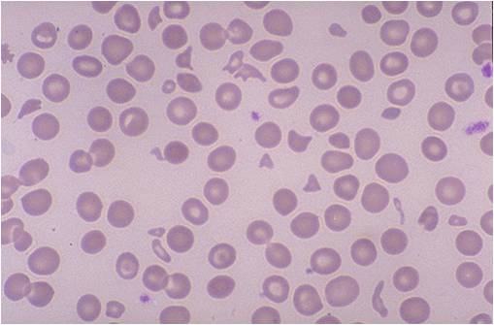
CASE 1 ACUTE BLOODY DIARRHOEA

Slide 10
CASE 1 E COLI 0157 (Shiga Toxin)
E COLI Haemolytic Uremic Syndrome (HUS)
5% infected cases develop HUS (young and old)
Antibiotic treatment may increase incidence
Toxin binds to GB3 in Kidneys/brain
Inactivates ADAMTS3 protein
Treatment supportive inc Plasma exchange

Slide 11
CASE 2 Chronic diarrhoea
35 yr old male 8 weeks grade 3 initially bloody diarrhoea with vomiting ,RIF pain ,febrile
Wt loss 5Kg
Hb 11g Platelets 523,000,CRP 45, Albumin 29,Creatinine 90 Calprotectin 1200(Normal <50) Stool culture negative.
CT abdo .. Diffuse thickening of colon = Colitis

Slide 12
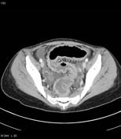
CT Colitis

Slide 13
Case2 Chronic diarrhoea
Colonoscopy (unprepared) diffuse colitis consistent with UC
Colonic Bx Active colitis with Crypt distortion Consistent with Ulcerative colitis
Treated tapering course of Prednisolone + Augmentin/Metronidazole
Diagnosis Ulcerative Colitis Gastro Follow up

Slide 14
CASE2 Chronic Diarrhoea
95% of acute onset colitis are infective
OPD Follow up Off steroids Grade 2 diarrhoea no blood ? Colitis ? Post infective IBS (up to 30% post gastroenteritis)
Management Faecal calprotectin Normal 95 % accurate in colitis but less so in Crohns
Colonoscopy Normal
Second opinion

Slide 15
CASE3 Flare ulcerative colitis +/- infection
44yr old male Ulcerative pancolitis 5years well controlled on Mesalazine 2.4grams+ Azathioprine
Works in India returns every 3months
In UK acute flare, stool culture negative . Grade 3 diarrhoea. Returning to India next week
Option 1 Increase Mesalazine 4.8gms+ enemas
Option 2 Tapering course oral Prednisolone 40mg
Option 3 But ?? infection

Slide 16
CASE 3 Differential Diagnosis
CAMPYLOBACTER DNA
SALMONELLA (NON TYPHI) DNA
SHIGELLA DNA
E.COLI O157 DNA
C DIFFICILE DNA
CRYPTOSPORIDIUM DNA
GIARDIA DNA

Slide 17
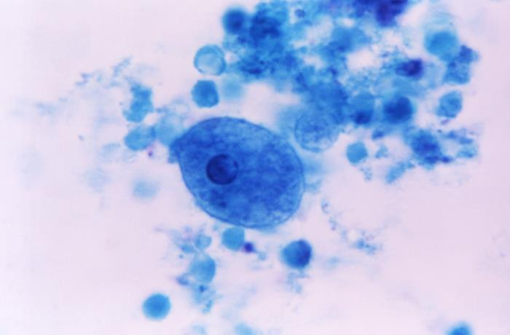
AMOEBIASIS

Slide 18
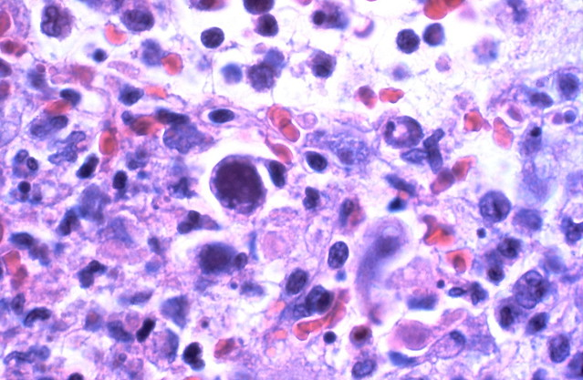
CMV COLITIS

Slide 19
CASE 3 CMV colitis in IBD
Contraversial maybe colonisation.
Diagnosed by flexible sigmoidoscopy + biopsy and request specific stains for CMV
Most treat with IV Gancyclovir +/- Prednisolone

Slide 20
Case3 Latent Amoebiasis and IBD
High rate of asymptomatic colonisation in IBD in Asia. Stool culture/Flexible Sigmoidoscopy + Biopsy unreliable
Prednisolone treatment may precipitate fulminant Amoebic colitis with high complication rate (perforation /surgery)
Option 3 Prednisolone 40mg tapering dose + Metronidazole 750mg tds for 10days followed by luminal treatment.

Slide 21
Case 3 Eosinophilia in Asian colitis
What parasite are we concerned about in patients returning from Asia which can result in hyperinfestation if treated by steroids?
Backpackers and walking barefoot are at risk.

Slide 22
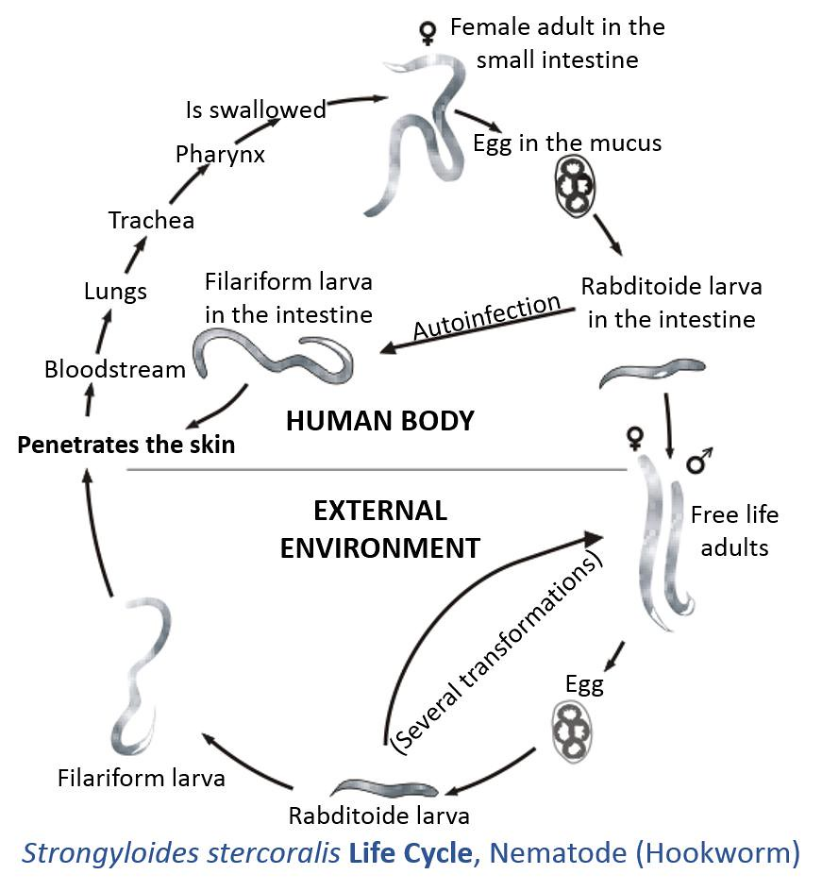
STRONGYLOIDES STERCORALIS

Slide 23
Strongyloides Stercoralis
Contracted by larvae in soil penetrating skin of foot,then burrow under skin causing an itchy rash ,homes to lungs where microfiliaria hatch and coughed up then swallowed and complete the faecal excretion.
Management difficult ..stool tests unreliable
Empiric treatment Ivermectin/Aldendazole

Slide 24
CASE4 HIV Diarrhoea
23 Male HIV+ve on retrovirals
8 /52 Grade 2 /3 Watery Diarrhoea 10Kg Wt loss
Stool MC&S /DNA testing liase with micro.
Routine Crytosporidium,Giardia,
Rare Cyclospora,Isospora,microsporidia
Trial of Metronidazole ?

Slide 25
HIV DIARRHOEA
Think CMV/malignancy
CT CAP includes small bowel Negative
OGD + D2 Bx and Colonoscopy + Bx
Duodenal Bx No giardia/villous atrophy/lymphoma/ CMV/ microsporidia but PAS positive Diastase resistant organisms = WHIPPLES Disease (Tropheryma Whipplei)

Slide 26
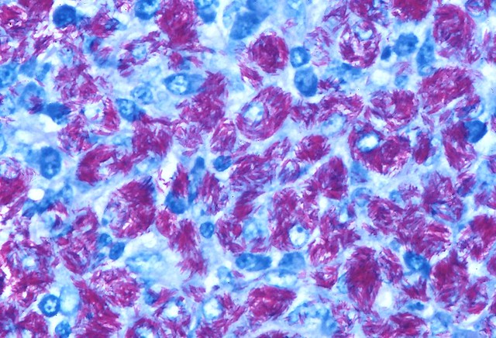
MYCOBACTERIUM AVIUM INTRACELLULARE

Slide 27
INFECTIVE DIARRHOEA
Acute onset +/- Vomiting
Self limiting
> 4 weeks ? HIV
Bloody diarrhoea Campylocacter
Watery diarrhoea Giardia (travellers)
Adults Stool culture +ve in 5% but with DNA analysis maybe >20%
Viruses are common Norovirus,Rotavirus,

Slide 28
CASE 5 IRRITABLE BOWEL SYNDROME
IBS (ROME IV Criteria 2016)
3 months Abdominal pain (once weekly) associated bowel disturbance .
IBS (D) Diarrhoea predominant 75% diarrhoea
IBS (C) Constipation predominant 75% constipation
IBS (M) Mixed
Why present to A& E?

Slide 29
CASE5 IRRITABLE BOWEL SYNDROME + Raised calprotectin
40 Female 10yrs IBS(D) Grade 1-2No red flags
PMH Migraine,Anxiety,Arthritis
DH Propranolol Bloods Normal
Calprotectin 180 (Normal <50) GP ?colitis
Referred Colonoscopy 6 week delay
Why visit A&E ? ...Bad day Watery Diarrhoea 10 X daily ? Needs steroids

Slide 30
CASE 5 IRRITABLE BOWEL SYNDROME
Management
Examination Afebrile ,Abdo soft
No Dehydration, No Tachycardia
Bloods Normal (CRP/WBC)
Further history ? Infective diarrhoea
Previous episodes of flares yes but knowing possible colitis now worried

Slide 31
CASE5 IRRITABLE BOWEL SYNDROME
Faecal Calprotectin 180(Normal <50)
80% Calprotectin have normal colonoscopy
High rate of false positive Calprotectin
Most frequent cause of false positives infection and NSAIDs..often no cause
Management Reassure
Stool culture but not calprotectin

Slide 32
CASE5 IRRITABLE BOWEL YNDROME
GP BLOODS ( on system)
TTG 80 Normal <7
?Coeliac disease
? IBS + Coeliac disease
Next step
? Further blood tests
? trial of Gluten Free Diet
? OGD + Duodenal biopsy (+Colonoscopy)

Slide 33
CASE5 IBS/ Coeliac disease
Further blood tests ....Anti-endomysial antibodies more specific
HLA DQ2/DQ8 present in 99% Coeliac disease
Gluten free diet
ESPAN guidelines (Paediatric) TTG > 10X upper normal limit 7 our case 80 = 11X
ADULTS gastroenterologists BSG guidelines Sheffield/Cambridge insist on D2 biopsy

Slide 34
CASE 5 IBS/COELIAC
OUTCOME
OGD D2 Marsh 3 changes (Coeliac disease) Colonoscopy Normal
Gluten Free Diet ..No improvement despite TTG falling to <7
FODMAP (Monash University) Diet 50% better
CBT /Mindfulless (Headspace/Shannon Harvey The Connection ) 80% better

Slide 35
CASE6 CHRONIC IBS(D)
60 Female 5years watery diarrhoea 5X daily + once at night Loperamide 6 daily ineffective
PMH T2DM(Metformin) Reflux (Lansoprazole) Hypetension (Olmersartan)
TTG /CRP/Calprotectin Normal
Colonoscopy Normal to ileum
Referred to Gastroenterologist Appt 6 weeks

Slide 36
CASE6 CHRONIC IBS(D)
Why attend A&E?
Incontinence..’hidden symptom of IBS’
Wedding in 4 weeks time
Differential diagnosis
?Small bowel Crohns MR Enterography
? OGD + D2 TTG-ve Coeliac
? Non coeliac gluten sensitivity IBS Gluten free /FODMAP diet
? microscopic/collagenous colitis

Slide 37
CASE 6 IRRITABLE BOWEL SYNDROME
Two ‘treatable causes of IBS(D) ‘
Microscopic colitis Diagnosed by Colonoscopy + Biopsies Right and Left side of colon. Flexible sigmoidoscopy + Biopsy miss up to 30% Calprotetcin Normal
Primary Bile Acid Malabsorption Diagnosed by Radioactive SeCHat Bile Acid retention test

Slide 38
Case6 IRRITABLE BOWEL SYNDROME
Microscopic colitis
Lansoprazole changed to Omeprazole
Trial of Budesonide works within 2 weeks often days
Few side effects.
6 week course 9mg 2weeks,6mg weeks 2 weeks,3mg 2weeks
Relapse common Maintenance now licensed or Azathioprine

Slide 39
Bile Salt Malabsorption
Primary
Secondary
Ileal resection
Radiation Enteritis
Crohns Ileal involvement
(Cholecystecomy)
Treatment Cholestyramine 4g tds Colesavalam1.25g tds Colestipol

Slide 40
CASE7 UNTREATABLE IRRITABLE BOWEL SYNDROME/FAPS (CAPS)
30 male mugged .Broke jaw needing liquid feed for 3 months .
IBS(D) 10X daily, urge incontinence
Abdominal pain 7/10 Continuously
Ist opinion Queens PTSD IBS
2nd opinion St Marks PTSD IBS
3rd opinion Broomfield PTSD IBS

Slide 41
FAPS = CENTRALLY MEDIATED ABDOMINAL PAIN CAPS)
2-5% IBS
CENTRAL PAIN DYSREGULATION
ASSOCIATIONS
Fibromyalgia/CFS
Migraine
Restless leg syndrome
Pelvic pain syndrome

Slide 42
CASE 7 UNTREATABLE IRRITABLE BOWEL SYNDROME /CAPS
DRUG/DIET Options
Psychotherapy
FODMAP Diet
Loperamide
Low Dose Tricyclics
Duloxetine
Gabapentin
Opioids (Narcotic bowel syndrome)
Cannabis
CBT
Mindfullness
EMDR (Eye movement desentisation and reprocessing)
Gut directed hypnotherapy

Slide 43
Centrally Mediated Abdominal Pain (CHRONIC PAIN SYNDROMES)
BIOPSYCHOSOCIAL
TREATMENT
LIFE EVENTS
PTSD/ADJUSTMENT DISORDER
CHILDHOOD/ADULT ABUSE
PSYCHIATRIC COMORBITY
SUBSTANCE ABUSE
EMPATHY
AVOID OPIOIDS
PAIN CLINIC /Psychologist
FUTURE
Dedicated clinics (Derby)
Liaision between GP , Emergency Dept, Gastroenterologist and Pain clinic
Dedicated ward (Truro)

Slide 44
CASE8 IBS/CROHNS
50 yr Female 3yrs IBS then developed ileal Crohns needing surgery
GP prescribes OPIOIDS until surgery
Curative surgery
Patient on OPIODS 12 months post op despite attending pain clinic ? Element of Narcotic bowel syndrome

Slide 45
CASE8 IBS/CROHNS
50% Crohns patients have IBS
Hazard Ratios Mortality
Azathioprine 1.0
Steroids 1.4
Opioids 2.0
LANCET Nov 2019 Olorinab (Selective cannabinoid Type2 receptor agonist) showed a signal in pain control

Slide 46
CASE 9 ‘TREATABLE ,UNTREATABLE’ IBS
30yr working Mother IBS(D) Autistic child
Bloods OGD+ D2/Colonoscopy/SeCHat normal
Follow up 18 months late… Wt loss 10Kg
HIV-ve, Elastase/CT CAP /MR Enterography
Exquisite Abdominal tenderness
Light touch painful = ALLODYNIA

Slide 47
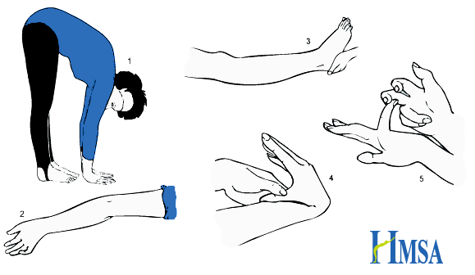
JHS/EDS Type3

Slide 48
CASE9 JOINT HYPERMOBILITY SPECTRUM IBS
SIBO Small Intestinal Bacterial Overgrowth
Diagnosed by Breath test (Royal London/Colchester) ...maybe unreliable
Treat RIFAXIMIN 200mg tds then rotating Antibiotics Augmentin/ Tetracycline
Good symptomatic response ..little objective improvement (weight gain)

Slide 49
JOINT HYPERMOBILITY SPECTRUM IBS
CONTRAVERSIAL!!!
CHRONIC PAIN DYSREGULATION SYNDROMES
PSEUDOBSTRUCTION /GASTROPARESIS
POTS (Postural Orthostatic Tachycardia Syndrome)
FOWLERS SYNDROME (Acute Urinary retention)

Slide 50
GRADING DIARRHOEA
GRADE 1 <4 Loose stools daily
GRADE 2 4-6 Loose stools daily ?Discharge
GRADE 3 7-12 Loose stools daily ? Admit
GRADE 4 >12 Loose stools daily
GRADE 5 DEATH

Slide 51
CHEMOTHERAPY DIARRHOEA
CAPECITABINE/FLUOROURACIL up 47% GRADE3and 4 diarrhoea 5% Mortality
DIHYDROPYRIMIDINE DEHYDROGENASE (DPD) deficiency 5% UK population results in severe Grade 4 diarrhoea with first week
Antidote Uridine Triacetate Orally

Slide 52
Checkpoint Inhibitor Colitis
Ipilimubab (Melanoma)
Nivlumab(Melanoma,Non small cell lung cancer,Urothelial cancer)
TREATMENT
Grade 2 Diarrhoea Budesonide 9mg escalate to Prednisolone 60mg with in 72hours
Grade3 /4 Diarrhoea Prednisolone 60mg escalate to Infliximab/Vedolumibab within 72hours

Slide 53
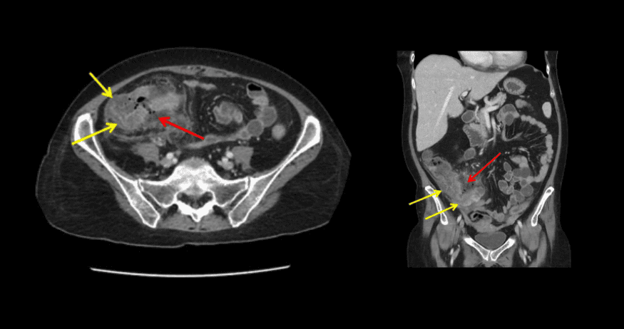
Neutropaenic Enterocolitis

Slide 54
Neutropaenic Enterocolitis
Diagnosis Diarrhoea, ‘Appendicitis’,Fever, neutopenia (<1000Neutrophil) post chemo ..high Mortality
Treatment
Broad spectrum Antibiotics,G –CSFs
Serial abdo Xrays
Joint management with surgeons because of high incidence of bleeding,perforation and abscess

