Slide 1


Diabetes Update
Dr K Vithian
Consultant in Diabetes & Endocrinology
NEEDS & ESNEFT

Slide 2
Diabetes in the UK is increasing
Adapted from: 1. Diabetes UK. Diabetes in the UK 2004. Diabetes UK, London, 2004.
2. Diabetes UK. State of the Nation 2005. Diabetes UK, London, 2005.
Notes:
2
Diabetes is a rapidly increasing epidemic in the UK which is likely to worsen considerably with increasing prevalence.
Although diabetes has been described as an epidemic waiting to happen, in fact it’s happening now, and it’s getting worse.
These figures include cases of Type 1 and Type 2 diabetes, with Type 2 diabetes accounting for approximately 90% of diabetes cases worldwide.^{1,2}
The prevalence of Type 2 diabetes in the UK is currently 3.9%.¹ By 2025, this is expected to rise to 4.7%.¹
The National Diabetes Audit estimates that about 19% of the population in England and Wales with diabetes are either undiagnosed or not recorded on practice registers.³
Link to next slide:
What is influencing the increase in Type 2 diabetes?
References
International Diabetes Federation. E-Atlas. 2003; Available at: www.eatlas.idf.org/ (accessed 15.12.06)
World Health Organization. Diabetes mellitus. Fact Sheet No 138. 2002. Available at www.who.int/mediacentre/factsheets/fs138/en/index.html (accessed 15.12.06).
The Information Centre. National Diabetes Audit, Abridged report for the audit period 2004/2005. London: The Information Centre, 2006.

Slide 3
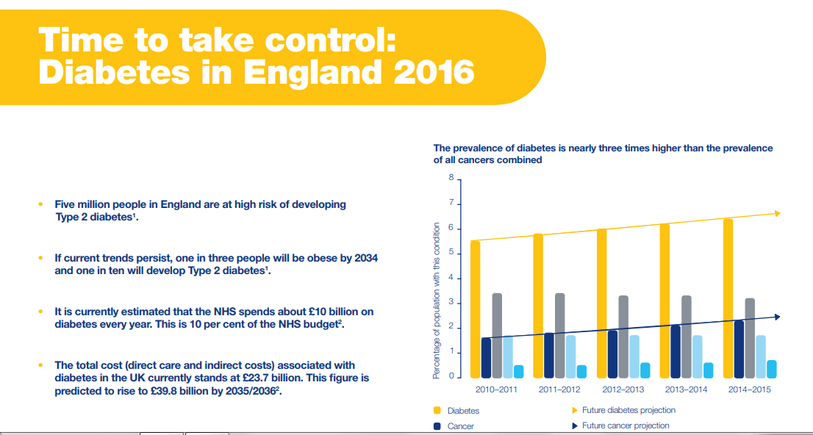

Slide 4
A Human Tragedy
100 (major) amputations a week in the UK
20% of diabetes care costs
25% lifetime risk of developing an ulcer
85% non-traumatic amputations preceded by foot ulcers
80% of complications are avoidable

Slide 5
Goals in diabetes care
Early detection
Annual reviews and checking 8 care processes
Three treatment targets
CV risk management
Patient empowerment and lifetime partnership

Slide 6
Early diagnosis- opportunistic testing
HbA1c
<42 mmol/mmol
Diabetes unlikely
43-47 mmol/mmol
Diabetes / IGT
Intensive lifestyle advice and reassess after 6 months
> 48 mmol/mmol
Diagnostic of diabetes

Slide 7
Annual reviews in NE Essex
Year of Care Model
Focusing on all patients to have 8 care processes
  Weight/BMI
  Smoking status
  BP
  Cholesterol
  HbA1c
  Creatinine
  Urine ACR
  Foot Check

Slide 8
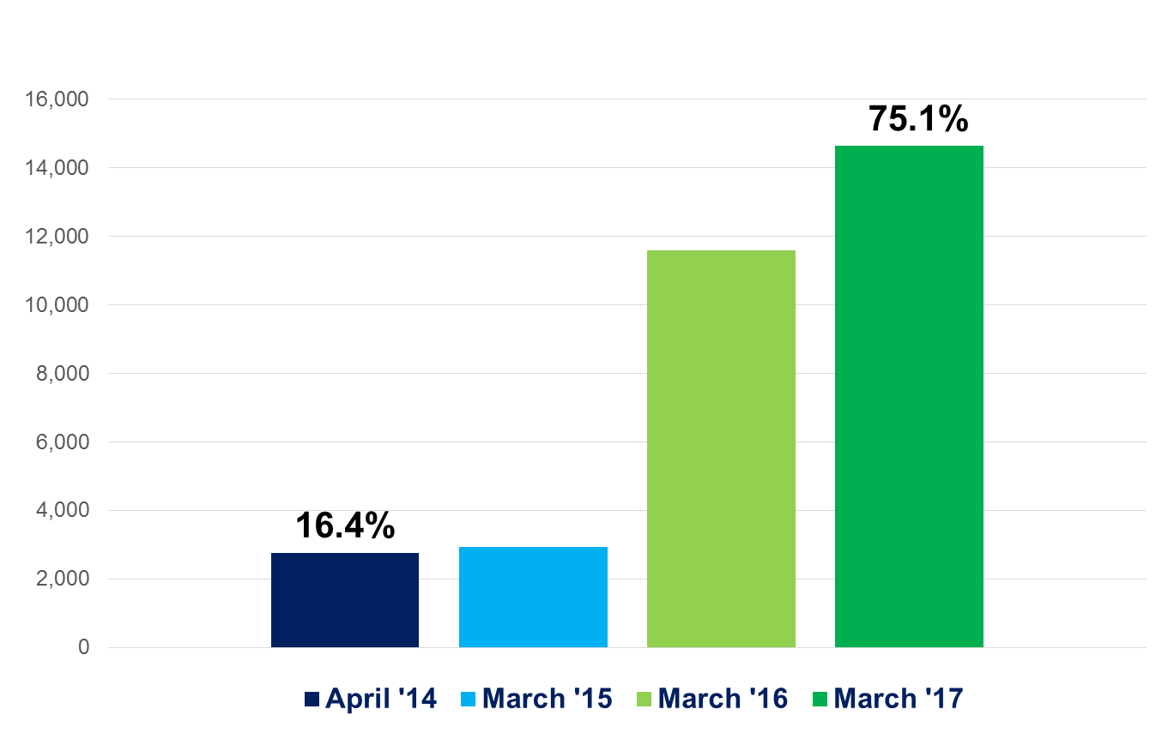
Patients With A Care Plan (YoC)
Number of patients
Notes:
Figures
April 2014
Number on register: 16,780
Number with a care plan 2,752 (16.4%)
March 2015
Number on register: 17,460
Number with a care plan: 2,927 (16.8%)
March 2016
Number on register: 18,938
Number with a care plan: 11,587 (61.2%)
March 2017
Number on register: 19,476
Number on care plan: 14,622 (75.1%)

Slide 9
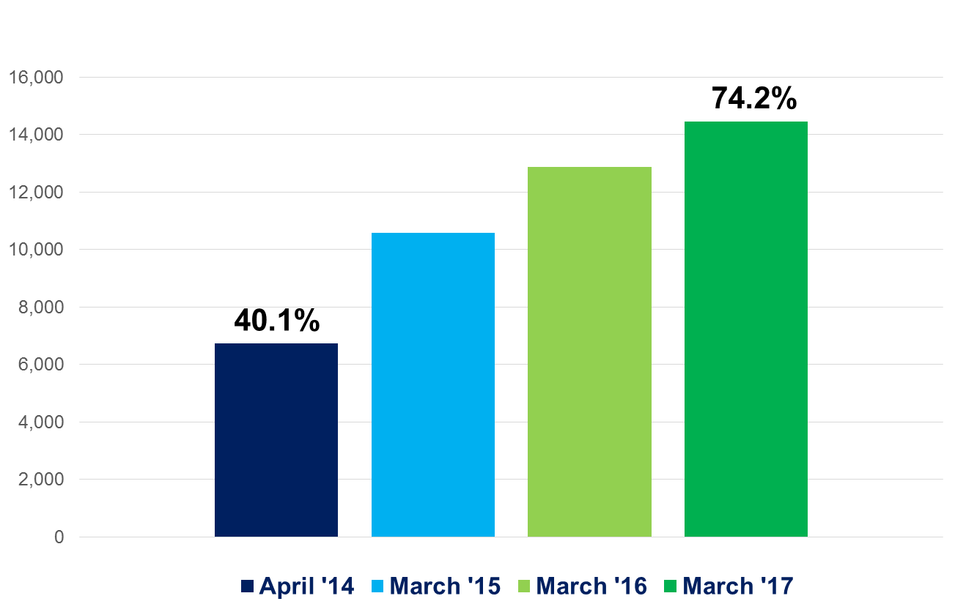
Patients Receiving All 8 Clinical Processes
Number of patients
Notes:
Patients receiving all eight clinical outcomes
Figures:
Heading towards top 5 CCG after starting in the bottom quartile
April 2014: 16,780 on register
6,722 received all eight care processes
March 2017: 19,476 on register
14,451 received all eight care processes
NEE moved into top five best performing CCG areas (up from 180th)
Nationally – 39% of T1s and 59% of T2s received all eight care processes in 2015/16 – so performing well above average
Discuss source of figures?

Slide 10
3 Treatment Targets (National Diabetes Audit)
HbA1c- individualised varying 48-64 mmol/mol
BP<140/80
Cholesterol< 5 mmol/l

Slide 11
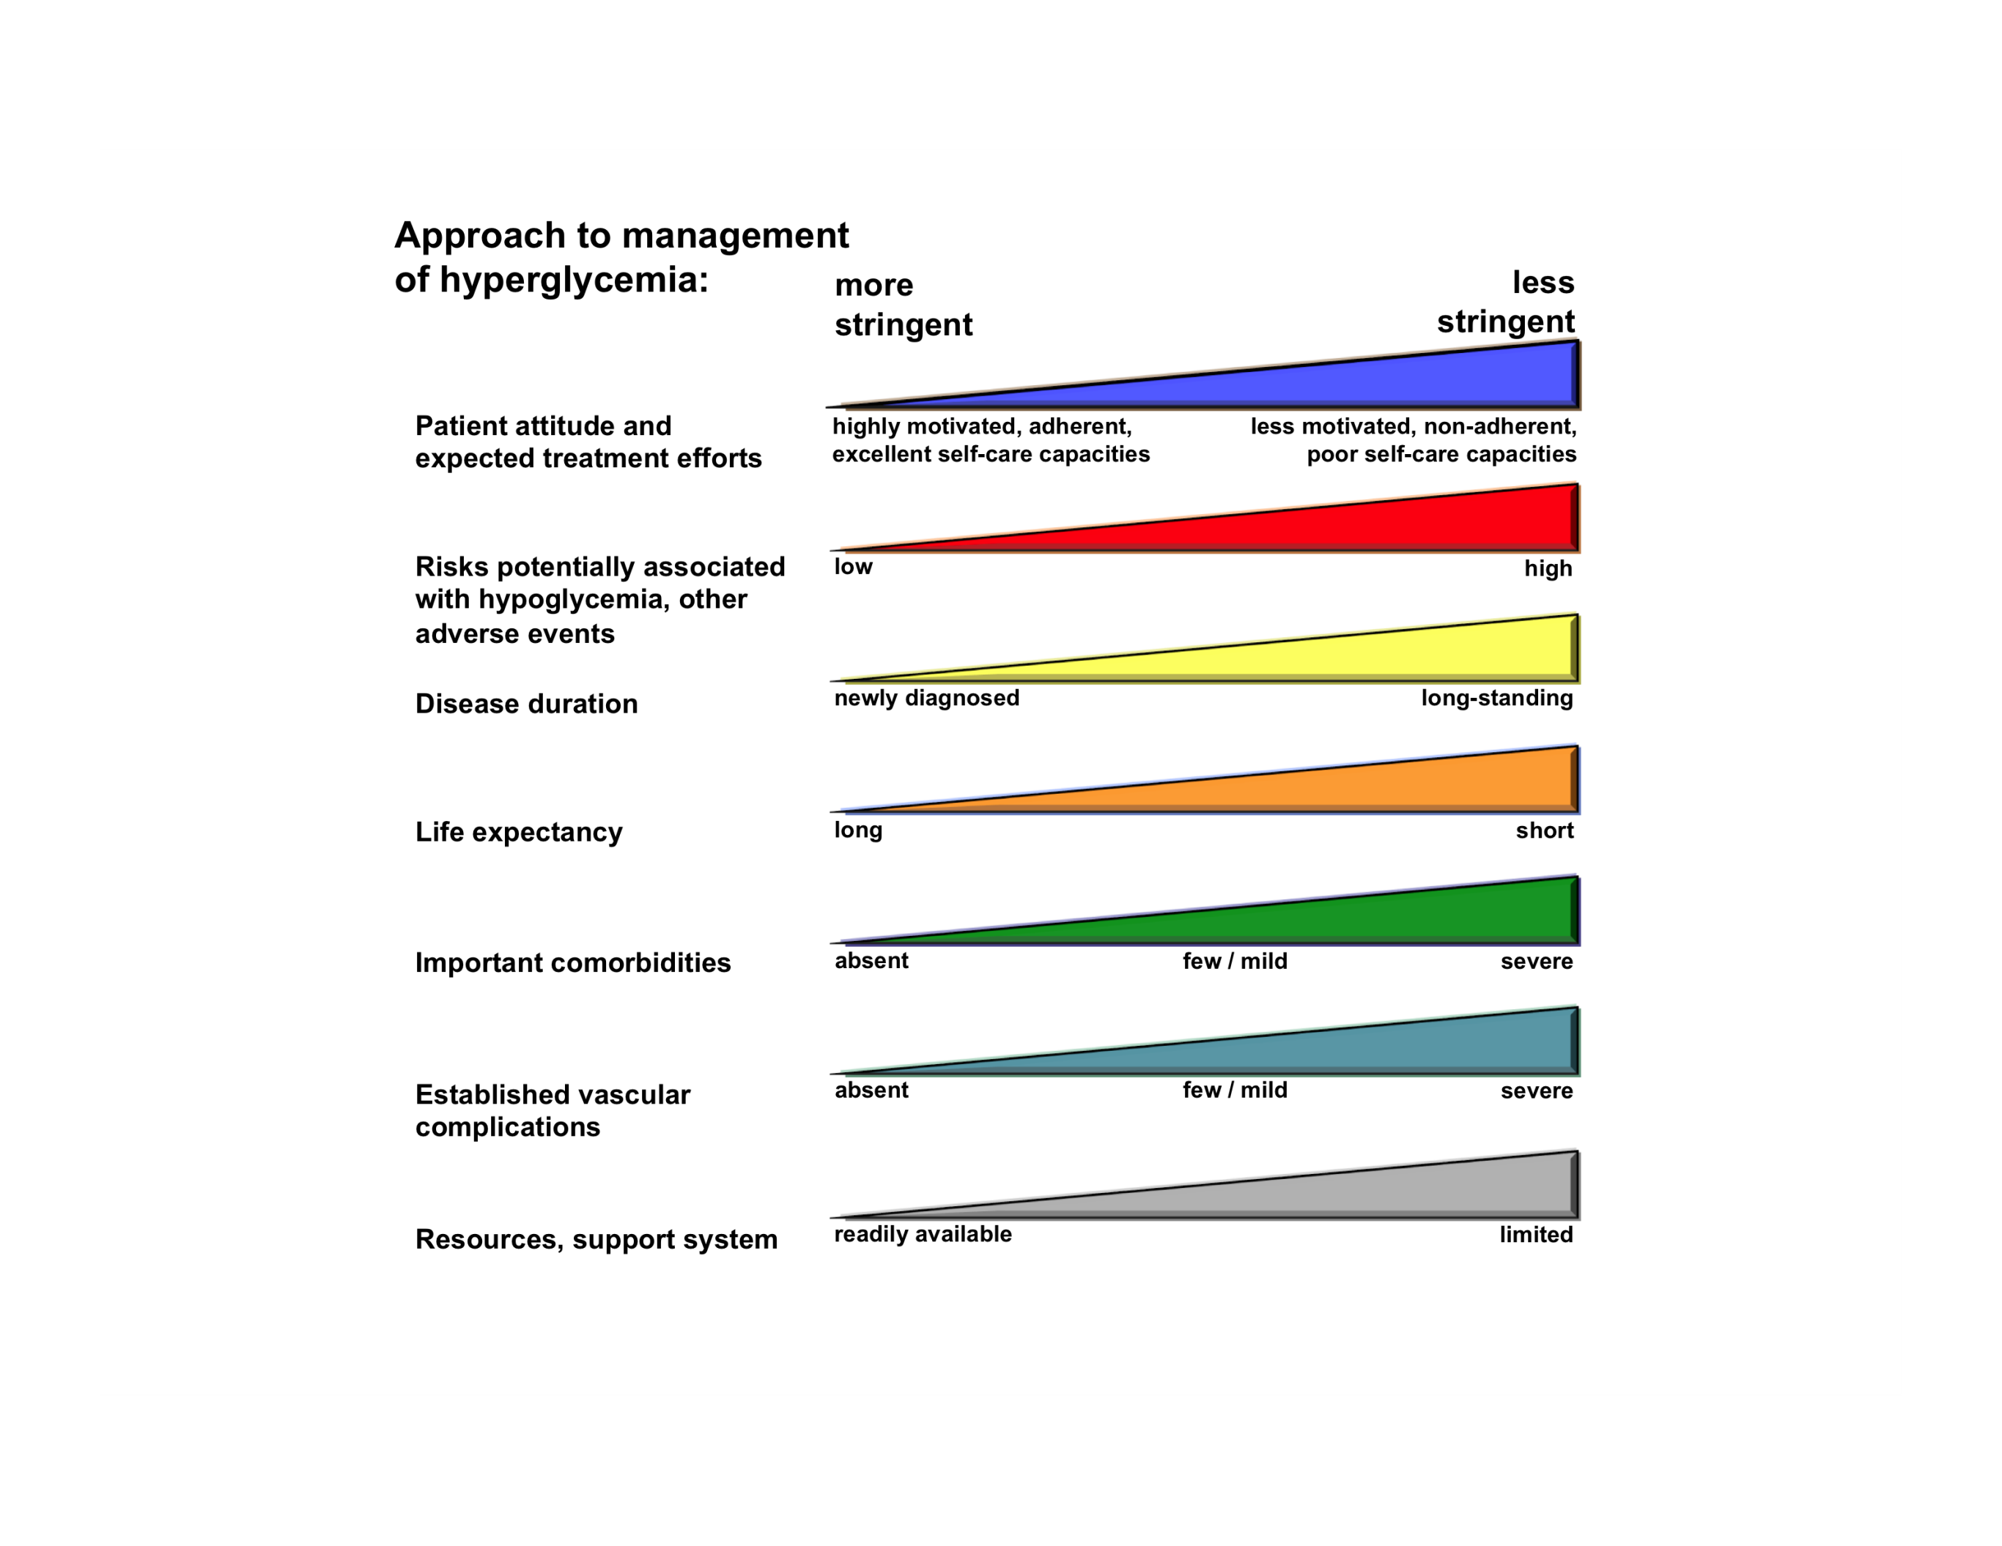
UKPDS: 10 year follow-up
Study | Microvasc |  | CVD |  | Mortality
UKPDS | ⬇ | ⬇ | ⬅➔ | ⬇ | ⬅➔ | ⬇
DCCT / EDIC* | ⬇ | ⬇ | ⬅➔ | ⬇ | ⬅➔ | ⬅➔
ACCORD | ⬇ |  | ⬅➔ |  | ⬆
ADVANCE | ⬇ |  | ⬅➔ |  | ⬅➔
VADT | ⬇ |  | ⬅➔ |  | ⬅➔
Glucose Control
  Between-group differences in HgA1c gone after 1 year
  In the sulfonylurea–insulin group, relative reductions in risk persisted at 10 years for:
    any diabetes-related end point (9%, P=0.04)
    microvascular disease (24%, P=0.001)
    risk reductions for myocardial infarction (15%, P=0.01)
    death from any cause (13%, P=0.007)
  In the metformin group:
    any diabetes-related end point (21%, P=0.01)
    myocardial infarction (33%, P=0.005)
    and death from any cause (27%, P=0.002).
Published at www.nejm.org September 10, 2008

Slide 12
Insulin degludec³
Human insulin analogue¹
Exenatide³
Linagliptin³
Canagliflozin³
Acarbose³
Vildagliptin³
Dapagliflozin³
Long acting insulin¹
Metformin⁴
Sitagliptin³
Lixisenatide³
Insulin¹
Meglitinides³
Liraglutide³
Sulphonylureas⁴
Exenatide long-acting³
Alogliptin³
Pioglitazone³
Saxagliptin³
1920s
1930s
1960s
1970s
1990s
2000
2005
2010
2013/2014
CG63:Diabetes in pregnancy²
CG15:T1D management²
CG119:Diabetes foot problems²
HbA_{1c}
CG87:T2D management²
T1D: Type 1 diabetes. T2D: Type 2 diabetes. The examples of approved glucose lowering agents is not exhaustive.
All online resources accessed October 2013.
Adapted from History of Diabetes in Timeline. Defeat Diabetes Foundation. Available at http://www.defeatdiabetes.org/about_diabetes/text.asp?id=Diabetes_Timeline.
Guidelines from National Institute for Health and Clinical Excellence. Available at http://www.nice.org.uk.
SmPCs available from http://www.medicines.org.uk/EMC/default.aspx.
FDA approval for sulphonylureas (tolbutamide as example) and metformin. Available at http://www.accessdata.fda.gov/scripts/cder/drugsatfda/.

Slide 13
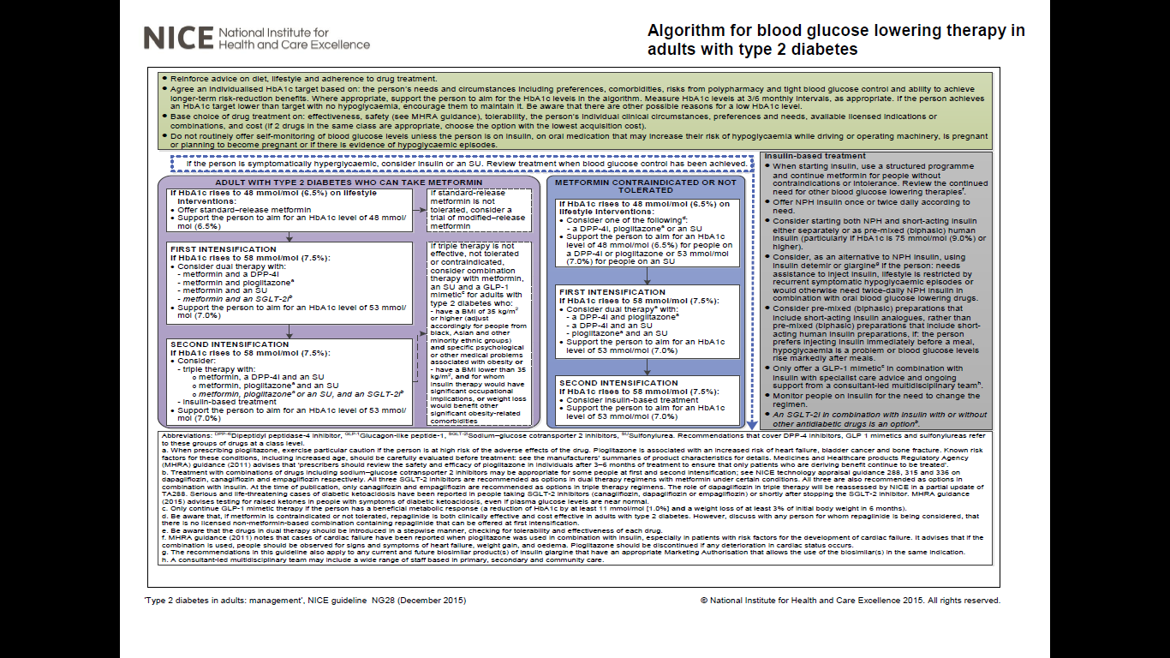

Slide 14
There is a strong association between hyperglycaemia and diabetes complications (UKPDS)
Microvascular endpoints
Each 1% reduction in HbA_{1c} level associated with 37% decrease in microvascular risk
(95% CI: 33%, 41%; p<0.0001)
60
50
40
Adjusted incidence per
1000 person-years (%)
Each 1% reduction in HbA_{1c} level associated with 14% decrease in myocardial infarction risk
(95% CI: 8%, 21%; p<0.0001)
30
Myocardial infarction
20
10
0
5.5
6.5
7.5
8.5
9.5
10.5
Updated mean HbA_{1c} level (%)
Data from a prospective observational study of 4585 patients, of these 3642 were included in analyses of relative risk.
Incidence rates were adjusted for age, sex, and ethnic group, expressed for white men aged 50-54 years at diagnosis and with mean duration of diabetes of 10 years.
Stratton IM, et al. BMJ 2000;321:405–12.
Notes:
14

Slide 15
Metformin
Works on insulin sensitising especially in liver
Benefits on weight
No hypos
Modest CV and mortality reduction on UKPDS
Anti-oxidant effect
Cheap!!
First line on all guidelines

Slide 16
Sulphonylureas
Works on K channels on beta cells
Glucose independent insulin release
Established track record
Impressive HbA1c reduction
Hypoglycaemia risk –especially in the elderly
Weight gain- modest
Cheap

Slide 17
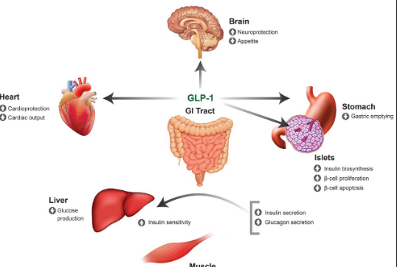

Slide 18
Gliptins
Modest efficacy
Excellent tolerability
No hypo risk
CV neutrality across all agents

Slide 19
Gliptins safety data
Pancreatic cancer risk refuted
Pancreatitis- any risk if existent small
  Risk doubled in patients with diabetes
  Meta-analysis BMJ 2014- no negative signals
Heart failure- signal from SAVOR-TIMI53

Slide 20
Glitazones
Pros | Cons
Familiarity | Weight gain
Oral formulation | Heart failure
Efficacy (1% HbA1c reduction) | Increased CV risk with rosiglitazone
Improves insulin sensitivity | Bladder cancer
? Prolongs beta cell activity | Osteoporosis
Notes:
20

Slide 21
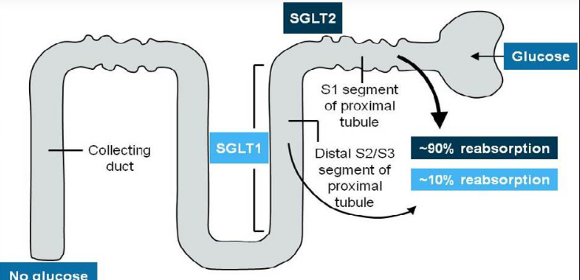
SGLT2 inhibitors

Slide 22
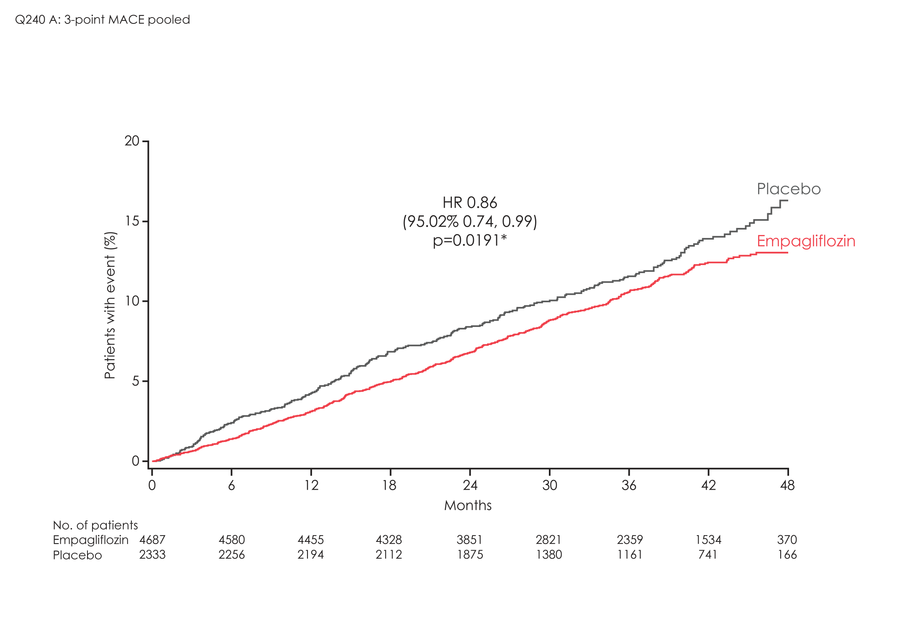
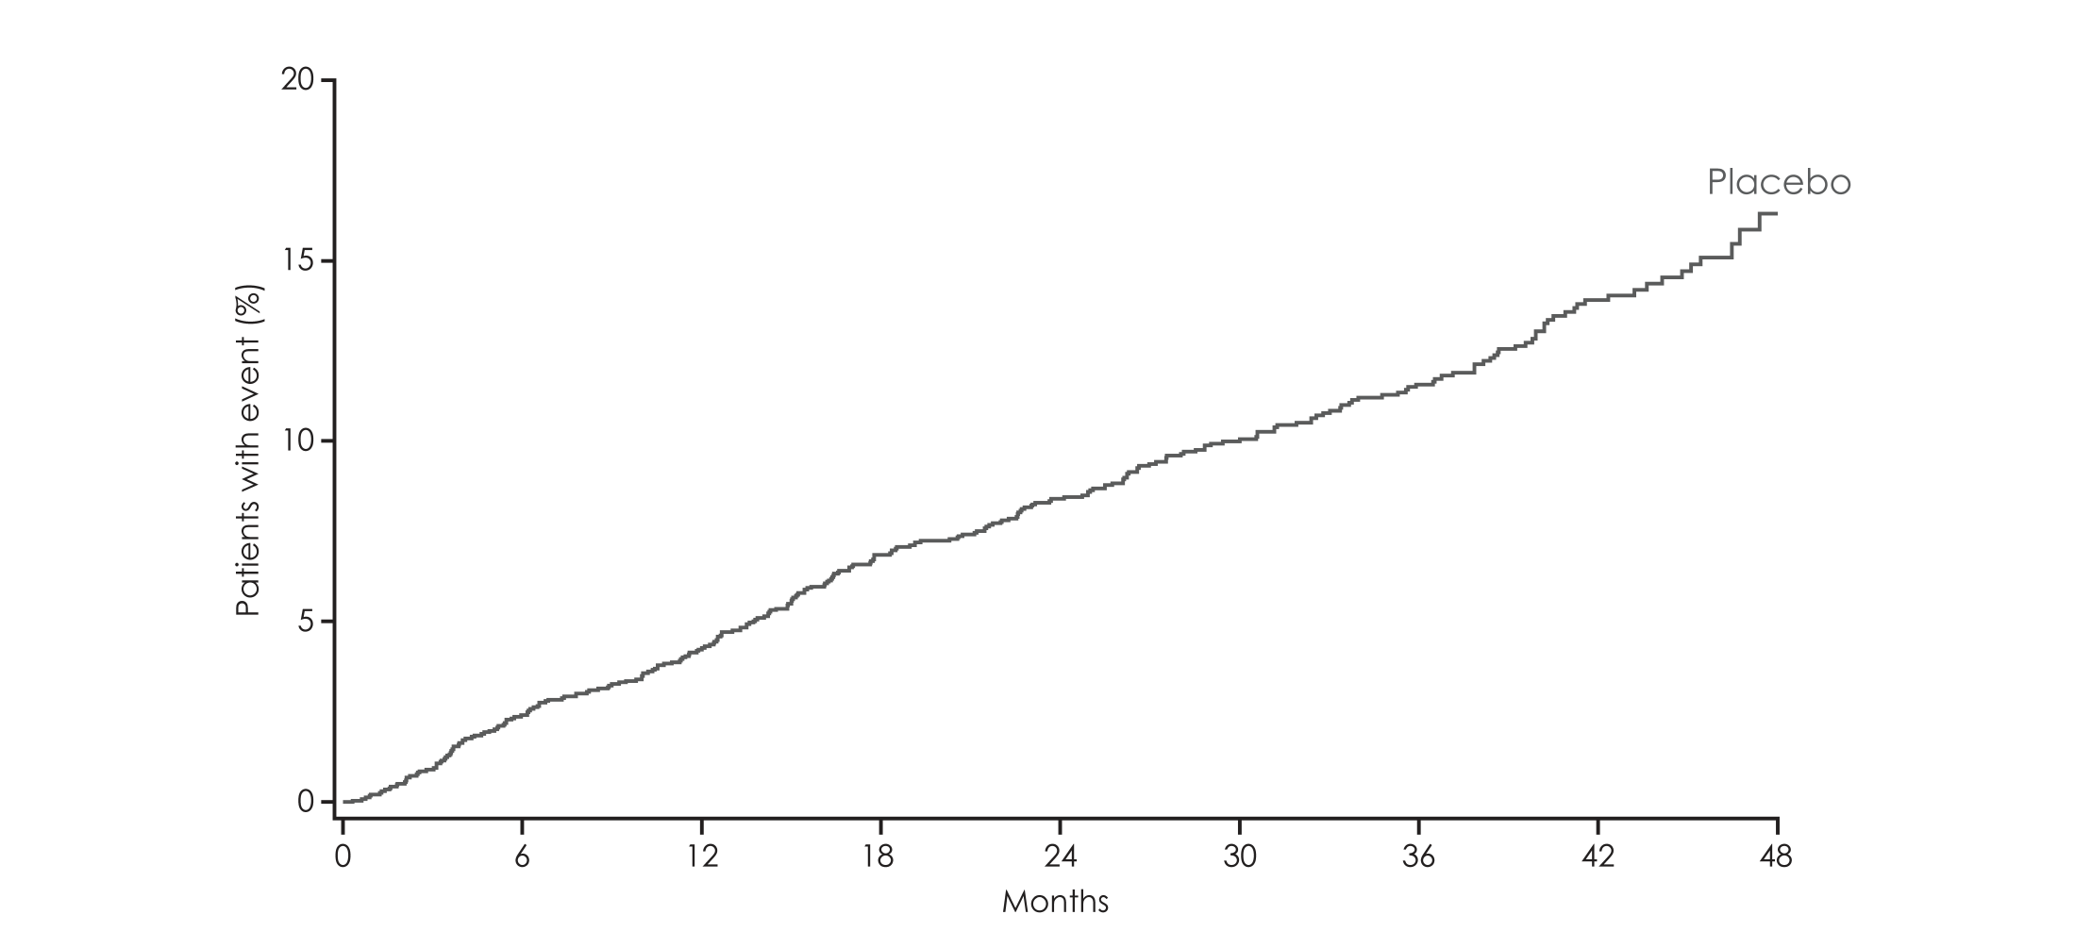
EMPA REGPrimary outcome:
HR 0.86
(95.02% CI 0.74, 0.99)
p=0.04*
RRR: 14%; ARR: 1.6% (CER – EER): Incidence of 3P-MACE: 10.5% (empagliflozin) vs. 12.1% (placebo). CER: Control event rate; EER: Experimental event rate.
Zinman B et al. N Engl J Med 2015 DOI: 10.1056/NEJMoa1504720
Notes:
Notes:
The primary outcome occurred in a significantly lower percentage of patients in the empagliflozin group (490 of 4687 [10.5%]) than in the placebo group (282 of 2333 [12.1%])
(hazard ratio in the empagliflozin group, 0.86; 95.02% confidence interval [CI], 0.74 to 0.99; P<0.001 for noninferiority and P=0.04 for superiority)
Primary outcome: 3P-MACE, 3-point major adverse cardiovascular events (cardiovascular death, non-fatal myocardial infarction or non-fatal stroke)

Slide 23
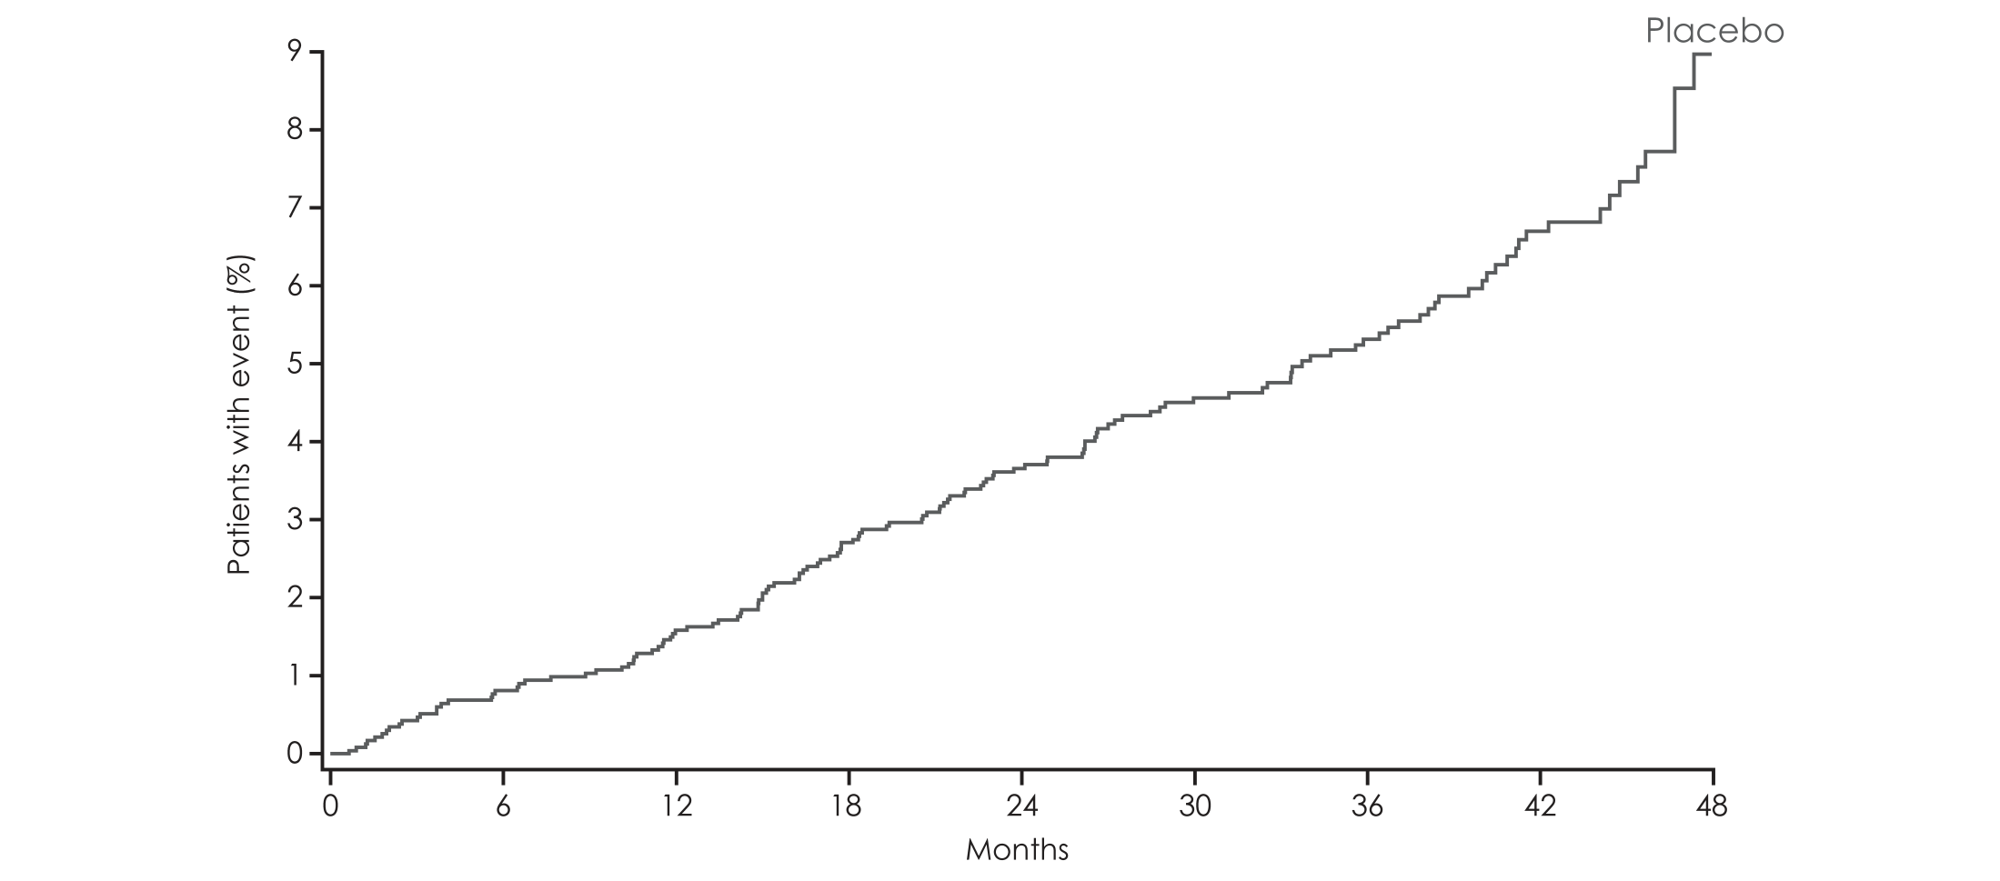
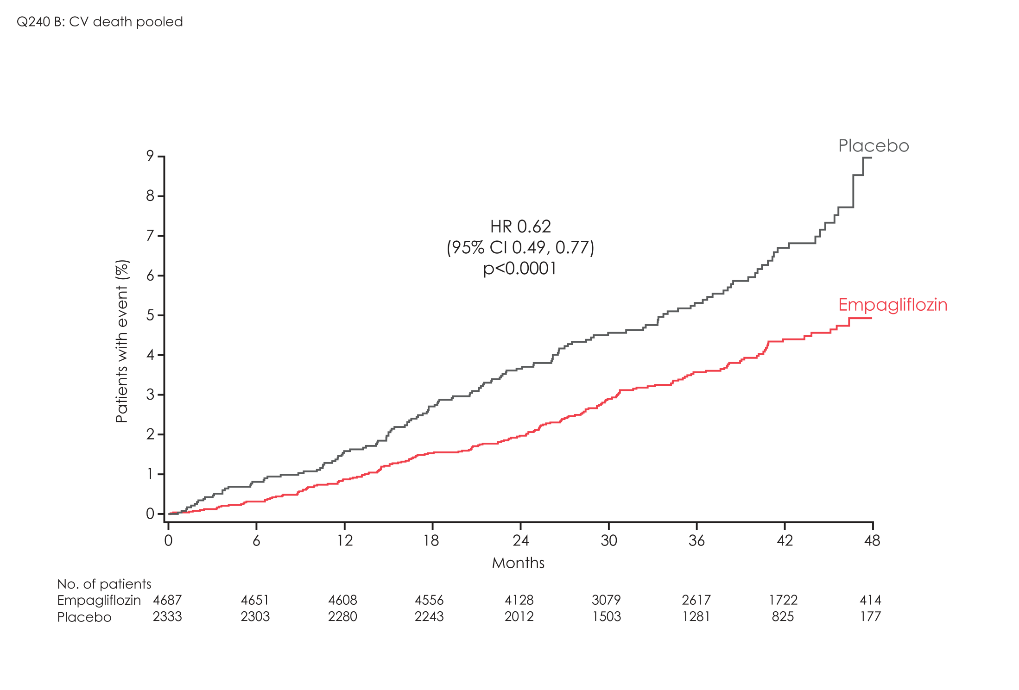
CV death
HR 0.62
(95% CI 0.49, 0.77)
p<0.001
Cumulative incidence function HR, hazard ratio. Indicated with 95% confidence intervals; RRR: Relative risk reduction; ARR; Absolute risk reduction; CER: Control Event Rate; EER: Experimental Event rate. Zinman et al N Engl J Med 2015; doi: 10.1056/NEJMoa15047201
Notes:
Notes:
As compared with placebo, empagliflozin resulted in a significantly lower risk of death from cardiovascular causes (hazard ratio, 0.62; 95% CI, 0.49 to 0.77; P<0.001)
The benefit of reduced rates of CV death was apparent early within the trial.
Sub analyses showed that these results were consistent across both empagliflozin doses (10 mg and 25 mg)

Slide 24
GLP-1 analogues
 | Lixisenatide | Liraglutide | Dulaglutide | Exenatide QW | Semaglutide
HbA1c reduction | 0.5-0.9% | 1-1.5% | 1.5% | 1.5% | 1.5%
Weight loss | 0.65 kg | 1.5-2.5 kg | 1.5 kg | 2.3-3 kg | 5 kg
Administration | Daily | Daily | Weekly | Weekly | Weekly
CV risk | Neutral | Positive | Positive | Neutral | Positive

Slide 25
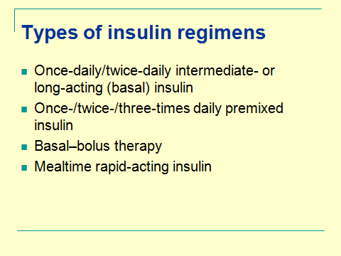
INSULIN
Recommendation
Start of basal NPH for most
Consider twice daily pre-mixed
When HbA1c>75 mmol/mol

Slide 26
Insulin-new developments
Ultra-long acting insulins
  Toujeo
  Degludec
High concentration insulins
  Humalog U200
  Toujeo U300
  Degludec U200
Biosimilars
  Abasaglar

Slide 27
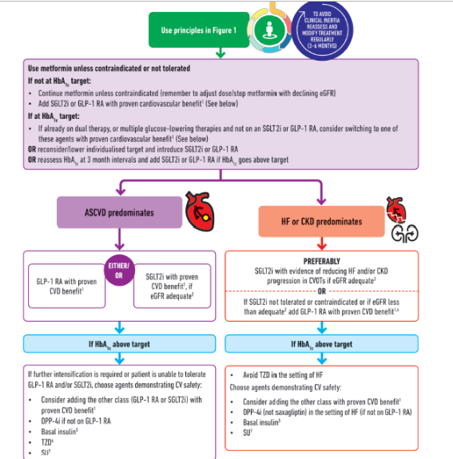

Slide 28
Blood Pressure
Lancet Volume 387, No. 10022, p957–967, 5 March 2016
<140/80
<130/80 if end organ damage (including ACR postivity)
10 mm Hg SBP reduction results in...
  Major CV events RR 0.8(0.77-0.83)
  CHD RR 0.83 (0.78-0.88)
  Stroke RR 0.73(0.68-0.77)
  Heart failure RR 0.72(0.66-0.78)
  All cause mortality RR 0.87 (0.84-0.91)

Slide 29
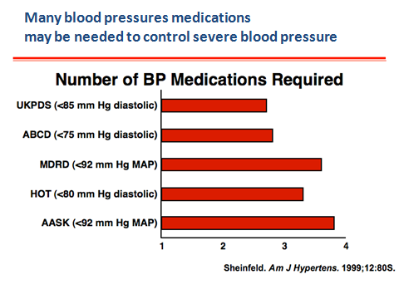

Slide 30
SPRINT study
Primary objective is target 120 mm Hg better than 140 mm Hg in adults aged over 50
Study size- 9361 participants
Primary outcome CV outcomes reduced by 30% in intensive arm and all cause mortality reduced by 25%
Old age no exception

Slide 31
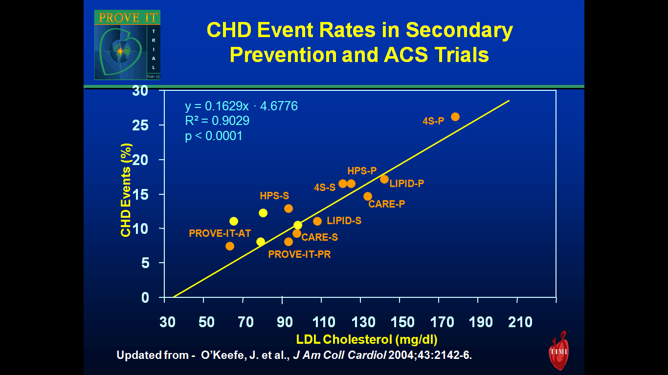
Notes:
N

Slide 32
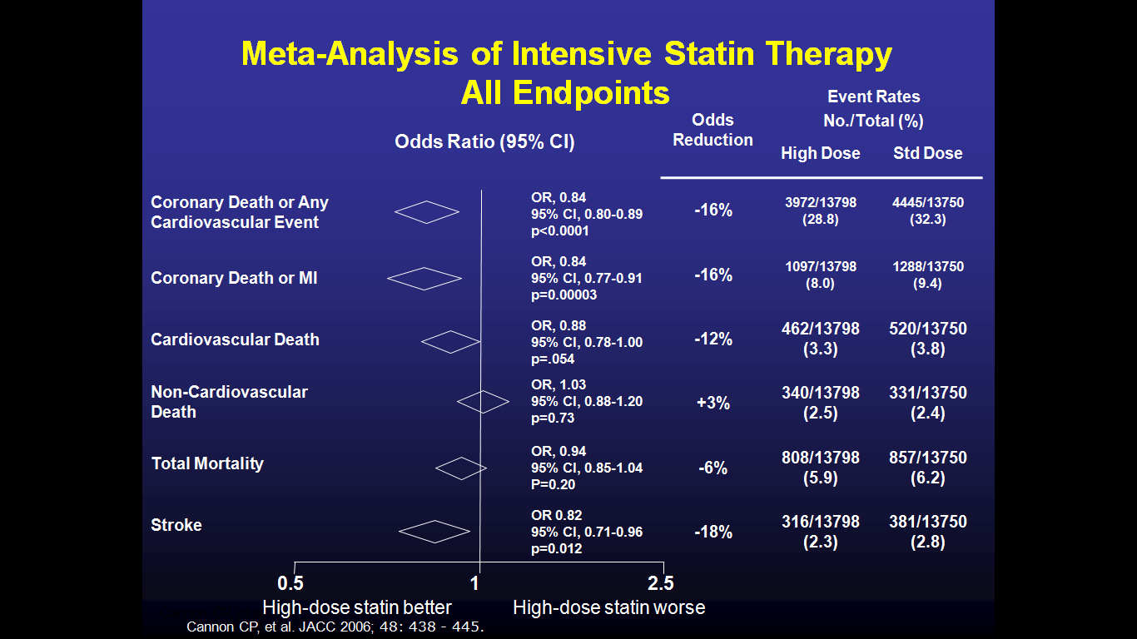

Slide 33
Ezetimibe
IMPROVE-IT
  Simvastatin monotherapy Vs. Simva/Ezetimibe combination
  6.4% risk reduction (p=0.016)
  ARR 2% over 7 years
  32.7% in combination vs. 34.7% in monotherapy
No CV risk reduction for ezetimibe monotherapy

Slide 34
Fibrates
FIELD study- 2005
9795 patients
5 year follow-up
CV outcome | Effect size
Coronary events | 0.89(0.75-1.05)
CHD Mortality | 1.19(0.9-1.57)
Non-fatal MI | 0.76(0.62-0.94)

Slide 35
