Slide 1
Developing GP Nursing
Recruit, Retain & Return
September 2015
Jenny Aston
Advanced Nurse Practitioner
Chair RCGP GPF
Notes:
I work in large teaching Practice outside Cambridge. I have a teaching role as ILS instructor . Take part in GP recruitment & am CQC specialist advisor.
Sit on HEE GPN Career framework group student placement . NHSE & RCGP GPF .
Locally RCGP Faculty board & workforce group. I am passionate about developing the GP Nursing workforce which is why I have been asked to do this session

Slide 2
Learning objectives
Gain understanding of context of GP Nursing
Explore issues with recruitment
Explore retention
Explore ways to encourage returners
Discuss possible solutions
Notes:
The current context is hotting up but at risk of being swallowed up buy GP problems
We need GP Nursing on the map
Will look at recruitment Retention & returners.
I would like to utilize your own experiences to inform some recommendations/ solutions

Slide 3
Context
FYFV
Shape of caring
Transforming Primary care
Federations
Roland report
Other new models
Workforce issues
Revalidation
Notes:
For the first time in last 10 years General Practice is now up the political agenda FVFV, 10 pt plan- who has read?
HEE have worked on Shape of caring review.- who has read
Transforming Primary care-
Federated working * Commission into G Practice
Roland report was much weaker on GP Nursing that I had hoped
Workforce issues
Revalidation

Slide 4
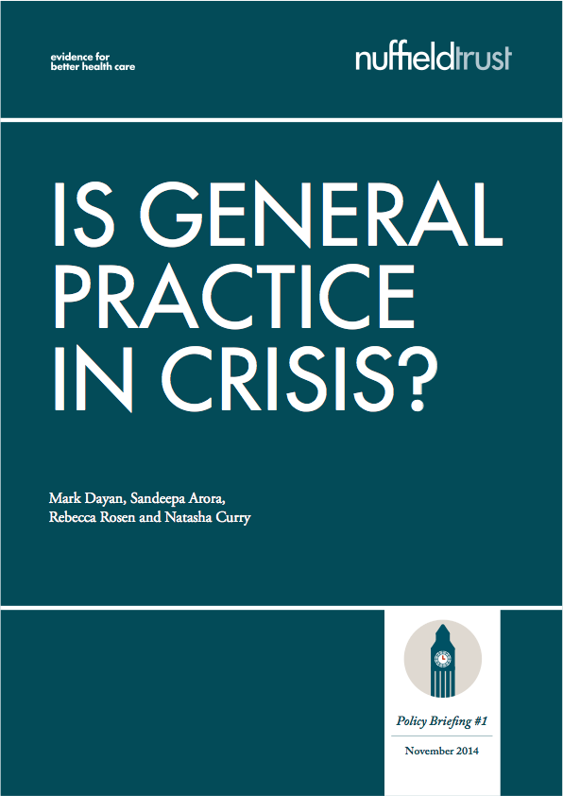



Notes:
Now is the moment for GP Nursing very little in 10 p plan . NHSE England are preparing a response I what does it mean for nursing
Advanced Nurse Practitioner Survey 15.9% HSCIC 19.7%,
Experience GPNs Survey 35% HSCIS 21%,
Practice Nurses Survey 40% HSCIC 58%
Healthcare Assistants Survey 11% HSCIC 9.2%

Slide 5
Shape of Caring
^{NMC}
^{Revalidation Consultation}
^{HEE’s Strategic Framework}
^{The Shape of Caring Review}
^{NMC} Evaluation of pre-degree nursing education
^{HEE}
^{The role of the trainer}
^{Pre-degree Nursing}
^{The Shape of Training}
^{Bands 1-4}
^{Care Certificate}
^{Community & Primary Nursing}
^{CPD}
Notes:
Shape of caring – Lord willis is very clear that HCAs & nurses should all be trained to do their job.
Important to remember HCA may have been working in Tesco
Nurses only have a 3 year non primary care training and may never have had paediatric or mental health at all.
Do you know about revalidation?
Lots about bands 1-4 but how many of you know about apprenticeships how to access them how funding works??
Do you know about the Care cert? 12 weeks induction still vague I would like to see
Big Question who is responsible for funding this CCG, GP LMC HEE - ? Allow time to discuss

Slide 6

Shape of Caring pathway
^{Level 2}
^{Level 3}
Access Courses Bridging Courses A Levels
^{Intermediate Apprenticeships}
^{Advanced Apprenticeships}
^{Level 4}
^{e.g. Certificate of Education}
^{Level 4 & 5}
Foundation Degrees Higher Apprenticeships
^{QCF Diploma Level 2}
^{QCF Diploma Level 3}
Notes:
HCA training level,
Latest document Talent for care.

Slide 7
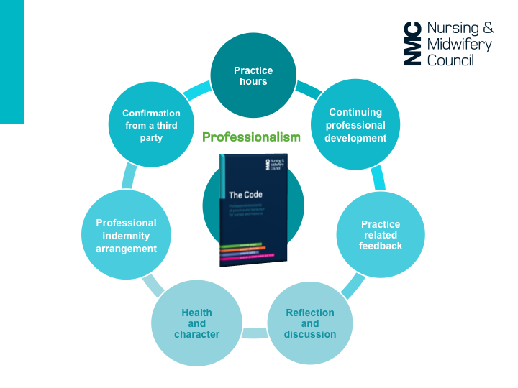
Notes:
It will be less onerous than GP
I am not clear who is funding it. 450 hours in practice over 3 years and 40 hours CPD
Good slide pack on NMC website
Hopefully there will be some ½ day preparation for all GPNs

Slide 8
Group work - Recruitment
How did you recruit you last Nurse / HCA?
How did you recruit your last GP?
How did you recruit your last PM
What are the issues?
Notes:
Did you advertise ?
Did you wait for someone to apply?
Did you poach?
How does this compare to GP / P Manager.
10 minutes in group or 3-4 spread out experts

Slide 9
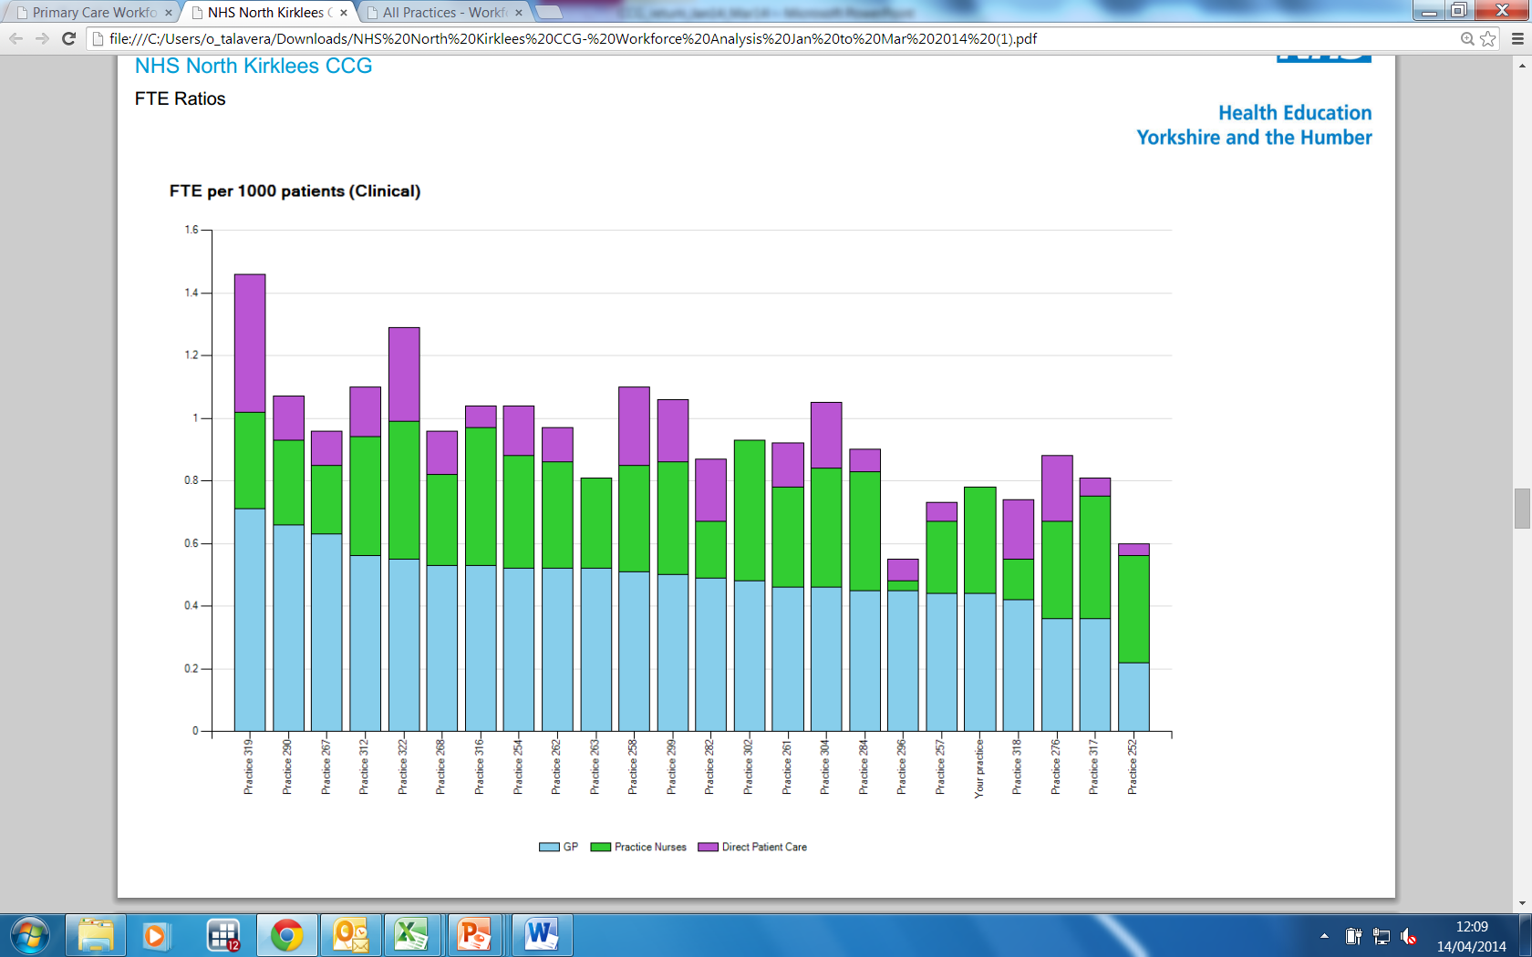
Yorkshire and Humber
Clinical staff per 1,000 patients
Is your practice resilient?
Data from a Local Yorkshire CCG
Notes:
Good data is essential to convince GPs there is a problem.
Example of what good data can show. Here is an example of where Y&H are using good data to inform GP workforce

Slide 10
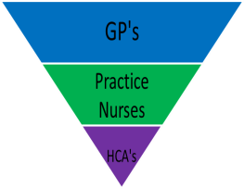
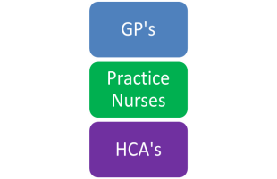
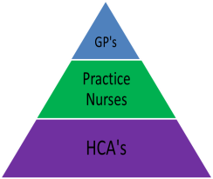
Evolving Workforce Configurations
The Toblerone Manoeuvre Dr Pete Lane
Notes:
Here is the model Pete shared at the E Mids Event - it is a bit radical but it makes you think. Think about your surgery!
Permission to share.
BMA figures are frightening - we know we cant recruit enough GPs
GPN Survey show same for GPNs 25% or more nurses retiring now.
Where are you on this model???

Slide 11
Ageing GPNs
Notes:
Where are they going ? Where are the new ones ?
53% GPN over 50 + 11% = 64% over 50
Very few 20-29

Slide 12
Recruitment
Career framework
Investing in training (HCA-ANP)
Training hubs
Students
Start young
HCAs & Care certificate
Notes:
Identify people with the right attitudes =Look for the long term. Sarah , Julie, Donna
Investment in training pays off - but beware they may move if you don’t plan ( ANPs often move)
Students Y&H 5 years investment paying off
Start young - children take a moment to make their experience fun. Why did we choose this career . My research time in hospital - nursing ??? Less exposure but we are not selling it. Well
HCAs are an excellent way in value & support them

Slide 13
Group work - retention
What things can you do to retain nurses?
What incentives do you use ?
Why do nurses leave?
Notes:
Ask
Responses valuing , safe environmnent, ( ANPs)
Social like the people you work with.
Incentives - titles, training, money. Holiday,- education , Revalidation e-portfolios
Why do nurses leave? Stress, not valued , pay conditions OOH better pay
. BMA scotland idea nurses would not do certain thing for eg Imms smears
Group work 10 minutes

Slide 14
Retention
Growing future GPNs & ANPs
Supporting development (prescribing)
Pay & conditions
Valuing your nursing team
HCA development
Opportunities –
Revalidation
Notes:
How are you growing and developing your HCAs & Nurses?
How are you supporting your Nurses?
What about pay & conditions - Survey .

Slide 15
How do you compare –pay?
Notes:
Bands 1-4 12.8% £ 14.295-22016
Bands 5 16.8% £21,388 - £27,901)
Band 6 36.1% £25,783 - £34,530)
Band 7 18.3% 30,764 - £40,558)
Band 8&9 7.6% £39239-98453
Other 7.5%

Slide 16
What do you do to keep staff?
Financial/ holidays
Social?
Training
Supporting development?
Notes:
Do you pay well/ discuss AFC or who practice % rises . Pay for MDU, RCN, NMC?
Do you pay for Christmas meal or other social events?
What training have you paid for ( mandatory of other)
Encouraged to do leadership, research, Education / Mentorship?

Slide 17
Returners
Helping nurses to access return to nursing courses
Have a training lead who can signpost
Identify patients - advertise locally
Have a training ethos
Notes:
If you have nurse patients encourage them to consider returning
Know where to signpost interested patients
Consider advertising HCA post with built in return to nursing access course. Annie example
Be aware of those wanting to become nurses and encourage them .eg BLS in schools teenage health sessions.
Group work 5-10 mins

Slide 18
How do we encourage returners ?
What might attract someone ?
What can practices do?
What can HEE and others do?
http://eoe.hee.nhs.uk/our-workforces/essex-workforce-partnership/essex-workforce-partnershipworkforce-transformation-priorities-2014-2015/primary-care-project/
Notes:
Discuss
Schools work
1:1 friend I have personally encouraged 2 people to do so both now P Nurses
Publicity, HEE plan a dvd .Essex have done one.

Slide 19
http://www.nhscareers.nhs.uk/explore-by-career/nursing/careers-in-nursing/general-practice-nursing
QNI https://vimeo.com/125480281
http://eoe.hee.nhs.uk/our-workforces/essex-workforce-partnership/essex-workforce-partnershipworkforce-transformation-priorities-2014-2015/primary-care-project/

Slide 20

Students
who?
how?
what?
when?
outcomes?
HCAs
Substantive pre reg placements
Funding
% in 3 + 5 years
Collaboration
Hub Practices
new
Apprenticeships
Unregistered nurses
ANPs
LTMC
Nursing Homes
Acute
Leadership
innovation
We want enough trained HCA’s & nurses
to share the workload in General Practice
GPNs
foundation training
Minimum standards
Mentors
Identify leaders
Future ANPs
New GPNs
Specialists
Returners
Recruited
Diabetes
Asthma
COPD
F Planning
CVD
60 credit foundation
Funding
? rotation posts
Jenny Aston
2015
Notes:
There are 3 key things
1.A clear properly properly funded plan I have shared with various people most recently Rob Bowman.
Must deal with the whole and must be fully funded. It is inequitable that GP training is so well funded Nurses are not.
2. Career Framework to shape commissioning of education
3. Buy –in form GPs PM and Nurses as well as HEE and commissioners and Ed providers

Slide 22

Solutions
Student Placements
A career framework
Local strategy
Support training at all levels
Training hubs
Value you exsisting staff
Notes:
In my view it is essential that student have placements

Slide 23
Thank you & Questions

