Slide 1
Cultural Competence in Health Education
Vijay Nayar
Autumn Seminar
September 2015

Slide 2
Why are we doing this?
Increasing diversity of:
Population
Workforce
Trainees
Legislative frameworks - Equality Act (2010)

Slide 4
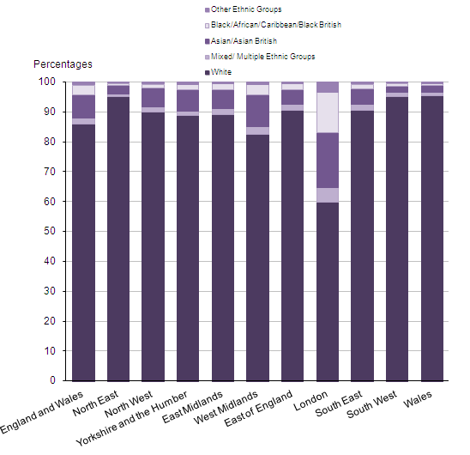

Slide 5
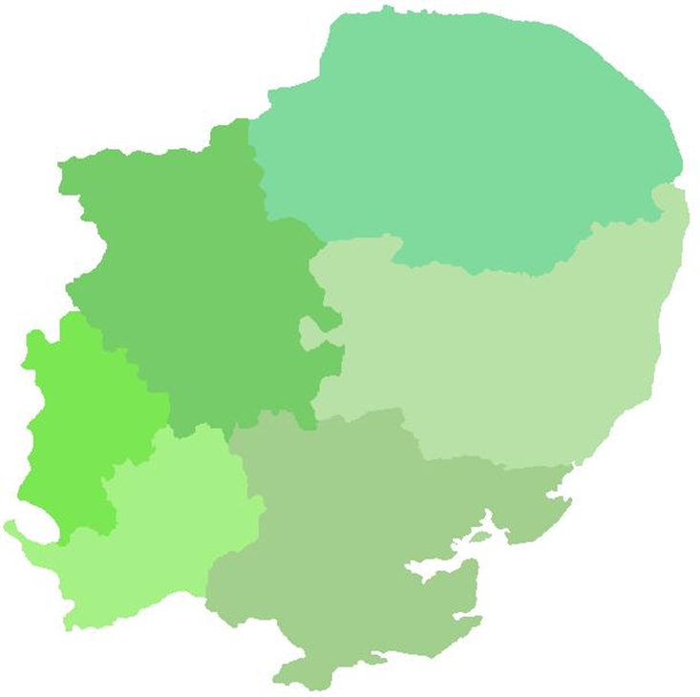
East of England
Population of 5.8 million people
Higher than average proportion of people aged over 65 yrs
Approximately 400,000 people from non-white backgrounds
Highest concentration of Gypsies and Travellers in its population compared to the rest of England.

Slide 6
Doctors by PMQ
17%
25%
58%

Slide 7
Why are we doing this?
Promoting Equality and Valuing Diversity is a section of the GP curriculum
Part of the Foundation curricula
Part of many other specialties curricula

Slide 8
Why are we doing this?
Relevant to clinical care
Relationships with patients
Working with colleagues
Helps to reduce Health Inequalities

Slide 9
Cultural competence
Equality and Diversity, Culture, Race, Ethnicity
Health inequalities and literacy
Epidemiology of population health in different cultures
Healing traditions and beliefs

Slide 10
Cultural competence
Cross-Cultural Clinical Skills, language barriers, using interpreters
Self-awareness of own culture, assumptions, stereotypes, biases and their impact
Impact of culture on learning and teaching

Slide 11
Health inequalities and literacy Epidemiology of population health in different cultures

Slide 12
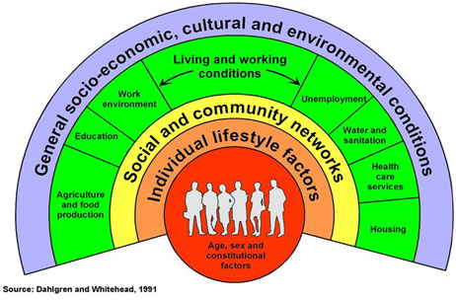
Notes:
The health inequality agenda goes to the heart of the NHS changes and the point of moving PH into LAs – they can only be tackled by concerted, coordinated effort between LA, primary care, acute trusts and others.
Social determinants also highlighted in the Marmot report – conditions in which people are born, grow, live, work and age

Slide 13
Health Literacy
A person with adequate health literacy is someone with the perception, reasoning and language knowledge for accessing, understanding and applying information for healthy living and keeping medically fit.
(WHO, 1998)

Slide 14
Poor Health Literacy
Individual
Organisational
Professional
Poor Health Outcomes

Slide 15
Health Illiteracy
mainly older
educated to lower standards
in low paid employment
lower socioeconomic influence
mostly of ethnic minorities
those with disabilities
poorer knowledge about health
acquire poor preventive care
poorer CDM
poorer mental health
attend A/E more often
admitted into hospital more frequently

Slide 16
Poor Health Literacy
Individual
Organisational
Professional
Cultural Competence
Poor Health Outcomes

Slide 17
Equality
Diversity
Race
Culture
Ethnicity

Slide 18
Diversity
The recognition and valuing of difference between people

Slide 19
Dimensions of diversity, some more visible than others
Gender
Age
Ethnicity
Nationality
Language
Skin colour
Religion
Disability
Class (wealth, education)
Occupation
Sexual orientation
Political orientation
Culture (beliefs, expectations, behaviour)

Slide 20
Equality
Is about creating a fairer society in which everyone has the opportunity to fulfil their potential

Slide 22
Equality Act (2010)- Prohibited Conduct
Direct discrimination, including by association and perception
Indirect discrimination – now covers all characteristics
Harassment
Third party harassment
Victimisation
Duty to make reasonable adjustments

Slide 23
Diversity and Equal Opportunities
Not about treating everyone the same
More about providing a LEVEL PLAYING FIELD
Equal access to opportunities

Slide 24
Defining terms...
Race
Ethnicity
Culture

Slide 25
Race
A socially defined population that is derived from distinguishable characteristics that are genetically transmitted eg skin colour, facial features, hair texture

Slide 26
Ethnicity
The belonging to a social group often linked by race, nationality, religion and language often with a common cultural heritage.

Slide 27
Ethnicity
Race
Religion
Language
Culture
Country of origin
Nationality

Slide 28
Culture
Shared beliefs, values and attitudes that guide the behaviour of group members

Slide 29
Culture
Shared beliefs, values and attitudes that guide behaviour of members
Complex social phenomenon, multi-dimensional
Dynamic concept - keeps changing
We are all multicultural but selective

Slide 30
Create working culture that recognise, respect, value and harness difference
Recognition and valuing of difference between people
Ability to interact with different cultures
Ability to respond to their healthcare needs
Cultural Competence

Slide 31
Self awareness
Culture biases
Different cultures
Communication
Assessment
Care provision
Skills
Attitudes
Knowledge
Valuing diversity
Respecting individuality

Slide 32
Cross-Cultural clinical skills, language barriers, using interpreters

Slide 33
Barriers to communication
Language
Accent
Nonverbal cues misinterpreted
Cultural assumptions and stereotypes
Preconceptions
Attitude towards another culture
Ethnocentricity
Unconscious bias

Slide 34
Barriers to communication
Lack of knowledge of healthcare system
Differences in health seeking behaviour
Doctor-patient roles unclear:
doctor centred
patients “told” what to do and they accept this
not used to being asked about their I, C, E
Not used to shared management plan
May be normal for children of elderly folk to be part of decision making

Slide 35
Consequences of poor communication
May make people appear awkward or difficult
Lack of English can make someone appear less intelligent, or lack sense of humour
Misinterpretation
“I don’t know how to help this person”
“Heartsink” patient

Slide 36
Overcoming barriers
Building relationship
Managing patient’s problems
Assessing patient’s problems

Slide 37
Cultural knowledge about...
Family life
Attitude to illness
Death and bereavement
Sexual issues
Dietary restrictions, alcohol
Childbirth, circumcision

Slide 38
Impact of culture on learning and teaching

Slide 39
Influence of Culture on Learning and Performance
Overseas Trainees confronted by a:
new culture
different educational system
different learning and teaching styles

Slide 40
Culture is not an excuse for poor performance but may put it into context

Slide 41
Power distance
In some cultures – quite large power distance teacher to student, led by teacher, not contradicted or criticised
In others - increasingly more self directed, encouraging to challenge knowledge
Potential implications – no experience of challenging or debate therefore unable to unpack the knowledge, difficulty with SDL

Slide 42
Individualism vs. Collectivism
Think of themselves as an individual with a focus on ‘I’
Individual excellence is nourished and celebrated
Learn to intuitively think of themselves as part of a group/family focusing on ‘we’
Unquestioning loyalty is expected and assumed

Slide 43
Potential implications
Exams are focussed on evidence of knowledge and recall vs knowledge applied to practice – requiring demonstration of critical reasoning
Need to maintain ‘face’, do not like ‘I don’t know’ – see it as a threat
Difficulty managing uncertainty

Slide 44
Useful interventions
Induction and preparatory work
Discuss their approaches to learning
Supervision and Support
Mentorship
Feedback on performance-good and bad
Correct performance problems as they occur
Encourage resilience

Slide 45
Implications for Educators
Be aware of your own cultural assumptions and biases
Appreciate the extent to which difficulties that arise are due to cultural factors
“Reality shock” and need to deal with unmet expectations
Induction – not only policies and procedures but also “cultural induction”

Slide 46
Cultural Induction
Raise awareness of culture
its effects on learning
its effect on performance
Discuss models of learning
Requirements of exams
Educational contract – this is not prejudice

Slide 47
Cultural Induction
Help their frustration and other emotions
Fear of failure/criticism
Self Directed Learning
Reflective practice
Managing uncertainty
Encourage resilience

Slide 48
Communication skills:
Deconstruct language
Problem solving skills
Overcoming artificiality and being formulaic
Interpersonal skills
Verbal and non-verbal cues
Subtleties and nuances of language
Doctor-Patient relationship

Slide 49
Professionalism
GMC
Confidentiality
Leadership and Teamworking
Feedback on performance-good and bad
Correct performance problems as they occur
Role modelling and Reflective practice

Slide 50
Cultural Competence
It’s always OK to ask
Keep questioning your assumptions
Remember–
culture is complex and multidimensional
culture is dynamic, not static
most people are a mixture of cultures

Slide 51
Cultural competence
Rationale, context, definitions
Health inequalities and literacy
Epidemiology of population health
Healing traditions and beliefs
Cross-Cultural Clinical Skills
Understanding language barriers and working with interpreters
Self-awareness of own culture, assumptions, stereotypes, biases and their impact
Impact of culture and learning and teaching

Slide 52
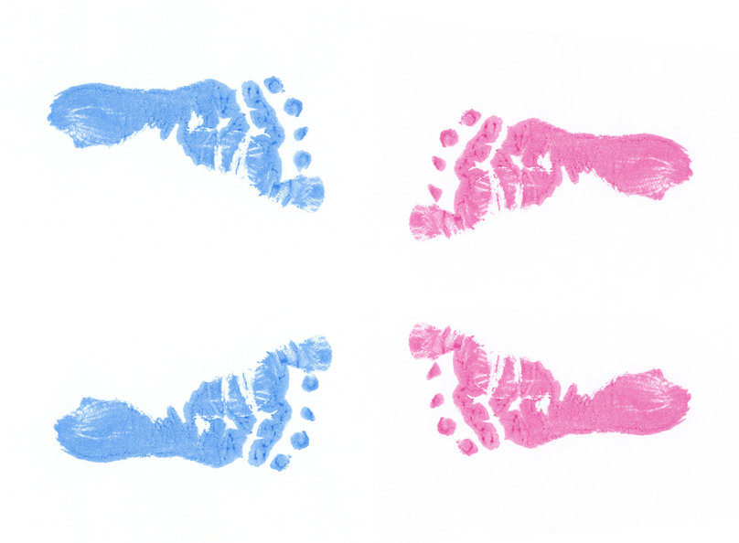
“The journey towards cultural competence is difficult and fraught with hazard. It also promises personal enrichment and self-discovery for those prepared to put in the effort.”
Laird (2008)

