Slide 1
Test Your Knowledge!
Dr Ooi Huah Chiang
ACCS-EM ST3
Colchester General Hospital
16/9/2020

Slide 2
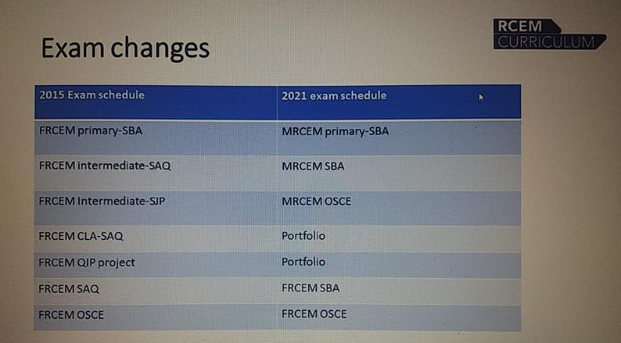
Changes coming 2021!

Slide 3
FRCEM Intermediate SAQ
60 clinical scenarios with 1-3 stems each
Duration: 3 hour
Covers ACCS ST1-ST3 curriculum as follows:
  Common Competencies x7
  ACCS Major/Acute Presentations x18
  ACCS Anaesthesia Competencies x4
  ICM within ACCS x2
  ST3 Adult Presentations (majority trauma) x6
  ST3 Paeds EM x11
  Practical Procedures x 12

Slide 4
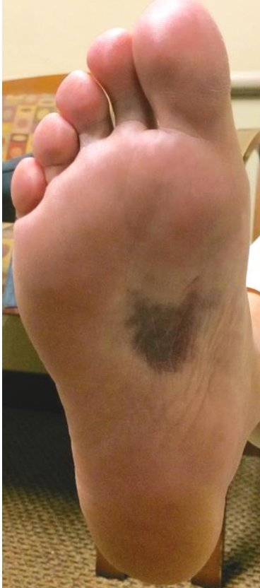
Q1 - A 23 year old female presents to your department after falling off a horse with her left foot trapped in the stirrup. She complains of pain and swelling in her left ankle and foot, and is unable to weightbear. On examination, you find the following:
What is the likely mechanism of this patient's injury? (1 mark)
List 2 images and views you will obtain for this patient (1 mark)
What is your provisional diagnosis? (1 mark)

Slide 5
Answers and Explanations
Rotational force on a plantarflexed foot
The other common MoIs for Lisfranc injury are crush injury and axial loading onto foot.
Left foot Xray - AP, oblique and lateral (weightbearing lateral if able)
Left ankle X-ray - AP and lateral
Don't forget ankle pain and inability to weightbear
Homework: Xray findings of Lisfranc injury!
Lisfranc injury
The photo shows plantar ecchymosis, which is classically associated with Lisfranc (tarsometatarsal joint) injury

Slide 6
Q2 - The GP has referred you a 68-year old lady who was found to have an INR of 7.0 on her latest review with no evidence of bleeding. She is on warfarin for atrial fibrillation, and was recently started on an antibiotic for a chest infection.
What antibiotic may cause this derangement? (1 mark)
What is your management? (1 mark)
This lady would like to be managed at home. What discharge advice would you give her? (1 mark)

Slide 7
Answers and Explanations
Macrolides
Look up other common drugs that affect warfarin therapy. Keep a mental list of examples ones that prolong effect, and ones that shorten
Omit next 1-2 doses warfarin, and repeat INR in 24 hours, then adjust maintenance dose
Oral vitamin K if high risk of bleeding
Stop or change antibiotic
Seek medical attention if fall or trauma to head, or other major bleeding (GI, intracerebral)
Avoid contact sports or high impact activities
Avoid alcohol and foods that may interact with warfarin

Slide 8
Overwarfarinisation
Major Bleeding
Minor Bleeding
No Bleeding
INR <5
INR <5
INR 5-8
INR 5-8
INR >8
INR >8
Look up management guidelines for each group

Slide 9
Q3 - You are planning the surgery for a 60-year old man who has sustained a left neck of femur fracture. The surgeon says he may need access to the posterior side of the left hip.
Which side will you ideally place your IV cannula? (1 mark)
What is the flow rate of an 18G cannula? (1 mark)
How would you minimise the complications of IV cannulation? (1 mark)

Slide 10
Answers and Explanations
Left antecubital fossa
If surgeon plans to access posterior, patient may be positioned right side down and compress veins of right upper limb. Also hip fractures and surgeries may have large volume losses and would require good venous access
90-100mL/min
Memorise all the cannula flow rates days before exam
Choose large straight veins, avoid veins over joints, ensure aseptic technique, flush with saline after insertion, dispose sharps into sharps bin, secure cannula dressing
Exam tip: If no specific number of answers requested, give one per line, and assume 1/2 mark per answer.

Slide 11
Q4 - You have just intubated a 30-year old male with a head injury. You review the ventilator settings which are:
TV 300; f 10; PEEP 5; FiO2 1.0; I:E 1:2
How would you adjust your settings in this patient? (1.5 marks)
What other non-pharmacological options can be used to manage a raised ICP before neurosurgical intervention? (1.5 marks)

Slide 12
Answers and Explanations
Increase TV (tidal volume) and f (resp rate) to achieve normocapnea
Reduce FiO2 to achieve sats 94-98%
Tidal volume and resp rate (sometimes labeled as 'f'requency) are your main controllers of PaCO2, while FiO2 and PEEP are your main controllers of PaO2. You may not want to increase PEEP in this situation for fear of raising ICP.
30 degrees head raise
Remove cervical collar
Cooling to avoid hyperthermia
Hyperventilation
Other managements eg normoglycemia, sedation, controlling seizures, osmotherapies etc involve medications so not appropriate answer
Fluids to maintain normovolemia may be considered a 'pharmacological' option so probably not accepted either

Slide 13
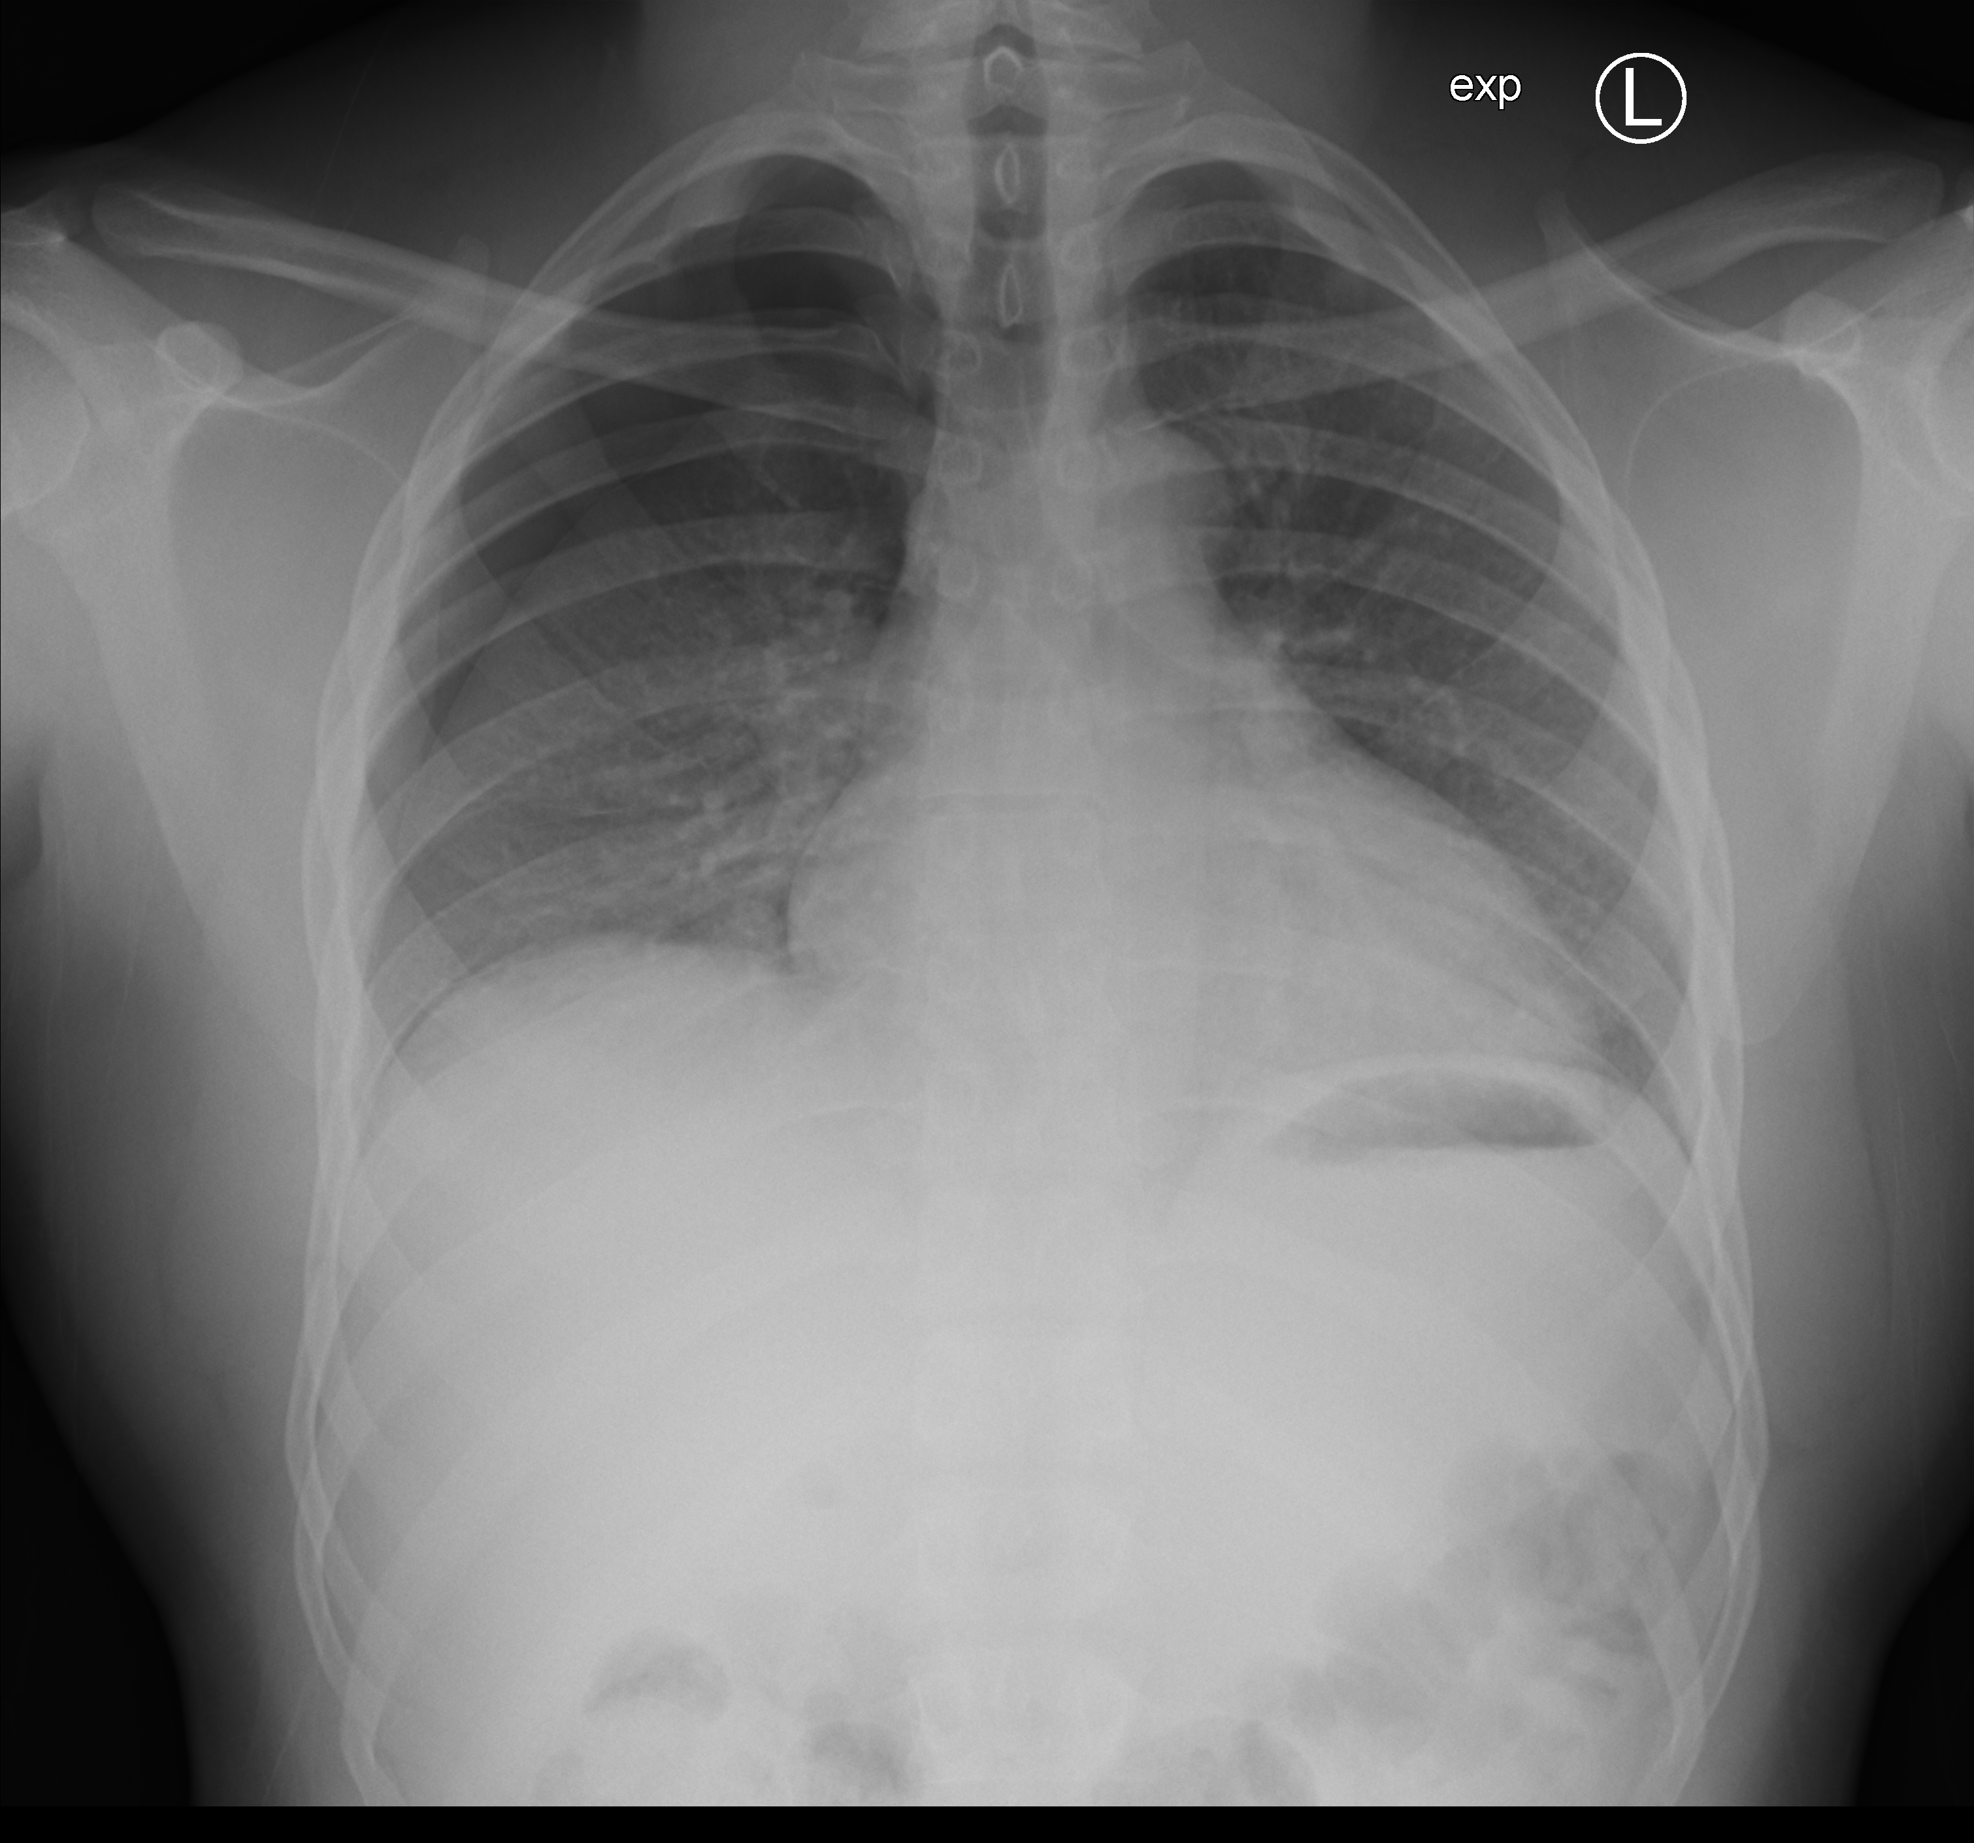
Q5 - A 48-year old heavy smoker presents to you with sudden right sided chest pain and shortness of breath. You obtain the following chest X-ray:
What is the diagnosis? What is your immediate management? (1 mark)
Give 1 absolute contraindication and 1 relative contraindication to Seldinger chest drain. (1 mark)
Give 2 complications of the procedure in this patient and how you may reduce the risk? (1 mark)
Case courtesy of Dr Andrew Dixon, Radiopaedia.org, rID: 48365

Slide 14
Answers and Explanations
Right sided secondary spontaneous pneumothorax
Oxygen and Seldinger chest drain insertion (if >2cm at hilum)
Sorry for contentious size. It's likely the exam will provide a measurement or a clearcut hilum distance
Absolute CI: Patient refusal; haemothorax
Relative CI: Coagulopathy, pleural adhesions, emphysematous bullae
Intercostal neurovascular bundle injury - Insert drain over the rib
Infection over insertion site - Ensure aseptic technique
Surgical emphysema - Ensure all distal lumens are in pleural space
Tube dislodgement - Suture and secure dressing
Liver/Diaphragm injury - Insert in safety triangle and be careful of excessive needle/tube angulations

Slide 15
Thank You!

