Slide 1
Annual School Development Plan 2025-26
Notes:
Standard title slide

Slide 2
Themes
From GP Programme Development Plans
2024
Notes:
Standard title slide

Slide 3
Successes:
Increased face to face teaching/more purposeful hybrid sessions
Adjustments to SCA exam/preparation
Co-operative working across patches and with area TPDs
Increased learning organizations and educators
Pastoral support/supporting TiDs
Several excellent local educator events
Practice Manager meetings
SuppoRTT uptake

Slide 4
Challenges:
Room capacity for HDR
Admin support (local)
Admin support capacity (central)
Hospital CS engagement
Some quality challenges in 2ry care
Programme capacity (1ry care)
Educator and trainee morale
Challenging trainees

Slide 5
Context
Time of considerable uncertainty within deanery, ICBs and wider NHS
General theme across NHS that finances are tightening rather than additional resource.
Key focus this year will again rest in prioritising and delivering core service rather than significant innovation or radical reform*.
Notes:
*unless national directive

Slide 6
6 key strands:
Placement Capacity
Learner Support
Educator Support
System Involvement
Quality Management
EoE
Primary Care School

Slide 7
Placement Capacity (1/2)
Placement Capacity
Continue work on growing placements such that the expanded expansions in numbers in 2027 and 2028 can be accommodated
Successfully declare the expanded GP rotations for Round one 2026 (expected to be 480)
Increase PCN learning organisation numbers – minimum target 3 per ICB (based on current ICS areas)
Continue work on growing placements such that the expanded expansions in numbers in 2027 and 2028 can be accommodated

Slide 8
Placement Capacity (2/2)
Placement Capacity
Roll out the pilot of Blended Learning Placements
Run a 36 month community programme pilot with appropriate evaluation
Work with Foundation School to identify 2 new GP placements per ICS area

Slide 9
Learner Support (1/2)
Learner Support
Refresh/replace the ITAR group
Relaunch Trainee Forum
Implement a Peer review system for PLPs to share best practice
Implement Quality Assurance System for SOX Supervision

Slide 10
Learner Support (2/2)
Learner Support
Provide more pre-CCT fellowships aligned to the 10YP / three shifts
To work with Commissioning, Quality and N&M Teams, HEIs, and THs, to support the improvement and uptake of the GPN Fundamentals Programme
Work with MPS post Leng Review publication
Reestablish Consulting and Thinking programme
Review and update GP Study Leave Policy

Slide 11
Educator Support
Educator Support
Work towards delivering an in person regional event for GP educators after an enforced hiatus.
Create a workstream supporting trainers workshops with guidance and resource
Deliver TPD development day focussed on personal development
Work with training hubs and trainers workshops to ensure the increased numbers of new educators are supported in their early years post-approval.
Introduce guidance on supporting educators on return from prolonged absence

Slide 12
System Involvement
System Involvement
Work with the Nurse and Midwifery team to support and our new primary care Nurse lead, to work on nurse educator pathway for ACPs, FCPs and nurses.
We will link with ICBs to share best practice on EDI matters in primary care across the region.
Support Training Quality and Expansion Leads in training hubs.
Continue to support the regions training hubs during this period of NHS structural change
We will work with ICBs on estate strategy to ensure primary care education targets might be considered.
To work with THs, Systems, and N&M team, to collate & support placements and newly qualified professionals within Nursing, in Primary Care.

Slide 13
Quality Management
Quality Management
Review the rating of O&G hospital posts across the region and consider if further work is needed to improve satisfaction with these placements.
Continue the intervention with a programme in BLMK which raised concerns on last years GMNC survey. .
Work to increase the completion rate of the GMC survey amongst GP trainees across the region
Work with THs to standardise application/approval processes – especially around payments/finances and to resolve discrepancies between deanery and training hub data.
Continue the formal school visits in response to concerns, but look to develop a template to generate a report from the ongoing programme of informal visits.

Slide 14
Finance
Cost Code | Cost Code Description | Detail | 25/26 Budget allocation
126059 | EE Postgraduate Medical - GP inc RTP | Salary costs during GP Placements Tariff payments for Hospital Placements Trainers Grant TERS Apprenticeship Levy Indemnity Lead Employer Costs | £113, 156, 171
126060 | GP Trainee Support | Educational Supervision CPD Excess Travel / Relocation Study Leave | £2, 387, 069
126066 | EE Fellow Posts | PC Allocation of fellowship Budget | £386, 856
Notes:
Increase of approx. £300k
Increase of approx. £75k

Slide 15
Finance
Cost Code | Description | 24/25 Budget
125855 | GP Educators | £2,465,740
125862 | Primary Care Training Hub (PCS) | £627,391
125862 | Primary Care Training Hubs (System) | £1,862,610
125864 | IMG Support ES | £587, 933
Notes:
Cost pressures already on all of these budgets due to the annual uplifts

Slide 16
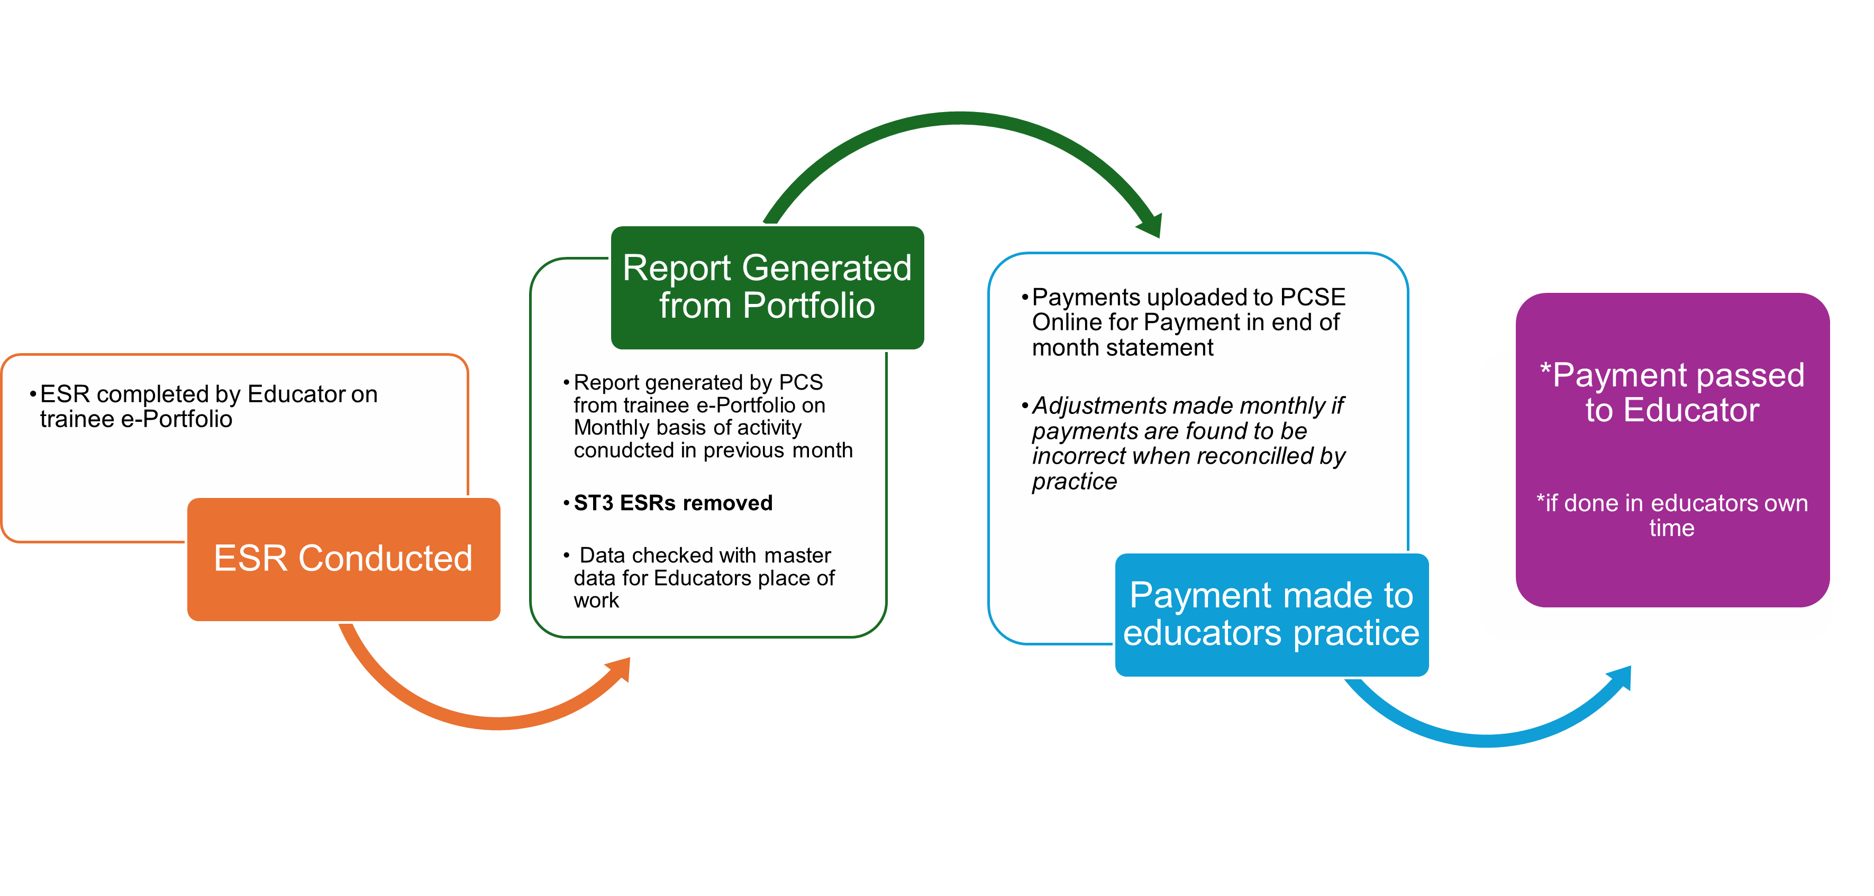
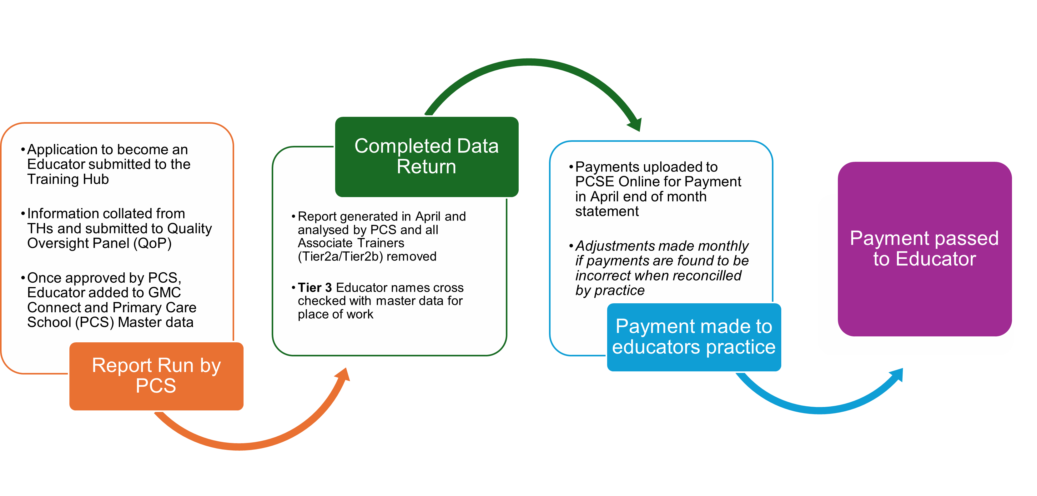
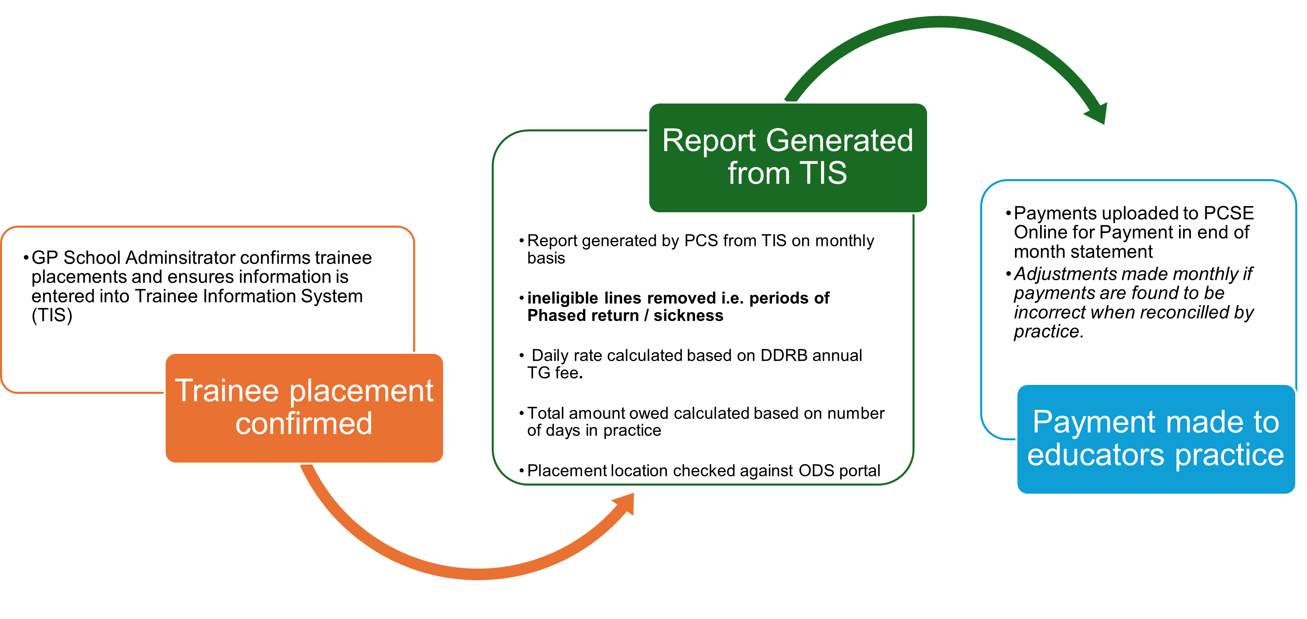
GP Practice payments
Previously paid twice yearly
Moved to monthly ESR and TG payments
Moved to April CPD payments

Slide 17
Fellowships
All fellowships are now pre-cct
International Support and Deprivation fellow programmes continued
Final ST4 fellows finishing this year
To be replaced by Transformation Fellowship – Supporting the three shifts
New fellowship added – Integrated Neighbourhood Working
PG Cert offer for all appointed fellows
Fellows development programme

Slide 18
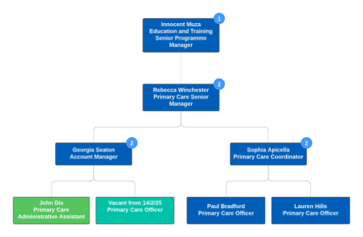
PCS Capacity
Notes:
Capacity remains fairly unchanged from the previous slightly reduced position although limited impact on number of workstreams delivered
Work to commence in august on review workload distribution in readiness for potential structure changes, and based on some development programmes we are undertaking as a team (strengths based approach)
Ambitious plans recording and reporting outcomes, particularly for GP trainees

Slide 19
Recruitment to educator roles
Educator roles remain exempt in the current climate
FTCs until October 2026
Gt Yarmouth, Ipswich, C&P area roles appointed to
Harlow / Southend outstanding
Capacity funding Educators

Slide 20
Post Audit
ODS codes
Site names
Educator names
Other data quality issues

