Slide 1
Approving Educators and Learning Environments
John Kedward & Kate Wishart

Slide 2
Workshop plan
Round to elicit wants and needs (flipchart)
Aims & Objectives?
Give out standards – GMC and AoME
Divide into groups
Pick one set of standards
Consider what evidence needed to demonstrate the standards – for environment and trainer
Plenary to discuss
Give out evidence list/ process documents?

Slide 3
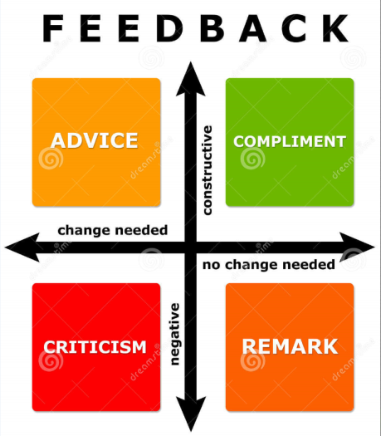
Design/ planning of learning activities
AoME standards
Teaching/ supporting learners
Assessment & Feedback
Educational management & leadership
& Evidence based practice

Slide 4
GMC standards
Patient safety
Learning environment & culture
Developing/ implementing curriculum & assessment
And leadership
Supporting learners and educators

Slide 5
Application evidence
Completed application form
Last report
Successful completion of relevant course
Equality & Diversity certificate
Statement of satisfactory performance from employer (if appropriate)
Induction timetable/ plan
Trainee timetable including teaching timetable
Teaching and learning plan
Applicant’s learning as an educator (2yrs)
Peer feedback on teaching (3yrs)
CQC report
Primary care web-tool evidence
Feedback from current and previous trainees/ TPDs

Slide 6
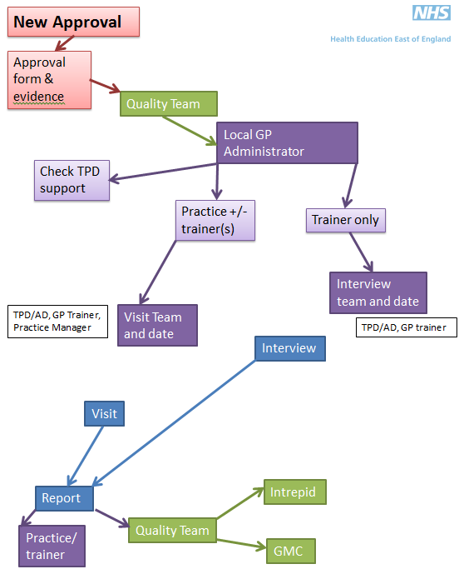

Slide 7
