Slide 1
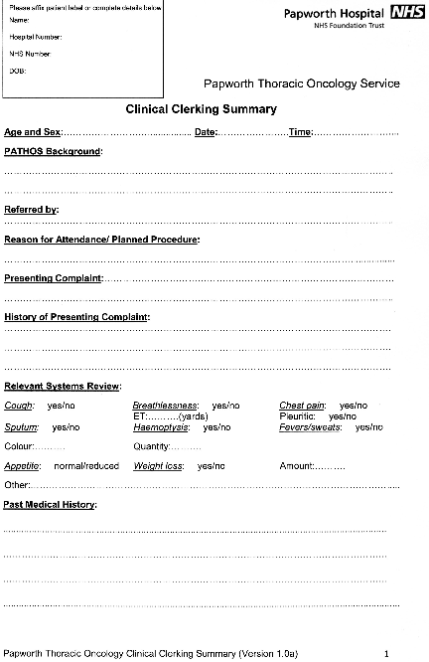
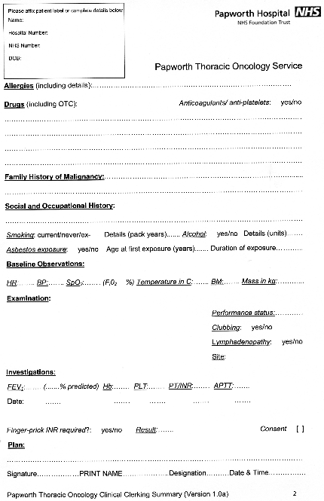
Papworth Thoracic Oncology Service (PATHOS) Proforma Project A. Ćorović
Background
The Papworth Thoracic Oncology Service (PATHOS) is a leading regional centre for the investigation and management of patients presenting with suspected thoracic malignancy. The Service receives referrals from across the region for diagnostic procedures, including fibre-optic bronchoscopy, endobronchial ultrasound-guided fine needle aspiration and CT-guided needle biopsy. As part of the Service, referred patients are assessed on the Thoracic Day Ward at Papworth Hospital, where full clinical clerking is undertaken prior to procedures being performed. The information gained from this initial assessment, together with that sent by the referring centres, forms the basis for subsequent Multi-Disciplinary Team (MDT) discussion and decision-making for the cases that come through the Service.
Fig 1. The PATHOS Clerking Proforma
Needs Identified
Prior to the commencement of this QIP, clerkings undertaken on the Thoracic Day Ward were documented in the patient’s main medical notes. The format of these clerkings had hitherto been very variable in the amount and quality of the information provided, yet it is clear that the MDT needs certain key information to be known about the patients referred to the Service. The aim of the PATHOS Proforma Project was to design a concise yet informative clinical clerking summary document, with clear sections for the documentation of information thought most relevant to the Service. A well-completed clerking proforma would: i) facilitate the MDT’s discussion and decision-making for the patients seen through the Service; ii) facilitate audit by having all relevant information held in one place; iii) may obviate the need for multiple clerkings for patients returning to the Service for repeated procedures.
The Project in Practice
A clinical clerking summary proforma (Fig. 1) was designed, with the needs of the Service in mind. The aim was to have a one-sheet (two-sided) document that was easily identifiable in the patient’s medical notes [by colour] and that held all the relevant information about the patients seen through the Service in one compact location. Interested parties (consultant medical and nursing staff) were consulted about the key information that needed to be encapsulated in the proforma. The finished document was submitted for approval to the hospital’s medical records committee, whereupon it was approved by Chairman’s action. The project was also presented at a departmental meeting. The PATHOS Proforma has been in trial since 27th April 2015.

