Slide 1
Current Management of Heart Failure GP clinical update 17th June 2015
Dr Raj Bilku
Consultant Cardiologist
Clinical Lead Cardiology QEH

Slide 2
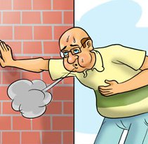
HF Definition
Multiple and inadequate definitions
“Inability of the heart (cardiac pump) to deliver adequate oxygenation (via blood flow) to tissues”
Different types (and definitions):
Acute vs. Chronic
Left vs. Right
Symptomatic vs. Asymptomatic
Systolic vs. Diastolic

Slide 3
Definition of Heart Failure
Classification | Ejection Fraction | Description
I. Heart Failure with Reduced Ejection Fraction (HFrEF) | ≤40% | Also referred to as systolic HF. Randomized clinical trials have mainly enrolled patients with HFrEF and it is only in these patients that efficacious therapies have been demonstrated to date.
II. Heart Failure with Preserved Ejection Fraction (HFpEF) | ≥50% | Also referred to as diastolic HF. Several different criteria have been used to further define HFpEF. The diagnosis of HFpEF is challenging because it is largely one of excluding other potential noncardiac causes of symptoms suggestive of HF. To date, efficacious therapies have not been identified.
a. HFpEF, Borderline | 41% to 49% | These patients fall into a borderline or intermediate group. Their characteristics, treatment patterns, and outcomes appear similar to those of patient with HFpEF.
b. HFpEF, Improved | >40% | It has been recognized that a subset of patients with HFpEF previously had HFrEF. These patients with improvement or recovery in EF may be clinically distinct from those with persistently preserved or reduced EF. Further research is needed to better characterize these patients.

Slide 4
Epidemiology
Increasing in prevalence
Affects 1-2% of UK population
Estimated 2-5% population over 65 years (10% over 75 years)
Many undiagnosed
Commoner in Western world
Major burden on health care resources
Worse prognosis than many forms of cancer

Slide 5
The prognosis of heart failure is as bad as for many cancers
One year survival rate %
British Heart Foundation, 2002
Notes:
The figure shows the one year survival rates for heart failure and the main cancers in England and Wales for the mid-1990s.
Petersen S, Rayner M, Wolstenholme J. Coronary heart disease statistics: heart failure supplement. London: British Heart Foundation, 2002.

Slide 6
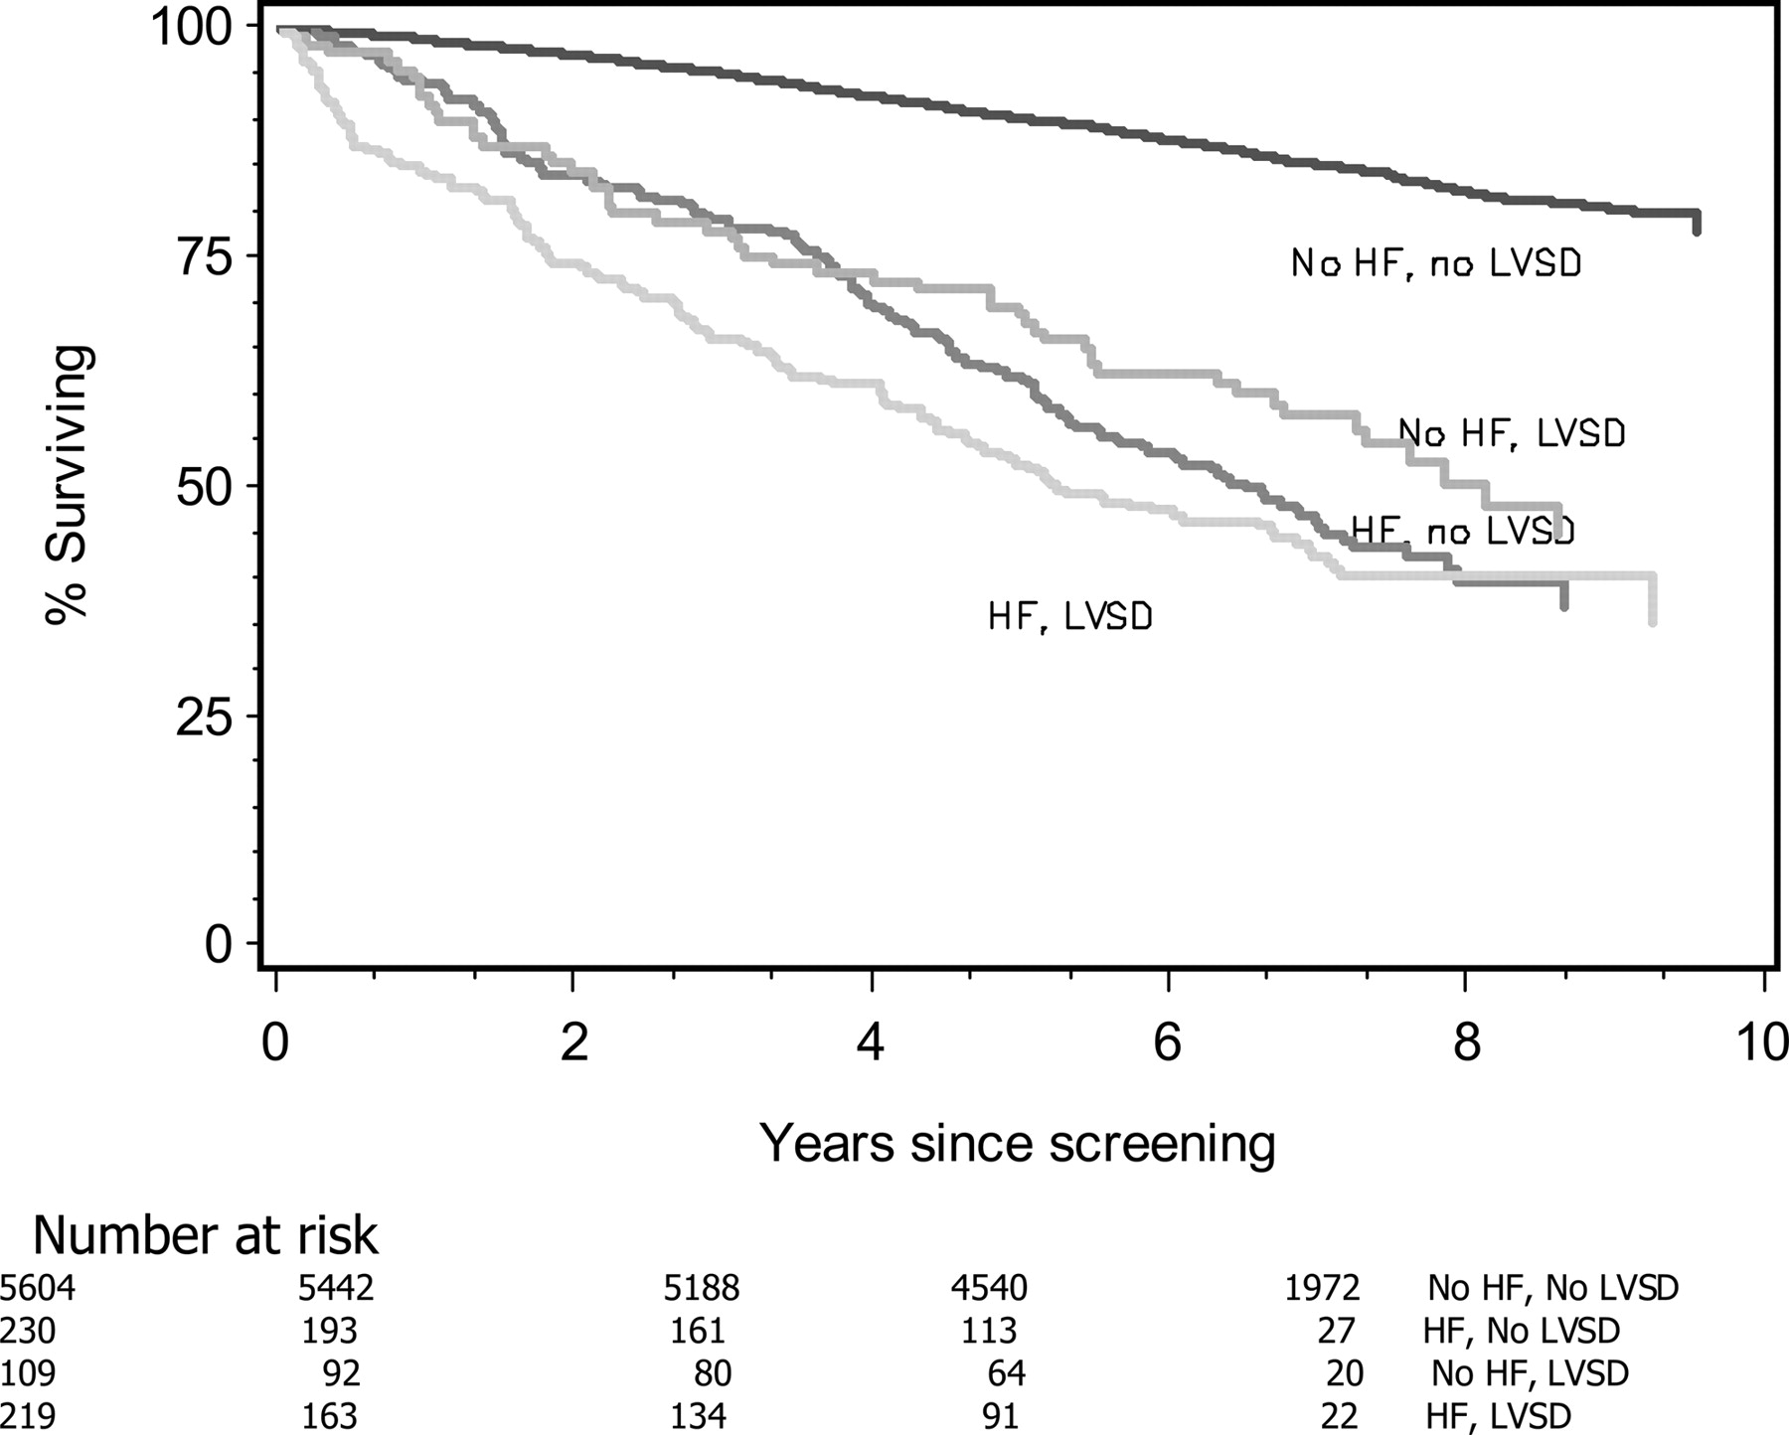
Kaplan–Meier curves showing the effect of heart failure and left ventricular systolic dysfunction on survival.
F.D. Richard Hobbs et al. Eur Heart J 2007;28:1128-1134
© The European Society of Cardiology 2007. All rights reserved. For Permissions, please e-mail: journals.permissions@oxfordjournals.org
Notes:
Kaplan–Meier curves showing the effect of heart failure and left ventricular systolic dysfunction on survival.

Slide 7
NYHA functional classification, 1964
Class I | No limitations on activity. No fatigue, breathlessness or palpitation on ordinary physical activity |  | Annual mortality 3-5%
Class II | Patients are comfortable at rest but ordinary physical activity such as climbing stairs or doing housework results in symptoms | ‘Mild’ heart failure | Annual mortality 10%
Class III | Patients have a marked limitation of physical activity. Although patients are comfortable at rest, less than ordinary physical activity will lead to symptoms | ‘Moderate’ heart failure | Annual mortality 12-16%
Class IV | Patients have symptoms even at rest and are unable to undertake any physical activity without discomfort | ‘Severe’ heart failure | Annual mortality 15-20% Worse prognosis than most cancers
Notes:
Once a diagnosis of heart failure has been made, the severity of symptoms and level of incapacity can be categorised according to the New York Heart Association (NYHA) classification. This classification recognises four classes in which symptoms increase in severity, increasingly limiting the ability of patients to undertake normal daily activities.
Task Force for the Diagnosis and Treatment of Chronic Heart Failure, European Society of Cardiology. Guidelines for the diagnosis and treatment of chronic heart failure. Eur Heart J 2001;22:1527–60.

Slide 8
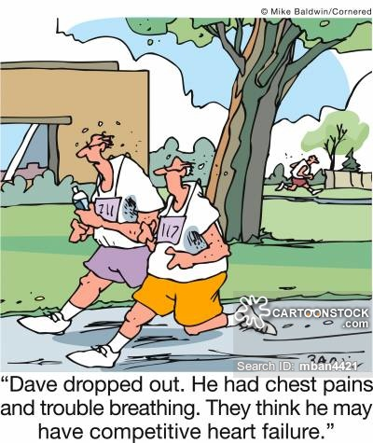
Aetiology
Commonest cause is IHD
Other Causes:
Dilated Cardiomyopathy
HBP (LVH)
viral (post myocarditis),
valvular disease, drugs, alcohol, thyroid disease
Arrhythmia
Chronic RV pacing

Slide 12
Causes for Elevated Natriuretic Peptide Levels
Cardiac | Noncardiac
Heart failure, including RV syndromes Acute coronary syndrome Heart muscle disease, including LVH Valvular heart disease Pericardial disease Atrial fibrillation Myocarditis Cardiac surgery Cardioversion | Advancing age Anaemia Renal failure Pulmonary causes: obstructive sleep apnea, severe pneumonia, pulmonary hypertension Critical illness Bacterial sepsis Severe burns Toxic-metabolic insults, including cancer chemotherapy and envenomation

Slide 14
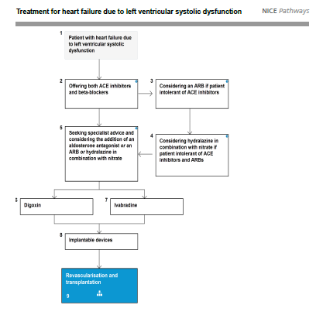

Slide 18
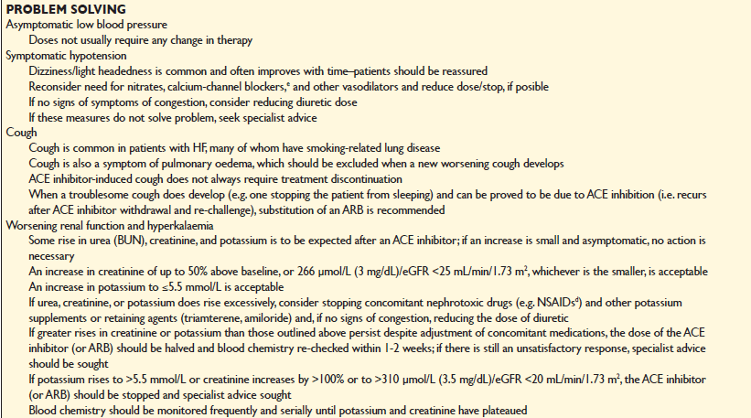

Slide 19
Device Therapy for Heart Failure
(also known as CRT or BiV)

Slide 20
LBBB
LBBB

Slide 21
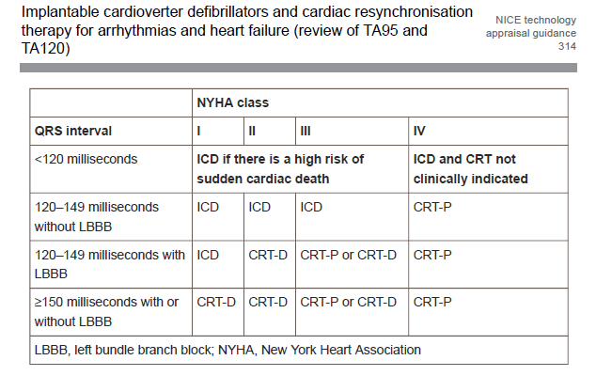
Table 1 Treatment options with ICD or CRT for people with heart failure who have left ventricular dysfunction with an LVEF of 35% or less (according to NYHA class, QRS duration and presence of LBBB)

Slide 22
Summary
CHF is a growing problem
Diagnosis can be difficult
BNP used as a screening test – not a replacement for echocardiography
Ensure optimal medical therapy including new treatments
Perform ECG to see if there is a device option

