Slide 1
ACID BASE DISORDERS
Nikki Yeo
Critical Care Clinical Fellow
Royal Papworth Hospital

Slide 2
Metabolic Acidosis: Anion Gap
[Na⁺] - [Cl⁻] - [HCO₃⁻]
Reference range 8 – 12 (+/- 4) mmol/L
Sometimes [K⁺] is included:
[Na⁺] + [K⁺] - [Cl⁻] - [HCO₃⁻]
* Relative to the three other ions, [K⁺] is low and typically does not change much so omitting it from the equation does not have much clinical significance.
Notes:
AG: normal range varies from 2-10mmol/L to 12+/-4

Slide 3
HAGMA and NAGMA
High Anion Gap Metabolic Acidosis (HAGMA):
Gain of anions (endogenous or exogenous)
Normal Anion Gap Metabolic Acidosis (NAGMA)
Hyperchloraemia
Bicarbonate loss

Slide 4
HAGMA | NAGMA
Renal failure | Iatrogenic: Saline Parenteral nutrition Carbonic anhydrase inhibitors
Ketoacidosis: Diabetic Alcoholic Starvation | Renal losses: Renal tubular acidosis Uretoenterostomy
Lactic acidosis | GI losses: Diarrhoea Small bowel/pancreatic drainage
Toxins: Methanol Ethylene glycol Salicylates Metformin Pyroglutamic acid
Notes:
Parenteral nutrition containing acetate

Slide 5
Lactic Acidosis
Type A: Imbalance between oxygen supply and demand | Type B: Altered metabolism
Reduced supply -Reduced tissue oxygen delivery: hypoxaemia, anaemia -Impaired tissue utilisation: CO poisoning -Hypoperfusion: Shock | B 1: Underlying disease Leukaemia, lymphoma Thiamine deficiency, infection,pancreatitis Failures: renal, liver
Increased demand: anaerobic muscle activities Seizures Sprinting | B 2: Drugs Beta agonists salicylates Cyanide Ethanol, methanol
 | B 3: Inborn errors in metabolism
Notes:
Lactate: product of anaerobic glycolysis. 50% eliminated by liver. Ethanol- increased hepatic NADH and decreased conversion of lactate to pyruvate

Slide 6
Other Considerations
Hypoalbuminaemia:
Albumin is a an anion
Hypoalbuminaemia decreases the AG
=> For every 10 g/L below normal, add 2.5 to anion gap

Slide 7
Delta Ratio
determine if there is a 1:1 relationship between increase anion gap and decrease in HCO₃⁻
Delta ratio = ___increase in anion gap__
decrease in HCO₃⁻
< 0.4: associated hyperchloraemia NAGMA
0.4-0.8: consider HAGMA and NAGMA
1-2: uncomplicated HAGMA
>2: pre-existing metabolic alkalosis or compensation to chronic respiratory acidosis

Slide 8
Causes of Low Anion Gap
Increased Unmeasured Cations | Decreased Anion | Artefactual Hyperchloraemia
Hypercalcaemia | Hypoalbuminaemia | Iodism
Hypermagnesaemia |  | Bromism
Lithium intoxication |  | Hypertriglyceridaemia
Multiple myeloma
*Table reproduced from Toxicology Handbook

Slide 9
Base Excess and Standard Base Excess
Base excess definition:
Dose of acid or base required to return the pH of a blood sample to 7.40
Measured at standard conditions: 37°C and 40mmHg (5.3 kPa) PaCO₂
isolates the metabolic disturbance from the respiratory
Standard base excess definition:
Dose of acid or base required to return the pH of an anaemic blood sample
Calculated for a Hb of 50g/L
Haemoglobin buffers both the intravascular and the extravascular fluid
=> SBE assesses the buffering of the whole extracellular fluid, not just the haemoglobin-rich intravascular fluid

Slide 10
Causes of Metabolic Alkalosis
Chronic hypercapnia
GI losses
Vomiting
NG losses (chloride loss)
Renal Losses
Diuretics
Primary hyperaldosteronism
Cushing’s syndrome
Bartter’s syndrome
Volume contraction
Hypochloraemia
Hypokalaemia
Administration of bases
Antacids

Slide 11
Summary of Acid Base Assessment
Step 1:
Acidaemia (pH < 7.35)
Alkalaemia (pH > 7.45)
Step 2:
Respiratory acidosis or alkalosis
Metabolic acidosis or alkalosis
Step 3:
AG if metabolic acidosis present

Slide 12
Step 4:
Check degree of compensation
Metabolic acidosis
Expected PaCO₂ (in mmHg) = (1.5 x HCO₃⁻) + 8
Or,
For every 1mmol/L decrease in HCO₃⁻ , PaCO₂ should decrease by 1.3mmHg
Metabolic alkalosis
Expected PaCO₂ (in mmHg) = (0.7 x HCO₃⁻) + 20
Or,
For every 1mmol/L increase in HCO₃⁻, PaCO₂ should increase by 0.6mmHg
* Conversion of mmHg to kPa ÷ 7.5
Notes:
Boston method

Slide 13
Step 4 cont:
Respiratory acidosis
For every 10mmHg (1.3 kPa) increase in PaCO₂, HCO₃⁻ should increased by 1 mmol/L (acute) or 4 mmol/L (chronic)
Respiratory alkalosis
For every 10mmHg decrease (1.3 kPa) in PaCO₂, HCO₃⁻ should decrease by 2 mmol/L (acute) or 5mmol/L (chronic)
Step 5:
Determine the delta ratio

Slide 14
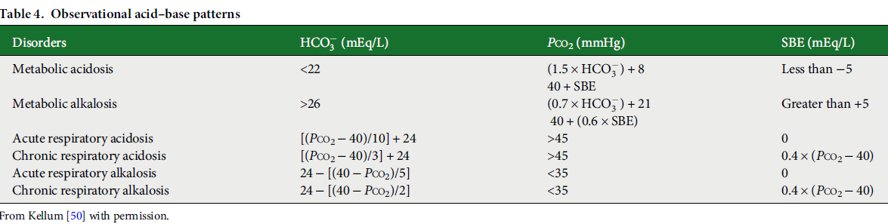

Slide 15
Question 1
62 year old lady with history of multiple bowel surgeries and severe rheumatoid arthritis presented to ED with abdominal pain and diarrhoea.

Slide 16
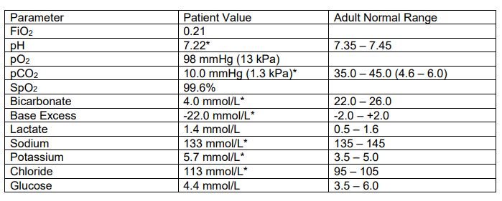
Step 1: Acidaemia or alkalaemia
Step 2: respiratory acidosis/alkalosis
metabolic acidosis/alkalosis
Step 3: AG ([Na]-[Cl]-[HCO₃⁻] (ref 8-12)
Step 4: Compensation
Step 5: Delta ratio
Notes:
Extra questions: if she was hypotensive, what could be the causes?

Slide 17
Step 1: Acidaemia
Step 2: metabolic acidosis
Step 3: AG=133-113-4 = 16 (HAGMA) (ref range 8-12)
Step 4: Compensation
Expected pCO₂ = (1.5 x 4) + 8 = 14 mmHg (1.9 kPa)
=> respiratory alkalosis
Step 5: Delta ratio
16-12/ 24-4 = 0.2 (associated hyperchloraemic NAGMA )

Slide 18
Question 2
A 60-year-old male was admitted after an argument with his partner who found him, 2 hours later, unconscious in his workshop, having likely ingested an unknown substance with empty liquid bottles around him.
Describe the significant abnormalities in the results below:

Slide 19
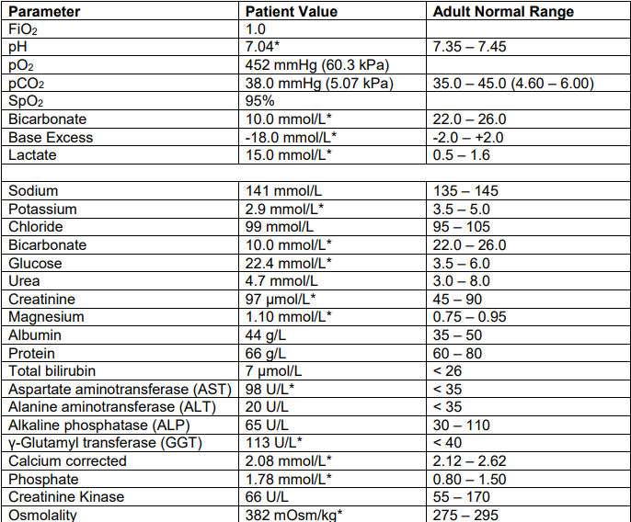

Slide 20
Question 2
Step 1: Acidaemia or alkalaemia
Step 2: respiratory acidosis/alkalosis
metabolic acidosis/alkalosis
Step 3: AG ([Na]-[Cl]-[HCO₃⁻] (ref range 8-12)
Step 4: Compensation
Step 5: Delta ratio

Slide 21
Question 2
Step 1: Acidaemia
Step 2: Metabolic acidosis
?Respiratory acidosis
Step 3: AG 141-99-10=32 (ref 8-12)
Step 4: Compensation
Expected pCO2 (1.5 x 10)+8= 23
Respiratory acidosis/incomplete compensation
Step 5: (32-12)/ (24-10) = 1.4 (HAGMA)
Osmolar gap

Slide 22
Question 3
72 year old man presented to ED with abdominal pain, nausea and vomiting. PMH: T2DM and AF

Slide 23
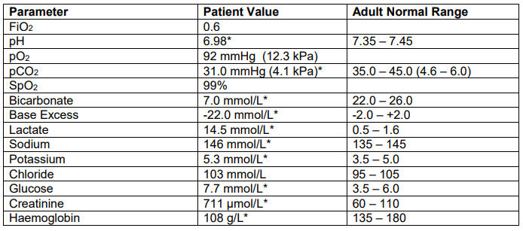
Step 1: Acidaemia or alkalaemia
Step 2: respiratory acidosis/alkalosis
metabolic acidosis/alkalosis
Step 3: AG ([Na]-[Cl]-[HCO₃⁻] (ref 8-12)
Step 4: Compensation
Step 5: Delta ratio

Slide 24
Step 1: Acidaemia
Step 2: metabolic acidosis
?respiratory acidosis
Step 3: AG ([Na]-[Cl]-[HCO₃⁻] = 36 with profound lactic acidosis
Step 4: Compensation
Expected pCO₂= (1.5x7) + 8 = 19.9 mmHg = 2.7 kPa
Step 5: Delta ratio
(36-12)/(24-7) = 1.4
Notes:
Causes for metabolic acidosis

Slide 25
Question 4
23 year old female admitted with severe asthma

Slide 26
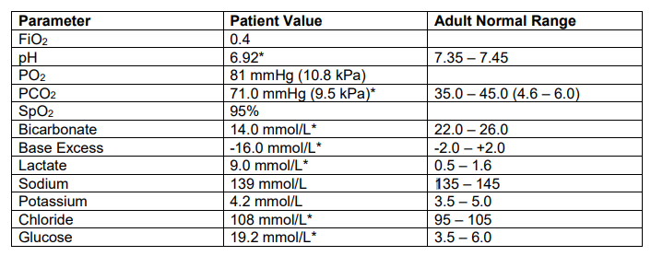
Step 1: Acidaemia or alkalaemia
Step 2: respiratory acidosis/alkalosis
metabolic acidosis/alkalosis
Step 3: AG ([Na]-[Cl]-[HCO₃⁻] (ref 8-12)
Step 4: Compensation
Step 5: Delta ratio

Slide 27
Step 1: Severe acidaemia
Step 2: respiratory acidosis
metabolic acidosis
Step 3: AG (139-108-14 ) = 17 with lactic acidosis (ref 8-12)
Step 4: Compensation
Expected HCO₃⁻ 24+ 3 [(71- 40) = 31]
Expected pCO₂ = (1.5x 14 )+ 8 = 29 mmHg = 3.9 kPa
Step 5: Delta ratio (17-12)/(24-14) = 5/10 = 0.5 (HAGMA and NAGMA)
Notes:
Elevated lactate – sepsis, B2 agonist use Elevated glucose – pre-existing diabetes, stress, B2 agonist, stero

Slide 28
Question 5
35 year old female presented to ED with poorly controlled hypertension, paraesthesia and weakness. Her blood results are as follow:

Slide 29
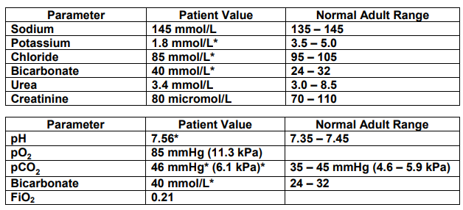
Step 1: Acidaemia or alkalaemia
Step 2: respiratory acidosis/alkalosis
metabolic acidosis/alkalosis
Step 3: AG ([Na]-[Cl]-[HCO₃⁻] (ref 8-12)
Step 4: Compensation
Step 5: Delta ratio

Slide 30
Step 1: Alkalaemia (severe hypokalaemia)
Step 2: metabolic alkalosis
Step 3: AG ([Na]-[Cl]-[HCO₃⁻] (ref 8-12)
Step 4: Compensation
pCO₂ = (0.8x 40) +20 = 42 mmHg = 5.6 kPa
Step 5: Delta ratio
Notes:
Causes: Primary Hyperaldosteronism most likely secondary to an aldosterone producing adenoma (Conn’s syndrome – 50 – 60%) or adrenal hyperplasia (40 – 50%). • Licorice ingestion. • Liddle’s syndrome. • Excessive diuretic use.

Slide 31
References
Al-Jaghbeer M, Kellum JA. Acid base disturbances in intensive care patient: etiology, pathophysiology and treatment. Nephrology Dialysis Transplantation 2015; 30(7): 1104-1111.
Murray L, Daly F, Little M, Cadogan M. Acid Base Disorders. Toxicology Handbook. 2nd Ed. Elsevier Australia, 2011: 658-685.
Derangedphysiology.com
UpToDate.com
Litfl.com

