Slide 1
Therapeutics and Safer Prescribing How to avoid error ?
Carolyn Meredith East and North Hertfordshire NHS Trust

Slide 2
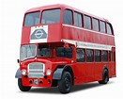
How common are medication errors?
10% of patients harmed
Nearly 2 bus loads per week per Trust

Slide 3
How common?
1 in 8-20 prescriptions have an error
1 in 400 – severe
60,000 serious incidents reported year
harm or death - 92 severe harm
38 deaths
Notes:
Of these,
the most common type of error was wrong dose, strength or
frequency of medication (28.7 per cent). Systems for checking
doses are essential for those prescribing, dispensing and
administering medication.
Omitted medicines were also commonly reported
Of these,
the most common type of error was wrong dose, strength or
frequency of medication (28.7 per cent). Systems for checking
doses are essential for those prescribing, dispensing and
administering medication.
Omitted medicines were also commonly reported

Slide 4
What is meant by a Never event ?

Slide 5
Never event
Never Events are serious, largely preventable patient safety incidents that should not occur if the available preventative measures have been implemented.

Slide 6
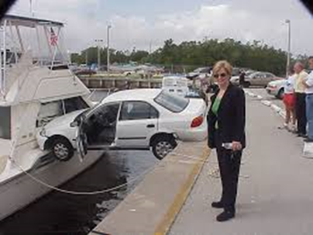
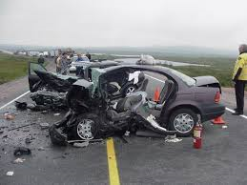
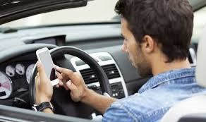

Slide 7
Never events
Wrong site surgery
Retained instrument post-operation
Wrong route administration of chemotherapy
Misplaced naso or orogastric tube not detected prior to use
Inpatient suicide using non-collapsible rails
Escape from within the secure perimeter of medium or high secure mental health services by patients who are transferred prisoners
Maternal death from PPH after elective caesarean section
Maladministration of a potassium-containing solution
Wrongly prepared high-risk injectable medication
Maladministration of Insulin
Overdose of midazolam during conscious sedation
Opioid overdose of an opioid-naïve patient
Inappropriate administration of daily oral methotrexate
Failure to monitor and respond to oxygen saturation
Wrong gas
Air embolism
Transfusion of ABO-incompatible blood components
Falls from windows/ Entrapment in bed rails/severe scalding
Misidentification of patients

Slide 8
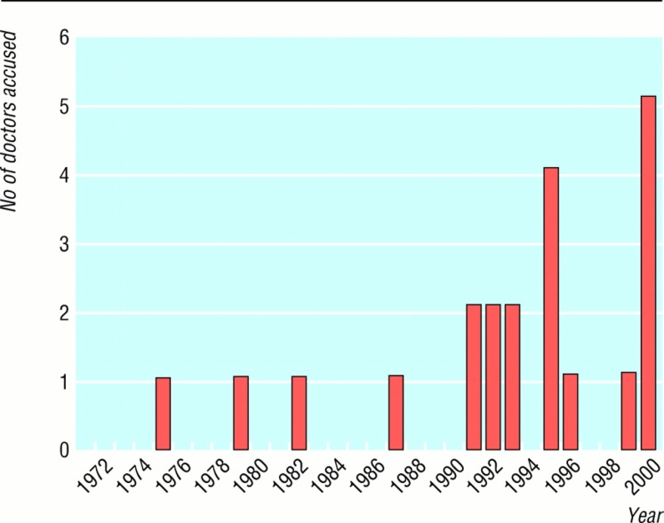

Slide 9
Medication never events 2018
Administration of medication by the wrong route
Overdose of insulin due to abbreviations or incorrect device
Overdose of methotrexate for non-cancer treatment
Mis-selection of high strength midazolam during conscious sedation
Mis-selection of a strong potassium solution

Slide 10
Any other high risk drugs?

Slide 11
What are the high risk drugs?
Insulin
Opiates
Warfarin
Methotrexate
Antibiotics

Slide 13
What type of Prescribing
errors can occur?
Wrong dose, strength or frequency of medication
Omitted medicines
Wrong drug
Wrong route

Slide 14
Insulin prescribing – wrong dose errors ?

Slide 16
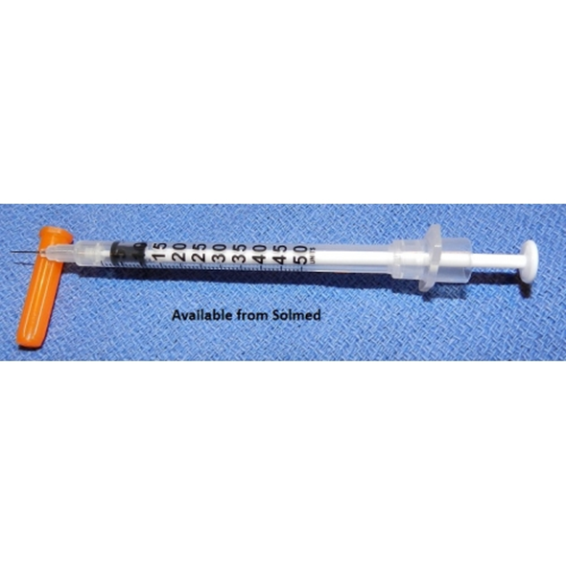
Insulin prescribing - Only ever use insulin syringe (orange top)

Slide 18
Methotrexate prescribing

Slide 20
Methotrexate Policy
Must not be prescribed (or administered) for any acute admissions
Relevant speciality team (e.g. gastro, dermatology, rheumatology) must review the patient and decide if still appropriate.
DO NOT ADMINISTER unless the Pharmacy checklist is attached and complete.
Be familiar with the Methotrexate Policy

Slide 21
Antibiotic anaphylaxis
Penicillin containing antibiotics
penicillin G, V, amoxicillin, ampicillin, cloxacillin, flucloxacillin, piperacillin, and ticarcillin
The clinical notes of a patient showed a record of penicillin
allergy but amoxicillin had been prescribed in the past.
From these old prescriptions it was assumed that
amoxicillin would be safe and it was prescribed again. The
patient died later that day as a result of the anaphylactic
reaction. (Death)
Augmentin
Tazocin

Slide 22
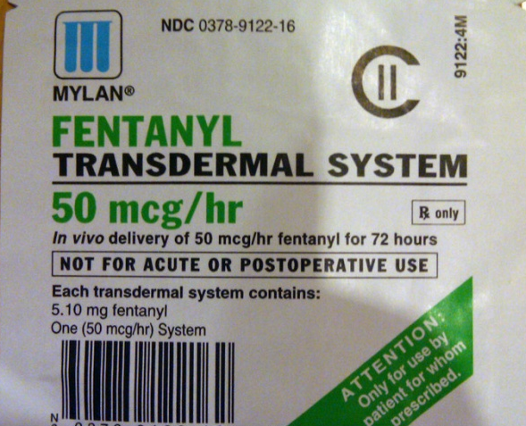
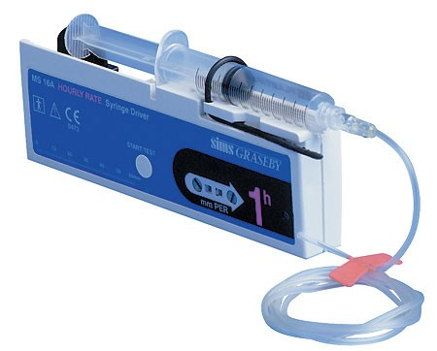
Problem drugs - Opioids
Fentanyl Patches Risk or errors and overdose 50mcg/hr patch=120mg po morphine Trust policy: Consultant only initiation | Alfentanil Injection/infusion 10x stronger than diamorphine i.e. 50mg alfentanil = 500mg diamorphine
If in doubt about prescribing opioids always ask for advice!

Slide 23
Ward prescribing of opiates – SI themes
87 year old male deterioration of Myasthenia Gravis -ptosis and mild dysarthria.
Forced vital capacity (FVC) reading as 1.74 litres reduced to 0.46 litres over 48 hrs. Normal RR and Sp02 98%
Prednisolone and IV immunoglobulins
Difficulty swallowing – SALT team

Slide 24
At 18:40 nursing staff documented patient had “become panicky”.
The on-call doctor was contacted who prescribed PRN Oramorph. Patient JW was given 10 mg Oramorph and documentation at 23:30 stated he had settled and was calm and comfortable

Slide 25
During the night - very anxious and had had a “panic attack”.
At 05:10, A full assessment was done, including an ABG which showed ;
pH = 7.28
pC02 = 7.89
p02 = 21.62
HC03 (act) = 27.2
BE = -0.9
What would you do next?

Slide 26
Patient JW was given further Oramorph “to calm him” and his oxygen stopped.
pH = 7:08
pC02 = 16.11
p02 = 8.22
HC03 (act) = 35.0
BE = 0.7

Slide 27
Beware the label of “panic attack” !!!!!!!!!!!!!!!!!!
Do not “treat” incipient respiratory failure with medication which is a respiratory depressant

Slide 28
Critical medicines
What are they?
Drugs that must never be missed/delayed
List available on knowledge Centre also poster on all wards
At risk groups – become NBM
Notes:
Insulin / anti parkinsonian/ anti epileptic/ diabetes/ immunosuppression

Slide 29
Back to basics
Refer to Trust policy on all high risk medication
Don’t rely on your memory! - MEDUSA IV Guide, BNF, prescribing guides
Get to know your pharmacist – use there expertise
Handwriting
Drug charts
Be aware of lookalikes

Slide 30
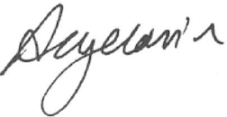
Handwriting!

Slide 31
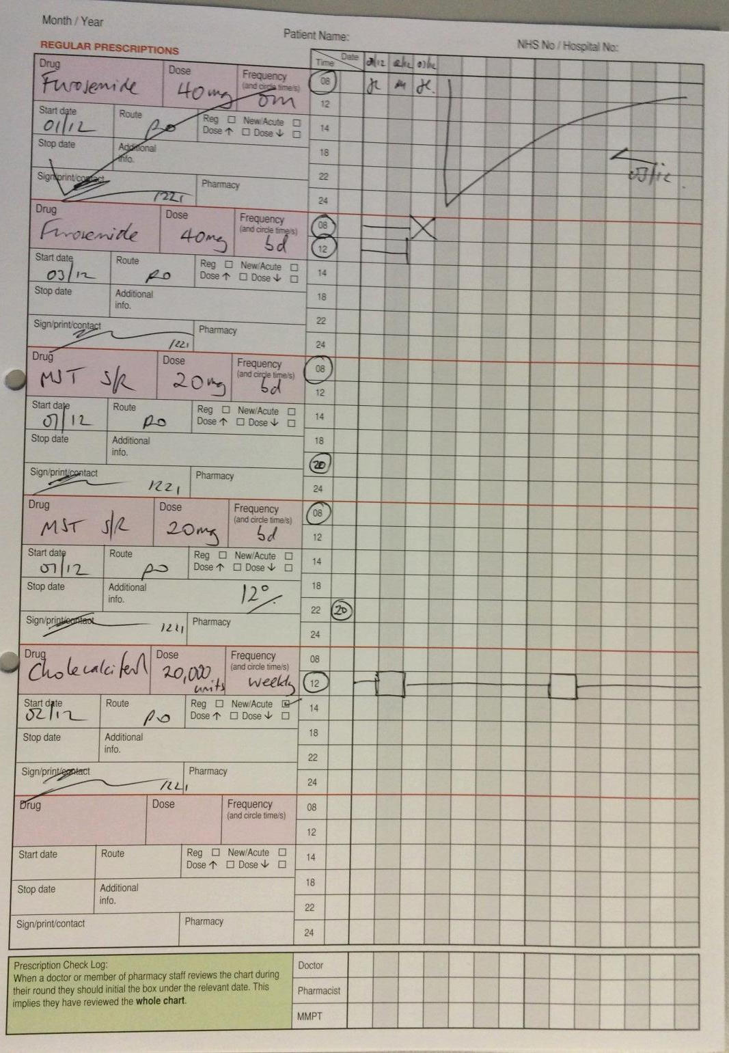
Cross out
drug and administration boxes.
Sign and date each time
You have to re-write every time you make ANY changes
Please don’t amend times
Use the blank boxes instead
Box and block out days appropriately
Start date- make sure this is correct on transcribing
Have you ever noticed this box..?

Slide 32
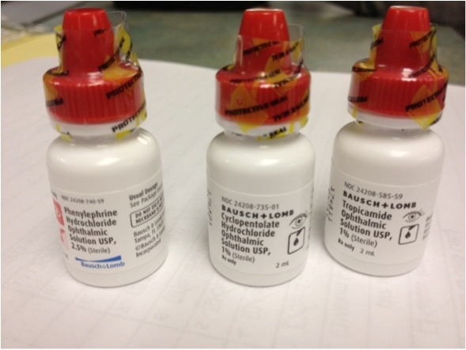
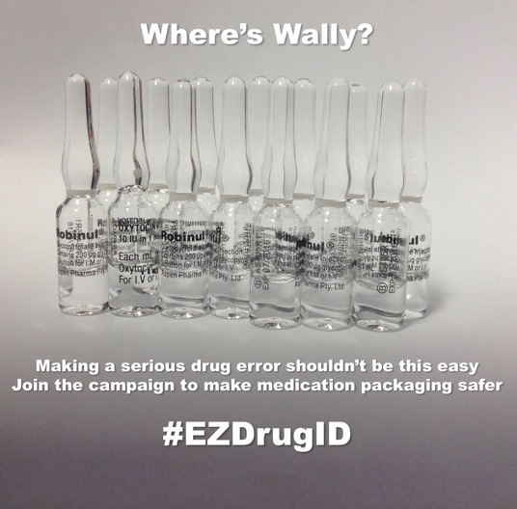
Look alikes – sound alikes
vinblastine and vincristine
cefotaxime and cefuroxime
morphine and diamorphine
adrenaline and amiodarone
hydroxyzine and hydralazine
amiodarone and allopurinol
prostacyclin and prostaglandin
bisacodyl and bisoprolol

Slide 34
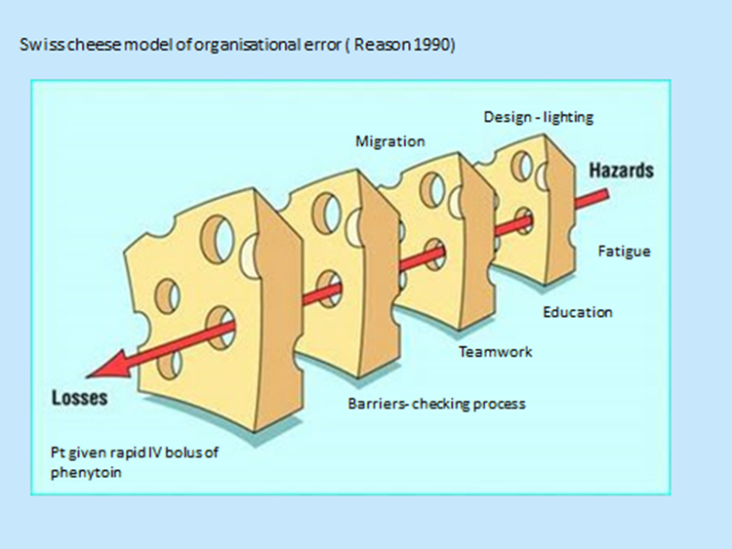

Slide 35
Any questions ?
Thankyou

Slide 36
Extended interval Gentamicin
Trust uses 5mg/kg/dose in patients with CrCl ≥20ml/min
maximum daily dose of 400mg irrespective of weight.
Dosing interval dependant on renal function and/or levels taken and plotted on Urban-Craig nomogram.
Please refer to full Trust Antibiotic Policy on Knowledge Centre, download the micro app or speak to your ward pharmacist.
Notes:
36

Slide 37
Controlled Drug Prescribing
Common cause of delay with TTOs!
Need name, strength and form of medicine and dose
Need total quantity in words and figures
e.g. 60 (sixty) x morphine sulphate 10mg S/R tablets
100ml (one hundred ml) of morphine sulphate 10mg/5ml solution
5 (five) x midazolam 10mg/2ml amps
Remember: tramadol and temazepam are (unfortunately) now CDs

Slide 38
Missed Doses
Updated trust policy ‘ Reducing harm from delayed and omitted medication’
Nursing staff should alert you when they are unable to give a critical medication
You will need to action this and document the plan in the notes

Slide 39
The updated Trust policy for reducing harm from delayed and omitted medicines (CP142)

Slide 40
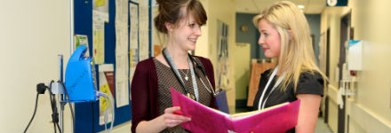
How can your pharmacist help you?
Medicines reconciliation
Now accessible to pharmacists anytime via SCR
Need patient consent
Provide guidance/advice on
Drug/Dose/Regimen selection & preventing harm
Interactions
Administration
Adverse drug reactions
Therapeutic drug monitoring
Guideline production
Audits
Drug expenditure/savings

Slide 41
Doctors own prescribing policy
Trust drugs are for patients only
Get a GP if you haven’t got one.
You cannot self prescribe
Occupational Health available

