Slide 1
Health Visiting and the Healthy Child Programme 0-5
Tracey Cogan, Head of Public Health, NHS England, East Anglia
24th June 2014

Slide 2



The Context – What changed in health 2013?
NHS commissioning responsibility shared between NHS England and CCGs
Public Health commissioning responsibility shared between local authorities and NHS England.
Public Health England and PHE Centres created
Health Education England created
Foundation Trust achievement rules changed
Not a change, but we are still focused on the money!

Slide 3

Commissioning for Health Visiting
Government commitment to increase the numbers of Health Visitors by 4200 by 1 April 2015
New national service specification
New reporting arrangements for providers
Transfer of commissioning responsibility for health visiting and Family Nurse Partnership (FNP) to local authorities in October 2015
Commitment for health visiting to be an integral part of the Healthy Child Programme and health visitors to be leaders of the programme.
Notes:
Revised trajectories in 2014.
National service spec reflects transfer of commissioning responsibility to LA. Work underway to ensure the specs meet local need.
Dashboard, new KPIs, Unify submissions
Working with LA s to ensure a smooth transition of commissioning responsibility
HV as the lead for HCP 0-5 with a coordinated response by other professions and agencies to ensure an integrated HCP

Slide 4


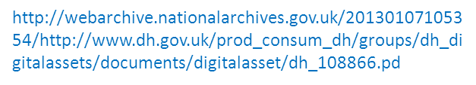
The Healthy Child Programme
Pregnancy and the first five years of life
From 5 – 19 years old
https://www.gov.uk/government/uploads/system/uploads/attachment_data/file/167998/Health_Child_Programme.pdf
Notes:
Chief Medical Officer annual report focusing on child health recommends an update of the HCP, starting with 0-5. Recognising the crucial role it plays in child health and for future adult health

Slide 5
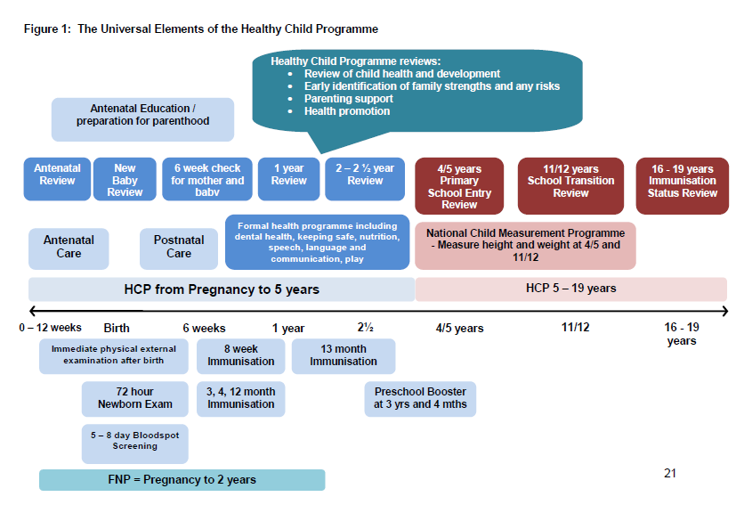


Slide 6
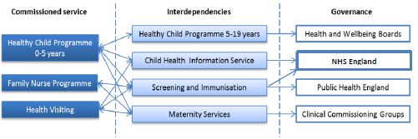
Interdependencies and ensuring a seamless pathway

Slide 7

Priorities of the HCP 0-5
Strong Parent Child attachment and positive parenting
Better Social and emotional wellbeing among children
Children are healthy and Safe
Reduction in unhealthy weight
Prevention of serious and communicable diseases through increased immunisation rates
Increased breastfeeding initiation and continuation rates
Readiness for school and improved learning
Early detection of developmental delay and abnormalities
Identification of factors that could influence health and wellbeing in families
Better short and long term outcomes for those at risk of social exclusion

Slide 8
Outcomes demonstrated from the HCP
Health Visiting
Overall, health visiting is able to demonstrate:
Improvements in parenting - self reported and observed.
Improved cognitive development, especially among some sub-groups of children such as those born prematurely or born with low birth weight
A reduction in accidental injury among children
Improved detection and management of post-natal depression
Improved rates of breastfeeding.
The health visiting service uses evidence based practice for delivery.
Demonstrating health outcomes will be an essential focus for the future.
Elkan et al (2000) The effectiveness of Domiciliary Health visiting – systematic review

Slide 9
Outcomes demonstrated from the HCP
Focus – Family Nurse Partnership
FNP has one of the best evidence bases for preventive early childhood programmes, an example of just some outcomes include:
Decreases in smoking during pregnancy
48% reduction in verified cases of child abuse and neglect by age 15
56% reduction in A&E attendances for injuries and ingestions during child’s second year of life
Better language and emotional development at age 4
28% reduction in 12 year olds mental health (anxiety and depression) problems
Mothers have increased confidence and aspirations for future

Slide 10
Key Challenges
The need for health and local government to focus on the older age group, vulnerable and elderly
The financial resource available and the requirement to make improvements without additional funding
Shift in focus to keeping patients out of hospital
Demand on primary care and specialised services
Joining up commissioning intentions
Within HCP 0-5:
Midwifery to health visiting pathway
Primary Care involvement
Adult Mental Health Services involvement
Health visitor role in safeguarding and supporting vulnerable families
Time for the HV to promote good health outcomes
Nos. of midwives and school nurses
Geographical boundaries – Resident/Registered
Loss of skill mix

Slide 11
What can we all do?
Build on the current excellent joint working
Support providers to redesign services within existing financial resource
Ensure service users are able to tell us about their experiences of using our services and their views influence service change
Address health inequalities as an integral part of what we do
Consider the contribution that everyone can make to improving outcomes for 0-5 and their families and gain commitment
Learn from the Integrated commissioning and delivery toolkit for HCP 0-5 and ensure it influences our commissioning and delivery decisions for 15/16 onwards.

Slide 12

HCP Integrated Commissioning and Delivery Toolkit Overview
Key sections
Best practice pathways – 17 in total
Guidance/Enablers
Outcomes & Key performance Indicators
Workforce Development

Slide 13
Toolkit Overview
17 Pathways
Single Universal Pathway
8 Universal Plus Pathways
8 Universal partnership Plus Pathways

Slide 14
Phase 2 til November 2014: Five Pilots Sites
Suffolk
Norfolk
Bedfordshire
Cambridgeshire & Peterborough
Hertfordshire
Maternal mental health
Antenatal pathway > 10 days post birth
Integrated outcomes and KPIs

Slide 15
Deliverables and Timescales
Pilot Sites - Pathways
Review and test appropriate elements of the Universal pathway
Review and test both the Universal Plus and Universal Partnership Plus pathways
Provide an evaluation of the testing identifying:
  Operational constraints/difficulties
  Changes to the pathways based on either best practice or evidence
  Lessons learnt
Contribute to and review the final Integrated Commissioning & Delivery Toolkit

Slide 16
Deliverables and Timescales
Pilot Sites – Outcomes & KPIs
Review and Revise HCP Ambitions
Review and articulate local child population health outcomes
Review and revise/develop additional KPI’s
Establish local systems and process for delivery of integrated monitoring of the HCP
Provide an evaluation of the above identifying:
  Operational constraints/difficulties
  Changes to the current toolkit based on either best practice or evidence
  Lessons learnt
Contribute to and review the final Integrated Commissioning & Delivery Toolkit

Slide 17






What can we all do?
Be outcomes focused rather
than service focused

Slide 18
Thank you
Tracey Cogan
Head of Public Health
NHS England East Anglia tracey.cogan@nhs.net
Mobile: 07956331416

