Slide 1
Improving outcomes for children and young people: a Public Health perspective
Sally Hogg
Assistant Director of Public Health
Suffolk County Council

Slide 2
Public Health: our new world!
Employed by local government
Health and Wellbeing Board
Joint Strategic Needs Assessment
Joint Health and Wellbeing Strategy
Public health nurses – school nurses, health visitors
Wider public health family
Co-production
The public

Slide 3
What do we mean - Public Health?
Public health is about helping people to stay healthy, and protecting them from threats to their health. We want everyone to be able to make healthier choices, regardless of their circumstances, and to minimise the risk and impact of illness.

Slide 4

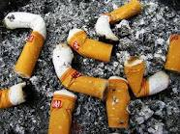
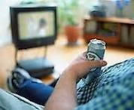
Causes of inequality

Slide 5
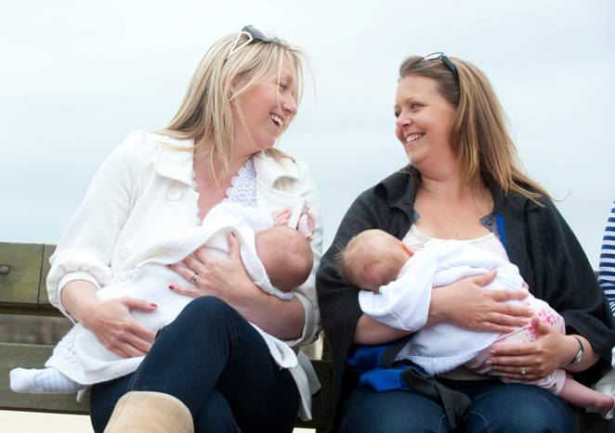
Public Health: commissioners for
0-19 public health nursing services
Prevention and health promotion core of early intervention
Asset based approaches
Safeguarding as a golden thread
Wider determinants
Evidence & evaluation
New opportunities

Slide 6
Key policy documents
Health & Social Care Bill (2012)
Healthy Child Programme: Pregnancy and the First Five Years of Life (DH, 2009)
Healthy Child Programme: 5-19 (DH, 2009)
Healthy Lives, Healthy People (DH, 2010)
Fair Society, Healthy Lives (Marmot, 2010)
Our children deserve better: prevention pays (CMO, 2012)
HV Implementation Plan: 2011-2015

Slide 7


Joint Health & Wellbeing Strategy

Slide 8
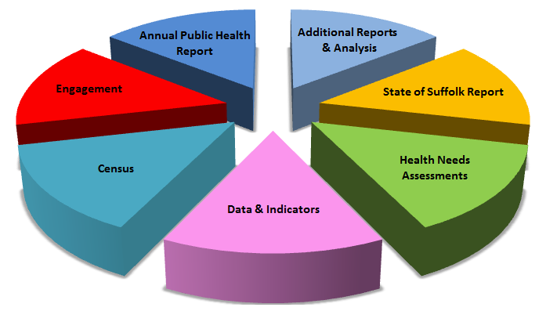
Joint Strategic Needs Assessment

Slide 9
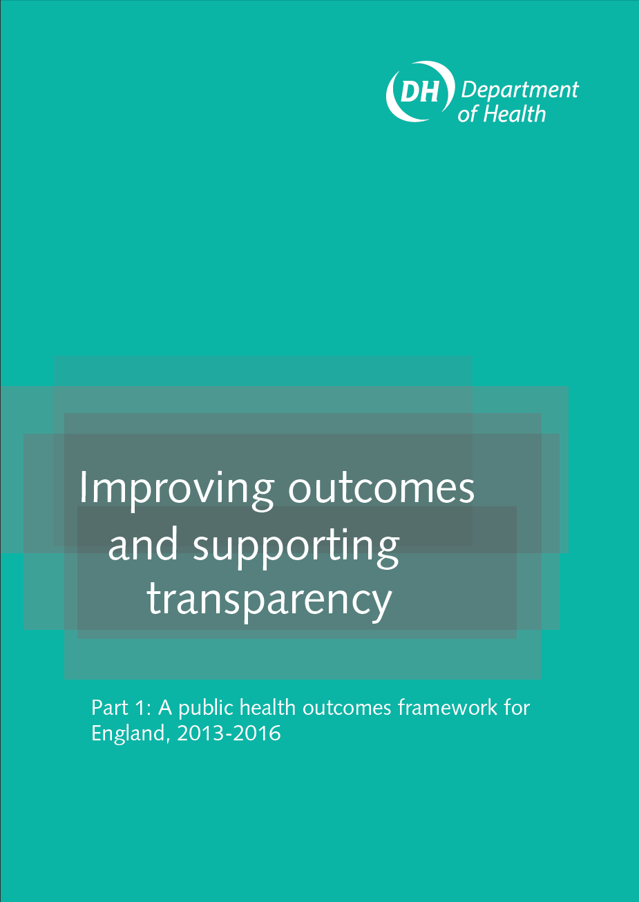
The Public Health Outcomes Framework
Improving the wider determinant of health
Health improvement
Health protection
Healthcare public health and preventing premature mortality
Notes:
9
The framework sets out the broad range of opportunities to improve and protect health across the life course and to reduce inequalities in health that still persist, focusing on two high-level outcomes to be achieved across the public health system. These are:
increased healthy life expectancy
reduced differences in life expectancy and healthy life expectancy between communities
The two high-level outcomes are supported by 66 public health indicators, taking a life course approach, organised in four domains shown in the slide
As with the high level indicators, not all can currently be measured and are identified in the PHOF as “placeholders”. For some of these indicators the data is not available, and for others the definition requires further clarification. The Department of Health intends to improve this range of information over the coming year and the framework also sets out how it intends to do that, with engagement and involvement of partners at local and national levels.

Slide 10
Child and Maternal Health (ChiMat)
Public Health England
Child Health profiles
- Local authority level
- Interactive
Tools & data
Maternity
Mental health
Young people
Youth justice

Slide 11
PREview
A set of planning resources for commissioners, managers and practitioners.
Based on evidence identifying the factors in pregnancy and infancy that are associated with outcomes and five years.
Focused on the Healthy Child Programme.
Focuses decision making about resources, and which families require support to affect outcomes at five.

Slide 12
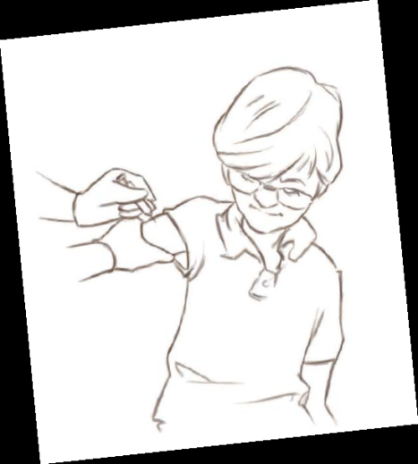
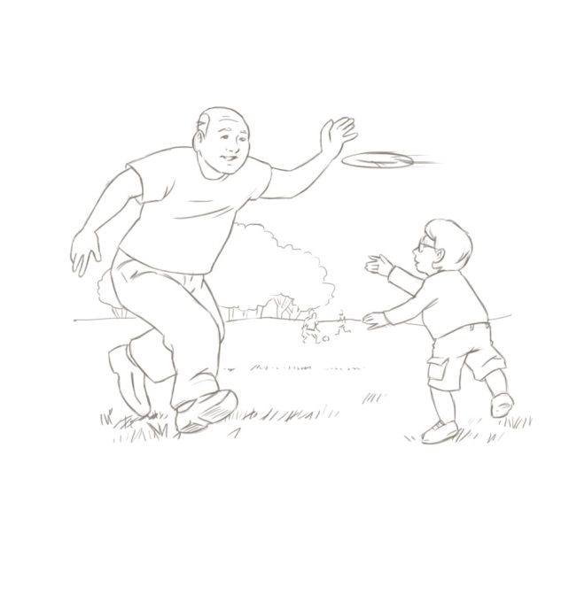


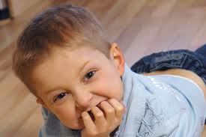
1001 Critical Days
The importance of conception to age two period: a cross party manifesto(2013)

Slide 13
