Slide 1
Referrals to the Patient Pathway Co-ordinator Following Suspected Malignancy at OGD Alice Malpas (CT1) Natasha Corballis (FY1)
Learning To Make a Difference
James Paget University Hospital

Slide 2
Project Aim(s)
To improve rate of referrals (by faxed copy of an OGD report) to the patient pathway co-ordinators (PPC) of suspected upper gastrointestinal (GI) malignancy by 100% within a 4 month period.
According to hospital guidelines OGD reports should be faxed to PPC
PPC reported this did not happen.
Manual searches/random referrals from UGI CNS/Consultants
Learning To Make a Difference
James Paget University Hospital

Slide 3
Action Planning
What are we trying to accomplish? | Increase same day faxed referrals to 100% in a 4 month period.
How will we know that a change is an improvement? | Patient pathway co-ordinator - time and energy saving. More reliable referral method.
What changes can we make that will result in improvement? | Reminder to all endoscopists. Posters in endoscopy suite. Fax number easily available Name and Shame Alter structure of endoscopy report.
Act
Plan
Study
Do
Learning To Make a Difference
James Paget University Hospital

Slide 4
Process mapping
PPC misses patient with suspected malignancy, not placed on pathway
Patient lost to follow-up/support
ISSUES
Local guidelines and protocols not met.
PPC adds patient to upper GI cancer pathway
PPC searches for OGD reports to add to pathway/depends on others to inform them
Patient undergoes OGD
Oesoph/ gastric cancer detected
Patient informed, CT requested, follow-up planned
Learning To Make a Difference
James Paget University Hospital

Slide 5
Driver Diagram
Documentation
Education
Administration
Endoscopist documentation to fax report
Endoscopist
Nurse
Administration staff
Fax referrals
Nurses
Administration staff
Endoscopy form layout
Knowledge of protocols
Knowledge of protocols
Knowledge of fax numbers
PRIMARY DRIVERS
SECONDARY DRIVERS
Aim: To improve faxed referrals to the patient pathway co-ordinators (PPC) of upper gastrointestinal (GI) malignancy by 100% within a 4 month period.
Learning To Make a Difference
James Paget University Hospital
Notes:
Primary Drivers - factors or improvement areas that we believe must be addressed to achieve the desired outcome
Secondary Drivers – Things we can improve/adjust

Slide 6
Tests of Change
Gastroenterology Meeting (27/2/14), email to all endoscopists
Endoscopy Unit Meeting (11/3/14)
Members of MDT (Admin, Nurses, Surgeons, Clinicians)
Yellow laminate (May 14)
Posters of guidelines and fax numbers (June)
Learning To Make a Difference
James Paget University Hospital

Slide 7
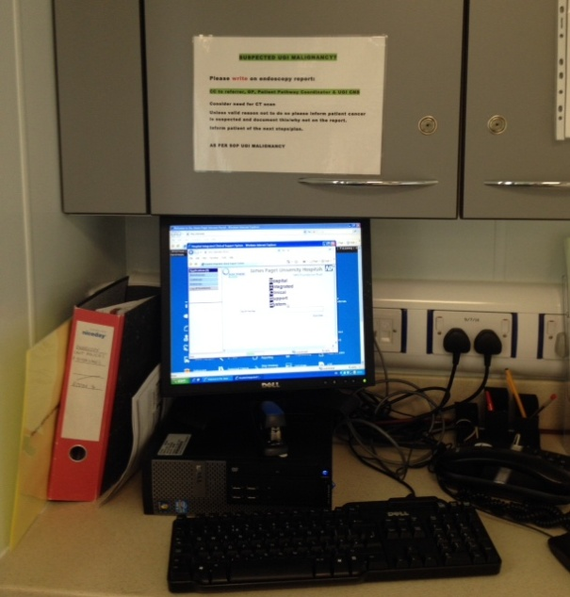
Runchart
Yellow Reminder Forms
Reminder Posters
FOLLOW SOP FOR UGI MALIGNANCY
Median
Gastro Meeting
Endoscopy Meeting
Initial Audit Period
Learning To Make a Difference
James Paget University Hospital
Notes:
Standard operative procedure

Slide 8
What difference has been made?
Endoscopy staff more aware of guidelines
May – 50% faxed referral rate
Learning To Make a Difference
James Paget University Hospital

Slide 9
Next Steps
What do we plan to do next?
Posters around Endoscopy unit giving clear guidelines in bold print, eye level
Email all consultants not complying with guidelines specifying what was not done.
What do we need?
Cooperation from endoscopy staff and principle endoscopy consultant
What has been the learning?
Without full cooperation, implementing change is difficult.
Multi-disciplinary involvement – priorities differ.
Quality improvement methods are more effective than one-off audit.
Learning To Make a Difference
James Paget University Hospital

Slide 10
Team Members
Dr Williams (Gastroenterology Consultant)
Dr. A Malpas (CT1)
Dr. N Corballis (FY1)
Learning To Make a Difference
James Paget University Hospital

