Slide 1
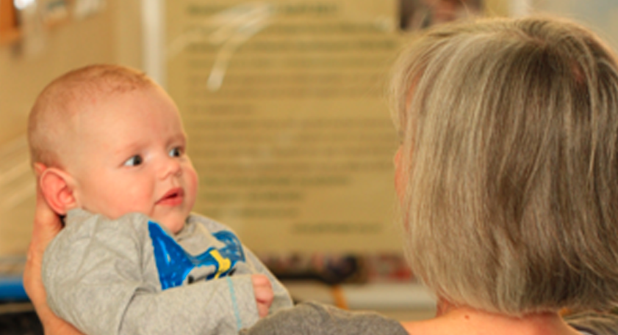
Supranuclear Eye movement disorders
Narman Puvanachandra
Training Program Director, Associate Dean, Associate Professor
Norfolk & Norwich University Hospital

Slide 2

Learning Objectives
Neuroanatomical basis for Supranuclear / Internuclear control
Understand the 6 basic types of eye movements
Pathway for each eye movement
How to test each movement
Example of diseases affecting each eye movement
Try not to get confused

Slide 3
Hierarchy of Oculomotor Control
Cortical (FEF,PPC,PEF,MT,MST) Superior Colliculus Vestibular Cerebellum Pontine Nuclei Basal Ganglia
Supranuclear
Affect both eyes together and similarly
Nuclear / Inter
Brainstem CN Nuclei 3rd/4th Midbrain 6th Pons Medial Longitudinal Fasciculus
Affect eyes individually or asymmetrically
Infranuclear
3rd, 4th & 6th Cranial nerves Extraocular Muscles

Slide 4
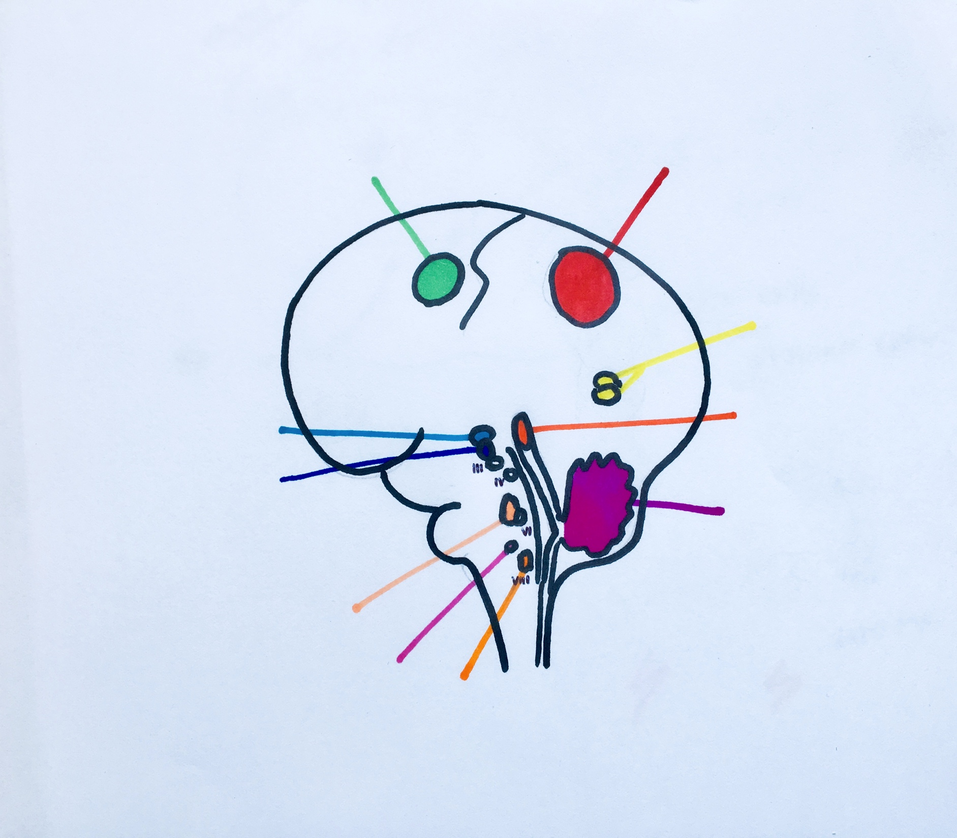
Supranuclear Control Centres of Eye Movement
Posterior Parietal (PPC) Parietal Eye Field (PEF)
Frontal Eye Field (FEF)
Middle (Superior) Temporal (MT / MST)
Occipital Lobe
Basal Ganglia (BG)
Vertical Gaze Centre
(Midbrain)
riMLF (Rostral
Interstitial N of MLF)
Superior Colliculus (SC)
Interstitial N of Cajal
Cerebellum
Horizontal Gaze Centre
(Pons)
PPRF (Paramedian Pontine
Reticular Formation)
NPH (Nucleus prepositus
hypoglossi)
Vestibular Nuclei

Slide 5
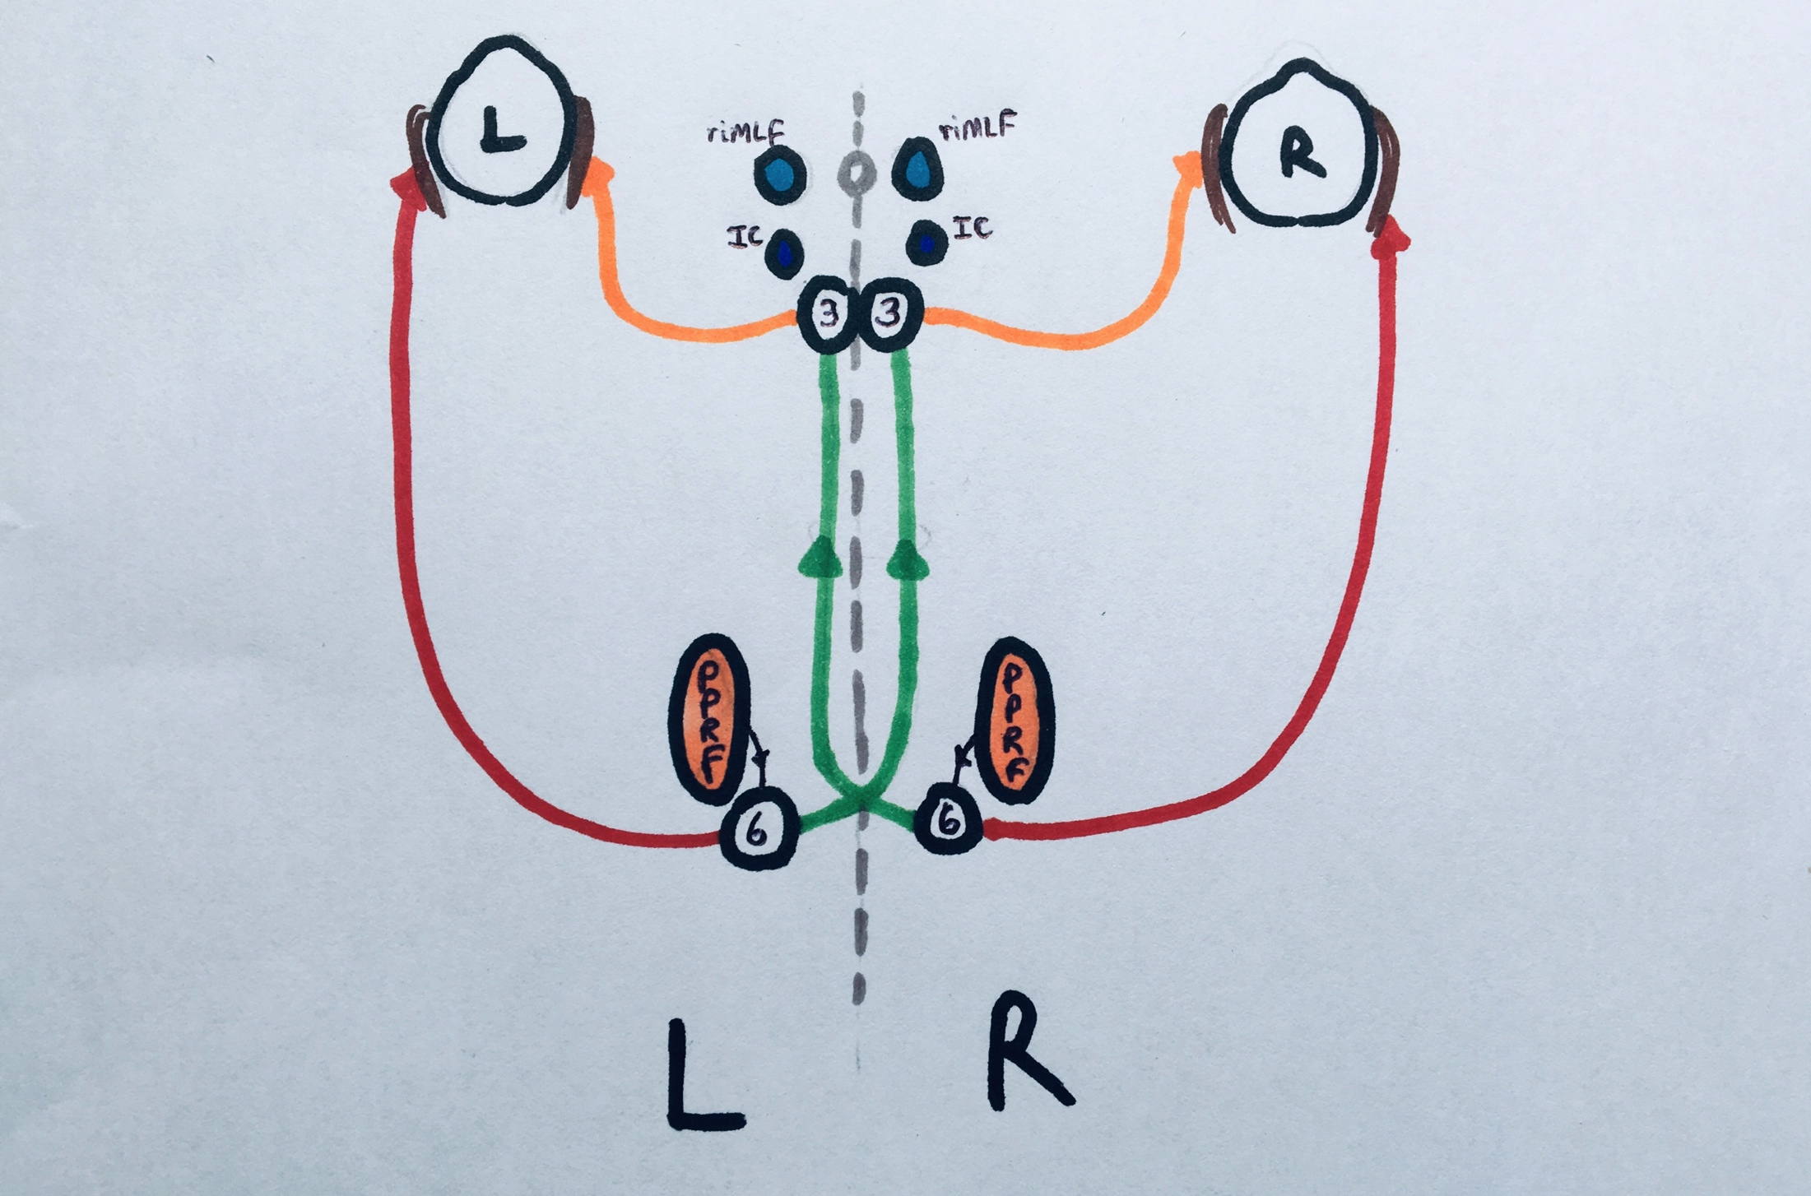
riMLF
riMLF
IC
IC
MIDBRAIN
MLF
MLF
P
P
R
F
P
P
R
F
PONS

Slide 6
EYE MOVEMENT JEOPARDY
WHAT IS ……… ?
Compensation for brief head movements =
Maintain eye position during sustained head = movements / visual scene moving
Hold target on fovea if target slow moving =
Place visual target on fovea =
Maintain eccentric position of gaze on target =
Binocular coordination of foveation =
(stereopsis)
Vestibular Ocular reflex (VOR)
Optokinetic reflex (OKR)
Smooth Pursuit (SP)
Saccades
Gaze holding
Vergence

Slide 7
History
Antenatal drugs / infection / medication / drug history
Development history (systemic disorders)
Family History (eyes / neuro / systemic e.g. SCA)
Visual behaviour (do they see, F/F, nyctalopia, photophobia)
Oscillopsia = acquired (if only on head movements = vestibular)
Neuro Hx (speech, swallowing, coordination, hearing/tinnitus)

Slide 8
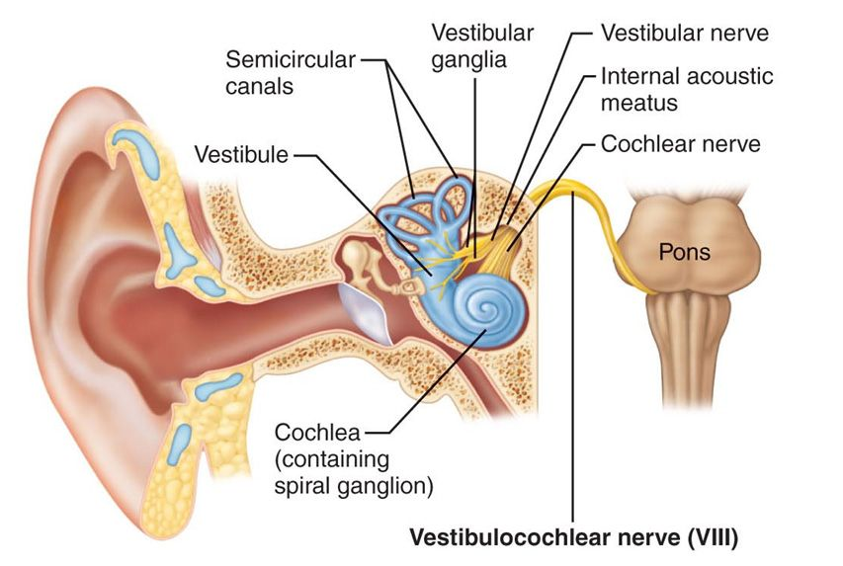
Vestibular Ocular Reflex (VOR) - Pathway
Maintain gaze on brief head movement
-> Semicircular canals (Inner ear)
-> Vestibular Ganglia (Scarpa’s) Internal Auditory Meatus
-> Vestibulocochlear Nerve (VIII)
-> Vestibular Nuclei (Pons / Medulla)
-> Oculomotility Nerves 3,4,6

Slide 9
VOR
Supranuclear Control Centres of Eye Movement
Cerebellum
Vestibular Nuclei

Slide 10
Vestibular Ocular Reflex (VOR)
Face turn to the right
COMPENSATION FOR BRIEF HEAD MOVEMENTS
SLOW EYE MOVEMENT
NORMAL = present at birth but some under 6 weeks can lock up in R/L gaze
e.g. Face turn to the right ----------------------------→
L Ear
VN
R Ear
VN

Slide 11
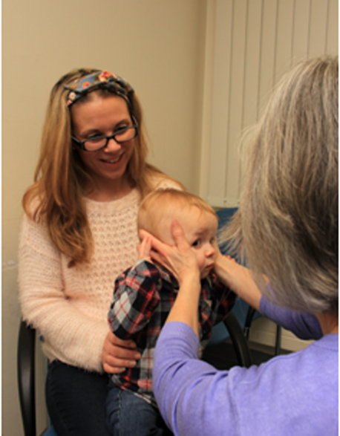
Vestibular Ocular Reflex (VOR) - Test
Doll’s head manoeuvre
Rapid but gentle
Horizontal / vertical
Don’t perform if cervical problems / downbeat nystagmus
Normal =
Eyes should stay fixed
R
L

Slide 12
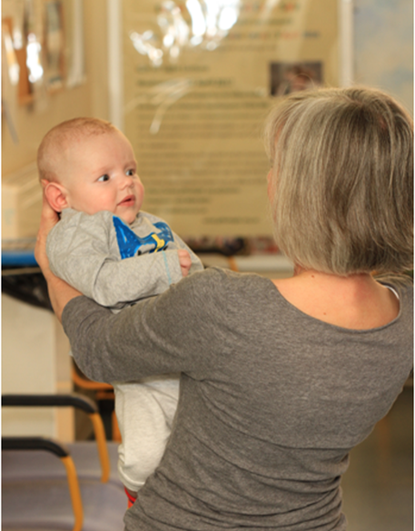
Vestibular Ocular Reflex (VOR) - Test
Spinning Baby test
Arm’s length / support neck
Rotate to right 2-3 revolutions
Induces nystagmus fast phase to left
Abrupt stop
Induces nystagmus fast phase to right
Repeat the other way
Driven by both VOR & OKR
R
L

Slide 13
Vestibular Ocular Reflex (VOR)
INTERPRETATION
Under 45 weeks (normal) - can be normal to lock up on spinning
Vestibular lesion = Impaired VOR + catch up saccade on Doll’s head
Poor vision / Cerebellar – post-rotational nystagmus > 2-3 beats
Systemic syndromes can have poor VOR e.g. CHARGE, Ushers, SCA
If patient has a gaze palsy but Doll’s head is preserved then implies a higher level supranuclear disorder

Slide 14
VOR – Clinical Case
Acute Peripheral Vestibular insult e.g. Labrynthitis
VOR impaired on ipsilateral head turn; catch up saccade
Unilateral nystagmus fast phase to opposite side (horiz / torsional)
Nystagmus worse on contralateral gaze (Alexander’s Law)
Ipsilateral Head tilt
Tinnitus, Acute painful Vertigo, Hearing loss
No Skew (brainstem / cerebellar)
No other Brainstem / cerebellar signs

Slide 15
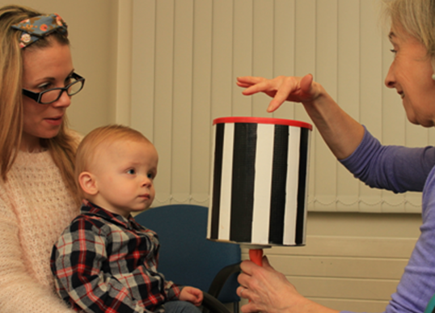
Optokinetic Reflex (OKR)
Maintain eye position if sustained head move / scene moves
Slow Pursuit Component tracks stimulus = Pursuit Pathway
Fast Saccadic Component re-fixates = Reflex Saccadic Pathway
Normal development
Binocular OKR present at birth
Monocular OKR present temporal -> nasal at birth
But Absent nasal -> temporal
At 3 months present both directions monocularly

Slide 16
Optokinetic Reflex (OKR) - test
Optokinetic drum / tape
50cm from face
Slow rotation
Horizontal both directions
Vertical up and down
Binocularly and monocularly
Normal =
Slow movement in direction of rotation
Fast movement in opposite direction to re-fixate

Slide 17
Optokinetic Reflex (OKR)
INTERPRETATION
Lack of any OKR = very poor vision (ocular / CVI / DVM)
OKR superimposed on child with nystagmus = reassures some vision
Fast phase OKR absent = poor saccadic initiation
Asymmetry of horizontal OKR binocularly = cortical / pontine lesion (abnormal OKR towards side of cortical / pontine lesion)
Vertical binocular OKR worse than horizontal = midbrain disease

Slide 18
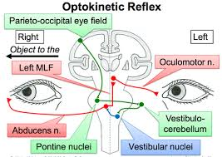
Smooth Pursuit - Neuroanatomy
Hold target on fovea if slowly moving (<30 degrees / second)
Slow Eye Movement
1. Ipsilateral Parieto-occipital
eye field
2. Pontine nuclei
3. Cerebellum (floccular)
4. Vestibular nuclei (contra)
5. Oculomotor nuclei (6,3,4)

Slide 19
SMOOTH PURSUIT
Supranuclear Control Centres of Eye Movement
Ipsilateral
Posterior Parietal (PPC) Parietal Eye Field (PEF)
Ipsilateral
Middle (Superior) Temporal (MT / MST)
Occipital Lobe
Cerebellum
Vestibular Nuclei
Contralateral

Slide 20
Smooth Pursuit – Test
Normal Development = jerky (saccadic) smooth pursuit at birth; 3-6 months becomes smoother to larger slow moving targets; gradually smooths out
Test
Horizontally and Vertically with large slow moving toy / mirror
Can use OKR drum / tape (slow component of OKR)

Slide 21
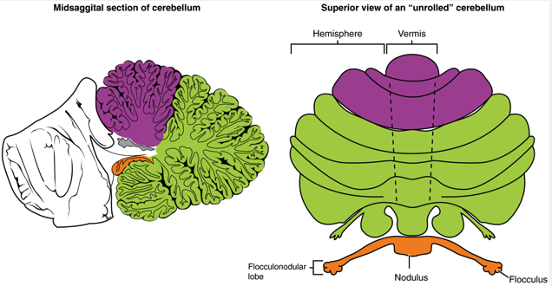
Smooth Pursuit – Clinical Case
Cerebellar Flocculus Damage – Alcohol, Drugs, SCA
Where you learn to coordinate and remember how to coordinate eye movements “vestibulocerebellum”
Jerky “Saccadic” pursuit all directions
(If only in 1 direction then could be ipsilateral flocculus or ipsilateral Parieto-occiptal cortex lesion)
Also effect gaze holding => Gaze evoked nystagmus
Also effect VOR (can’t “remember” coordination) => impaired VOR
Ataxia

Slide 22
Saccades
Place visual target on fovea – rapid eye movement
Normal Development
At birth – hypometric and small secondary saccades after large ones
3 months – less hypometric
1 year – secondary saccades gone

Slide 23
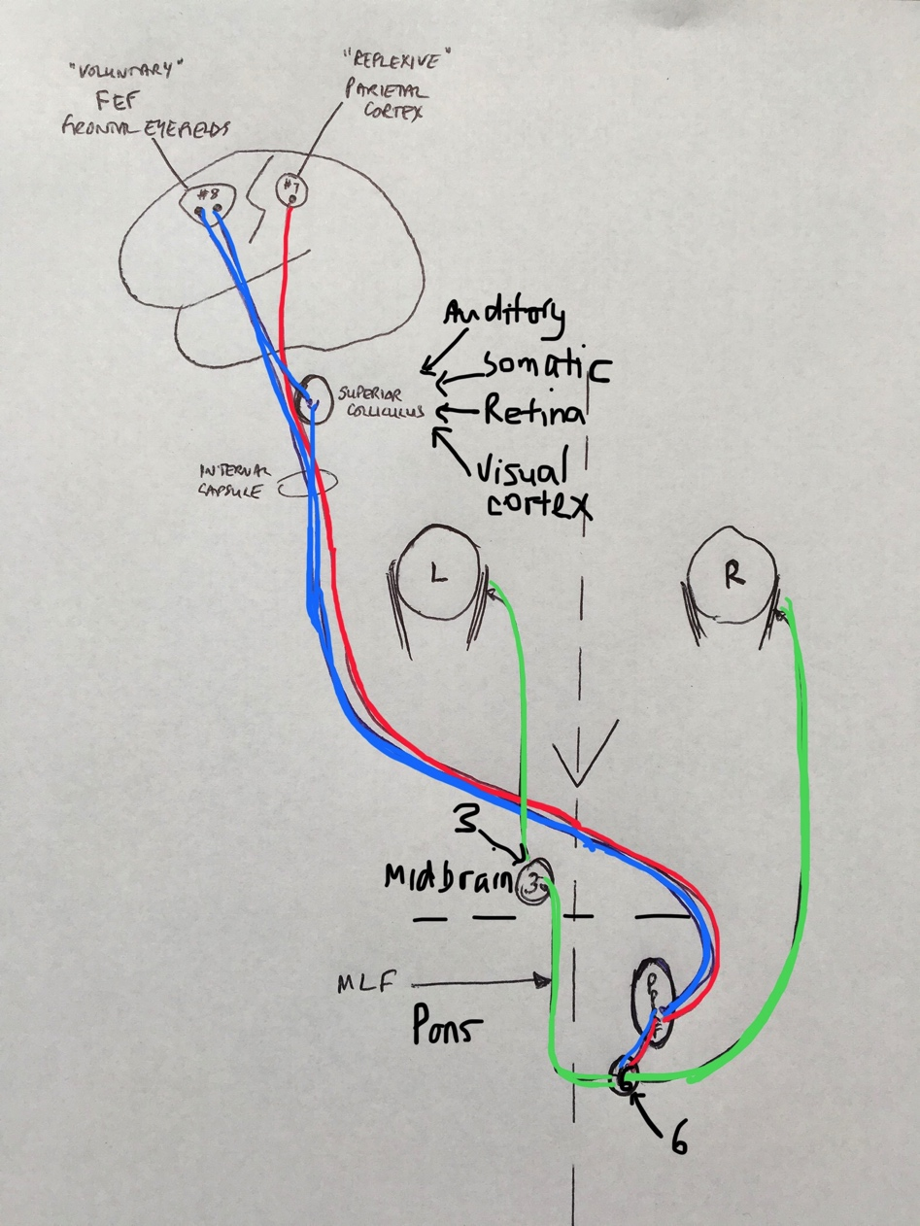
Saccades - Neuroanatomy
FEF (contralateral)
= Voluntary
PEF (contralateral)
= Reflexive
Auditory
Somatic
Superior Colliculus
Retina
Visual Cortex
Ipsilateral PPRF
Ipsilateral
riMLF
Cerebellum controls metrics of both
Inhibitory burst neurons inhibit contralateral gaze

Slide 24
SACCADES
Supranuclear Control Centres of Eye Movement
Contralateral
Contralateral
Posterior Parietal (PPC) Parietal Eye Field (PEF)
Frontal Eye Field (FEF)
VOLUNTARY
REFLEXIVE
Vertical Gaze Centre
(Midbrain)
Ipsilateral
SENSORY INTEGRATOR
riMLF (Rostral
Interstitial N of MLF)
Superior Colliculus (SC)
Cerebellum
Horizontal Gaze Centre
(Pons)
Ipsilateral
CONTROLS
METRIC
PPRF (Paramedian Pontine
Reticular Formation)

Slide 25
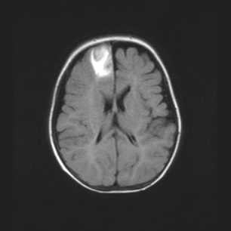
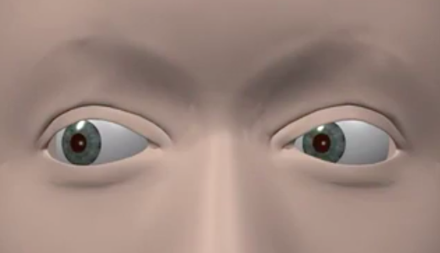
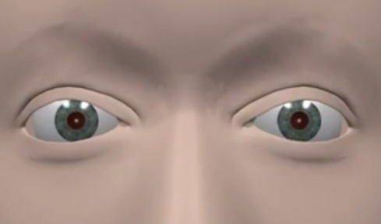
Frontal Eye Fields (FEF)
Voluntary Saccades
Saccade away from target (remember/scan) = Antisaccade
Acute deviation of eyes to right and inability to saccade to Left
Recovers due to alternative pathways through Superior Colliculus

Slide 26
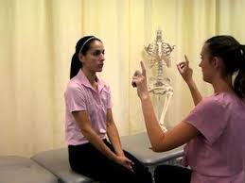
Saccades - Test
Classic Saccadic testing (finger / fist or use toys)
Test Horizontal separately from centre to left / centre to right
Test Vertical top to bottom and back to top
OKN drum includes saccades

Slide 27
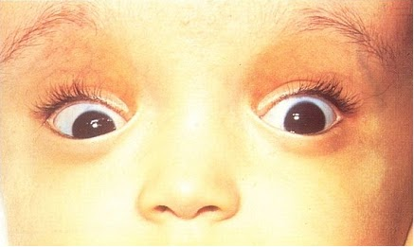
Saccades – Clinical Cases
Saccadic Initiation failure – lag of saccade / head thrust = Oculomotor Apraxia (FEF / PEF / Cerebellar Vermis)
Isolated horizontal saccade dysfunction (hypometric / lag) = Pontine lesion (bleed / glioma / Gauchers type 3)
Isolated veritical saccade dysfunction = Midbrain lesion (bleed / Niemann-Pick type C) if Convergence retraction nystagmus / lid retraction / skew = Dorsal Midbrain (Parinauds - aqueduct stenosis / pinealoma) if setting sun sign (tonic downward deviation = raised ICP)
Hypermetric Saccades = Cerebellar lesions

Slide 28
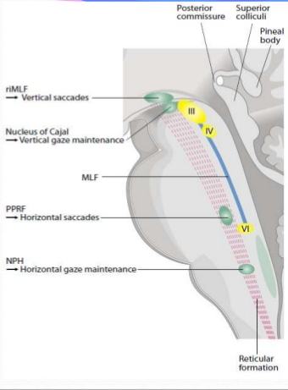
Gaze holding - Neuroanatomy
Tonic discharge to maintain eccentric gaze
Horizontal neural integrator
  - Nucleus prepositus hypoglossi (Pons)
  - Vestibular nuclei (Pons / Medulla)
  - Vestibulo-cerebellum (Cerebellum)
Vertical neural integrator
  - Interstitial Nucleus of Cajal (Midbrain)
  - Flocculus (Cerebellum)

Slide 29
Gaze Holding - Test
Observe in primary position first
Observe eccentric gaze holding to a toy / target in different positions

Slide 30
Gaze holding - Abnormalities
Gaze evoked Nystagmus (GEN) slow drift towards midline and fast corrective saccade
Rebound Nystagmus nystagmus beats seen in opposite direction when returning from eccentric gaze to primary position. Often chronic cerebellar disease.
Causes
– anti-convulsants / drugs
- Cerebellar disease (especially if GEN in all directions)
- Pontine lesions (purely horizontal GEN)
- Midbrain lesions (purely vertical GEN)

Slide 31
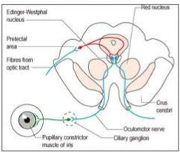
Vergence - Neuroanatomy
Poorly understood
Midbrain / Superior Colliculus
Convergence and Divergence neurons
Normal Development
- start with slight divergence
- 2-4 months convergence establishes
- Initially driven by accommodation then retinal disparity

Slide 32
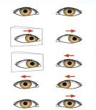
Vergence - Test
Large visual target brought towards nose
20 PD Base out test from around 6 months

Slide 33
CONVergence - Abnormalities
Convergence Excess – Near > Distance Esotropia; bifocals / surgery
Convergence Spasm – typically non-organic
Convergence insufficiency – common, benign, use exercises / prism
Convergence paralysis – rare; rarely isolated, Scan (midbrain)

Slide 34
DIVergence - Abnormalities
Divergence Excess – Exotropia Distance > Near; either true or simulated (accommodation / fusion)
Divergence insufficiency – v.rare distance esotropia, if other signs scan
Divergence paralysis – v.rare. Scan (midbrain / brainstem)

Slide 35
PPRF lesion =
Ipsilateral Saccadic Gaze Palsy
Ipsilateral Saccadic failure
Contralateral gaze evoked nystagmus
Acute lesion contralateral gaze deviation
riMLF
riMLF
IC
IC
MLF
MLF
P
P
R
F
P
P
R
F

Slide 36
MLF lesion =
Internuclear Ophthalmoplegia
On Saccade to contralateral side:
Ipsilateral Adduction deficit
Contralateral Abduction nystagmus
riMLF
riMLF
IC
IC
MLF
MLF
P
P
R
F
P
P
R
F

Slide 37
Bilateral MLF lesion
Bilateral Internuclear Ophthalmoplegia
Exotropia
Bilateral Adduction deficit
Bilateral Abduction nystagmus
riMLF
riMLF
IC
IC
MLF
MLF
P
P
R
F
P
P
R
F

Slide 38
PPRF & MLF
One & a Half Syndrome
Ipsilateral Saccadic Gaze Failure
On contralateral gaze
Failure of adduction ipsilateral eye
Preserved Abduction contralateral eye
riMLF
riMLF
IC
IC
MLF
MLF
P
P
R
F
P
P
R
F

Slide 39
Large Pontine lesion
Bilateral Horizontal Gaze Palsy
Can be associated with Progressive Scoliosis (ROBO3 gene mutation)
riMLF
riMLF
IC
IC
MLF
MLF
P
P
R
F
P
P
R
F

Slide 40
Dorsal MIDBRAIN LESION
UpGaze Palsy (pursuit / saccade)
(overcome by VOR unless severe)
Skew Deviation
Lid Retraction
Convergence Retraction Nystagmus
Light / Near Dissociation
+/- loss of Convergence
riMLF
riMLF
IC
IC
MLF
MLF
P
P
R
F
P
P
R
F

Slide 41
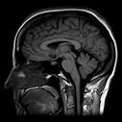
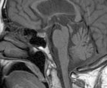
Progressive Supranuclear Palsy
Progressive Neuro-degenerative disease (tauopathy) affecting
Basal Ganglia
Midbrain (pons spared)
Cortex
Cerebellum
+ rigidity, ataxia, pseudobulbar palsy etc
Resembles Parkinson’s but no tremor
Classically develop a Supranuclear Palsy with
Impaired voluntary vertical saccades
Downgaze first affected
Square-wave jerks
Poor convergence

Slide 42
Supranuclear Control Centres of Eye Movement
Posterior Parietal (PPC) Parietal Eye Field (PEF)
Frontal Eye Field (FEF)
BASAL GANGLIA (BG)
Middle (Superior) Temporal (MT / MST)
Occipital Lobe
Superior Colliculus (SC)

Slide 43
Basal Ganglia
FEF
PPC
Parkinson’s Disease
Progressive loss of dopaminergic cells in the substantia nigra
Impaired
Voluntary Saccades
Then Reflexive saccades
+ then Slow pursuit too
Also reduced vergence
MT / MST
Basal
Ganglia
CN
SN
SC
Caudate Nucleus
Substantia
Nigra

Slide 44
Neuroanatomical centres
REFLEXIVE CONTRALATERAL SACCADES & IPSILATERAL PURSUIT
VOLUNTARY CONTRALATERAL SACCADES
Posterior Parietal (PPC) Parietal Eye Field (PEF)
Frontal Eye Field (FEF)
PAUSE ON SUPERIOR COLLICULUS
Middle (Superior) Temporal (MT / MST)
Occipital Lobe
Basal Ganglia (BG)
Ipsilateral
IPSILATERAL PURSUIT
Vertical Gaze Centre
(Midbrain)
riMLF (Rostral
Interstitial N of MLF)
Superior Colliculus (SC)
Interstitial N of Cajal
SENSORY INTEGRATOR
Ipsilateral
Cerebellum
Horizontal Gaze Centre
(Pons)
PPRF (Paramedian Pontine
Reticular Formation)
CONTROLS METRIC
SMOOTH / SACCADE / VOR / VERGENCE
NPH (Nucleus prepositus
hypoglossi)
Vestibular Nuclei
VOR control & Pursuit path

Slide 45
6 Types of Eye Movement
Vestibular Ocular Reflex (VOR)
For brief head turns
Vestibular stimulation leads to Contralateral Gaze
Doll’s Head / Spinning baby
e.g. acute labrynthitis
Optokinetic Reflex (OKR)
Sustained head turn / moving visual scene
Slow phase pursuit
Fast re-fixation saccade
OKN Drum
e.g. good test for vision
Smooth Pursuit (SP)
Hold slow target on fovea
Ipsiltateral Parieto-occipital
Via Cerebellum / Vestibular
Slow target / OKN drum
e.g. Cerebellar Flocculitis
Saccadic
Place visual target on fovea
Contralateral FEF (volunt) / PEF (reflexive)
Via S.Colliculus / Basal G
Ipsilateral PPRF / riMLF
Saccadic testing / OKN
e.g. Frontal CVA, PPRF lesion
Gaze Holding
Hold target eccentric gaze
NPH (horizontal)
INC (vertical)
+ Cerebellum
Hold eccentric gaze
e.g. Gaze Evoked Nystagmus
Vergence
Binocular control (stereo)
Midbrain
Superior Colliculus (SC)
Convergence / Divergence
e.g. DI / DP / DE / CI / CP / CE

