Slide 1
Respiratory Paediatrics in Emergency Medicine
Dr Louise Selby
Dr Donna McShane

Slide 2
Contents
The upper respiratory tract.
The child with noisy breathing (upper airway).
  Croup, bacterial tracheitis
  Foreign body
Pneumonia and complications
Lower airway problems.
Asthma.
‘Viral wheeze’.
Bronchiolitis.
Questions.
Close.

Slide 3
Upper Respiratory Tract
Comprises of:
  Nose in continuity with the sinuses and lacrimal sac
  Nasopharnyx
  Mouth and oropharnyx (plus Eustachian tube)
  Larynx and laryngopharnyx.
Functions to:
  Warm inspired air before it reaches lungs
  Trap and remove particles
  Innate/adaptive immunity

Slide 4
Approach to the Child with Noisy Breathing – Upper Airway
Parents descriptions of noisy breathing can be misleading.
Respiratory noises maybe intermittent and not necessarily present when the child reaches the department.
More than one respiratory noise maybe present concurrently.
Try and ascertain whether noise is timed with inspiration or expiration.
Particular attention paid to onset of stridor.

Slide 5
Upper Airway - Causes
Noise | Site of origin | Causes
Snuffles | Blocked nasal passages | Common cold Allergic rhinitis
Stridor | Extrathoracic airways (primarily inspiratory) | Croup Bacterial tracheitis Epiglottitis Layrngomalacia Tracheomalacia Vocal cord paralysis Vocal cord dysfunction Foreign body
Grunting | Glottis | Pneumonia Bacterial infection
Notes:
Useful to try and determine origins of noisy breathing by thinking about site of origin to allow you to determine cause and treat.

Slide 6
Common Cold
Diagnosis of exclusion – inflammation of nasal epithelium alone.
Careful evaluation required in babies.
Ensure no fever >38 degrees and adequate feeding.
Consider choanal atresia as differential diagnosis – pass nasogastric tube down both nostrils.

Slide 7
Croup
Most common cause of acute stridor.
Accompanied by coryzal symptoms, hoarse voice, barking cough and fever.
Stridor results from viral inflammation and subglottic oedema.
Common causes including rhinovirus, respiratory syncitial virus or parainfluenza viruses.
Usually inspiratory (can be biphasic in severe disease).
Lasts 4-5 days usually.

Slide 8
Croup - Management
‘Hands off’ approach.
Oral dexamethasone 0.15mg/kg.
Nebulised budesonide 1-2mg (age dependent)
Nebulised adrenaline (1ml/kg of 1:1000 up to a maximum dose of 5ml).
Expert assistance.
<5% children will require intubation.

Slide 9
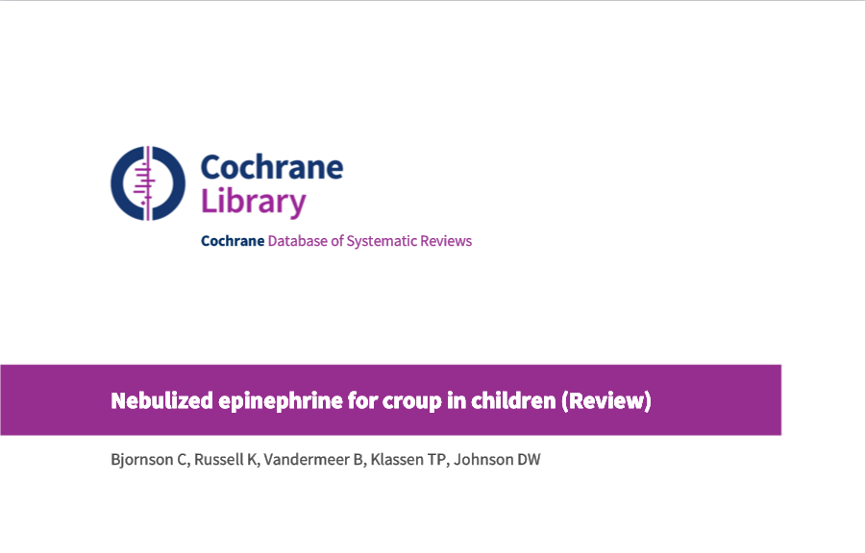
Notes:
Measured efficacy using croup scores (primary outcome) of moderate to severe croup. 8 studies, 225 children. Looked at adrenaline vs placebo (3 studies, 94 children), difference racemic forms of adrenaline (no difference) and adrenaline given by intermittent positive pressure breathing and without. Croup score improved 30 minutes after treatment but not 2 hours and 6 hours after – i.e. temporary effect to ‘buy time’.

Slide 10

Notes:
Dexamethasone and budesonide are effective in relieving the symptoms of croup as early as six hours after treatment. Fewer return visits and/or (re)admissions are required and the length of time spent in hospital is decreased. 38 studies, 4299 children. Improved westley score at 6h. Fewer return visits and/or (re)admissions occurred in participants treated with glucocorticoids (risk ratio (RR) 0.5.

Slide 11
Bacterial Tracheitis (1)
Rare.
Bacterial infection of the trachea with staphlococcus aureus, strep pneumoniae and streptococcus pyogenes.
Erythema, oedema and pus in the trachea.
‘Toxic’/’septic’ looking child with fever, cough, hoarse voice and stridor, with increased work of breathing.

Slide 12
Bacterial Tracheitis (2)
Early threshold for HDU/PICU involvement.
Needs aggressive treatment with IV antibiotics.
May need ENT support.

Slide 13
Foreign Body Inhalation
Most common aged 1-3 years – can be fatal.
Sudden onset stridor with no preceding fever or illness.
Upper airway involvement:
  Complete obstruction with hypoxia and cardiorespiratory compromise.
  Partial obstruction with cough, stridor, and respiratory distress.
Lower airway involvement can lead to collapse and consolidation.
Causes include nuts, seeds , small magnets, metallic parts in toys causing pressure necrosis of mucosal tissues.
Clinical examination may reveal unilateral wheeze and reduced breath sounds.
Chest x-ray may show air trapping, atelectasis, pneumothorax or be normal.
Requires rigid bronchoscopic removal +/- admission to PICU.
Complications of delayed diagnosis can include tracheal lacerations, inflammation, oedema, atelectasis and bronchopneumonia.
Notes:
USA collect data on children with foreign body – around 17,000 per annum – coins!

Slide 14
Pneumonia
An inflammatory disorder of the lung characterised by consolidation due to presence of exudate in alveolar spaces, with associated inflammation in interstitial fluids.
Community acquired pneumonia – usually acquired in a well individual outside of a hospital setting.
‘Consider in children where there is fever >38.5, chest recession and persistent raised respiratory rate.’
Notes:
Cough is not a key feature, until lysis of pneumonia occurs. Also few cough receptors in the distal lung.

Slide 15
Aetiology
Difficult to isolate specific organisms – cannot obtain samples in children.
Blood cultures taken after courses of oral therapy and only returning positive in invasive disease.
Mixed viral and bacterial infections are very common.

Slide 16
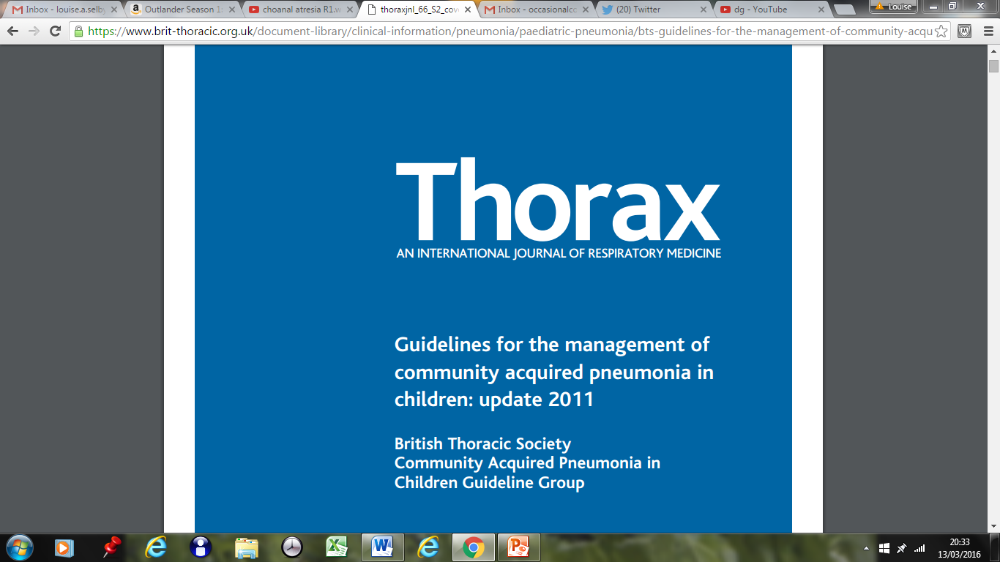

Slide 17
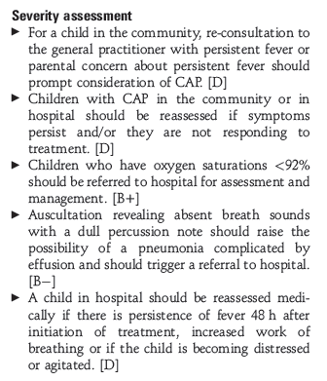
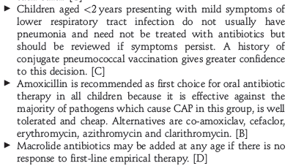
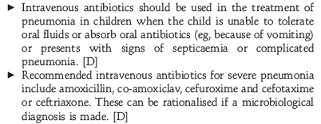
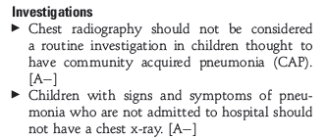
Management – CAP
Notes:
Co-amox is appropriate where influenza infection is suspected.

Slide 18
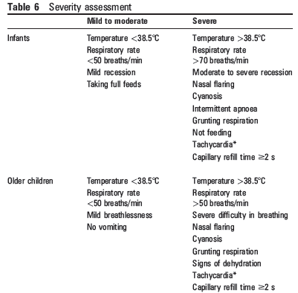

Slide 19
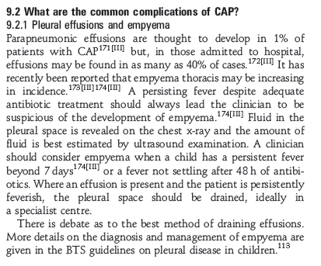
+

Slide 20
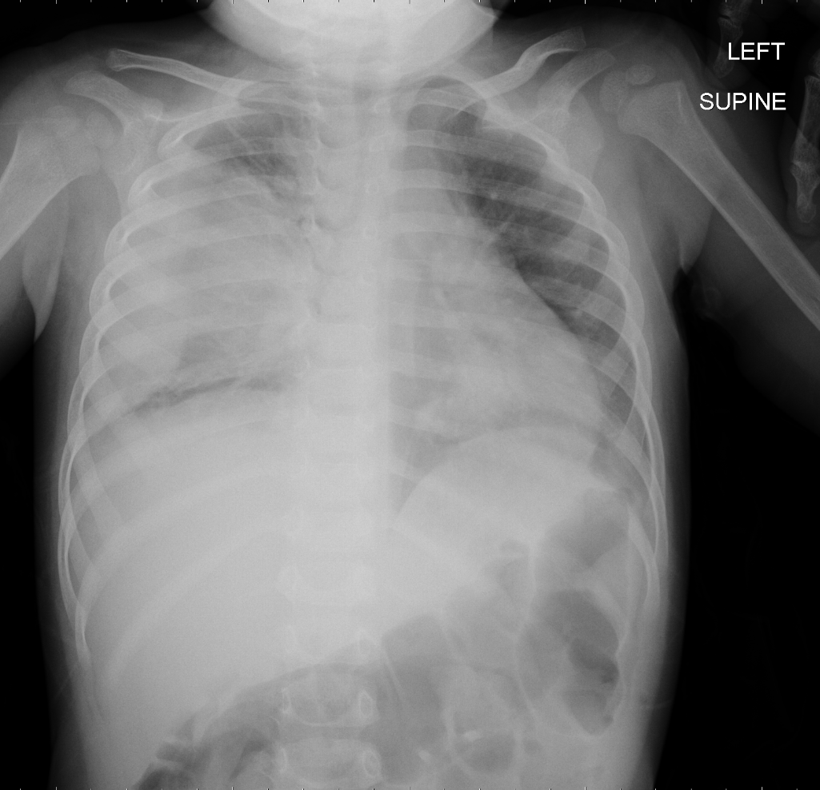
Interesting X-Rays (1)
Almost 2 year old boy, presented
with 2 weeks of fever and later
cough with increased work of
breathing. Drinking, normal oxygen
saturations, stable observations.
What to do?

Slide 21
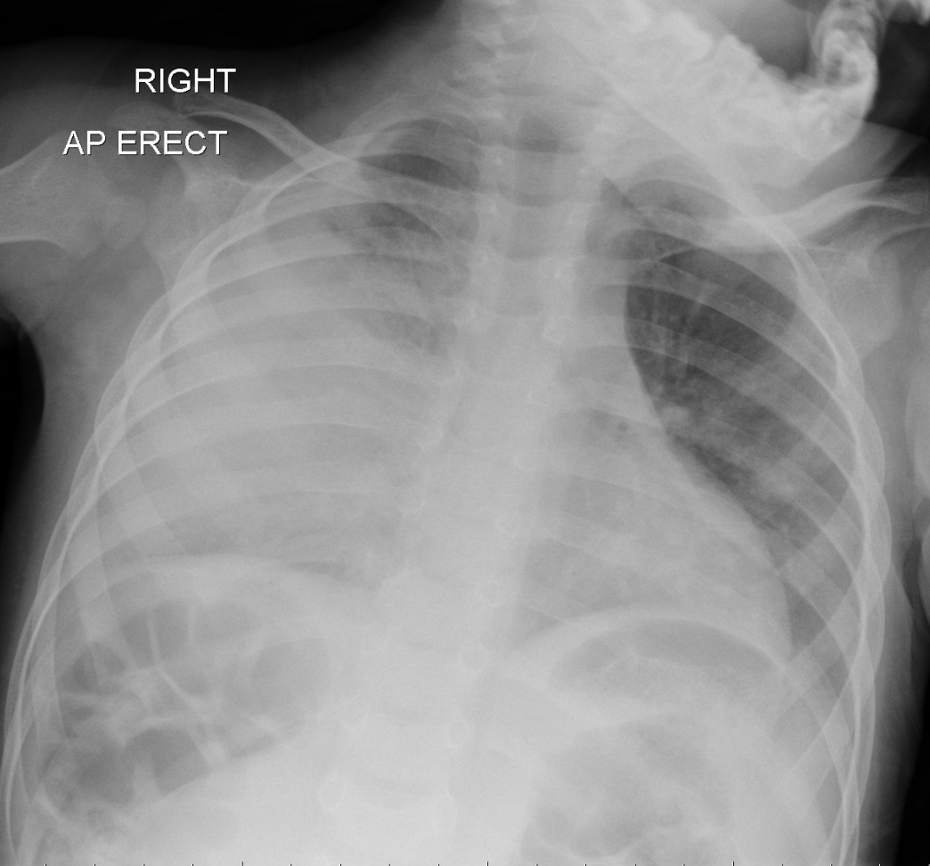
X–Ray (2)
Starts oral antibiotics and returns
after 5 days. Still spiking
temperatures but tolerating fluids
and oral antibiotics.
What to do?

Slide 22
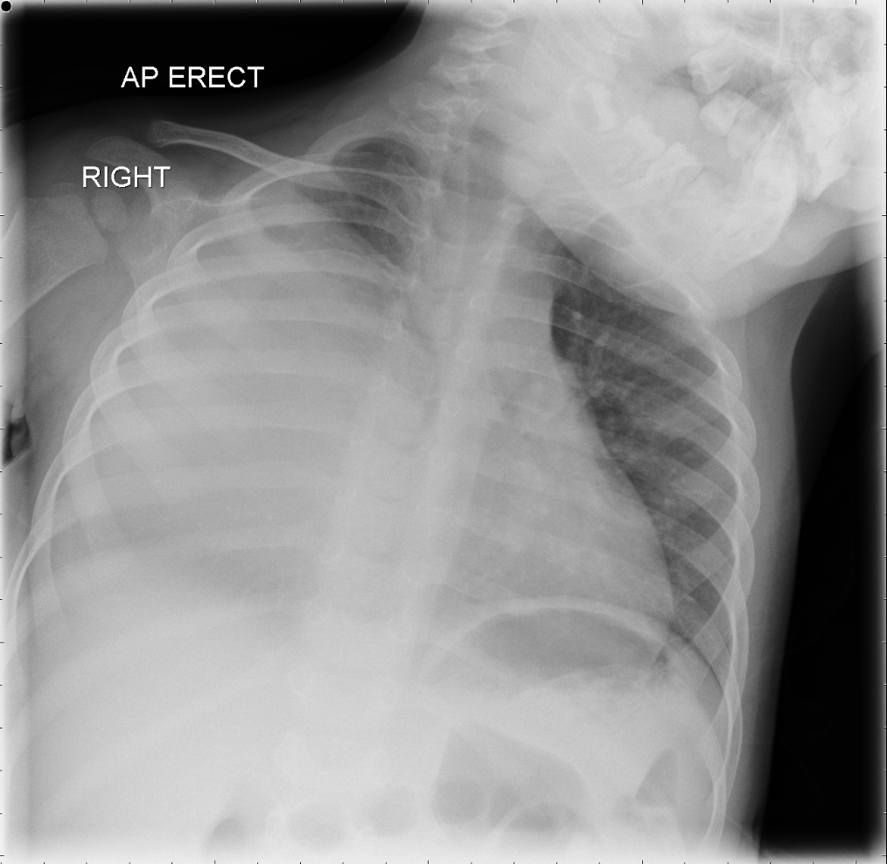
X – Ray (3)
Returns 48 hours later.
Still spiking temperatures after one
week of oral antibiotics.

Slide 23
Asthma
1.1 million children in the UK have asthma, approximately 1 in 11.
Characteristics include:
  Reversible airway obstruction
  Airway hyper-responsiveness
  Chronic inflammation.

Slide 24
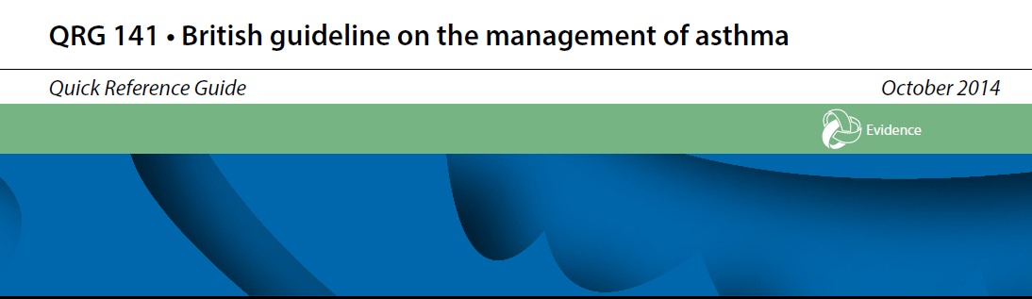

Slide 25
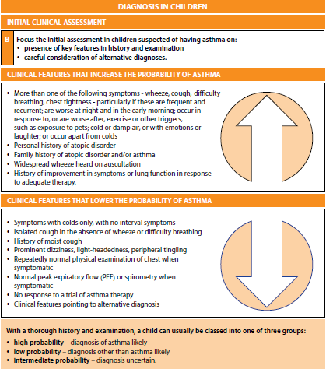

Slide 26

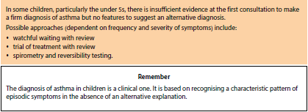
Notes:
Bring back to paediatric clinic

Slide 27
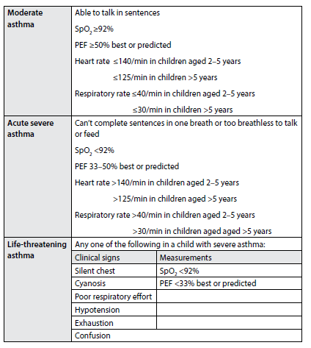
Assessing Severity

Slide 28
Management/Basic Principles
Oxygen saturations >94% -> Inhaled beta 2 agonists (up to 10 puffs salbutamol).
Oxygen saturations <94% -> Nebulised beta 2 agonists with high flow oxygen.
Add in ipratropium bromide for symptoms refractory to salbutamol.
Oral prednisolone: age < 5y = 20mg, >5 years = 40mg (unless unable to tolerate).
IV salbutamol 15mcg/kg (max 250 micrograms) if failed response, followed by IV salbutamol infusion in HDU/PICU setting.
Notes:
10 puffs salbutamol is neb equivalent. Use opportunity for training inhaler technique with parents and offer tips. SPACERS. Peak flows >5y.

Slide 29
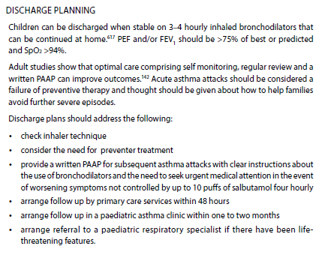
Discharge
Important Points:
Primary care follow up 48h
Asthma clinic WITHIN 30 DAYS
Notes:
NRAD showed that of children that died with asthma, which was 18/195, 60% of their deaths were outside of hospital. Stresses need for asthma action plans to be given, accurate safety net advice. Only 23% of children who died had a PAAP.

Slide 30
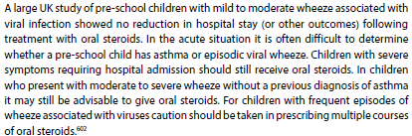
‘Viral Wheeze’
Wheezing in <2 year olds can be difficult to manage.
Children can wheeze intermittently with viruses and response to bronchodilators is variable (multifactorial).
Consider a trial of bronchodilators where symptoms are a concern.
Notes:
Genetic factors, viruses causing mucosal oedema can prevent drug delivery from actually getting where it needs to get. Difficult area. If in doubt arrange follow up.

Slide 31
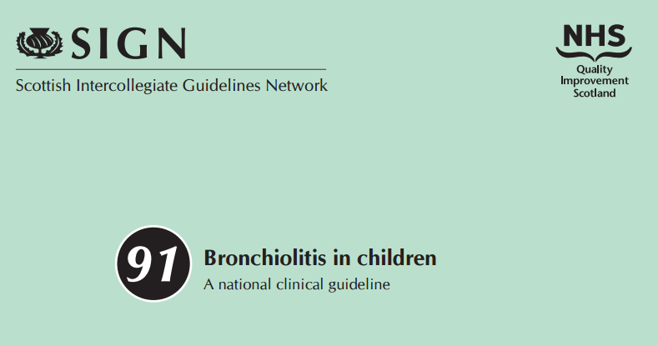
Bronchiolitis
‘A seasonal viral illness characterised by fever, nasal discharge and dry wheezy cough.
On examination there are fine inspiratory crackles and or high pitched expiratory wheeze.’
Age <1 year, peak incidence 3-6 months, first winter.
Risk factors for severe disease include congenital heart disease, ex premature infants
with chronic lung disease and parental smoking.

Slide 32
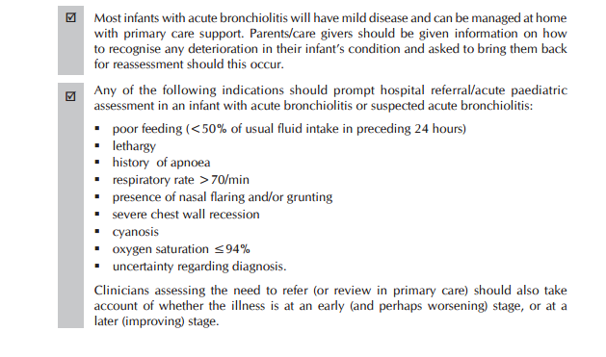
Admission Criteria

Slide 33
Investigations
Not needed unless there is diagnostic uncertainty or to aid further management (e.g. blood gas, IV access for IV fluids).
Nasopharyngeal aspirates are no longer routinely done unless a child is deteriorating and in need of HDU/PICU.
Treatment remains supportive care.
Notes:
This hasn’t changed since 1969…… SABRE trial – no difference, optiflow ?keeps small numbers of children out of PICU. Can try bronchodilators in a child with significant atopy.

Slide 34
Summary
Covered some common upper and lower airway problems presenting in the emergency department.
Important points are mainly to do with discharge planning around paediatric asthma patients.
In general. paediatrics tends to have a more hands off approach in terms of investigations, chest x-rays and a higher threshold for nebulised therapies.

Slide 35
Any questions?

Slide 36
References
ERS Handbook of Paediatric Respiratory Medicine, Ernst Eber and Fabio Midulla (European Respiratory Society).
Cochrane database of systematic reviews: Nebulised epinephrine for croup in children. Cochrane Library 2013.
Cochrane database of systematic reviews: Glucocorticoids for croup. Cochrane Library 2011.
BTS guidelines for the management of community acquired pneumonia in children, British Thoracic Society 2011.
BTS/SIGN guidance on the management of asthma, October 2014.
National Review of Asthma Deaths, Royal College of Physicians 2013.
SIGN Guidance Bronchiolitis in Children 2009.

