Slide 1
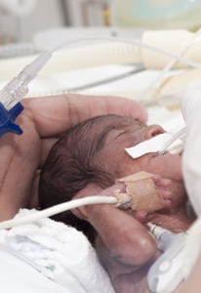
Essentials of:
Retinopathy of Prematurity

Slide 2
ROP
Pathogenesis of ROP
Classification of ROP
Screening
Treatment guidelines
Anti-VEGF agents for ROP

Slide 3

ROP
ROP accounts for 3-5% of severe childhood visual impairment in UK and is often associated with deafness, and neurological problems / cerebral visual impairment
Incidence: approx 50% in babies 1000-1251 g, 80% of premature babies under 1000g.
We screen 8000 babies a year an average 3.5 times: 28,000 examinations / yr
4% of babies screened overall require treatment: 320 / yr

Slide 4
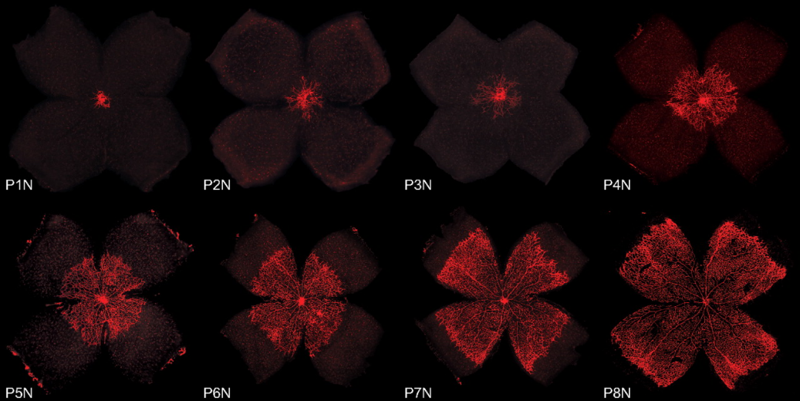
Normal retinal vascular development
Oxygen tension in is relatively low (2-3 kPa).
Vascular growth matches retinal metabolic demand in the environment of excess or insufficient oxygen.
Hyaloid regression is complete by 34 weeks gestational age (GA)
Reaches nasal ora serrata 36 weeks GA
Reaches temporal ora serrata at term
The Mouse Retina as an Angiogenesis Model Invest. Ophthalmol. Vis. Sci. 2010;51(6):2813-2826. doi:10.1167/iovs.10-5176

Slide 5
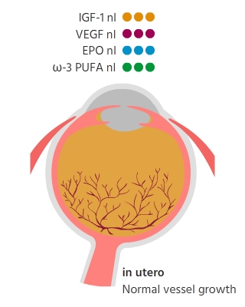
Endogenous factors
Vascular Endothelial Growth Factor (VEGF)
Insulin-like Growth Factor (IGF-1)
Erythropoietin (EPO)
Omega-3 polyunsaturated fatty acids (ⱳ-PUFA)

Slide 6
What do they do - VEGF?
  modified by levels of tissue oxygenation
  responsible for angiogenesis, particularly in the retina, lungs, brain and kidneys
  VEGF expression by relatively hypoxic astrocytes anterior to the peripheral limit of vasculature mediates the wave of normal angiogenesis

Slide 7
What do they do - IGF-1?
  non-oxygen regulated anabolic hormone
  Role in endothelial cell survival
  Protects from the effects of hyperoxia
  Levels increase with GA
  Post-natal levels correlate with fetal size
  Levels inversely correlate with ROP severity

Slide 8
What do they do-EPO?
  produced in the kidney
  Upregulated in response to hypoxia
  Promoting vascular stability

Slide 9
What do they do – omega 3 PUFAs?
  transferred from maternal circulation in the third trimester
  Cell membrane constituent
  Neural and vascular protective role

Slide 10
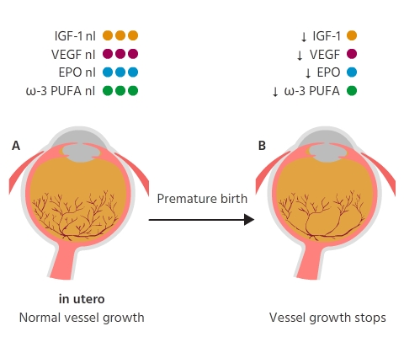
Phase 1 – hyperoxic / inhibitive
Premature birth:
Incomplete vascularisation
Supplemental oxygen 6-10kPa
Down regulation of VEGF

Slide 11
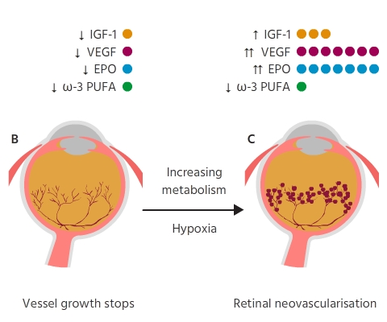
Phase 2 – hypoxic / proliferative
After 4 weeks PNA:
Supplemental oxygen weaning
Increased retinal metabolism
Retinal ischaemia
Upregulation of VEGF and EPO
Low IGF-1 and PUFA levels

Slide 12
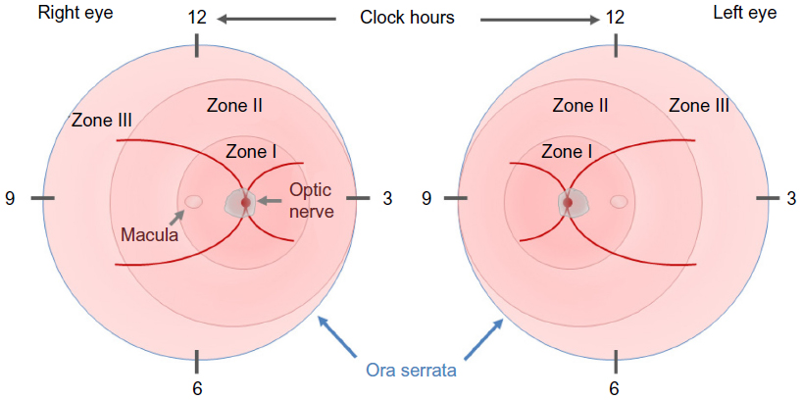
International Classification-ICROP
Zone
  Use 28D to define Zone I
Stage 1-5

Slide 13
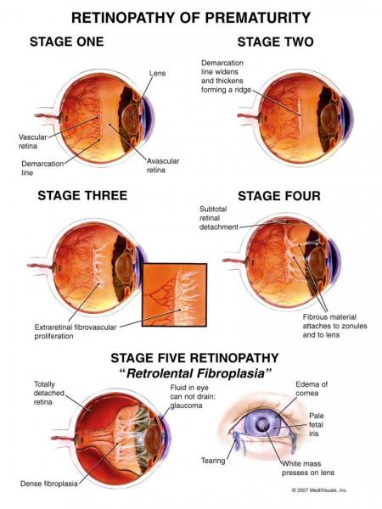
Stages
Stage 1
Stage 2
Stage 3
Stage 4
Stage 5
https://www.aao.org/interactive-tool/retinopathy-of-prematurity-case-based-training

Slide 14
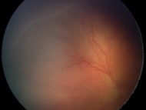
Stage 1
Demarcation line

Slide 15
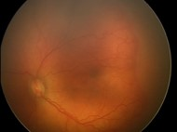
Stage 2
Ridge

Slide 16
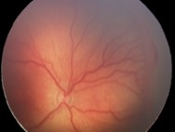
Stage 3
Ridge with neovascular proliferation

Slide 17
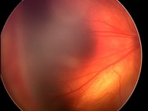
Stage 4
Tractional retinal detachment
A: extra foveal
B: foveal

Slide 18
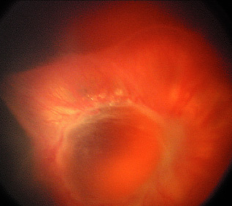
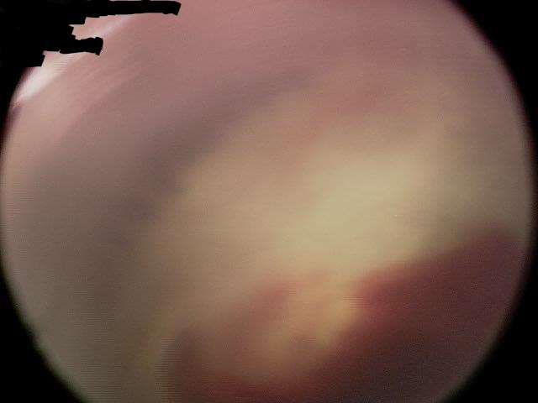
Stage 5
Funnel retinal detachment

Slide 19
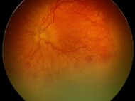
APROP
Zone I disease
Flat neovascularisation
Severe plus disease
Poor prognosis

Slide 20
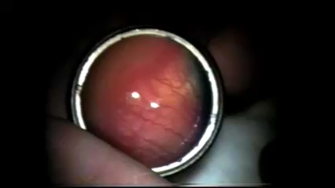
Plus disease
Retinal vascular tortuosity / dilatation
Present in at least 2 quadrants

Slide 21
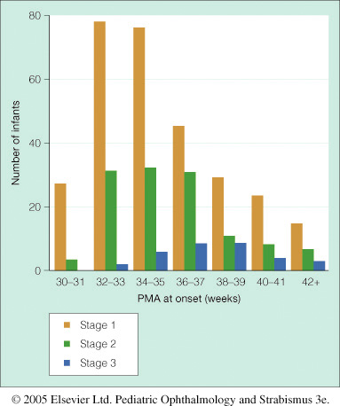
When does severe ROP occur?
Peak incidence of Stage 2 ROP at 32-37 weeks PMA
Peak incidence of Stage 3 ROP at 34-39 weeks PMA

Slide 22

Evolution of ROP
MacKeen et al JAAPOS 2008;12(4)349

Slide 23

Evolution of ROP

Slide 24
Proven Risk factors for ROP
Gestational age
IUGR / SGA babies- (low IGF-1 levels)
Oxygen supplementation (effect on VEGF / EPO)
Poor post-natal weight gain
Recurrent apnoea/fluctuating oxygen saturation
Blood transfusions
Twin to twin transfusion (mono-chorionic placenta)

Slide 25
Gestational age
GA (weeks) | % requiring ROP treatment
23 - 25 | 20
26 - 27 | 6
28 - 29 | 2
30 - 31 | 1
Kim SJ, Port AD, Swan R et al. Retinopathy of prematurity: a review of risk factors and their clinical significance. Archives of Ophthalmol 2018;63:618-637

Slide 26
IUGR / SGA babies- (low IGF-1 levels)
WINROP study
  Low levels of IGF-1 correlate with poor post-natal weight gain
CHOP study
Weight gain in first 28 days | Development of ROP
> 650 g | Will not develop any ROP
> 400 g | Will not develop sight threatening ROP
Hellström A, Hård AL, Engström E et al. Early weight gain predicts retinopathy in preterm infants: new, simple, efficient approach to screening. Pediatrics 2009;123(4):e638-e645
Binenbaum G, Ying GS, Quinn GE et al. The CHOP postnatal weight gain, birth weight, and gestational age retinopathy of prematurity risk model. Arch Ophthalmol 2012;130(12):1560-1565

Slide 27
Oxygen supplementation (effect on VEGF / EPO)
BOOST-II study
  Babies PMA <28/40
  85-89% target saturation: 9% Type 1 ROP
  91-95% target saturation: 18% Type 1 ROP
  Increased death rate at 36 weeks in lower
Stenson BJ, Tarnow-Mordi WO, Darlow BA et al. BOOST II United Kingdom Collaborative Group, BOOST II Australia Collaborative Group, BOOST II New Zealand Collaborative Group. Oxygen saturation and outcomes in preterm infants. N Engl J Med 2013;368:2094-2104

Slide 28

Babies <32 weeks GA
and /or <1501g
UK Retinopathy of Prematurity Guideline – May 2008

Slide 29
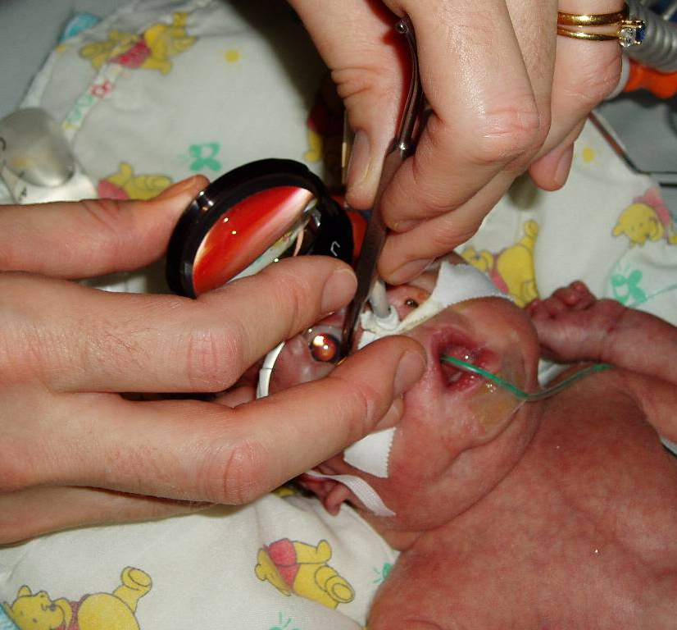
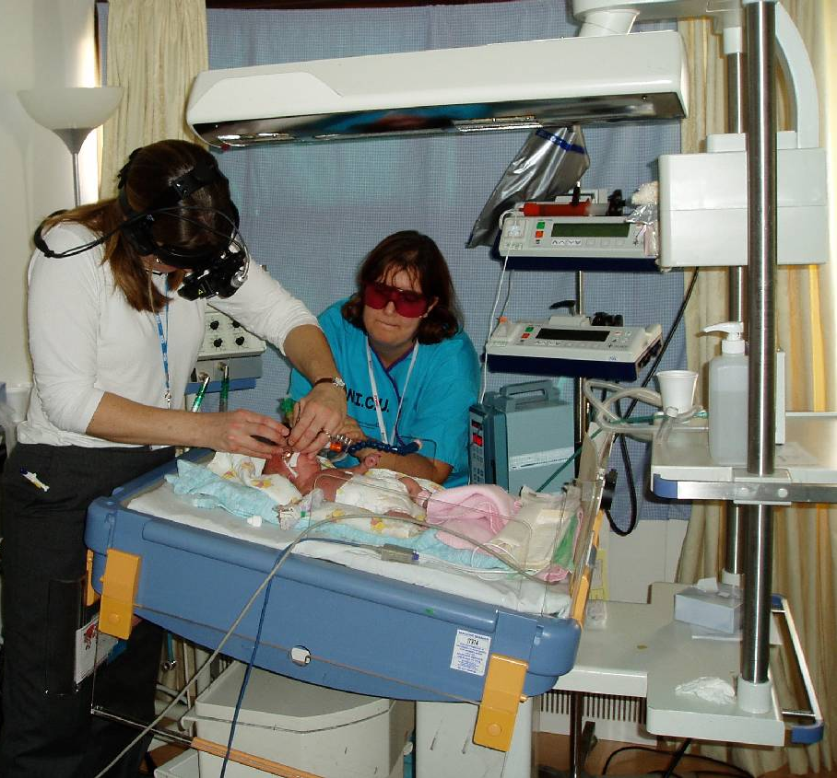
Retinal examination – indirect ophthalmoscopy

Slide 30
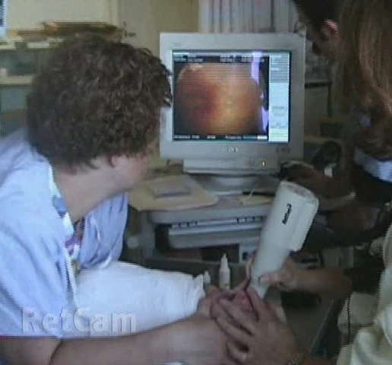
Retinal examination – Wide-angle digital retina camera (130 degrees)

Slide 31
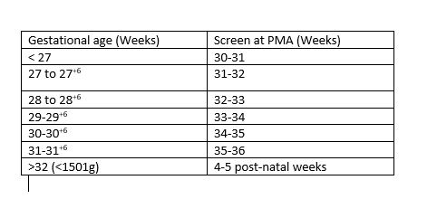
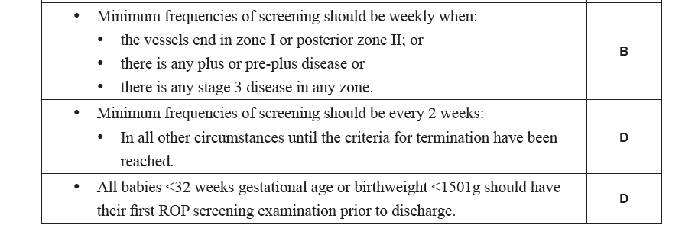
Screening timing

Slide 32
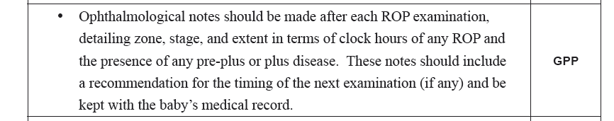
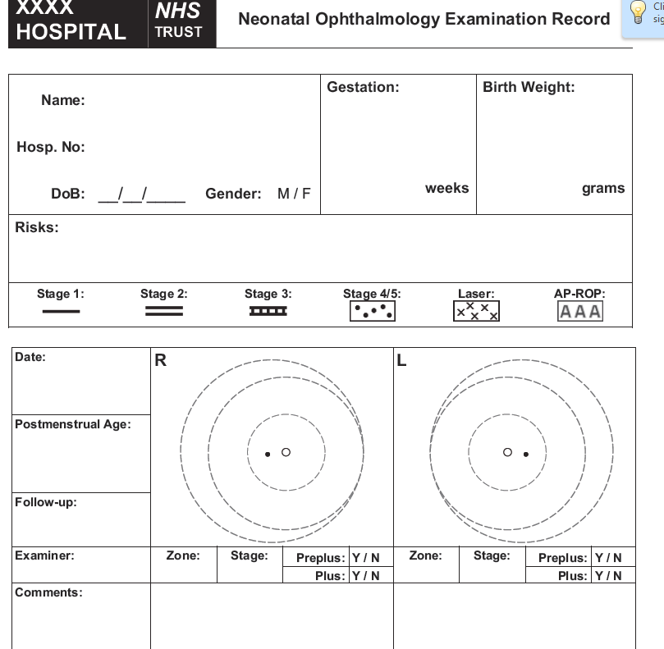
Documentation
Paper based
Electronic

Slide 33
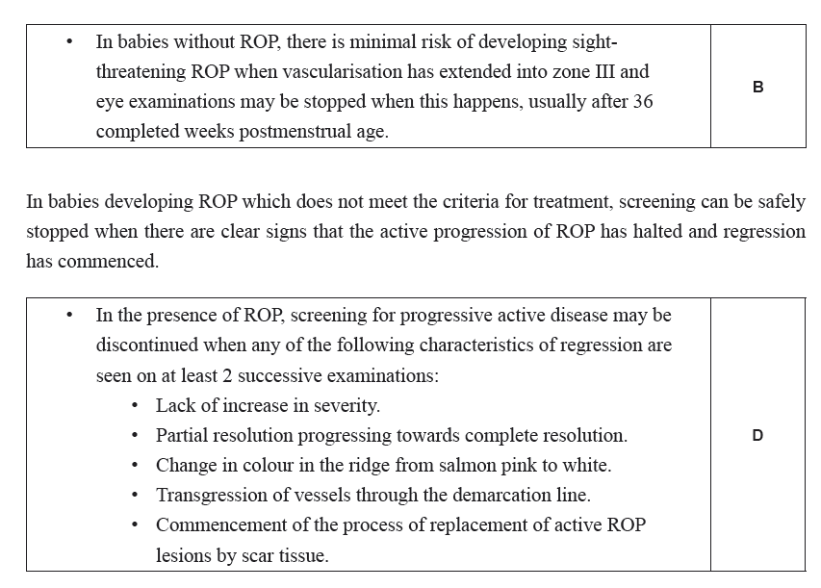
When to stop screening

Slide 34
Screening
What are the red flags?
????

Slide 35
What are the red flags?
Posterior pole plus
Persistent TVL
Poorly pupil dilation

Slide 36
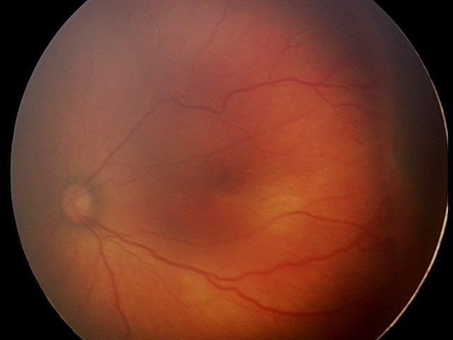
When is referral warranted - rwROP?
If there is any evidence of ROP in Zone 1
If there is any evidence of stage 3 ROP
If there is plus disease at posterior pole
If there is poor pupil dilatation
NB: significant inter-observer difference in grading plus!

Slide 37
When is referral warranted?
General details required for referral
Gestational and current age
Birth and current weight
Current oxygen requirement
In-patient or out-patient
Co-morbidities, such as: Chronic lung disease Intraventricular haemorrhage Necrotising enterocolitis
Infection risk/need isolation
If there is any evidence of ROP in Zone 1
If there is any evidence of stage 3 ROP
If there is plus disease at posterior pole
If there is poor pupil dilatation
NB: significant inter-observer difference in grading plus!

Slide 38
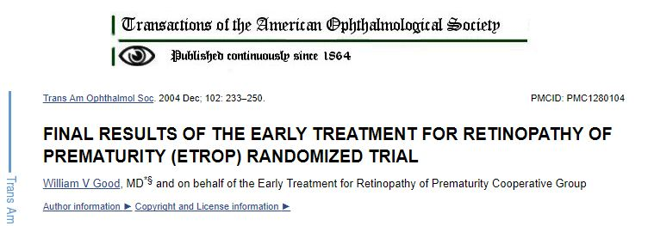
When is treatment warranted?

Slide 39
Guidelines for treatment
Treat all Type 1 ROP :
  Zone I, any stage of ROP with plus
  Zone I stage 3 without plus
  Zone II stage 3 with plus
Seriously consider treatment if
  Zone II stage 2 with plus
Type 2 ROP
  Zone I, stage 1 or 2 without plus
  Zone II, stage 3 without plus
Treat within 48 hours for APROP, other Type1 before 72 hours

Slide 40
Guidelines for treatment - twROP
Type 1 ROP :
  Zone I, any stage of ROP with plus
  Zone I stage 3 without plus
  Zone II stage 3 with plus
Seriously consider treatment if
  Zone II stage 2 with plus
Aggressive progressive ROP should be treated within 48 hours, other Type 1 disease 72 hours
ETROP Br J O 200690;11:1378-82

Slide 41
Outcomes from ETROP vs CryoROP
Treatment type 1
Reduction in unfavourable VA outcome
  19.8% to 14.3% p<0.005
Reduction in unfavourable structural outcome
  15.6% to 9.1% p<0.001
  Unfavourable structural outcome: RD, retinal fold across macula

Slide 42
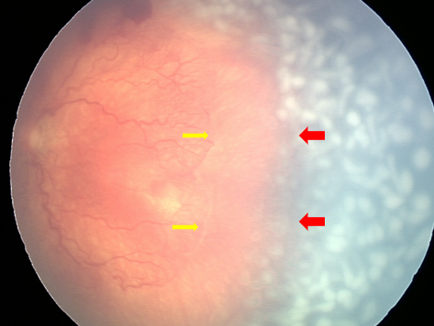
Laser treatment
Use 810 (IR) IO diode laser
Apply spots 0.5-1 burn width apart
Moderate intensity burn
Treat entire avascular retina 360 degrees
Treat from ridge to ora serrata
Post laser topical steroids
Review 5-7 days

Slide 43
Laser treatment risks
Inadvertent macular burn
Cataract
Choroidal effusion
Retinal / vitreous haemorrhage
Posterior synechiae

Slide 44
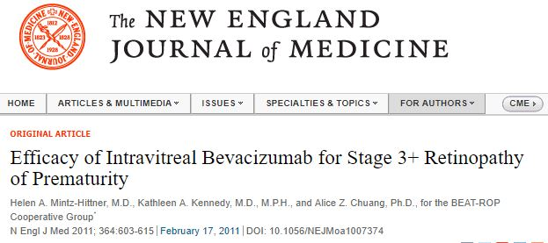
BEAT-ROP
Randomised control study laser vs Avastin for Stage 3+ ROP
Does not require intubation for treatment
Recurrence rate in Zone 1 disease higher with laser (26% vs 6%)
Long term FU suggested less myopia
BUT

Slide 45
BEAT-ROP
BUT
Neuro-developmental risks
Prolonged FU required, proportion do not vascularise Zone III and require laser
Risk of endophthalmitis
? What agent
? what dose
? What volume

Slide 46
RCOphth guidelines for treatment
BOSU study showed 90% treated with laser, 10% with anti-VEGF
Diode Laser photocoagulation by experienced ophthalmologist: Gold standard
Anti-VEGF agents only in APROP / unstable baby / rescue therapy
The first post treatment exam should occur at 5-7 days
Retreat if no improvement in 10-14 days

Slide 47
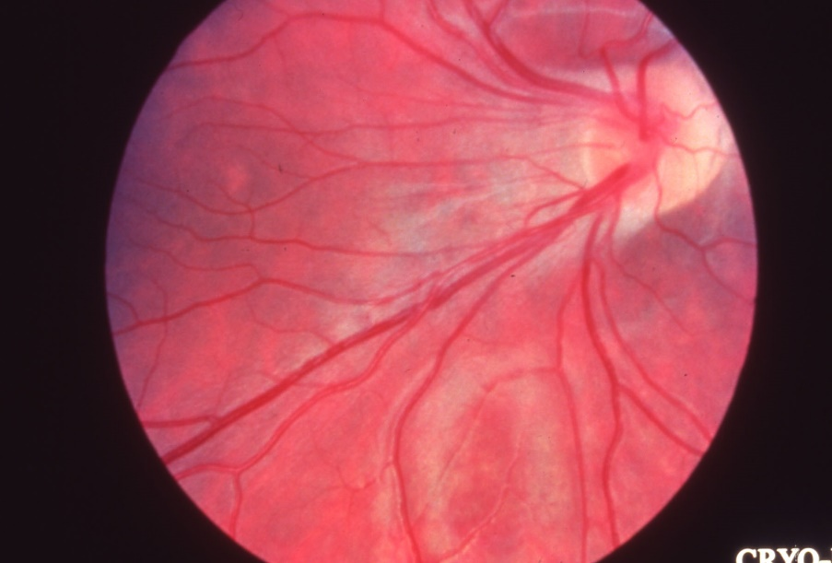
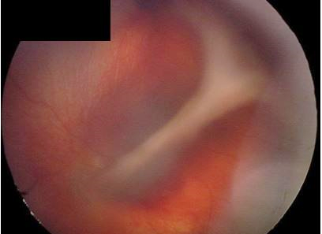
Fibrotic late phase of ROP
Due to vitreous fibroblast activation
Not mediated by VEGF
Vascular arcades straighten
Translucent vitreous opacity (condensation) overlying the ridge
Ridge elevation due to vitreous traction
Retinal detachment

Slide 48
Future of ROP
Reduce risk of severe ROP by:
Increase protection – exogenous IGF-1, PUFA , early EPO
Minimise hyperoxia
Maintain stable oxygen saturation
Improving detection - telemedicine Further anti-VEGF trials

