Slide 1
Test Your Knowledge!
Dr Ooi Huah Chiang
ACCS-EM ST3
Colchester General Hospital
6/1/2021

Slide 2
Exam Reminder
The last ever FRCEM Intermediate SAQ/SJP is in March 2021
The application deadline is 8 Jan 2021 (this Friday)
Will be replaced by MRCEM SBA
MRCEM OSCE will become mandatory again, and the earliest available to register is from 11 Jan for June 2021 sitting.

Slide 3
FRCEM/MRCEM Primary
180 Single-Best Answer Questions on applied basic science
Blueprint:
  Anatomy x60
  Physiology x60
  Pharmacology x27
  Microbiology x18
  Pathology x9
  EBM/Statistics x6

Slide 4
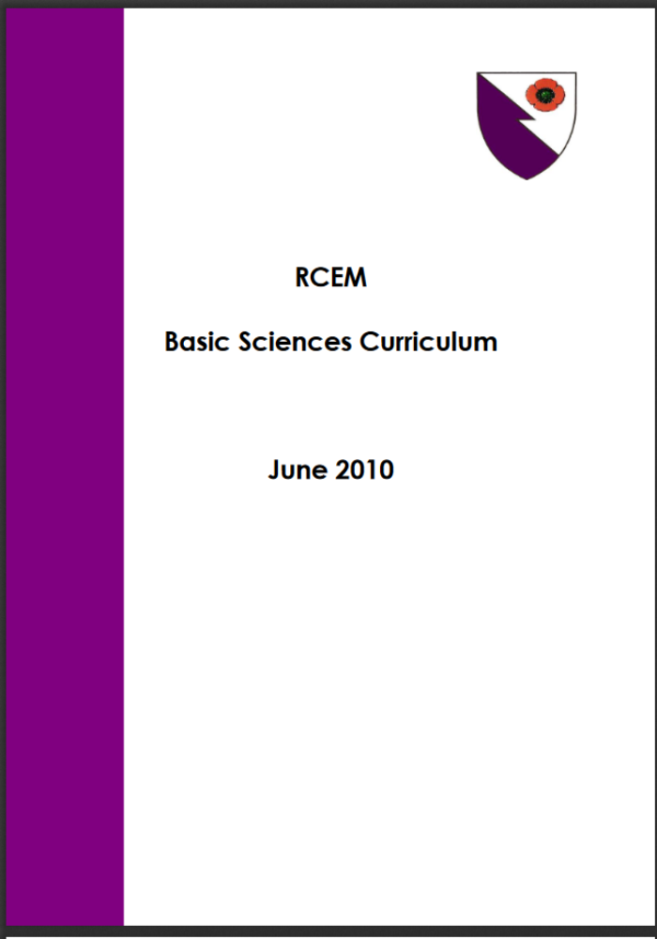

Slide 5
Q1 - A 21-year-old presents to you with right shoulder pain following an intense workout session at the gym. On examination, you notice that when he places both hands behind his lower back, he is unable to lift them against resistance. Which muscle is likely to be injured?
Supraspinatus
Infraspinatus
Teres minor
Teres major
Subscapularis

Slide 6
Special Tests for Rotator Cuff Muscles
Supraspinatus - Jobe’s test/Empty can test
Infraspinatus & Teres minor - External rotation of shoulder
Teres major is not a rotator cuff muscle
Subscapularis - Lift off test

Slide 7
Q2 - A 60-year-old female presents to you with right shoulder pain for 3 days. You notice that she is unable to abduct her right shoulder from rest, but is able to do so herself once you have helped her abduct it slightly. Which muscle is most likely to be injured?
Biceps brachii
Supraspinatus
Trapezius
Deltoid
Serratius anterior

Slide 8
Major Contributors to Shoulder Abduction
0-15° - Supraspinatus (Initiates abduction)
15-90° - Deltoid (Sustains abduction)
>90° - Trapezius and Serratius anterior (Rotates scapula)
NOTE: Different from ‘painful arc’ in shoulder impingement syndrome

Slide 9
Q3 - A 30-year-old male fell off his motorcycle and sustained an anterior dislocation of his right shoulder. After successful reduction, you find that he has lost sensation over the lateral surface of his proximal arm. What other function may be impaired in this nerve injury?
Internal rotation at the shoulder joint
Extension at the shoulder joint
Extension at the elbow joint
Sensation over the dorsal 1st webspace of the hand
Sensation over the thenar eminence

Slide 10
Explanation
Regimental badge sensation is supplied by axillary nerve, which also supplies:
  Deltoid muscle - Shoulder abduction, flexion
  Long head of triceps - Elbow extension
  Teres minor - External rotation of shoulder
Sensation of dorsal 1st webspace of hand is supplied by radial nerve
Sensation of thenar eminence is supplied by median nerve

Slide 11
Q4 - A 42-year-old man has been stabbed in the neck with transection of the accessory nerve. Which muscle function is likely to be impaired?
Deltoid
Platysma
Serratius anterior
Trapezius
Posterior scalene muscle

Slide 12
Explanation
Accessory nerve (CNXI) is a pure motor cranial nerve that supplies trapezius and sternocleidomastoid muscles
Tested by shrugging shoulder and looking away from the tested side

Slide 13
Q5 - A 20-year-old male attends the ED with shoulder pain after colliding his motorcycle against a lamp post. When asked to push against a wall, you notice the shape of his scapula protruding out of his back. Which nerve is likely to be injured?
Axillary nerve
Musculocutaneous nerve
Thoracodorsal nerve
Lateral pectoral nerve
Long thoracic nerve

Slide 14
Explanation
Winging of scapula classically associated with weakness of serratius anterior, which is supplied by long thoracic nerve
But can also occur with weakness of trapezius (supplied by accessory nerve)

Slide 15
Q6 - You are keen to perform a shoulder joint reduction using intra-articular lidocaine on a 50kg woman. What is the maximum amount of lidocaine you can administer to this patient?
10mL of 1% lidocaine without adrenaline
15mL of 2% lidocaine without adrenaline
20mL of 1% lidocaine without adrenaline
20mL of 2% lidocaine without adrenaline
35mL of 1% lidocaine with adrenaline

Slide 16
Calculations
Max dose lidocaine in 50kg patient:
  3mg/kg without adrenaline = 150mg lidocaine
  7mg/kg with adrenaline = 350mg lidocaine
1% lidocaine = 10mg/mL lidocaine
  Max volume without adrenaline = 150/10 = 15mL of 1% lidocaine
  Max volume with adrenaline = 350/10 = 35mL of 1% lidocaine
2% lidocaine = 20mg/mL lidocaine
  Max volume without adrenaline = 150/20 = 7.5mL of 2% lidocaine
  Max volume with adrenaline = 350/20 = 17.5mL of 2% lidocaine

Slide 17
Q7 - You provided sedation for a shoulder joint reduction. At the end of the procedure, you noticed that your patient appears flushed but has no other worrying features. Which of the following agents has vasodilatory properties?
Ketamine
Nitrous oxide
Midazolam
Lidocaine
Adrenaline

Slide 18
Additional Notes
Other common anaesthetic agents with vasodilatory properties are:
  Propofol
  Volatile anaesthetics eg sevoflurane, isoflurane etc.

Slide 19
Q8 - A 24-year-old male with sickle cell disease presents to you with severe arm pain and high fever. There is no history of trauma. X-rays show some periosteal reaction of the humerus. Which is the likely causative organism?
Pseudomonas spp
Salmonella spp
E. Coli
Staphylococcus spp
Streptococcos spp

Slide 20
Explanation
Staph aureus is the commonest cause of osteomyelitis in general population, but in patients with sickle cell disease, salmonella is twice as common as staph.

Slide 21
Q8 - Which struture in skeletal muscle cells stores calcium ions?
Sarcoplasmic reticulum
Ribosomes
Mitochondrium
Endoplasmic reticulum
T-tubules

Slide 22
Explanation
Calcium ions are stored inside the sarcoplasmic reticulum of myocytes and released via activation of L-type calcium channels and ryanodine receptors
Defects in ryanodine receptor gene (RYR1) is most commonly implicated in malignant hyperthermia
T-tubules help to transmit myocyte action potential to coordinate simultaneous contraction of a muscle group

Slide 23
Q9 - Which of the following is a function of the mitochondria?
Unrolling of new protein
RNA production
DNA production
NADH production via tricarboxylic acid cycle
ATP production via glycolysis

Slide 24
Explanation
Glycolysis occurs in cytoplasm and is responsible for anaerobic respiration
Energy production in mitochondria occurs via:
  TCA/Citric acid/Krebs cycle which produces NADH and FADH which indirectly produces ATP
  Oxidative phophorylation which produces most of the ATP of aerobic respiration
RNA and DNA production both occur in nucleus
New protein is synthesised by ribosomes

