Slide 1
Test Your Knowledge!
Dr Ooi Huah Chiang
ACCS-EM ST3
Colchester General Hospital
28/10/2020

Slide 2
FRCEM Primary
180 Single-Best Answer Questions on applied basic science
Blueprint:
  Anatomy x60
  Physiology x60
  Pharmacology x27
  Microbiology x18
  Pathology x9
  EBM/Statistics x6

Slide 3


Slide 4
Q1 - A 21 year old male stepped on a metallic shard at work. You examine the plantar aspect of his foot and believe only the first layer is involved. What structure may be involved in this injury?
Flexor digitorum brevis
Plantar arterial arch
Dorsal arterial arch
Peroneus longus
Tibialis posterior

Slide 5
Explanation
RCEM Basic Science Curriculum expects candidates to know:
  The plantar foot has 4 layers
  The long flexor tendons (FDL, FHL) lie within the second layer
  Tendons of tibialis posterior and peroneus longus are part of the fourth layer
  The neurovascular plane lies between the first and second layers
So the correct answer to this question lies in knowing only what RCEM needs you to know

Slide 6
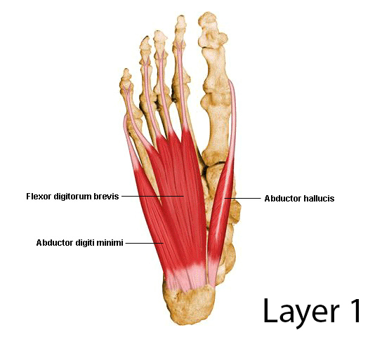
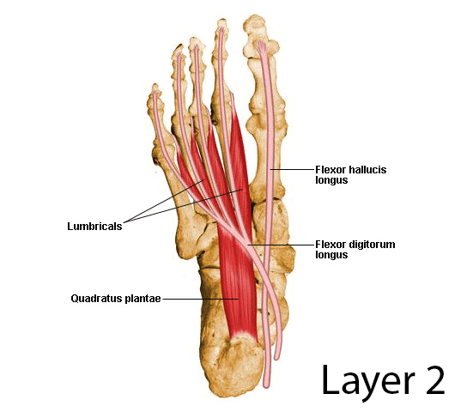
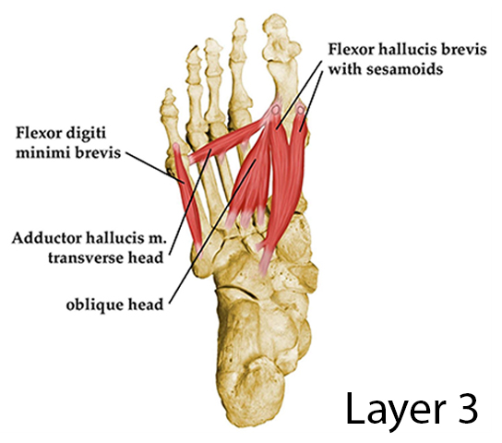
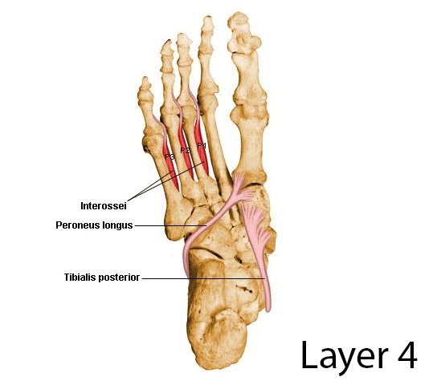
Flexor Hallucis Longus
Flexor Digitorum Longus
Peroneus/Fibularis Longus
Tibialis Posterior
Images taken from orthobullets

Slide 7
Q2 - A 31-year old man complains of knee pain after colliding with a slow moving car when he was jogging. Limb X-rays show a fracture at the neck of fibula. Which nerve is likely to be damaged?
Sciatic nerve
Tibial nerve
Common peroneal nerve
Sural nerve
Saphenous nerve

Slide 8
Explanation
The common peroneal nerve crosses the fibular neck and is susceptible to injury from a fibular neck fracture, the pressure of a splint or during surgical repair.
Common peroneal nerve injuries may cause foot drop (paralysis of ankle dorsiflexors) and loss of sensation of dermatomes L4-S2

Slide 9
Q3 - A 60-year-old lady has come in with worsening left hip pain after a fall where she did not seek medical attention. X-ray confirms a displaced fracture of the femoral neck with a flattening of the femoral head. An injury to which artery is most likely to have contributed to this?
Artery to ligamentum teres
Medical femoral circumflex artery
Lateral femoral circumflex artery
Femoral artery perforators
Superior gluteal artery

Slide 10
Explanation
MFC is the main source of arterial supply to the femoral head
MFC gives off the retinacular arteries of the femoral neck and is often disrupted in displaced hip fractures
Artery to ligamentum teres is significant for femoral head in paeds but not adults
Other arteries listed also contribute blood supply to various areas of the hip
Notes:
Not shown are lymph nodes

Slide 11
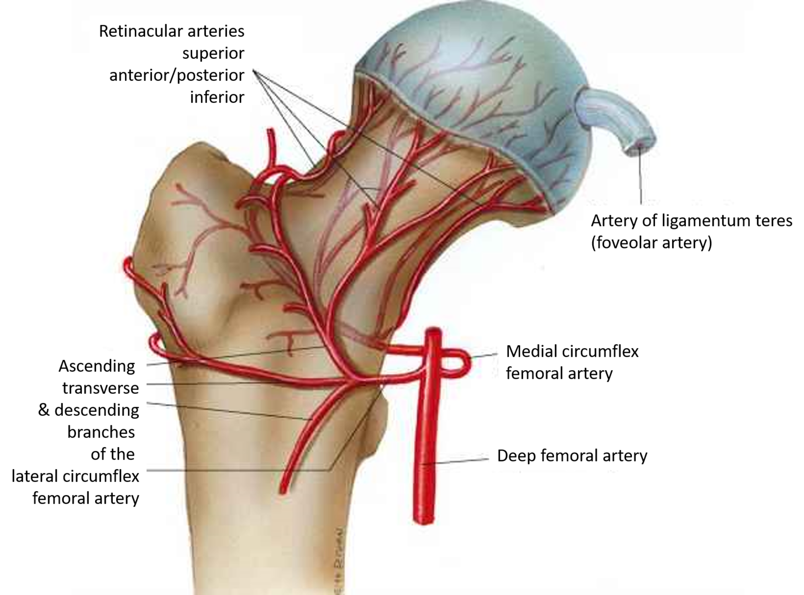
Image Source: https://www.cureus.com/articles/13561-osteonecrosis-of-the-femoral-head-etiology-investigations-and-management

Slide 12
Q4 - You are examining a patient who is complaining of back pain and left lower limb numbness and weakness. You notice he has an absent ankle reflex. Which nerve roots supply this particular reflex?
L1,L2
L3,L4
L5,S1
S2,S3
S4,S5

Slide 13
Explanation
Ankle reflex - S1
Knee reflex - L4
Biceps reflex - C5,C6
Triceps reflex - C7

Slide 14
Q5 - You have obtained a urine sample from a 50-year-old male complaining of frequent urination. Urine dipstick shows 4+ glucose, and 1+ ketone. Where is the site of glucose reabsorption in the nephron?
Collecting duct
Ascending loop of henle
Descending loop of henle
Proximal convoluted tubule
Distal convoluted tubule

Slide 15
Explanation
Virtually all glucose is reabsorbed in the PCT of nephron by a special transporter
The reabsorption limit is exceeded when blood glucose is >11.1mmol/L

Slide 16
Q6 - You are having difficulty bringing down the blood pressure of a 65-year-old man who is otherwise asymptomatic. Which structure contributes most to systemic vascular resistance?
Arteries
Arterioles
Capillaries
Venules
Veins

Slide 17
Explanation
In most patients, SVR is regulated mainly by changes in arteriolar tone.
This helps regulate blood pressure and flow velocity from arteries into capillaries

Slide 18
Q7 - You have started a patient on ramipril for cardioprophylaxis following his acute myocardial infarction. He returns a few days later with a persistent dry cough. Which substance is responsible for this phenomenon?
Histamine
Serotonin
Dopamine
Bradykinin
Nitrous oxide

Slide 19
Explanation
Angiotensin-converting enzyme also breaks down bradykinin
ACE-inhibitors block the function of ACE and cause bradykinin buildup
Bradykinin induces bronchoconstriction and inflammatory response in lung, hence producing a cough.

Slide 20
Q8 - You are resuscitating a hypotensive patient which you suspect is having an Addisonian crisis following prolonged steroid use. Which factors do not stimulate aldosterone production?
Atrial stretch receptors
Decreased serum sodium
Alkalosis
Increased serum potassium
Angiotensin II

Slide 21
Explanation
Aldosterone secretion is primarily stimulated by:
  Hyperkalemia (strongest regulator)
  Hypovolaemia (detected primarily via atrial stretch receptors)
  Angiotensin II levels (which via RAA-S is stimulated by hyponatremia)
  Acidosis

Slide 22
Q9 - A 50-year old man presents to you with jaundice, progressive weight loss and abdominal swelling. He tells you that he was diagnosed with hepatitis many years ago, but did not follow up for treatment. An abdominal ultrasound shows multiple hypoechoic lesions suggestive of tumours with no obvious cirrhosis. Which is the most likely causative organism?
HIV
Hepatitis A
Hepatitis B
Hepatitis C
CMV

Slide 23
Explanation
Hepatitis C particularly known to cause hepatocellular CA without cirrhosis.

