Slide 1
Test Your Knowledge!
Dr Ooi Huah Chiang
ACCS-EM ST3
Colchester General Hospital
8/9/2020

Slide 2
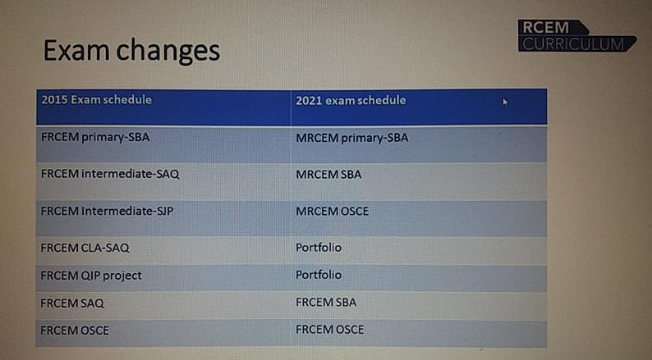
Changes coming 2021!

Slide 3
FRCEM Primary
180 Single-Best Answer Questions on applied basic science
Blueprint:
  Anatomy x60
  Physiology x60
  Pharmacology x27
  Microbiology x18
  Pathology x9
  EBM/Statistics x6

Slide 4
Q1 - A 17-year-old male competing in a 100-meter sprint develops a sudden pain in his left hip at the start of his race and attended your ED with a limp. You obtained a pelvic X-ray that showed a fracture of the left anterior superior iliac spine.
Which of the following regarding the associated muscle is false?
There may be weakness of knee flexion
The muscle affects abduction and external rotation of the hip
It forms the medial border of the femoral triangle
Its distal insertion is at the superomedial surface of the tibia
Its function can be affected by pes anserinus bursitis

Slide 5
Explanation
There is an avulsion fracture of the left ASIS
The ASIS is the proximal attachment of the sartorius muscle
The distal attachment of sartorius is superomedial tibia
The mechanical function of sartorius is synergistic at:
  Hip: Flexion, abduction, ext rotation
  Knee: Flexion when the knee is partially flexed
It forms the lateral border of the femoral triangle
Pes anserinus is the combined tendons of sartorius, gracilis and semitendinosus. It has a submuscular bursa that can be inflammed in overuse by atheletes

Slide 6
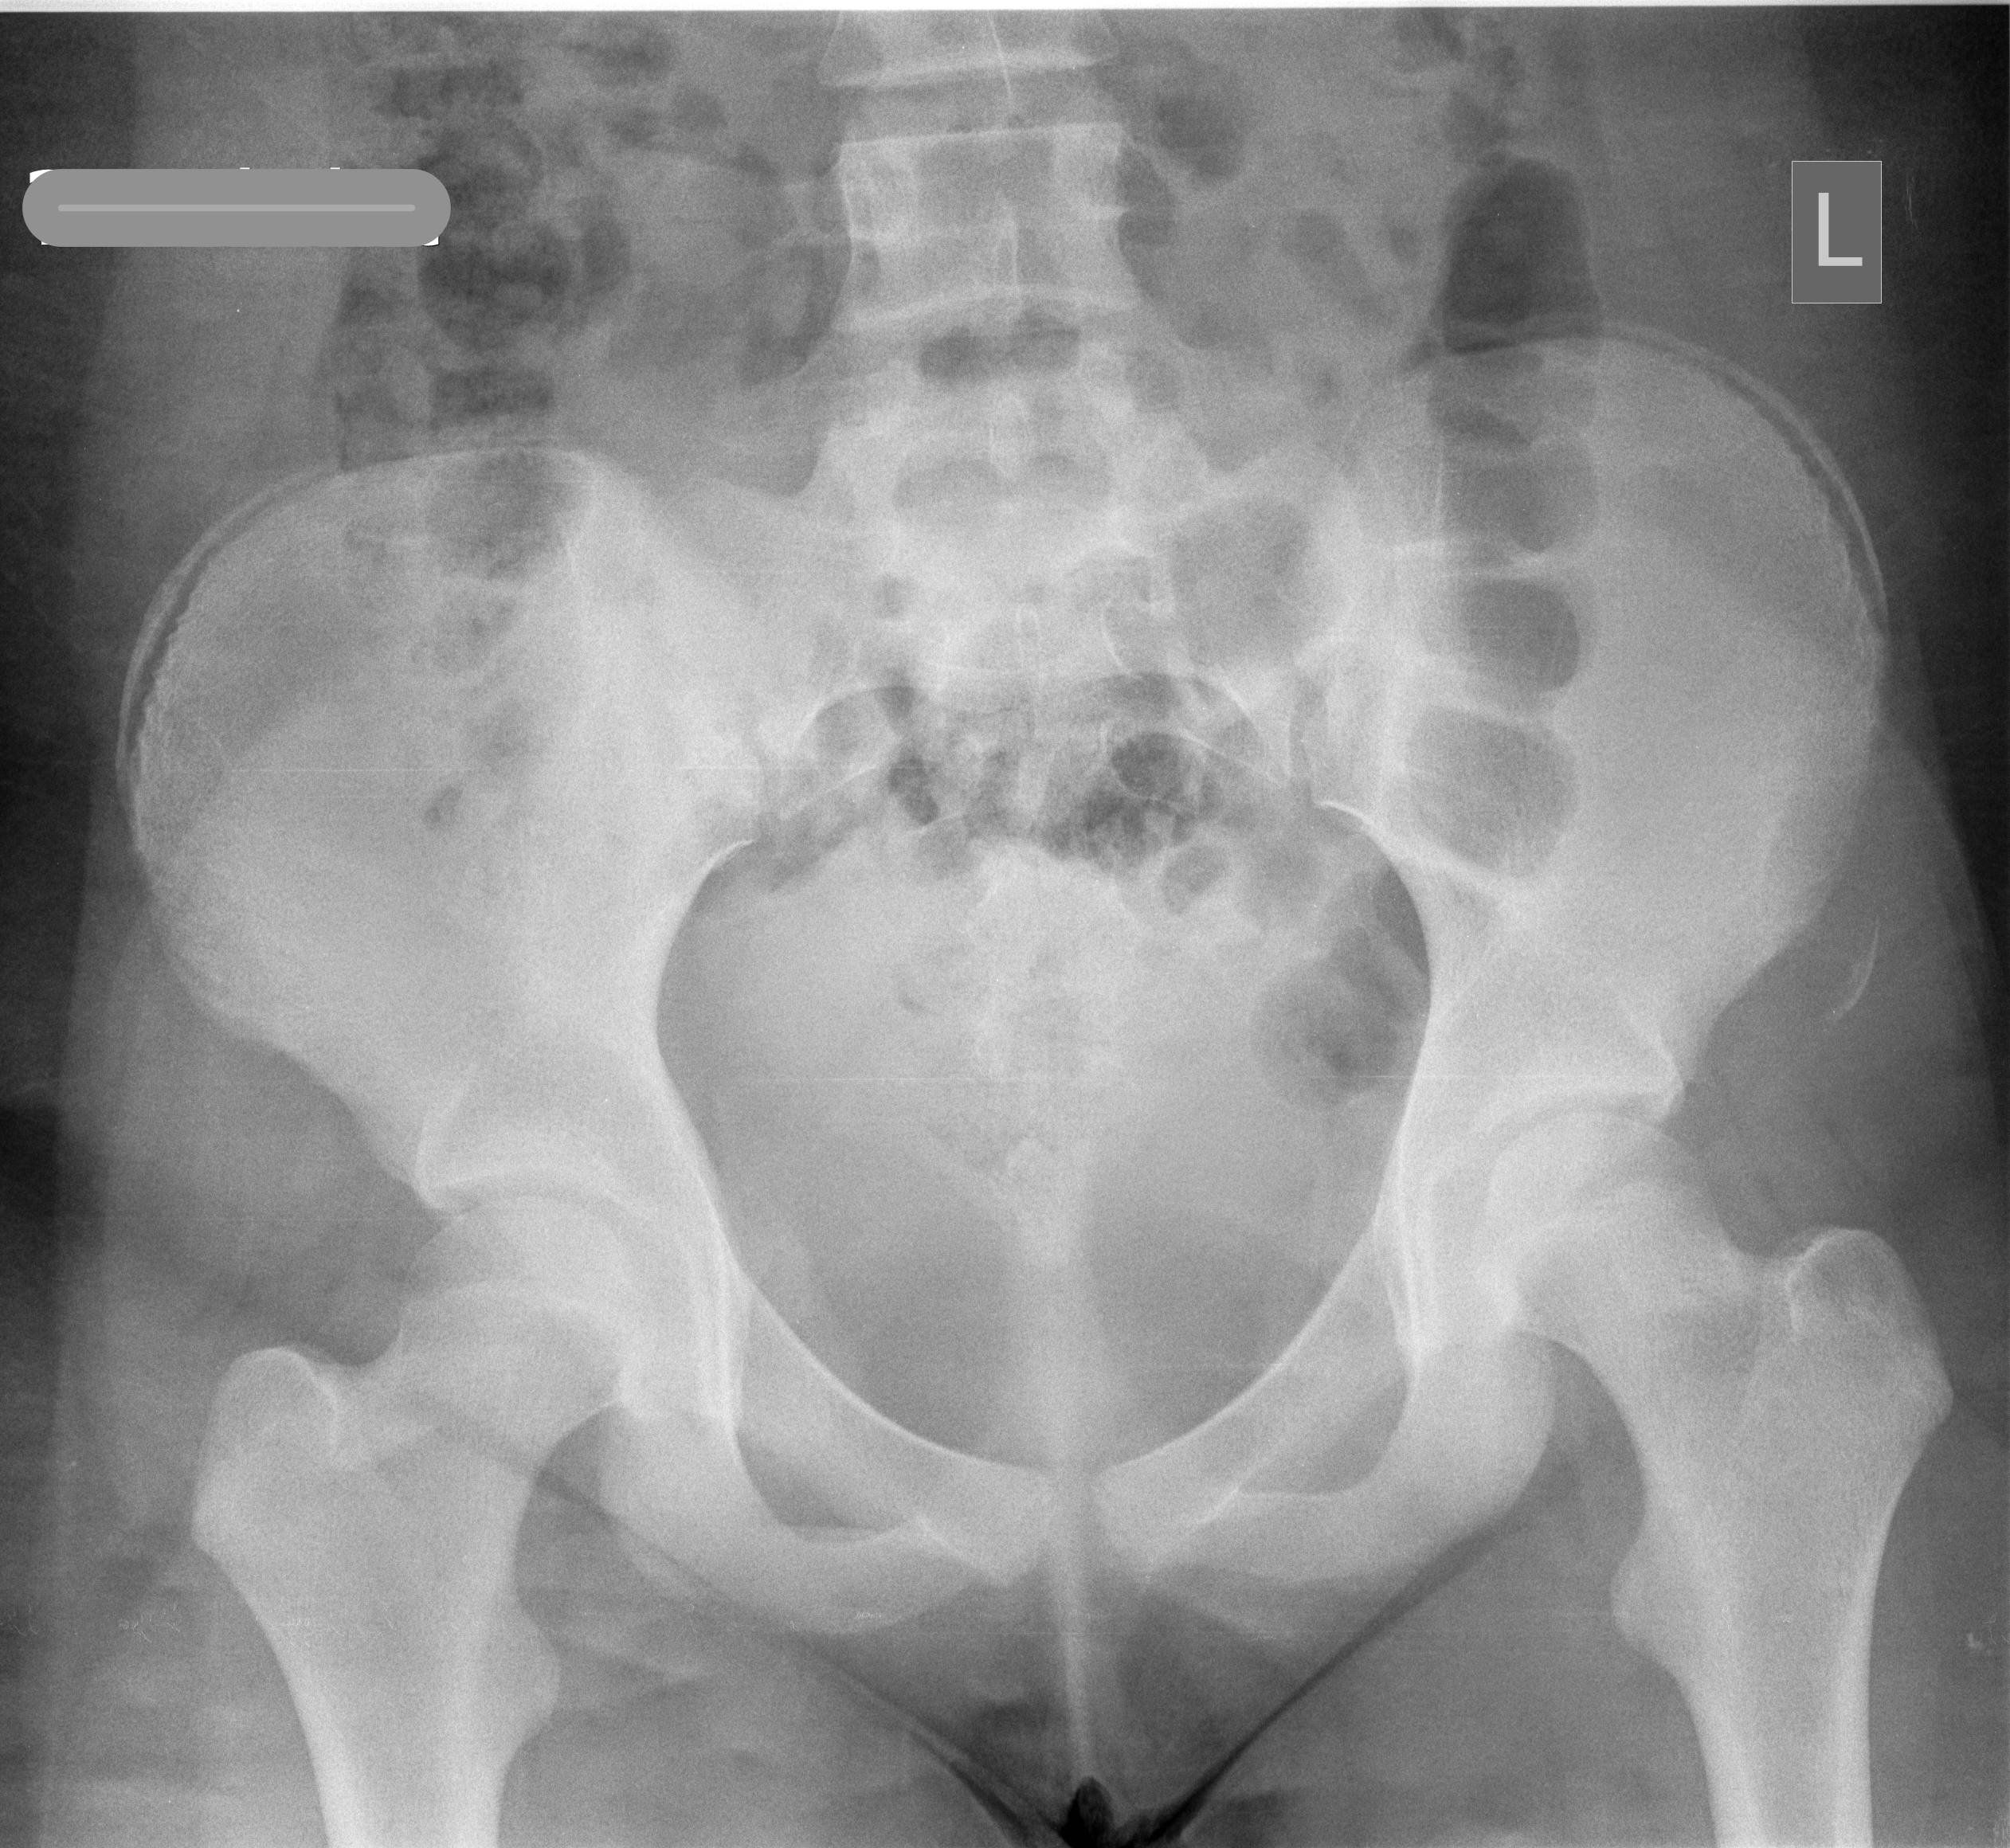
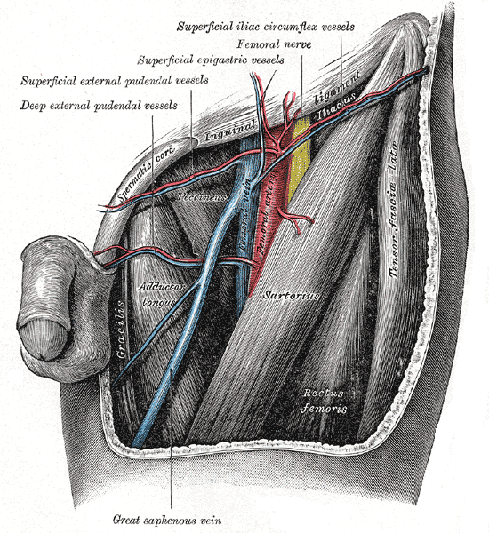
Some pictures...
Femoral triangle

Slide 7
Q2 - A 17-year-old hockey player attends the ED with a painful knee after being struck by a hockey stick. You diagnosed a patellar dislocation. Which muscular dysfunction may further predispose this condition?
Rectus femoris
Vastus medialis
Vastus lateralis
Vastus intermedius
Tensor fasciae lata

Slide 8
Explanation
Lateral patellar dislocation is most common
Latellar patellar dislocations often cause stretching and tearing of the medial patellar retinaculum
Medial patellar retinaculum is an important patella stabiliser, and recurrent lateral dislocation can occur if weakened.
Composition of medial patellar retinaculum:
  Most fibres come from the vastus medialis
  Sartorius
  Medial collateral ligament
  Medial patellofemoral ligament

Slide 9
Q3 - After a prolonged resuscitation of a patient in septic shock, you notice that the latest arterial blood gas shows the following result:
pH: 7.29
pCO2: 5.0
pO2: 12.1
HCO3: 17
BE: -7
Lac: 1.5
Na 145
K 4
Cl 116
What is the likely explanation for this abnormality?
Life threatening asthma exacerbation
Salicylate overdose
Diabetic ketoacidosis
Excessive saline infusion
Hypoxia

Slide 10
Explanation
Blood gas shows a normal anion gap metabolic acidosis
Excessive saline infusion causes hyperchloremic acidosis, which has a normal anion gap
Anion gap defined as [Na] + [K] - [Cl] - [HCO3], and normal is 4-16

Slide 11
Q4 - You are managing an unconscious patient who is a known alcohol abuser and was found to be hypoglyaemic. Which of the following would best explain a failure to treat his hypoglycaemia with glucagon?
Inadequate glycogen stores
Excess circulating insulin
Adrenal suppression
Increased insulin sensitivity
Failure of intestinal sodium-glucose cotransporter

Slide 12
Explanation
Glucagon works by driving glycogenolysis and gluconeogenesis
Alcohol abusers often have malnutrition or chronic liver disease that reduces their glycogen stores.
Other options listed are various dysfunctions of the hypoglycemic counterregulatory response that may explain refractory hypoglycemia

Slide 13
Q5 - You attend a patient with chest pain whose ECG shows an anterior STEMI. The cardiology team asks you to prepare the patient for PCI and asks you to give dual antiplatelet therapy. Which of the following statements regarding antiplatelet therapy is false?
Clopidogrel is metabolised by the liver into its active compound
Abciximab is a IIa/IIIb receptor antagonist
Aspirin is an irreversible inhibitor of the COX enzyme
Ticagrelor affects platelet aggregation by blocking ADP-mediated P2Y12 receptors
Dipyridamole also causes vasodilatation

Slide 14
Explanation
Abciximab is a glycoprotein IIb/IIIa receptor antagonist
Clopidogrel is a prodrug that require hepatic activation
Aspirin irreversibly blocks COX enzyme and reduces prostaglandin and thromboxane synthesis
Ticagrelor, clopidogrel, prasugrel, cangrelor etc all act via ADP-mediated P2Y₁₂ receptor antagonism
Dipyridamole is a phosphodieterase inhibitor which antithrombotic and vasodilatory effects

Slide 15
Q6 - You sent a central venous line for culture and the preliminary report found gram positive cocci. Which of the following statement is false?
Staphylococcus saprophyticus is a coagulase positive staphylococci
Staphylococcus epidermidis is a normal skin flora
Methicillin-resistant staphylococcus aureus is usually sensitive to vancomycin
Staphylococci species often appear as clusters under microscopy
Lung cavitations are typical in staphylococcal pneumonia

Slide 16
Explanation
Staph saprophyticus is a coagulase negative staph that commonly causes UTIs among sexually active young women.
MRSA is often sensitive to Vancomycin, Teicoplanin and Linezolid; and is resistant to beta-lactam antibiotics eg penicillins, cephalosporins and carbapenems
Staph species are often described as grapelike-clusters
Staph pneumonia is often caused by staph aureus, is characterised by lung cavitations, abscesses and necrotising pneumonia, and often accompanies influenza viral pneumonia

Slide 17
Q7 - You see a diabetic patient with a chronic leg ulcer. The wound borders are white and thick, and the central wound is pink and dry with some slough. It does not appear infected. At what stage of healing has the wound arrested?
Haemostasis
Proliferative
Inflammatory
Remodeling
Revascularisation

Slide 18
Explanation
The 4 stages of wound healing are:
Haemostasis → Inflammatory → Proliferative → Remodeling/Maturation
Haemostasis involves the clotting and complement cascades
Inflammatory phase involves immune system clearing out damaged and necrotic tissues
Proliferative phase involves laying down granulation tissue (pink), re-epithelialisation and revacularisation
Remodeling/Maturation involves wound contraction, ending granulation and restoring skin tensile strength

Slide 19
Q8 - You read about a new biomarker for cardiac ischaemia. Which statistical parameter would be most valuable in making a decision to discharge?
Sensitivity
Specificity
Negative likelihood ratio
Positive likelihood ratio
Negative predictive value

Slide 20
Explanation
Negative likelihood ratios allow you to calculate the post-test probability of a patient not having a disease based on a negative test, and is more useful on an individual level. It takes into account a clinician's judgement.
Sensitivity of 100% may theoretically detect all true positives, but it is population and setting based, and dependent on the gold standard reference of what a true positive is.
Predictive values are highly dependent on prevalence.

