Slide 1
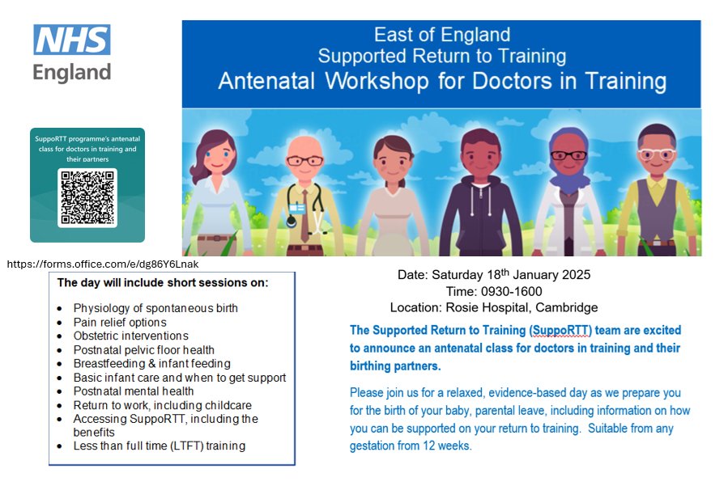
For more enquiries &
to book your place please email:
claire.carse@nhs.net
Date: Saturday 26th September 2026
Time: 09:30-16:00
Location: Rosie Hospital, Cambridge

