Slide 1
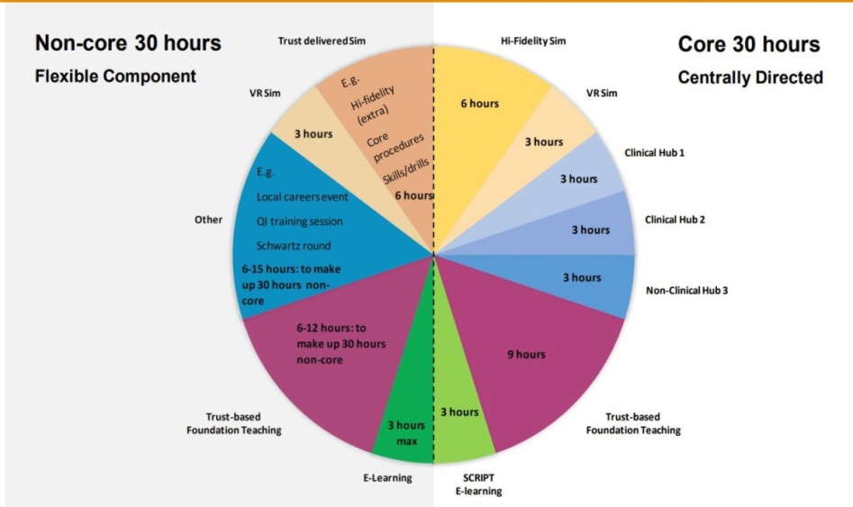
Welcome to the East of England Foundation School
https://heeoe.hee.nhs.uk/foundation
Workplace and Me –
wellbeing in the workplace
papworth.fyregionalteaching@nhs.net

Slide 2
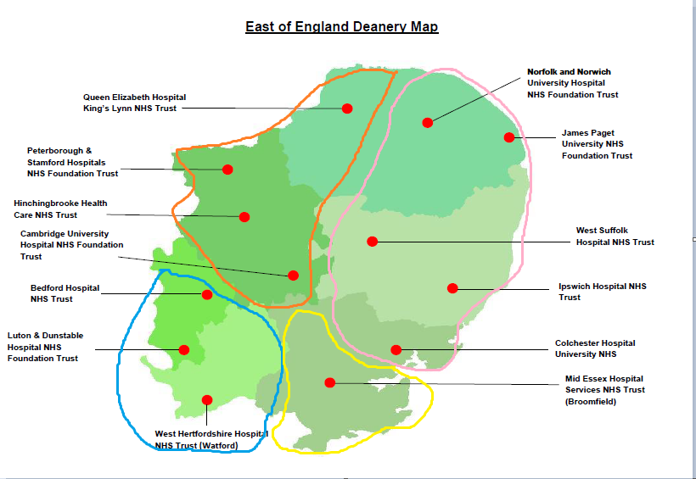
The East of England Deanery
EAFS West
EAFS East
EBH West (+Lister)
EBH East (+ Southend, Basildon, Harlow)

Slide 3
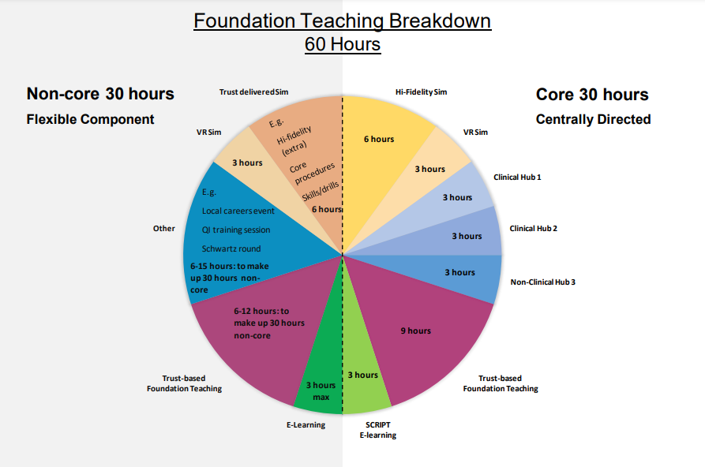
Taught Programme
Further info can be found at https://heeoe.hee.nhs.uk/foundation/training-programme/taught-programmestudy-leave

Slide 4
Hub days
3 x 1/2 days in both F1 and F2 – 2x Clinical and 1x Non Clinical
Sign ups open 3rd August
Focused teaching sessions on a given topic eg. Careers, Public Health, Surgical Skills
You are advised to sign up as soon as you are able to as spaces fill up quickly! This is done via Bridge, which you will receive access for in due course. If you are deferring your start date, you should still book early but for Hubs running after you start.
Although most hubs are a half day, we recommend to all the trusts that you have a full day of study leave, and include a half day study leave for other learning.
Each quadrant (made up of the different Trusts/hospitals below) offer their own Hubs and there are also some based Centrally via Victoria House in Fulbourn.
Further info can be found at https://heeoe.hee.nhs.uk/foundation/training-programme/hub-events

Slide 5
FAQ
Here’s a few answers to questions raised in other Welcome sessions that you may find useful:
General:
Q: What are the hubs and what do they involve
A: Hubs are regional teaching days that are part of your mandatory teaching hours during foundation - they give you the opportunity to explore topics and specialisms you are interested in
Q: If we sign up to hubs on 3rd aug, do we then have to confirm study leave days after with our hospital? A: Yes, this is part of your study leave allowance for FY1, but you will need to ensure that your hospital is aware that you will not be at work.
Q: Do we need to take annual leave in every rotation? Or not necessarily?
A: Yes definitely! You'll have 9 days per rotation, 27 overall. You can't usually roll them over
Q: With regards to exception reporting, at what point is it sensible to report as I’m aware there will be many days where you won’t actually leave on time.
A: What ever feels to you as being significant or regular lateness. As a guide anything more than 30mins.

Slide 6
FAQ
General:
Q: When do we get access to Horus? A: The National Team are currently uploading everyone.
Q: Do F1's do night shifts ?
A: Yes you are expected to undertake night shifts. More details on rota can be obtained from your Trusts.
Q: My start date needs to be delayed for XXX reason. What do I do? A: You need to contact the Trust, Programme team and recruitment to inform them why you will be unable to start and ask for a deferral. You will need to do that now and not delay in informing them.
Foundation Programmes (EoE) <foundationprogrammes.eoe@hee.nhs.uk>
Foundation Recruitment (EoE) <foundationrecruitment.eoe@hee.nhs.uk>
Foundation School Director : Helen.barker6@nhs.net

Slide 7
FAQ
Study Leave/Self Development:
Q: How many study days (which I assume are different to annual leave) can we take? Not just for hubs but conferences etc A: In f1 all of your study leave is for the taught programme e.g hubs etc. There is no additional study leave in f1. All f1 and f2 get 2 hours per week to use for self-development - which is not the 60 hours - and is for working on ePortfolio, doing audit, teaching medical and PA students, meeting supervisors etc. You do not need to use Non Working Days for Hubs.
I cant see self development days on my time table is this normal
Q: Is exception reporting done in retrospect? As in, when you notice a pattern over time rather than ASAP when something happens
A: As soon as possible, ideally within a few days of the incident
Q: Is Study Leave separate to Annual Leave? How much do I get? A: Yes. Further info on Study Leave can be found at https://heeoe.hee.nhs.uk/foundation/training-programme/taught-programmestudy-leave. Annual Leave, Sick Leave and Study Leave are all separate! All of study, annual and sick leave entitlements increase with service length through your training. For more details catch a BMA contract talk or visit their page on leave entitlements.

Slide 8
FAQ
Contracts:
Q: I have not received my contract and/or rota yet. What do I do?
A: Contractual issues are outside HEE’s remit and agreed between trusts and the BMA, so contact one or the other for more information. Contact your trust in the first instance, but BMA can advise further and help follow this up. You can receive your contract anytime up until you start work. It’s quite normal to negotiate contracts into the first few weeks of working.

Slide 9
FAQ
ALS:
Q: Do we have to pay for the in-person part of the ALS course?
A: If you do the eALS - that is one day of online learning (for which you get study leave) and one day in person (for which you also get study leave), and both days cost around £275 - that should be covered. If you did the two day all in-person course then that would be more expensive and you may need to top things up.
Q: If we’ve already completed ALS who do we send our certificate to?
A: That will be to your resus officer at the hospital from a trust mandatory training perspective; from an FY1 requirements perspective you will need to upload it onto your Horus eportfolio
Q: Is ALS part of the taught programme? Do we need to arrange/attend this as part of our foundation programme?
A: Yes it is part of the taught programme and you will need to have done this during your foundation programme.

Slide 10
More information
Further info about the Teaching Programme can be found at https://heeoe.hee.nhs.uk/foundation/training-programme/taught-programmestudy-leave
For more info on Hubs, https://heeoe.hee.nhs.uk/foundation/training-programme/hub-events
For info on Study Leave https://heeoe.hee.nhs.uk/faculty-educators/study-leave-homepage
All of these pages have useful guides and attachments, usually found at the bottom of the page.

