Slide 1
Specimen Appraisal Trial
Adrian Boyle

Slide 2
Suturing versus conservative management of lacerations of the hand: randomised controlled trial
BMJ

Slide 3
What did they do? PICO
Population
Consecutive (11am-11pm) patients with hand lacerations less than 2cm long
Excluded: Nail Bed / Diabetics / Deep structure injury / Bites
Intervention
Conservative management of hand wounds with irrigation and antibiotic cream
Control
Hand suturing under LA after irrigation and antibiotic cream
Outcome(s)
Pain (VAS) / Wound Infection / Scar review at 3 months

Slide 4
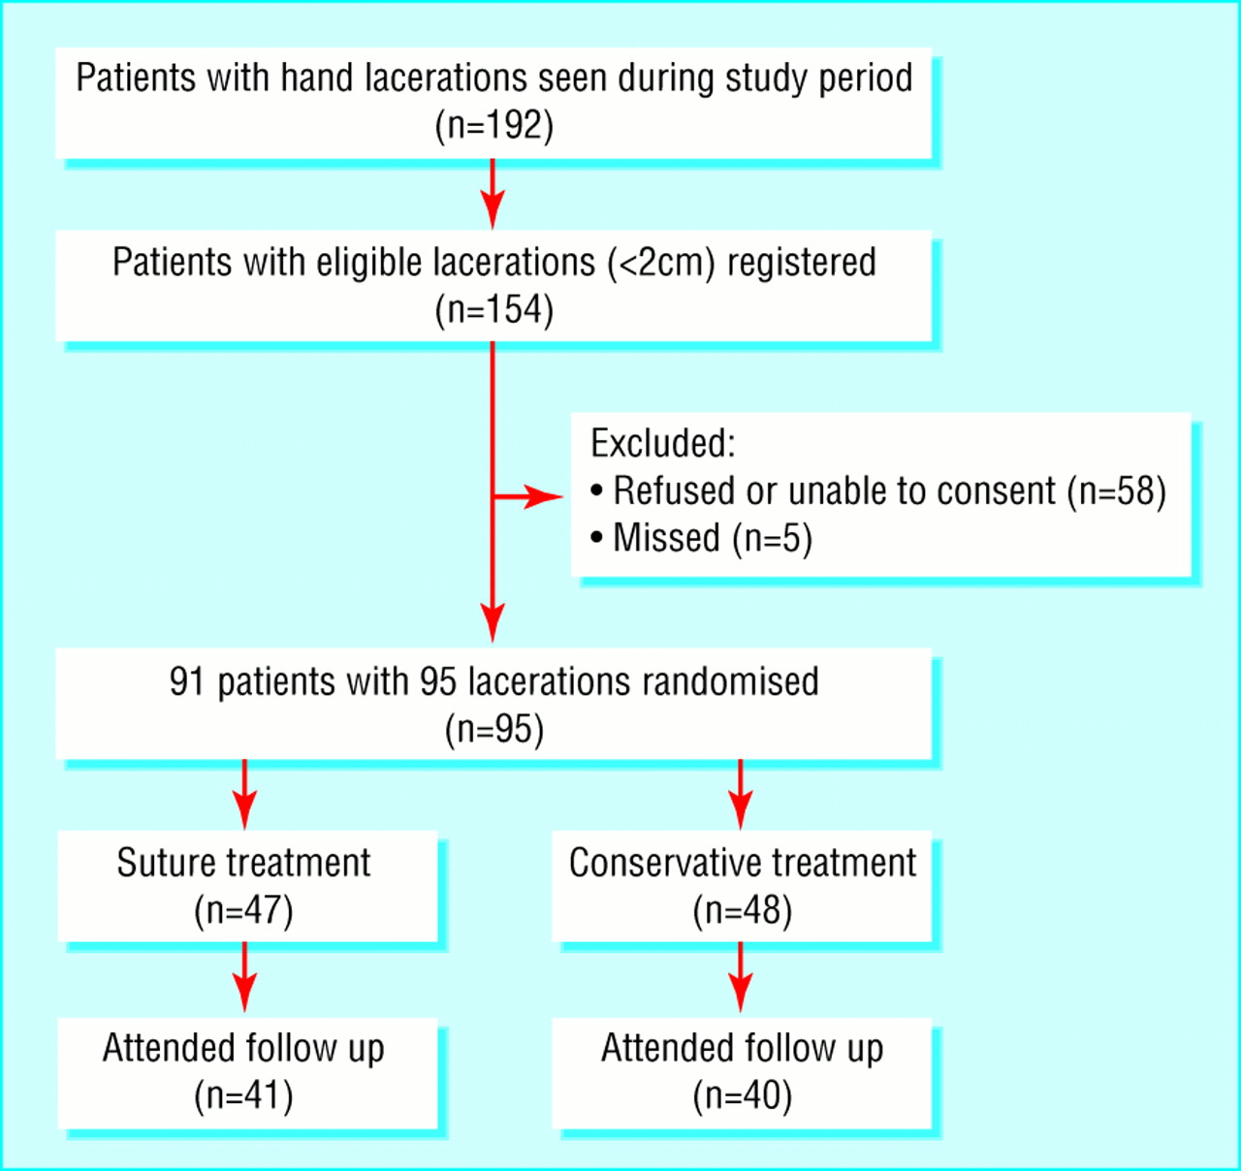

Slide 5
What did they find? Results
.
 | Treatment |  | Mean difference (95% CI)
Clinical outcome | Suture | Conservative
Cosmetic appearance at 3 months (mm)*:
Assigned by doctor | 83 (10.0) | 80 (11.3) | 3 (−1 to 8)
Self assigned by patients | 83 (18.1) | 82 (19.5) | 1 (−7 to 9)
Time to resume normal activities (days) | 3.4 (3.4) | 3.4 (2.9) | 0 (−1.4 to 1.3)
% (No) of optimal early wound scores | 92 (34/37) | 89 (31/36) | 3 (−11 to 17)
Pain during treatment (mm)* | 31 (16.4) | 13 (12.0) | 18 (12 to 24)
Duration of treatment (min) | 19 (12.8) | 5 (4.6) | 14 (10 to 18)
No of infections | 1 | 0 | —

Slide 6
Appraisal: Randomisation
Sealed envelopes: weak method of randomisation
Unblinded by patient and clinician
Blinded outcome
Table 1 suggests balanced confounders
Did randomisation work?

Slide 7
Validity
Lots of refusals, why? / Few misses
Power calculation is a little hazy
t-test is the right test for normally distributed continuous data (is this normally distributed?)
Single centre / Control care different to standard

Slide 8
The big 5
Chance
Is it big enough? / right stats?
Bias
Unblinded / weak randomisation
Confounding
Did randomisation work?
Fraud
Competing interests declared
Accept Result?

Slide 9
Strengths
Weakness
Relevant question
Blinding of follow-up
Single centre
Missed lots of people
Unblinded
? Non-inferiority design
? Under-powered

Slide 10
Would you use this study?
How much evidence do you need to change practice?

