Slide 1
SAS Steering Group
Thursday 29th September 2016

Slide 2
3 strands of SAS development funding
Individual SAS Doctors Development
(Trust based funding)
Generic Skills Development
(For Tutors to apply to HEE for)
Specialty Specific Development
(For Specialty Leads to apply to HEE for)
Intended for personal development of individual SAS Doctors (not generic skills)
Individual SAS Doctors complete funding application and SAS Tutors score and approve this.
This funding stream includes CESR
E.g. training through secondments, further training
SAS Tutors identify generic needs of multiple SAS Doctors at their Trust.
SAS Tutors apply to Associate Dean for funding to hold generic skills training/courses for a number of SAS Doctors.
Opportunity to link up with neighbouring Trusts/SAS Tutors to maximise number of attendees at training/courses
Specialty Leads with input from SAS Tutors identify needs of SAS Doctors in their given specialty across the region.
Specialty Leads apply to Associate Dean for funding to hold specialty specific development days, training courses etc. benefiting a large group of SAS doctors in the given specialty .
Opportunity to network with Training Programme Directors and Heads of School to access training for higher level junior Doctors.

Slide 3
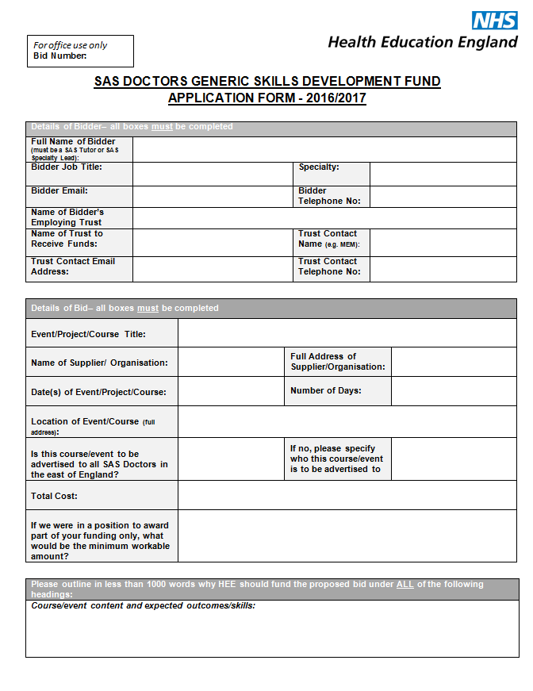
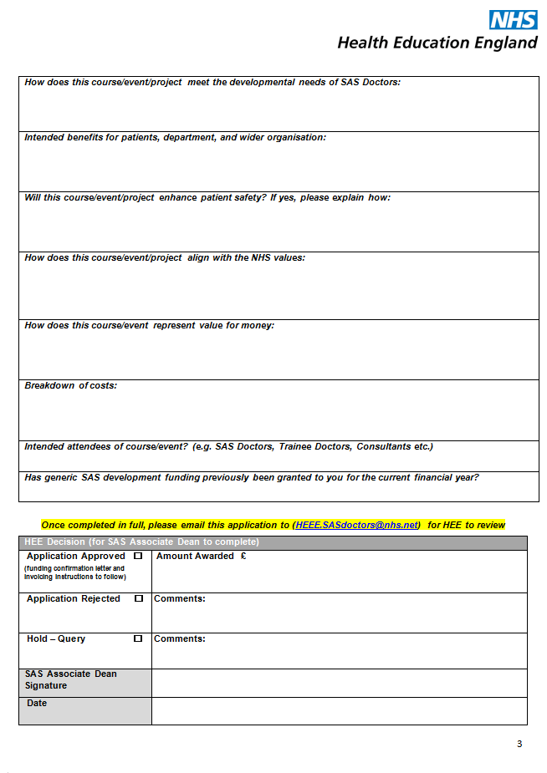
Funding application/bid form

Slide 4
SAS Development Days
HEE EoE are organising a Development Day that will be mirrored in 3 localities to maximise attendance:
Colchester
12/01/2017
Norwich
26/01/2017
Cambridge
02/03/2017
The programme for these Development Days will include:
Job planning
Appraisal and revalidation
Complaints management
SAS Doctors in this region have been emailed a ‘save the date’ notification directly.

Slide 5
LETS HEAR YOUR IDEAS!

Slide 6
SAS Development Suggestions
Individual Personal Development
Generic Skills
Development
Specialty Specific
Development
CESR applications
Fellowships
Audits
Research
Further education
Training the Trainer
Appraisal and Revalidation
Job planning
Use of ePortfolio
Coaching and Mentoring
Communication skills
Resilience
Medicolegal courses
Complaints management
Equality and Diversity
Cultural competencies
Leadership and Management
Interview skills
Time management
Presentation skills
Educational and Clinical supervision
Career development
IT skills
Specialty specific development days
Wide variety of simulation training
Mock exam / exam preparation courses
Nightsafe Programme (or similar)
Managing acutely ill patients
Specialty specific induction
Specialty specific refresher courses

Slide 7
SAS Doctor
As you are
Pay progression
Appraisals
CESR
Stay on as an SAS Doctor
Consultant
SAS
Research
Educational leadership
Clinical and management leadership roles
Specialty Specific Development

