Slide 1
QI: What is RCEM Saying
Adrian Boyle
Chair of the Quality Emergency Care Committee
@dradrianboyle

Slide 2
Successes
RCEM Audit Program voted the second most effective clinical audit in the UK
Near 100% sign up from EDs in England
Recognised by CQC and Patient Groups as a good quality indicator
Audit data performance is open access

Slide 3
Audit doesn’t work (mostly)

Slide 4
Fractured Neck of Femur Patients Receiving Analgesia within One Hour
%

Slide 5
Why Audit Fails?
Tick box exercise
Performed by temporary staff
Lack of feedback loops
Career advancement rather than care advancement
Lack of collective responsibility
Strangled with red tape

Slide 6
Evidence Based Medicine
Clinical Governance
Clinical Audit
Patient Safety
Competency
Resilience
good at QI

Slide 7
What is different about QI?
Quality Assurance
Quality Improvement
Standards compliance
Inspection
Defensive
‘Bad Apples’
Medical Provider
Individual responsibility
Continuous improvement
Prevention
Proactive
Systems, processes
Patient care
Collective responsibility

Slide 8
Quality Assurance
Quality Improvement

Slide 9
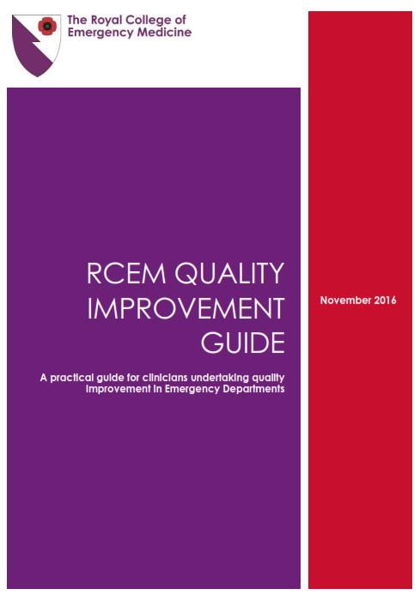
Over-arching document across RCEM committees
Aimed at both Members and Fellows

Slide 10
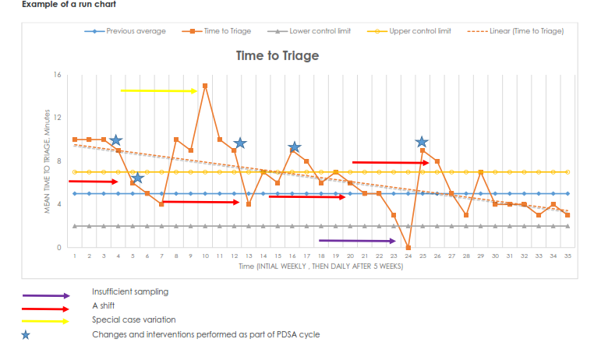

Slide 11
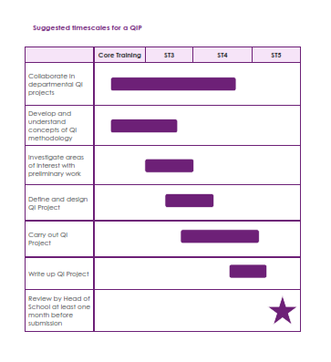

Slide 12
Effective QI from RCEM Audits
Do less, but do it better
Choose a single standard that needs improving
Important? Fundamental? Fixable?
Talk to people (also known as ‘stakeholders’)
Measure
Intervene
Rapid cycle

Slide 13
Why QI could fail?
Tick box exercise
Performed by temporary staff
Lack of feedback loops
Career advancement rather than care advancement
Lack of collective responsibility
Strangled with red tape

Slide 14
QI could also fail because..
Projectitis
QI co-ordinator
Magic Bullets
Checklists
Lack of learning
-/+ve

Slide 15
Effective QI
General Principles
Think like a sector
Share failings and successes
Be realistic: no magic bullets
Continued commitment
Prof M. Dixon-Woods 2016

Slide 16
Effective QI
General Principles
What this means for us
Think like a sector
Share failings and successes
Be realistic: no magic bullets
Continued commitment
Prof M. Dixon-Woods 2016
Use RCEM / National standards
Publish and sharefhsW2 H3ESW2H
Focus on a few key areas
Consultant and whole team ownership

Slide 17
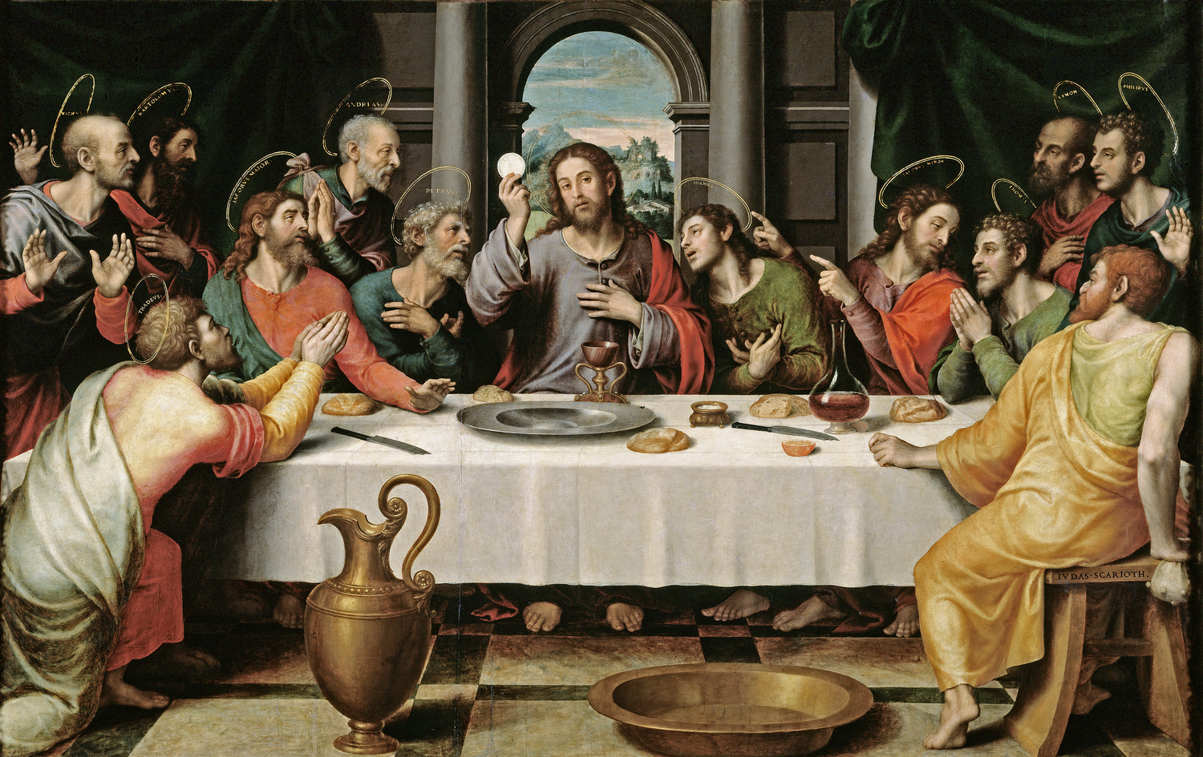

Slide 18
Close
QI is here
Not a fashion
Not a priesthood

