Slide 1
Paediatric Emergency Medicine
Infections
Sepsis
Exanthemata
Diane Williamson Adult and Paediatric Emergency Medicine Consultant Addenbrooke’s Hospital

Slide 2
Outline
Fever
Infections
Exanthemata
Sepsis
Other advice … questions

Slide 3
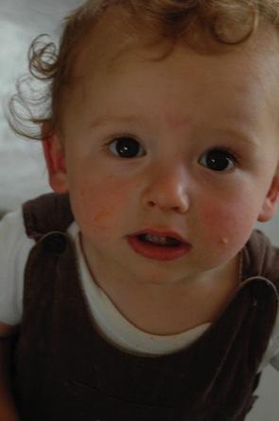
Noah
9 month old child, with Mother
Cough and runny nose x 2 days
Fever up to 39 degrees
Not eating, bit miserable, still playing
What else do you want to know?
What will you look for on examination?
Notes:
Feeding

Slide 4
Noah
HR 120, RR 30, T38 degrees, CR <2 seconds
Alert, smiling, interested in surroundings
Examination
ENT - Coryzal, red throat, TM pink but not bulging
Resp - No respiratory distress, chest clear
CVS - Well hydrated, CR <2s, HS normal
Abdomen soft and not tender
No rash
Notes:
Recheck obs you ust ot let them out of the dept with abnormal obs

Slide 5
What will you do?
What advice will you give?

Slide 6
Noah Returns
Persistent fever and now vomiting
More sleepy than usual
Only fed 2oz milk this morning
What else do you want to know?
What will you look for on examination?

Slide 7
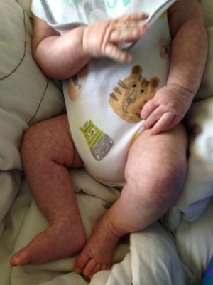
Noah
HR 180, Sats 94% air, RR 50
Lethargic, cool hands and feet
AB intact
C - Capillary refill 4 seconds
D - Lethargic, drowsy
E - Mottled limbs and torso
What will you do?

Slide 8
Assessing febrile children
Assess for life-threatening signs ABCDE
Look for evidence of serious illness
Assess for signs of dehydration
Consider - where is focus of infection?
Do they need investigations?
Don’t forget travel
Consider social situation

Slide 9
Warning Signs
First impressions matter
Reduced level of consciousness
Pale or mottled
Grunting, moderate or severe indrawing

Slide 10
Warning Signs
Examination
Tachycardia (out of proportion to fever, crying…)
Prolonged capillary refill
Cold hands and feet
Non-blanching rash

Slide 11
Investigations
Focus on the focus
Urine dip
CXR
FBC, CRP, Blood culture
LP in young babies or if signs of meningitis
Remember the social history
If recent travel to malarial area ALWAYS do malaria screen and repeat if negative

Slide 12
Management
Refer if there are any concerning features and no diagnosis made, or ANY red features
Often a period of observation is the most helpful investigation – go back and reassess
If sending home, give good discharge advice and safety net
Never send home a child you are worried about or with with persistent tachycardia

Slide 13
Discharge Advice
Antipyretics
Encourage fluids
Signs of dehydration (sunken fontanelle, dry mouth, no tears, overall lethargy)
How to identify a non-blanching rash
To keep the child out of school or nursery until the fever resolves
To seek review if >5 days of fever, fit, non-blanching rash, if they are more worried than when they last sought advice

Slide 14
When is it Sepsis?

Slide 15
The Diagnostic Matrix
Evidence: Positive
Looks Unwell
Looks Well
Evidence:
Negative
Thanks to:
Damian Roland, Honorary Senior Lecturer at University of Leicester

Slide 16
When is it Sepsis?
Investigations: Sepsis positive
Looks Unwell
Looks Well
Investigations:
Sepsis negative
Thanks to:
Damian Roland, Honorary Senior Lecturer at University of Leicester

Slide 17
Sepsis
Worldwide,
sepsis causes 60% of deaths in children under 5 years
US Data
Fatality Rate of children with sepsis 10%
Incidence per 2000 children
Neonatal 20
< 1 year 4
1 to 19 years 1
Sepsis in Children
Plunkett and Tong
The BMJ 13 June 2015

Slide 18
Risk Factors
<3 months
Co-morbidity (e.g. congenital heart disease, diabetes, neuromuscular disease, ex-prem)
Social concern

Slide 19
Sepsis presentations are non-specific
Suspect sepsis in the infant or child with
Temp <36 or >38.5
Tachycardia (or bradycardia in infants <1 year)
Tachypnea
High or low WBC
Beware of fever with limb pain
Beware of the blanching rash

Slide 20
Management
The golden hour - be prepared!
Oxygen (SaO2 >94%)
Access – IV or IO
Bloods – cultures, FBC, CRP, VBG, glucose
Treat hypoglycaemia – 2ml/kg of 10% glucose
Fluid resuscitation – 20ml/kg in 5 min, review and repeat
Inotropes (adrenaline or dopamine)
Antibiotics
Investigations – lactate, urinalysis, throat swab
Refer

Slide 22
Exanthemata
Rash Illnesses

Slide 23
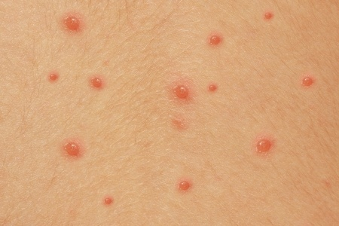
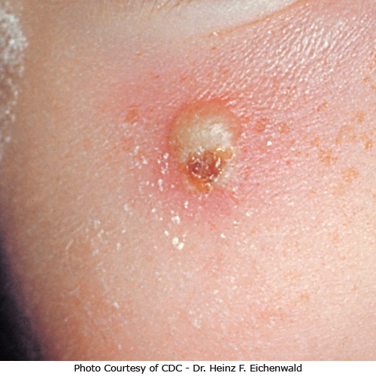
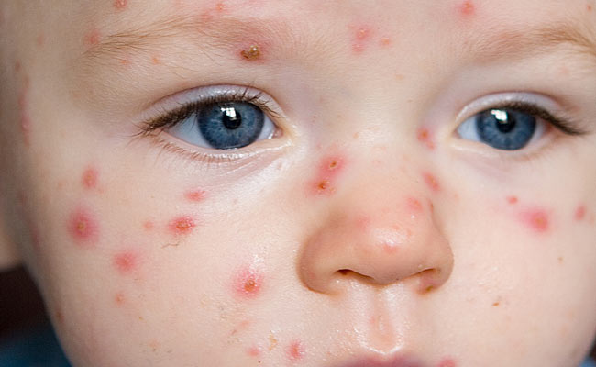

Slide 24
Chicken Pox
Varicella zoster virus – ds DNA alphaherpesvirinae
Airborne resp droplets and direct via vesicles
90% of cases <10 years of age
Incubation 10 – 21 days
Crops of itchy vesicular lesions
Consider acyclovir for at risk

Slide 25
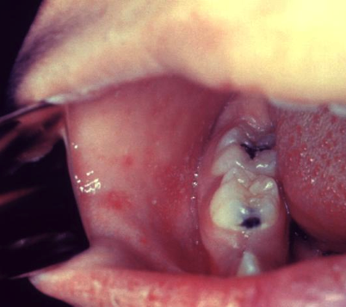
Measles
Morbillivirus, family Paramyxoviridae, RNA virus
Incubation 7 – 10 days after exposure
High fever, malaise, anorexia x 4-7 days
Classic triad: conjunctivitis, cough, coryza
Koplik spots (“grains of sand” on red base on buccal mucosa opposite second molars) are pathognomic
Blanching, eythematous maculopapular rash

Slide 26
Measles
Consider immunity of child and family
Consider immune globulin within 6 days of exposure in unimmunised or at risk
Avoid live virus vaccine in immunocompromised
Lab diagnosis: IgM and IgG titres, isolation of virus, PCR
Report
Complications – croup, encephalitis (10% mortality), pneumonia, SSPE

Slide 27
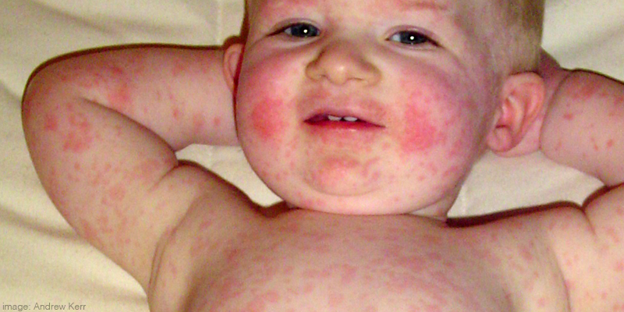
Fifth Disease Erythema Infectiosum
Parvovirus B19, an erythrovirus
Incubation 1 week
Mild prodrome – headache, fever, sore throat
7 - 10 day symptom-free period
Slapped cheek phase – can be prolonged

Slide 28
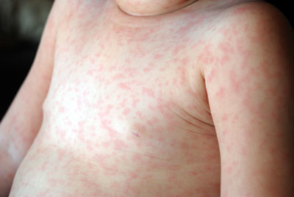
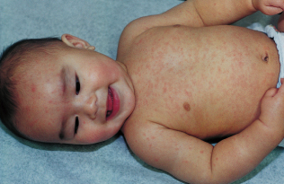

Slide 29
Roseola infantum
Human herpesvirus (HHV-6)
Respiratory transmission
9 – 12 month infant
Acute onset high fever x 3 – 4 days
Rash appears late
Benign in immune competent but remains latent and is a major cause of morbidity and mortality in immunocompromised e.g. HIV, organ transplant

Slide 30
Rubella
Rubella virus, encapsulated ssRNA virus
Respiratory transmission
Incubation 14 – 21 days
Malaise, conjunctivitis, sore throat 5 days prior to onset of rash
Enquire about contact immunity – congenital rubella is a risk

Slide 31
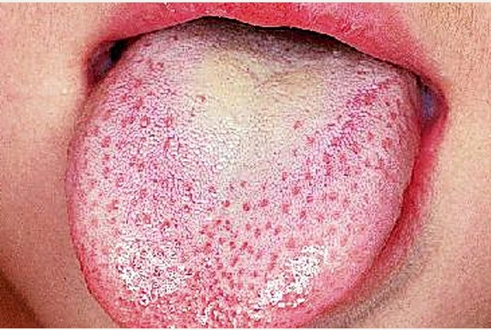
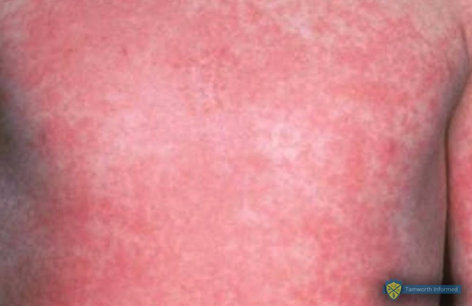
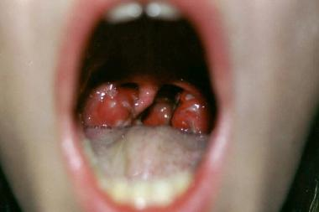

Slide 32
Scarlet Fever
Group A beta-haemolytic streptococcus
Respiratory droplets
Incubation 12 hours to 7 days
Age 1 to 10 years
Usual focus is tonsils, consider skin
Exudative pharyngitis, fever, exanthem
Complications: peritonsillar abscess, sinusitis, pneumonia, rheumatic fever, glomerulonephritis, septic shock
Penicillin

Slide 33
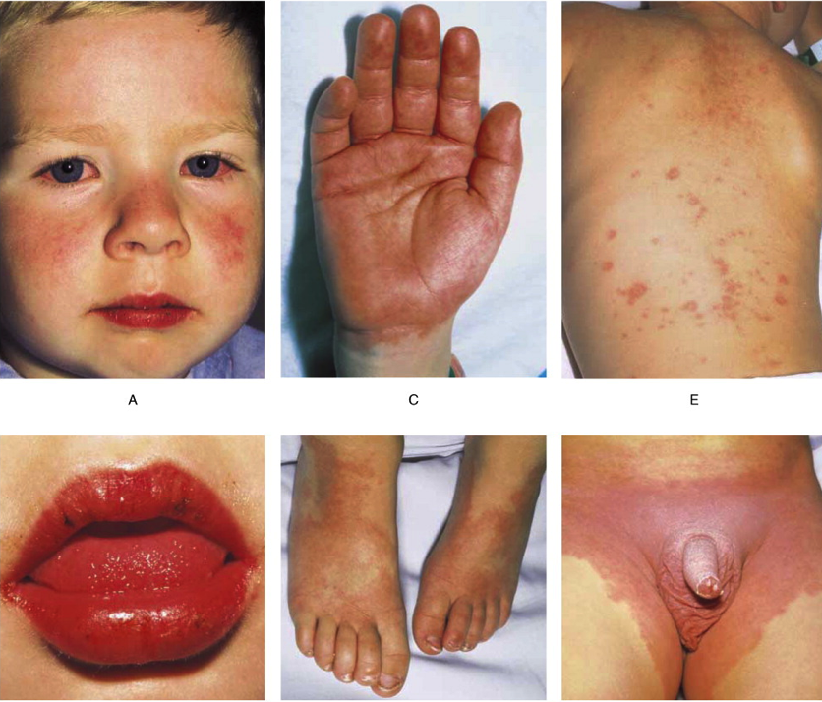
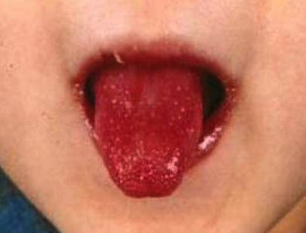
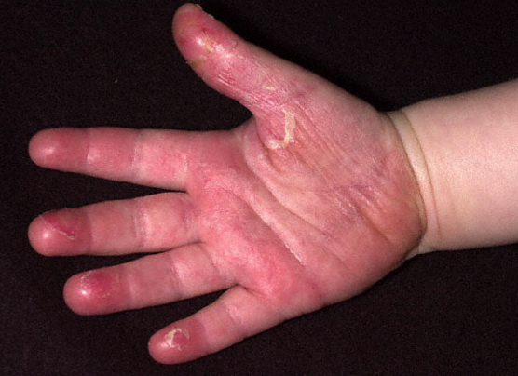

Slide 34
Kawasaki
Acute, febrile, vasculitic syndrome
Fever >5 days plus:
Conjunctivitis
Strawberry tongue, lip fissures
Erythema and oedema of hands
Lymphadenopathy
Rash – groin or extremities
Refer for investigation and management
Complication: coronary artery aneurysm

Slide 35
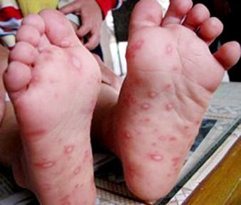
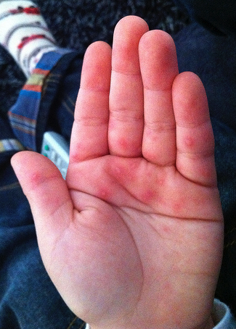
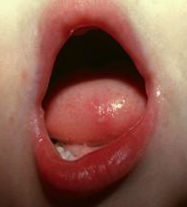
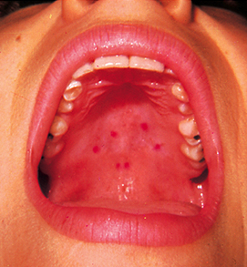

Slide 36
Hand, Foot Mouth
Coxsackie A type 16 and others, enterovirus
Malaise, sore throat, fever
Macular lesions on buccal mucosa, hands, feet and genitalia – become vesicular and erode
Symptomatic management
Complications: Encephalitis, Guillain-Barre, transverse myelitis
Viral culture, PCR

Slide 37
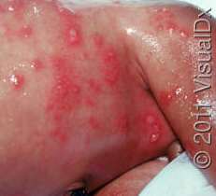
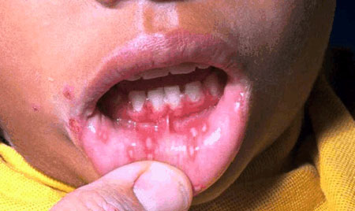
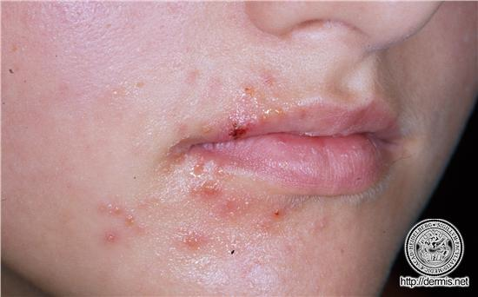

Slide 38
Herpes simplex
Herpesviridae, HSV-1 and HSV-2, dsDNA virus
Incubation 3 – 6 days
Abrupt onset – fever, painful gingivitis, vesicular lesions, lymphadenopathy
Viral shedding x 3 weeks
Aciclovir
Primary infection, latency and reactivation
Dissemination in immunocompromised

Slide 39
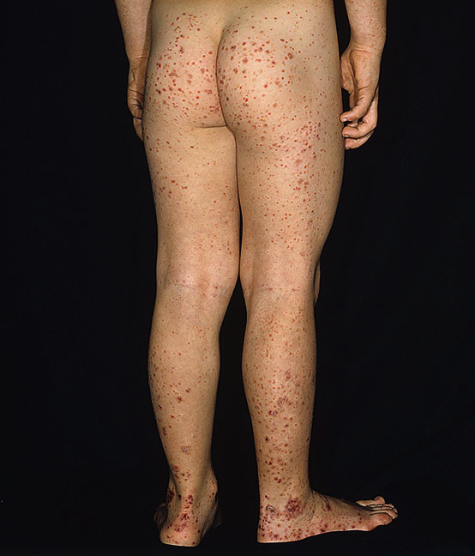
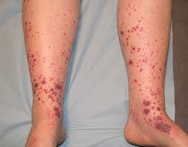
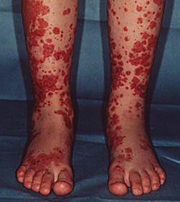
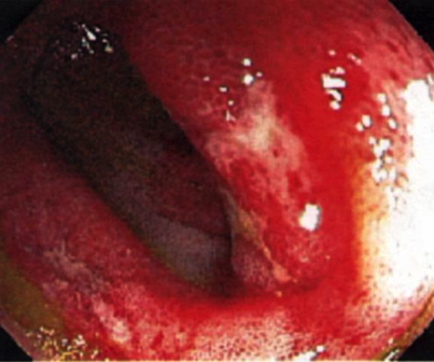

Slide 40
Henoch Schonlein Purpura
Immunoglobulin mediated vasculitis
Prodrome - headache, anorexia, fever
Rash, abdominal pain, vomiting, joint pain
Bloody stool, scrotal oedema
Investigations – FBC, renal function, coagulation
Management – hydration, analgesia, discontinue possible causative drugs
Refer

Slide 41
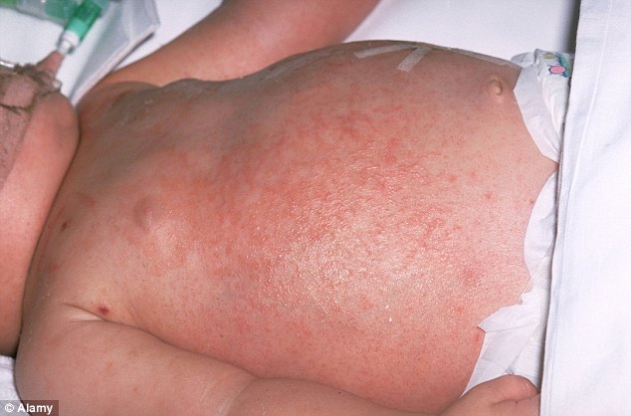

Slide 42
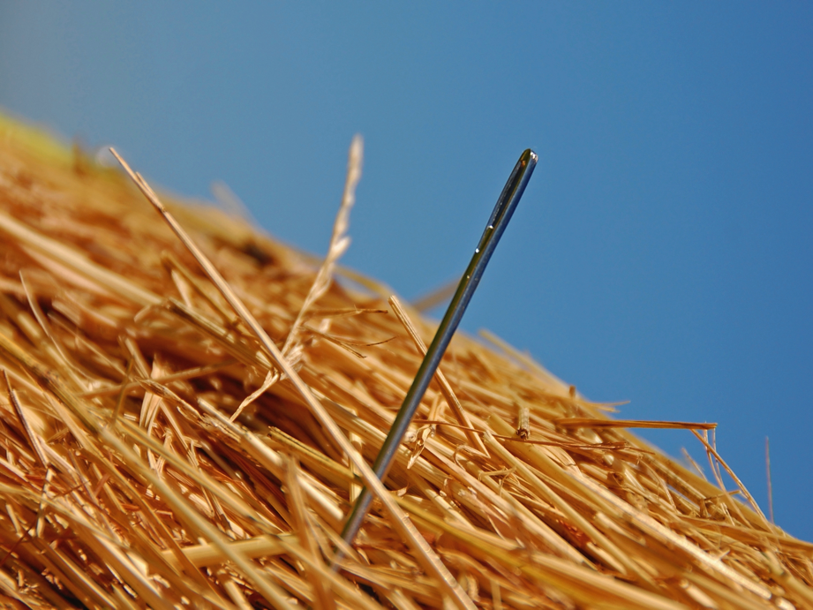

Slide 43
Meningococcal Disease
Suspect
Recognise
Sepsis management

Slide 44
Impetigo
Staphylococcus, streptococcus
Golden crust on existing lesion
Spreading, contagious by contact
Flucloxacillin, co-amoxiclav
Culture if resistant
Hand hygiene advice

Slide 45
Erysipelas
Streptococcus, staphylococcus
Spreading, painful, indurating rash
Risk of systemic sepsis
Penicillin, consider ceftriaxone
Refer and seek Microbiology advice

Slide 46
Urticaria
Etiology is diverse – allergy, idiopathic
Migratory, blanching, coalescing, erythematous rash
Increases when skin is warm
Antihistamine
Avoid provoking factors
Reassurance

Slide 47
Non-accidental injury
Get the history
Consider social concerns
Consider other children at risk
Complete safeguarding and Paediatric referral

Slide 48
Any Questions?

