Slide 1
NIHR Research Training Opportunities 21 June 2019
Tom Pratt
NIHR Academy

Slide 2
The research arm of the NHS
Established in 2006 as a vehicle for implementing Government’s strategy for applied health research
£1billion annual spend
Vision
To improve the health and wealth of the nation through research

Slide 3
Research Capacity Development
The NIHR Academy provides training and career development awards to:
Build a leading health and social care research faculty
Develop research careers, research leaders and collaborators
NIHR Academy Members
Conduct research to benefit NHS, public health, and social care
Prioritise questions where need and opportunity is greatest
Accelerate the translation of discoveries into improved treatments and services

Slide 5
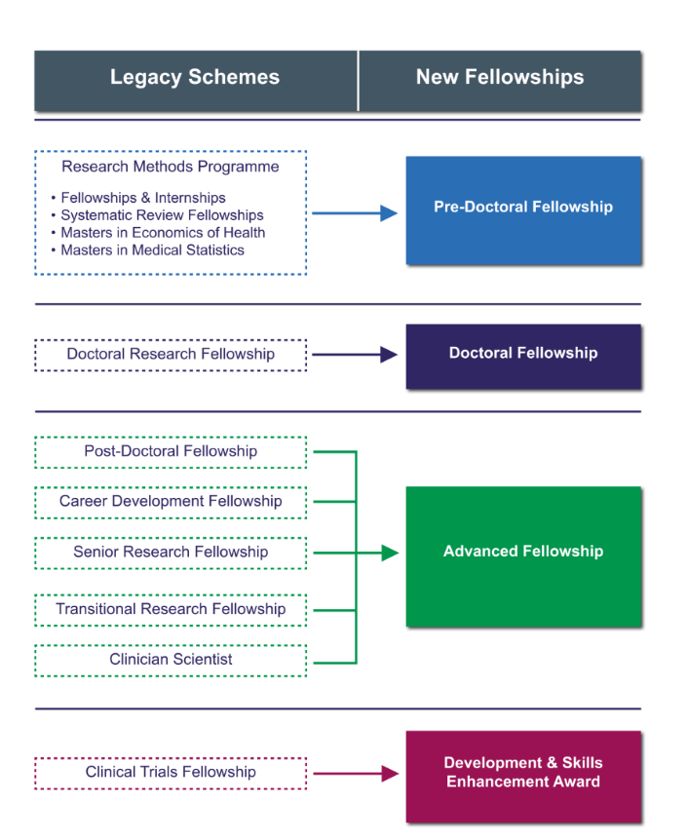

Slide 6
Key changes
Amalgamation and simplification of existing schemes.
2 rounds per year for Doctoral Fellowships and Advanced Fellowships.
The Advanced Fellowship will cover up to 40% clinical time for all clinical applicants.
Options for partnership with charities and industry.
Increased flexibility for part-time fellowships (50% to 100% options).
Limits on number of times a reapplication can be made.

Slide 7
The NIHR remit
The NIHR funds early translational (experimental medicine), clinical and applied health, and social care.
Early translational research and global health is funded through the NIHR Infrastructure (e.g. BRCs, CLAHRCs, NIHR Schools)
NIHR will support educational research and methodological research provided it has potential for practical application and the impact on patients and the public is clear.
The NIHR does not support basic research or work involving animals or their tissue.

Slide 8
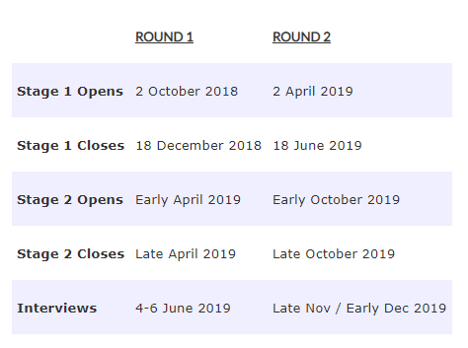
Personal Awards Remit
Doctoral Fellowship proposals:
must be for clinical and applied health research, or social care research
must have clear potential to directly benefit patients and the public (but recognising the training element of the research)
can involve: patients, samples or data from patients, people, populations, health technology assessment, or health services research.
www.nihr.ac.uk/fellow
There are two application rounds per year. You can apply for a Doctoral Fellowship in either Round 1 or Round 2

Slide 9
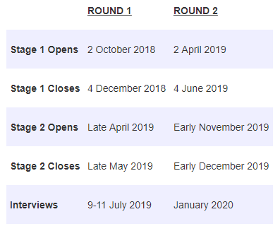
Personal Awards Remit
Advanced Fellowship proposals:
May include early translational (experimental medicine) research; however, a clear and plausible path to patient or public benefit must be demonstrable.
Read the full NIHR remit for personal awards here
www.nihr.ac.uk/fellow
There are two application rounds per year. You can apply for an Advanced Fellowship in either Round 1 or Round 2

Slide 10
Doctoral Fellowship
Fellowship to fund a PhD
Majority of funding awarded in response mode with minor proportion to NIHR Academy Strategic Themes
Open to clinical and non-clinical applicants
Funding and support
3 years (100% WTE; between 50 and 100% WTE options)
Funding for salary, research costs, and training and development

Slide 11
Advanced Fellowship
Fellowship designed to support the following points at post-doctoral level:
Early post-doc career following award of PhD
Establishment of independence
Transition or return from a career break
Majority of funding awarded in response mode with minor proportion to NIHR Academy Strategic Themes
Open to clinical and non-clinical applicants
Funding and support
2-5 years (100% WTE; between 50 and 100% WTE options)
Funding for salary, research costs, and training and development
Can apply for 2 sequential Advanced Fellowships up to a total of 8 years

Slide 12
Partnership Fellowships
Partners
Castang Foundation
Diabetes UK
Kidney Research UK
Moorfields Eye Charity
MS Society
Muscular Dystrophy UK
Pancreatic Cancer UK
Parkinson's UK
Through partnership with seven of the UK's leading medical charities, NIHR is offering jointly funded Fellowships at Doctoral and Advanced (post-doctoral) level.
Partnership Fellows will engage with and receive valuable input from patient groups, making the most of the public and patient engagement/involvement opportunities available.
The Fellowships will provide greater research exposure through a variety of media and communication channels.
The Guidance Notes contain further details regarding the specific eligibility criteria for each charity partner, the level of award available and the contact details for the relevant charity.

Slide 13
Development and Skills Enhancement Award
For NIHR Academy Members to gain specific skills and experience
Mix of response mode awards and applications in Strategic Themes
Includes support for career continuity for those who haven’t been able to source support elsewhere
Funding and support
1 year maximum (between 50 and 100% WTE)
Funding for salary, training and development, and supervision
Expectation of matched funding from host
Applications open every 4 months from May 2019

Slide 14
HEE/NIHR Integrated Clinical Academic Programme
The ICA Programme launched in 2015, combining the HEE-funded Clinical Academic Training (CAT) Programme for Nurses, Midwives and AHPs and the Healthcare Science Research Fellowship (HCS) Programme
The ICA Programme is open to all statutorily registered healthcare professionals, excluding doctors and dentists
The programme focus is to develop individuals and careers that combine clinical research and research leadership with continued clinical practice and clinical development.
Awards are available from Internship to Senior Clinical Lectureship.
ICA webpage

Slide 15
Integrated Academic Training
Academic Clinical Fellowships & Clinical Lectureships
Integrated academic training for doctors and dentists undertaking specialty training
ACFs for pre-doctoral and early ST training
CLs for post-doctoral and ST3+ training
To support next phase in clinical academic career e.g. PhD or Intermediate Fellowship
In-Practice Fellowship
The IPF is a pre-doctoral training award for GPs and GDPs to support a PhD application

Slide 16
Integrated Academic Training

Slide 17
Academic Clinical Fellowships
www.nihr.ac.uk/acfs
Integrated academic and clinical training
For entrants to specialty training
25% protected time for academic research
Support for PhD application
Up to 3 years (4 for GPs)
£1000 per annum bursary for conference attendance etc.
Structured Research Training Programme (RTP) providing Masters-level training in e.g. research methods, bioinformatics, etc.

Slide 18
Clinical Lectureships
www.nihr.ac.uk/cls
Postdoctoral award
50% academic and 50% clinical
ST3 and above entry
4 yr award duration, or until you reach CCT
Possibility for an extension beyond CCT
£1000 per annum bursary for conference attendance etc.

Slide 19
In-Practice Fellowship
www.nihr.ac.uk/ipf
Pre-doctoral award open to fully-qualified General Practitioners, General Dental Practitioners and Community Dentists
50% clinical, 50% academic for 2 years (100% WTE)
Funding: 50% salary (for academic time), plus £4,500 for training and development and £1,000 for conference attendance
IPFs aim to complete a Masters degree and prepare an application for a PhD.

Slide 20
Pre-application Advice
Know the process and the remit:
Look at the website
Read the guidance
Contact the NIHR Academy with any queries
Talk to the NIHR Research Design Service
Don’t add PPI as an afterthought!
Know your audience:
Look up previous award holders, panel members, topics
Talk, talk, talk, before you submit:
Supervisor, current awards holders, senior academics, methodological experts, collaborators, mentors, finance office, colleagues etc.

Slide 21
Common Weaknesses
Remit: Failure to show research important to NHS, benefits patients and/or public
Clarity & Details: Research questions not clear; don’t show the relevance of the aims and objectives; not enough detail and depth
Overambitious: Research programme not suitable for level of award; not achievable within time frame
Applicant: Person not quite experienced enough for level they are applying (research outputs, independence, etc.); not your project
Training: Programme too generic and not suited/specific to the applicant’s needs and project; too centred around host organisation
Value for Money: Budget unrealistic and/or failure to justify requested resources

Slide 22
Summary
The NIHR Academy offers a broad range of awards available at different career levels to suit different working arrangements, types of professional backgrounds, and career paths.
NIHR Integrated Pathways (clinicians) and NIHR Fellowships (all professions) allow you to undertake clinical and academic training during your career, from pre-doctoral level up to a professorial chair.

Slide 23
Thank you!
NIHR Academy, 21 Queen Street, Leeds, LS1 2TW
0113 532 8444 or academy-awards@nihr.ac.uk
@NIHRAcademy (twitter)
https://www.nihr.ac.uk/academy

